Slide 1
Modern Programming Tools And Techniques-I Introduction to JAVA Lecture 3: Operators and Expressions
Notes:
이 TP에서는 자바의 생성 배경과 그 동안 자바가 어떻게 발전해 왔는지에 대해 설명한다.

Slide 2
Contents
Operators in Java
Arithmetic Operators
Bitwise Operators
Relational Operators
Logical Operators

Slide 3
Operators in Java
Java’s operators can be grouped into following four categories:
Arithmetic
Bitwise
Relational
Logical.

Slide 4
Arithmetic Operators
used in mathematical expressions.
operands of the arithmetic operators must be of a numeric type.
most operators in Java work just like they do in C/C++.
We can not use them on boolean types, but we can use them on char types, since the char type in Java is, essentially, a subset of int.

Slide 5
Arithmetic Operators
Operator Result
+ Addition
- Subtraction (also unary minus)
* Multiplication
/ Division
% Modulus
++ Increment
+= Addition assignment
-= Subtraction assignment
*= Multiplication assignment
/= Division assignment
%= Modulus assignment
- - Decrement
Example: Arithmetic.java

Slide 6
Modulus Operator (%)
returns the remainder of a division operation.
can be applied to floating-point types as well as integer types.
This differs from C/C++, in which the % can only be applied to integer types.
Example: Modulus.java

Slide 7
Arithmetic Assignment Operators
used to combine an arithmetic operation with an assignment.
Thus, the statements of the form
var = var op expression;
can be rewritten as
var op= expression;
In Java, statements like a = a + 5; can be written as
a += 5;
Similarly:
b = b % 3; can be written as b %= 3;

Slide 8
Increment and Decrement
++ and the - - are Java's increment and decrement operators.
The increment operator increases its operand by one.
x++; is equivalent to x = x + 1;
The decrement operator decreases its operand by one.
y--; is equivalent to y = y – 1;
They can appear both in
postfix form, where they follow the operand, and
prefix form, where they precede the operand.

Slide 9
In the prefix form, the operand is incremented or decremented before the value is obtained for use in the expression.
Example: x = 19; y = ++x;
Output: y = 20 and x = 20
In postfix form, the previous value is obtained for use in the expression, and then the operand is modified.
Example: x = 19; y = x++;
Output: y = 19 and x = 20

Slide 10
Bitwise Operators
These operators act upon the individual bits of their operands.
can be applied to the integer types, long, int, short, char, and byte.

Slide 11
Operator Result
~ Bitwise unary NOT
& Bitwise AND
| Bitwise OR
^ Bitwise exclusive OR
>> Shift right
>>> Shift right zero fill
<< Shift left
&= Bitwise AND assignment
|= Bitwise OR assignment
^= Bitwise exclusive OR assignment
>>= Shift right assignment
>>>= Shift right zero fill assignment
<<= Shift left assignment

Slide 12
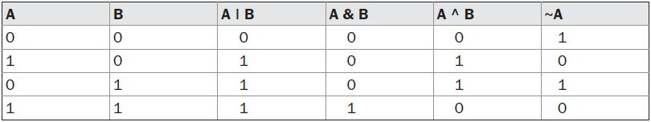
Bitwise Logical Operators
The bitwise logical operators are
~ (NOT)
& (AND)
| (OR)
^ (XOR)
Example:

Slide 13
The Left Shift
The left shift operator,<<, shifts all of the bits in a value to the left a specified number of times.
value << num
Example:
01000001 65
<< 2
00000100 4

Slide 14
The Right Shift
The right shift operator, >>, shifts all of the bits in a value to the right a specified number of times. value >> num
Example:
00100011 35
>> 2
00001000 8

Slide 15
When we are shifting right, the top (leftmost) bits exposed by the right shift are filled in with the previous contents of the top bit.
This is called sign extension and serves to preserve the sign of negative numbers when you shift them right.

Slide 16
The Unsigned Right Shift
In these cases, to shift a zero into the high-order bit no matter what its initial value was. This is known as an unsigned shift.
To accomplish this, we will use Java’s unsigned, shift-right operator, >>>, which always shifts zeros into the high-order bit.
Example:
11111111 11111111 11111111 11111111 –1 in binary as an int
>>>24
00000000 00000000 00000000 11111111 255 in binary as an int

Slide 17
Bitwise Operator Compound Assignments
combines the assignment with the bitwise operation.
Similar to the algebraic operators
For example, the following two statements, which shift the value in a right by four bits, are equivalent:
a = a >> 4;
a >>= 4;
Likewise,
a = a | b;
a |= b;

Slide 18
Relational Operators
The relational operators determine the relationship that one operand has to the other.
Relational operators determine equality and ordering.
The outcome of relational operations is a boolean value.
Operator | Function
== | equal to
!= | not equal to
< | less than
> | greater than
<= | less than or equal to
>= | greater than or equal to

Slide 19
The result produced by a relational operator is a boolean value.
For example, the following code fragment is perfectly valid:
int a = 4;
int b = 1;
boolean c = a < b;
In this case, the result of a<b (which is false) is stored in c.

Slide 20
Boolean Logical Operators
The Boolean logical operators shown here operate only on boolean operands.
Operator | Result
& | Logical AND
| | Logical OR
^ | Logical XOR (exclusive OR)
|| | Short-circuit OR
&& | Short-circuit AND
! | Logical unary NOT
&= | AND assignment
|= | OR assignment
^= | XOR assignment
== | Equal to
!= | Not equal to
?: | Ternary if-then-else

Slide 21
All of the binary logical operators combine two boolean values to form a resultant boolean value.
The logical Boolean operators,&, |, and ^, operate on boolean values in the same way that they operate on the bits of an integer.
The following table shows the effect of each logical operation:
A | B | A | B | A & B | A ^ B | ~ A
False | False | False | False | False | True
True | False | True | False | True | False
False | True | True | False | True | True
True | True | True | True | False | False

Slide 22
Short-Circuit Logical Operators
These are secondary versions of the Boolean AND and OR operators, and are known as short-circuit logical operators.
OR operator results in true when A is true , no matter what B is.
Similarly, AND operator results in false when A is false, no matter what B is.
If we use the || and && forms, rather than the | and & forms of these operators, Java will not bother to evaluate the right-hand operand when the outcome of the expression can be determined by the left operand alone.
This is very useful when the right-hand operand depends on the value of the left one in order to function properly.

Slide 23
For example
if (denom != 0 && num / denom > 10)
the following code fragment shows how you can take advantage of short-circuit logical evaluation to be sure that a division operation will be valid before evaluating it.
circuit form of AND (&&) is used, there is no risk of causing a run-time exception when denom is zero.
If this line of code were written using the single & version of AND, both sides would be evaluated, causing a run-time exception when denom is zero.

Slide 24
The Assignment Operator
The assignment operator is the single equal sign, =.
The assignment operator works in Java much as it does in any other computer language.
var = expression ;
Here, the type of var must be compatible with the type of expression.
The assignment operator allows to create a chain of assignments.
For example:
int x, y, z;
x = y = z = 100; // set x, y, and z to 100
This fragment sets the variables x , y, and z to 100 using a single statement.

Slide 25
The ? Operator
Java includes a special ternary (three-way)operator, ?, that can replace certain types of if-then-else statements.
The ? has this general form:
expression1 ? expression2 : expression3
Here,expression1 can be any expression that evaluates to a boolean value.
If expression1 is true , then expression2 is evaluated; otherwise, expression3 is evaluated.
The result of the? operation is that of the expression evaluated.
Bothexpression2 and expression3 are required to return the same type, which can’t be void.

Slide 26
Example: TestTernary.java
ratio = denom == 0 ? 0 : num / denom ;
When Java evaluates this assignment expression, it first looks at the expression to the left of the question mark.
If denom equals zero, then the expression between the question mark and the colon is evaluated and used as the value of the entire ? expression.
If denom does not equal zero, then the expression after the colon is evaluated and used for the value of the entire ? expression.
The result produced by the? operator is then assigned to ratio.

Slide 27
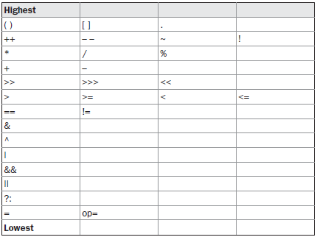
Operator Precedence

Slide 28

Questions

