Slide 1

Modern Programming Tools And Techniques-I
Lecture 5: Arrays

Slide 2
Array
Definition:
An array is a group/collection of variables of the same type that are referred to by a common name.
Arrays of any type can be created and may have one or more dimensions.
A specific element in an array is accessed by its index (subscript).
Examples:
  Collection of numbers
  Collection of names
  Collection of suffixes

Slide 3
Examples
Array of numbers:
Array of names:
Array of suffixes:
10 | 23 | 863 | 8 | 229
Sam | Shanu | Riya
ment | tion | ness | ves

Slide 4
One-Dimensional Arrays
A one-dimensional array is a list of variables of same type.
The general form of a one-dimensional array declaration is:
type var-name[ ]; var-name = new type[size];
or, type var-name[ ] = new type[size];
Example:
int num [] = new int [10];

Slide 5
Syntax
Declaration of array variable:
data-type variable-name[];
eg. int marks[];
This will declare an array named ‘marks’ of type ‘int’. But no memory is allocated to the array.
Allocation of memory:
variable-name = new data-type[size];
eg. marks = new int[5];
This will allocate memory of 5 integers to the array ‘marks’ and it can store upto 5 integers in it. ‘new’ is a special operator that allocates memory.

Slide 6
Accessing elements in the array:
Specific element in the array is accessed by specifying name of the array followed the index of the element.
All array indexes in Java start at zero.
variable-name[index] = value;
Example:
marks[0] = 10;
This will assign the value 10 to the 1st element in the array.
marks[2] = 863;
This will assign the value 863 to the 3rd element in the array.

Slide 7
Example
STEP 1 : (Declaration)
int marks[];
marks → null
STEP 2: (Memory Allocation)
marks = new int[5];
marks →
marks[0] marks[1] marks[2] marks[3] marks[4]
STEP 3: (Accessing Elements)
marks[0] = 10;
marks →
marks[0] marks[1] marks[2] marks[3] marks[4]
0 | 0 | 0 | 0 | 0
10 | 0 | 0 | 0 | 0

Slide 8
Size of an array can’t be changed after the array is created.
Default values:
  zero (0) for numeric data types,
  \u0000 for chars and
  false for boolean types
  Length of an array can be obtained as: array_ref_var.length

Slide 9
Example
class Demo_Array
{
public static void main(String args[])
{
int marks[];
marks = new int[3];
marks[0] = 10;
marks[1] = 35;
marks[2] = 84;
System.out.println(“Marks of 2nd student=” + marks[1]);
}
}

Slide 10
Note
Arrays can store elements of the same data type. Hence an int array CAN NOT store an element which is not an int.
Though an element of a compatible type can be converted to int and stored into the int array.
eg. marks[2] = (int) 22.5;
This will convert ‘22.5’ into the int part ‘22’ and store it into the 3rd place in the int array ‘marks’.
Array indexes start from zero. Hence ‘marks[index]’ refers to the (index+1)^{th} element in the array and ‘marks[size-1]’ refers to last element in the array.

Slide 11
Array Initialization
data Type [] array_ref_var = {value0, value1, …, value n};
data Type [] array_ref_var;
array_ref_var = {value0, value1, …,value n};
data Type [] array_ref_var = new data Type [n+1];
array_ref_var [0] = value 0;
array_ref_var [1] = value 1;
…
array_ref_var [n] = value n;

Slide 12
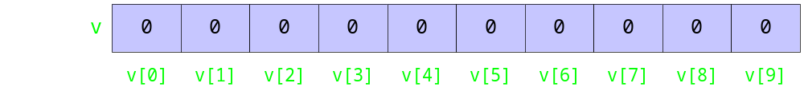
Example
int[] v = new int[10];
int i = 7;
int j = 2;
int k = 4;
v[0] = 1;
v[i] = 5;
v[j] = v[i] + 3;
v[j+1] = v[i] + v[0];
v[v[j]] = 12;
System.out.println(v[2]);
v[k] = stdin.nextInt();
Notes:
int i = 7;
int j = 2;
int k = 4;
v[0] = 1; // element 0 of v given value 1
v[i] = 5; // element i of v given value 5
v[j] = v[i] + 3; // element j of v given value
// of element i of v plus 3
v[j+1] = v[i] + v[0]; // element j+1 of v given value
// of element i of v plus
// value of element 0 of v
v[v[j]] = 12; // element v[j] of v given
// value 12
System.out.println(v[2]); // element 2 of v is displayed
v[k] = Integer.parseInt(stdin.readLine());
// element k of v given next
// extracted value

Slide 13
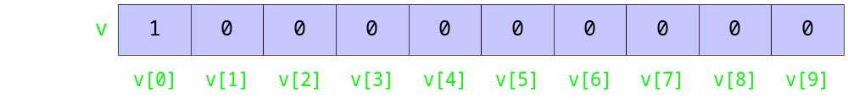
Example
int[] v = new int[10];
int i = 7;
int j = 2;
int k = 4;
v[0] = 1;
v[i] = 5;
v[j] = v[i] + 3;
v[j+1] = v[i] + v[0];
v[v[j]] = 12;
System.out.println(v[2]);
v[k] = stdin.nextInt();
Notes:
int i = 7;
int j = 2;
int k = 4;
v[0] = 1; // element 0 of v given value 1
v[i] = 5; // element i of v given value 5
v[j] = v[i] + 3; // element j of v given value
// of element i of v plus 3
v[j+1] = v[i] + v[0]; // element j+1 of v given value
// of element i of v plus
// value of element 0 of v
v[v[j]] = 12; // element v[j] of v given
// value 12
System.out.println(v[2]); // element 2 of v is displayed
v[k] = Integer.parseInt(stdin.readLine());
// element k of v given next
// extracted value

Slide 14
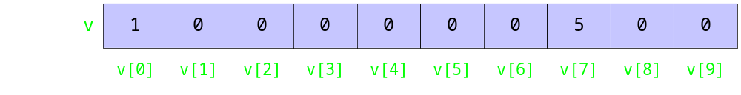
Example
int[] v = new int[10];
int i = 7;
int j = 2;
int k = 4;
v[0] = 1;
v[i] = 5;
v[j] = v[i] + 3;
v[j+1] = v[i] + v[0];
v[v[j]] = 12;
System.out.println(v[2]);
v[k] = stdin.nextInt();
Notes:
int i = 7;
int j = 2;
int k = 4;
v[0] = 1; // element 0 of v given value 1
v[i] = 5; // element i of v given value 5
v[j] = v[i] + 3; // element j of v given value
// of element i of v plus 3
v[j+1] = v[i] + v[0]; // element j+1 of v given value
// of element i of v plus
// value of element 0 of v
v[v[j]] = 12; // element v[j] of v given
// value 12
System.out.println(v[2]); // element 2 of v is displayed
v[k] = Integer.parseInt(stdin.readLine());
// element k of v given next
// extracted value

Slide 15

Example
int[] v = new int[10];
int i = 7;
int j = 2;
int k = 4;
v[0] = 1;
v[i] = 5;
v[j] = v[i] + 3;
v[j+1] = v[i] + v[0];
v[v[j]] = 12;
System.out.println(v[2]);
v[k] = stdin.nextInt();
Notes:
int i = 7;
int j = 2;
int k = 4;
v[0] = 1; // element 0 of v given value 1
v[i] = 5; // element i of v given value 5
v[j] = v[i] + 3; // element j of v given value
// of element i of v plus 3
v[j+1] = v[i] + v[0]; // element j+1 of v given value
// of element i of v plus
// value of element 0 of v
v[v[j]] = 12; // element v[j] of v given
// value 12
System.out.println(v[2]); // element 2 of v is displayed
v[k] = Integer.parseInt(stdin.readLine());
// element k of v given next
// extracted value

Slide 16

Example
int[] v = new int[10];
int i = 7;
int j = 2;
int k = 4;
v[0] = 1;
v[i] = 5;
v[j] = v[i] + 3;
v[j+1] = v[i] + v[0];
v[v[j]] = 12;
System.out.println(v[2]);
v[k] = stdin.nextInt();
Notes:
int i = 7;
int j = 2;
int k = 4;
v[0] = 1; // element 0 of v given value 1
v[i] = 5; // element i of v given value 5
v[j] = v[i] + 3; // element j of v given value
// of element i of v plus 3
v[j+1] = v[i] + v[0]; // element j+1 of v given value
// of element i of v plus
// value of element 0 of v
v[v[j]] = 12; // element v[j] of v given
// value 12
System.out.println(v[2]); // element 2 of v is displayed
v[k] = Integer.parseInt(stdin.readLine());
// element k of v given next
// extracted value

Slide 17

Example
int[] v = new int[10];
int i = 7;
int j = 2;
int k = 4;
v[0] = 1;
v[i] = 5;
v[j] = v[i] + 3;
v[j+1] = v[i] + v[0];
v[v[j]] = 12;
System.out.println(v[2]);
v[k] = stdin.nextInt();
Notes:
int i = 7;
int j = 2;
int k = 4;
v[0] = 1; // element 0 of v given value 1
v[i] = 5; // element i of v given value 5
v[j] = v[i] + 3; // element j of v given value
// of element i of v plus 3
v[j+1] = v[i] + v[0]; // element j+1 of v given value
// of element i of v plus
// value of element 0 of v
v[v[j]] = 12; // element v[j] of v given
// value 12
System.out.println(v[2]); // element 2 of v is displayed
v[k] = Integer.parseInt(stdin.readLine());
// element k of v given next
// extracted value

Slide 18
Example
int[] v = new int[10];
int i = 7;
int j = 2;
int k = 4;
v[0] = 1;
v[i] = 5;
v[j] = v[i] + 3;
v[j+1] = v[i] + v[0];
v[v[j]] = 12;
System.out.println(v[2]);
v[k] = stdin.nextInt();
8 is displayed
Notes:
int i = 7;
int j = 2;
int k = 4;
v[0] = 1; // element 0 of v given value 1
v[i] = 5; // element i of v given value 5
v[j] = v[i] + 3; // element j of v given value
// of element i of v plus 3
v[j+1] = v[i] + v[0]; // element j+1 of v given value
// of element i of v plus
// value of element 0 of v
v[v[j]] = 12; // element v[j] of v given
// value 12
System.out.println(v[2]); // element 2 of v is displayed
v[k] = Integer.parseInt(stdin.readLine());
// element k of v given next
// extracted value

Slide 19

Example
int[] v = new int[10];
int i = 7;
int j = 2;
int k = 4;
v[0] = 1;
v[i] = 5;
v[j] = v[i] + 3;
v[j+1] = v[i] + v[0];
v[v[j]] = 12;
System.out.println(v[2]);
v[k] = stdin.nextInt();
Suppose 3 is extracted
Notes:
int i = 7;
int j = 2;
int k = 4;
v[0] = 1; // element 0 of v given value 1
v[i] = 5; // element i of v given value 5
v[j] = v[i] + 3; // element j of v given value
// of element i of v plus 3
v[j+1] = v[i] + v[0]; // element j+1 of v given value
// of element i of v plus
// value of element 0 of v
v[v[j]] = 12; // element v[j] of v given
// value 12
System.out.println(v[2]); // element 2 of v is displayed
v[k] = Integer.parseInt(stdin.readLine());
// element k of v given next
// extracted value

Slide 20
Multi-Dimensional Array
Multidimensional arrays are arrays of arrays.
Two-Dimensional arrays are used to represent a table or a matrix.
Creating Two-Dimensional Array:
int twoD[][] = new int[4][5];

Slide 21
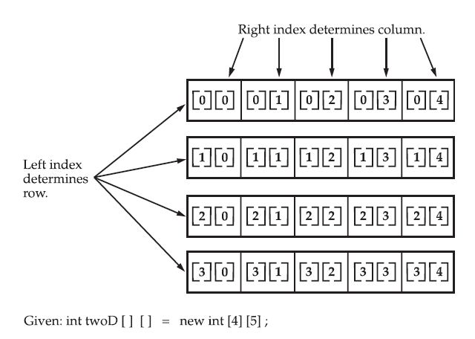
Conceptual View of 2-Dimensional Array

Slide 22
class TwoDimArr
{
public static void main(String args[])
{
int twoD[][]= new int[4][5];
int i, j, k = 0;
for(i=0; i<4; i++)
for(j=0; j<5; j++)
{
twoD[i][j] = k;
k++;
}
for(i=0; i<4; i++)
{
for(j=0; j<5; j++)
System.out.print(twoD[i][j] + " ");
System.out.println();
}
}
}

Slide 23
When we allocate memory for a multidimensional array, we need to only specify the memory for the first (leftmost) dimension.
int twoD[][] = new int[4][];
The other dimensions can be assigned manually.

Slide 24
// Manually allocate differing size second dimensions.
class TwoDAgain {
public static void main(String args[]) {
int twoD[][] = new int[4][];
twoD[0] = new int[1];
twoD[1] = new int[2];
twoD[2] = new int[3];
twoD[3] = new int[4];
int i, j, k = 0;
for(i=0; i<4; i++)
for(j=0; j<i+1; j++)
{
twoD[i][j] = k;
k++;
}
for(i=0; i<4; i++) {
for(j=0; j<i+1; j++)
System.out.print(twoD[i][j] + " ");
System.out.println();
}
}
}

Slide 25
Initializing Multi-Dimensional Array
class Matrix {
public static void main(String args[]) {
double m[][] = {
{ 0*0, 1*0, 2*0, 3*0 },
{ 0*1, 1*1, 2*1, 3*1 },
{ 0*2, 1*2, 2*2, 3*2 },
{ 0*3, 1*3, 2*3, 3*3 }
};
int i, j;
for(i=0; i<4; i++) {
for(j=0; j<4; j++)
System.out.print(m[i][j] + " ");
System.out.println();
}
}
}

Slide 26
Alternative Array Declaration
type[ ] var-name;
Example:
char twod1[][] = new char[3][4];
char[][] twod2 = new char[3][4];
This alternative declaration form offers convenience when declaring several arrays at the same time.
Example: int[] nums, nums2, nums3;

Slide 27
Array Cloning
To actually create another array with its own values, Java provides the clone()method.
arr2 = arr1; (assignment)
is not equivalent to
arr2 = arr1.clone(); (cloning)
Example: ArrayCloning.java

Slide 28


