Slide 1
APPIUM

Slide 2
What is Appium?
APPIUM is a freely distributed open source mobile application UI Testing framework that allows native, hybrid and web application testing and supports automation test on physical devices as well as an emulator or simulator both.
It offers cross-platform application testing, i.e. single API works for both Android and iOS platform test scripts.
It has NO dependency on Mobile device OS. Because APPIUM has framework or wrapper that translate Selenium Webdriver commands into UIAutomation (iOS) or UIAutomator (Android) commands depending on the device type, not any OS type.

Slide 3
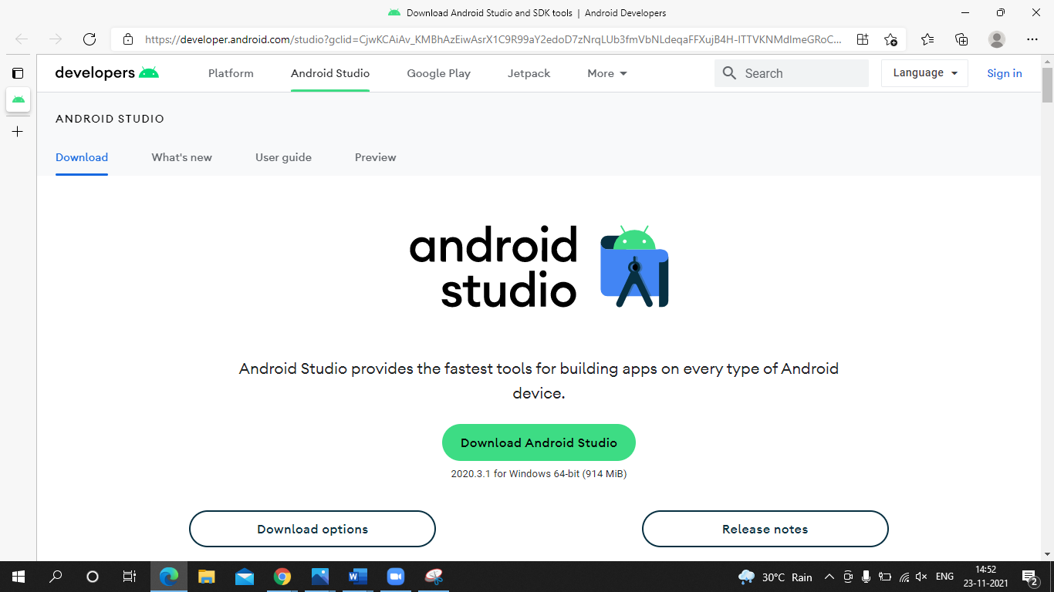
How to setup Appium
Step1: Download Android SDK :-https://developer.android.com/studio?gclid=CjwKCAiAv_KMBhAzEiwAsrX1C9R99aY2edoD7zNrqLUb3fmVbNLdeqaFFXujB4H-lTTVKNMdlmeGRoCxLUQAvD_BwE&gclsrc=aw.ds

Slide 4
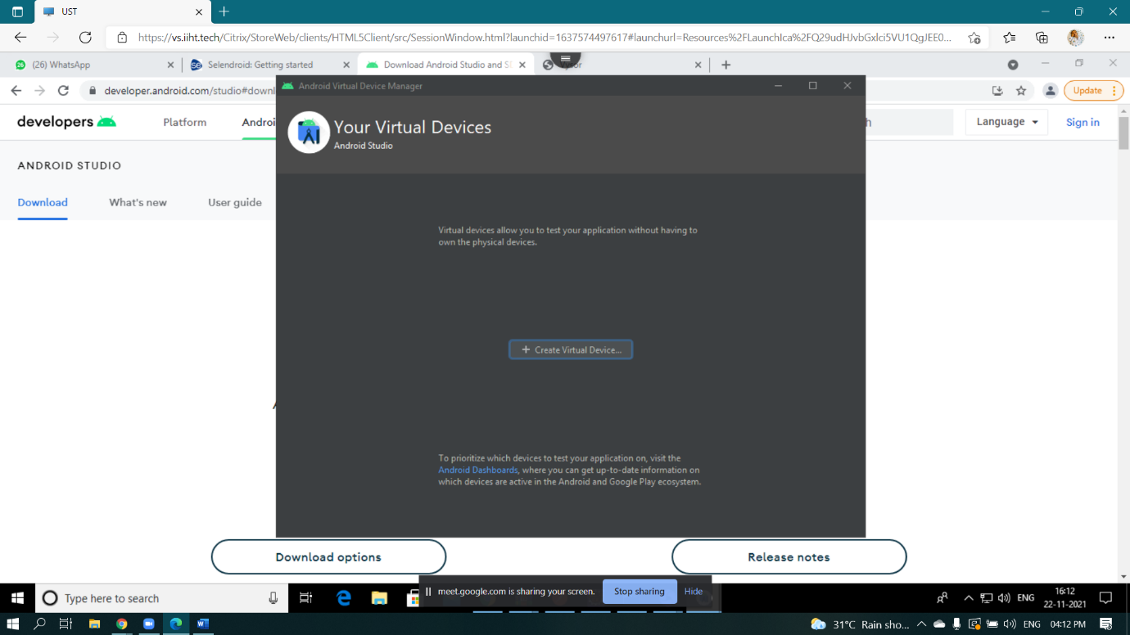
Step 2:- Create a Virtual Device

Slide 5
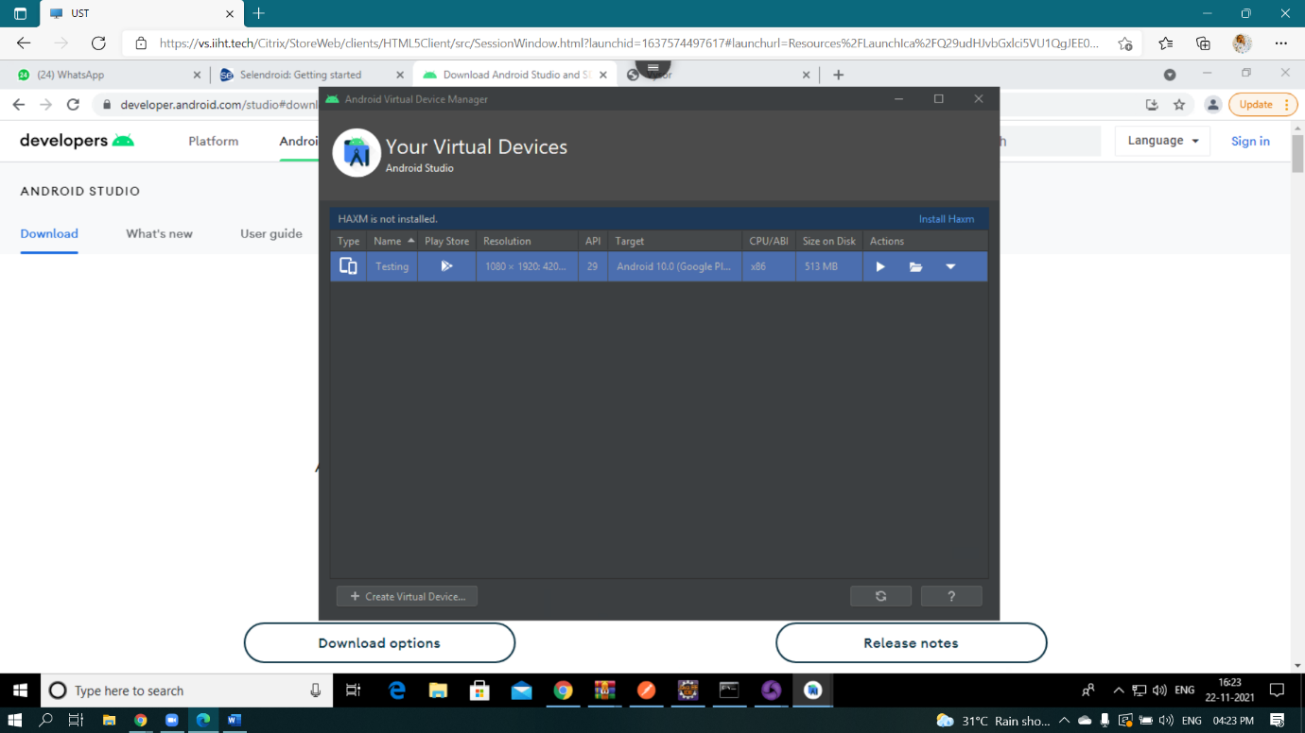
Step 3:-Run the virtual Device

Slide 6
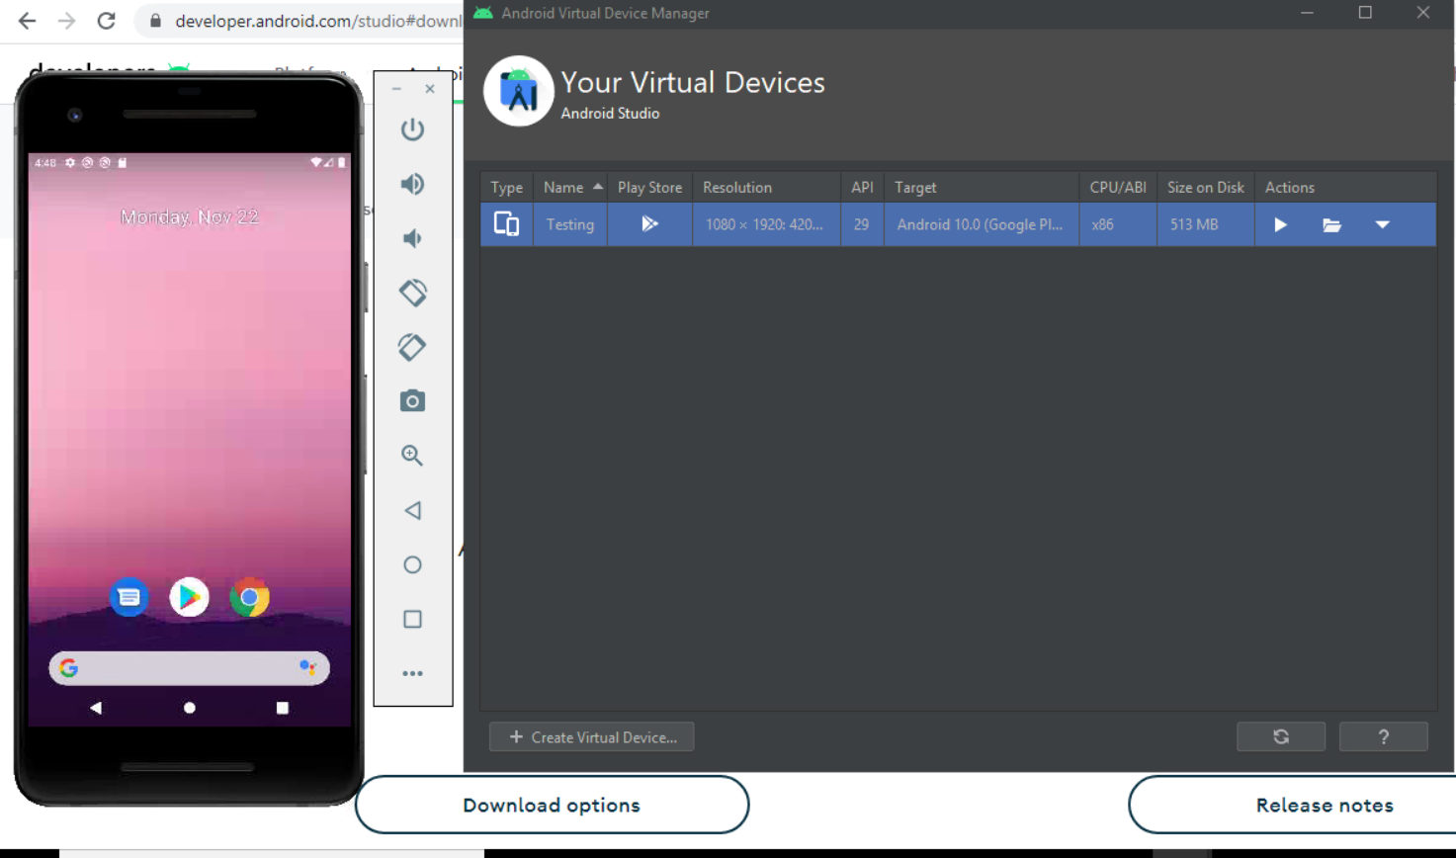

Slide 7
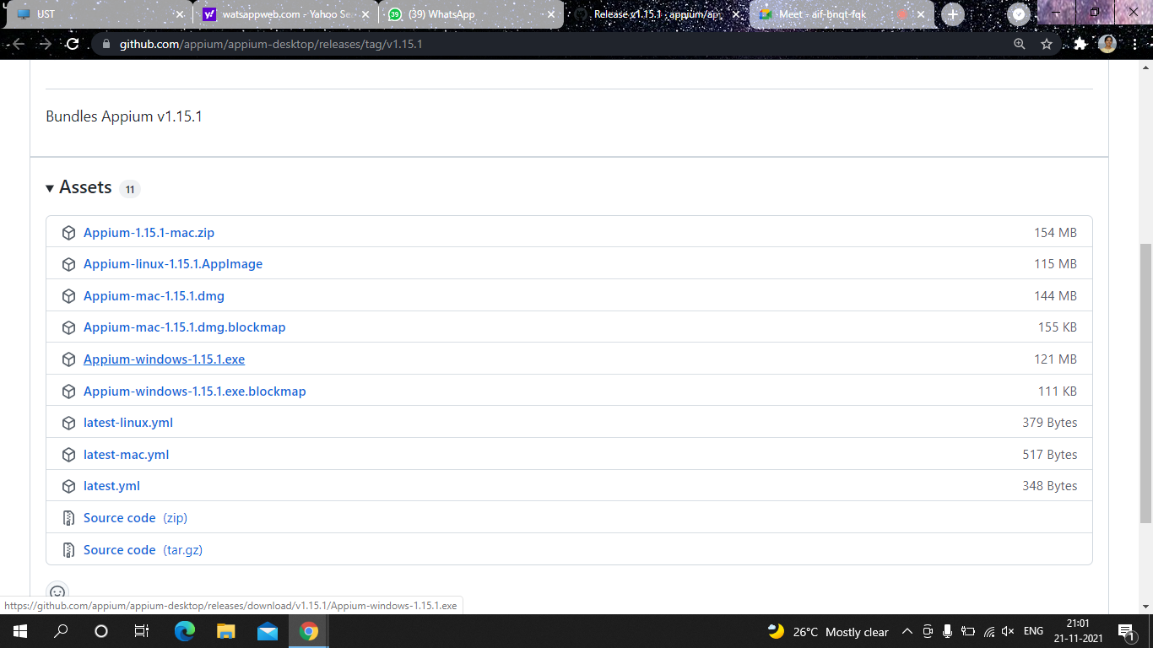
Step 4:Install Appium

Slide 8
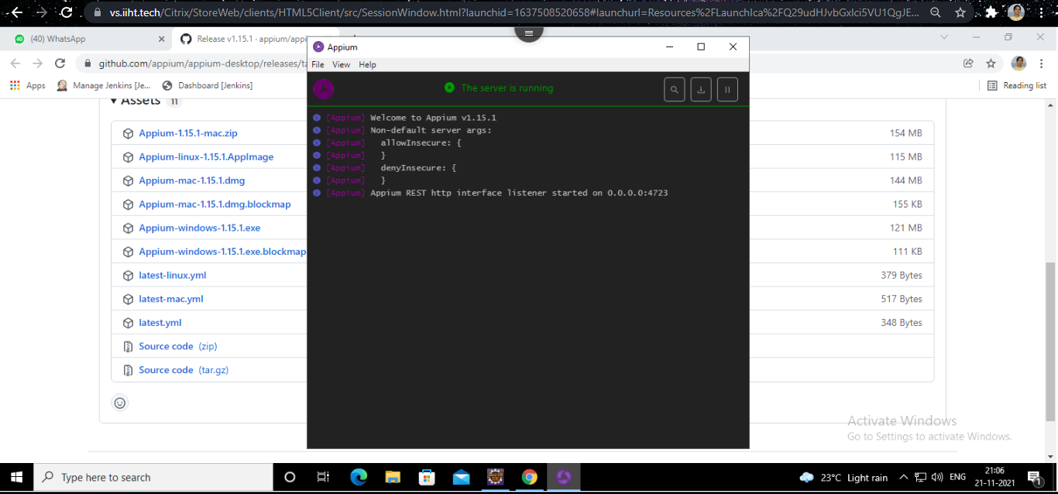

Slide 9
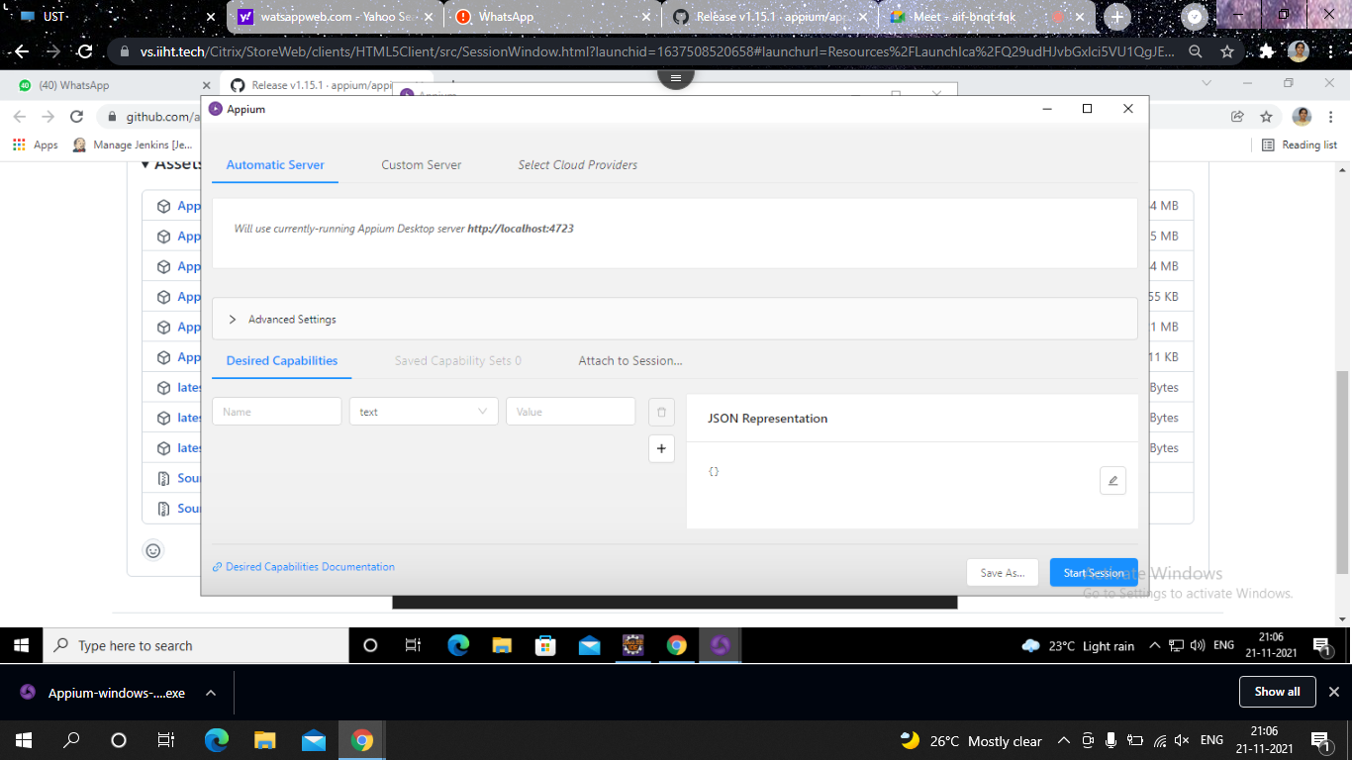
Step 5: Go to Settings

Slide 10
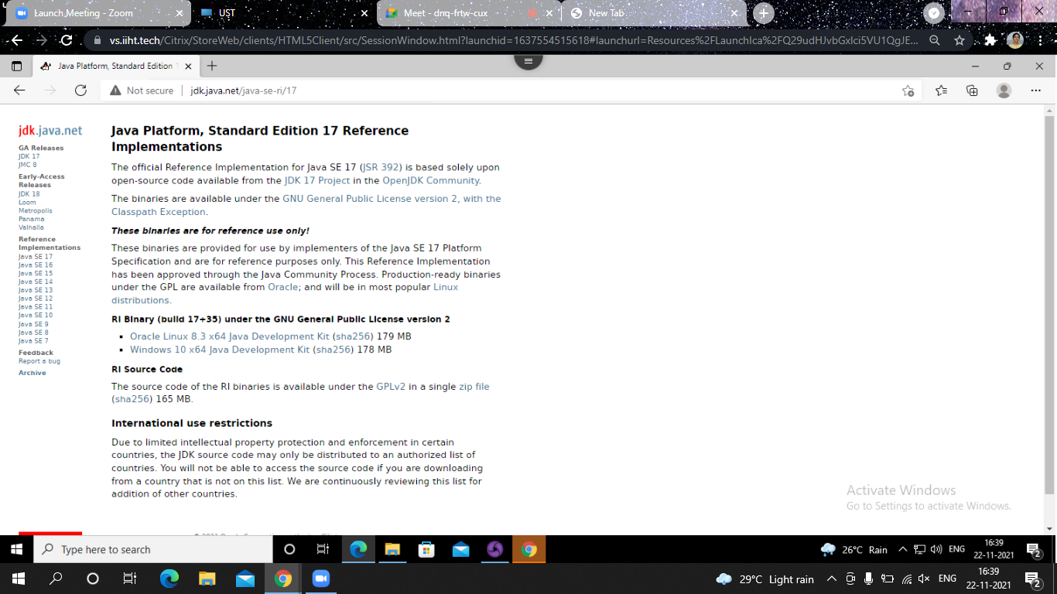

Slide 11
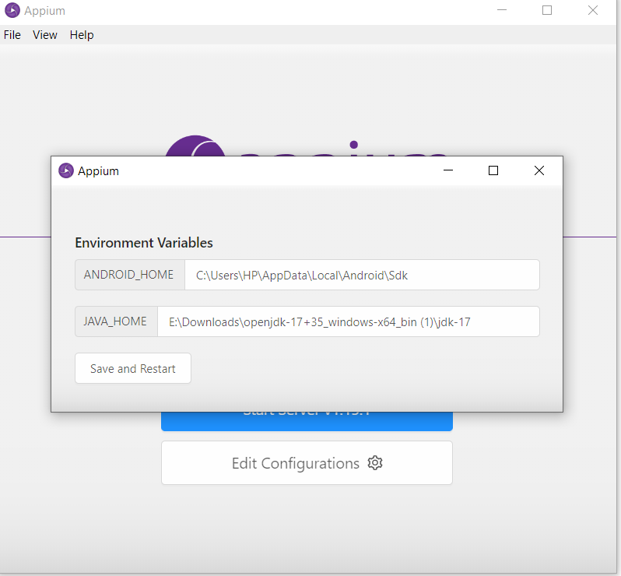
Step 6: Set Enviornment Variables

Slide 12
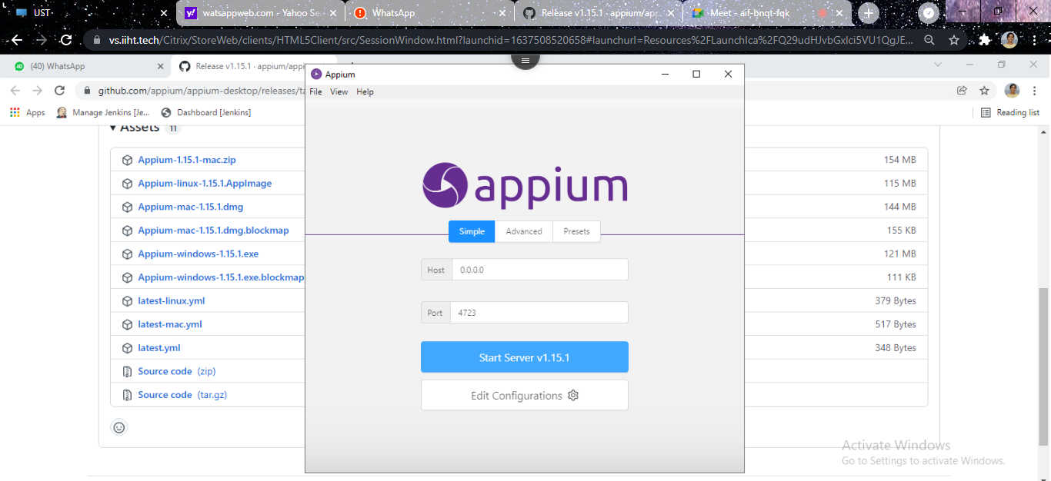
Step 7:Edit Config

Slide 13
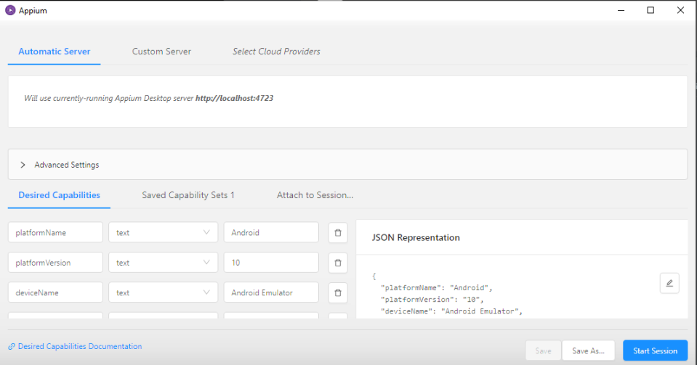

Slide 14
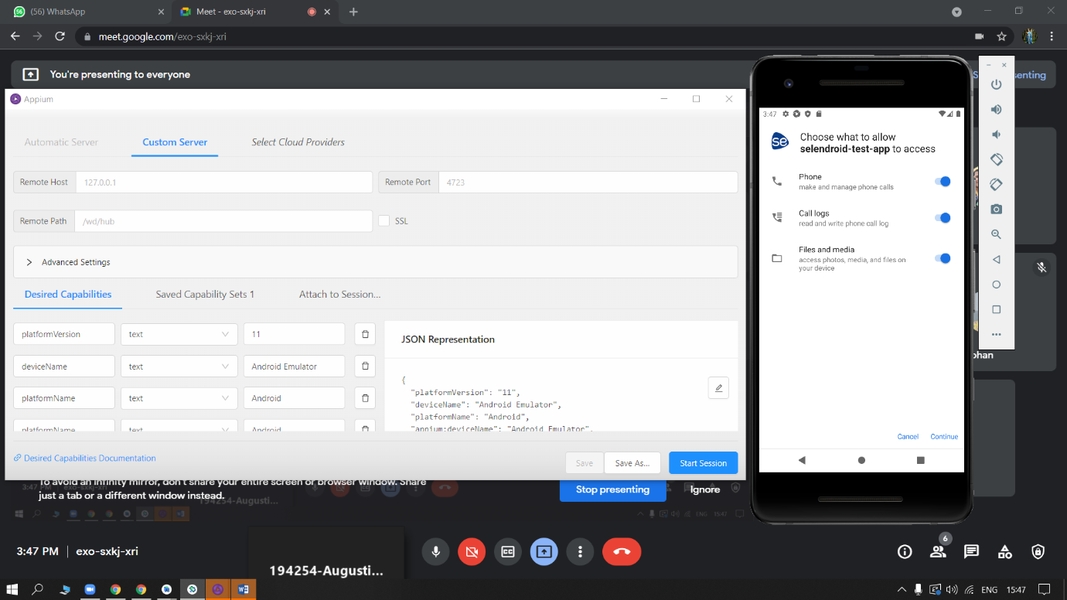

Slide 15
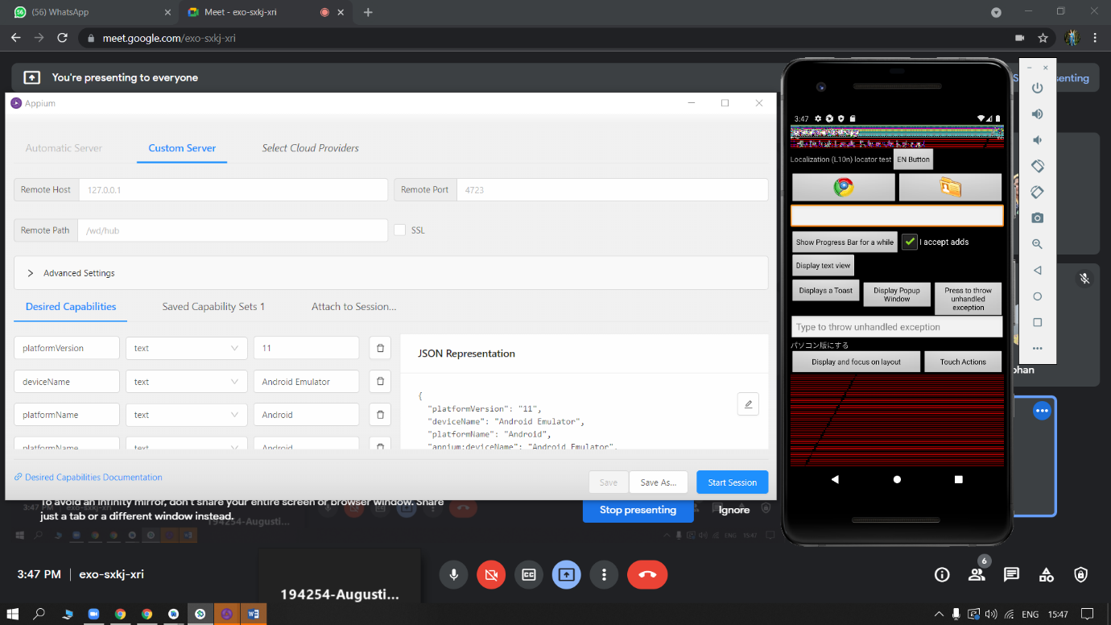

Slide 16
Step 7: Edit system environmental Variables
Edit environment Variable:
Add sdk path in System Variable
Edit path: Add path of platform tools, tools, buildtools\31.1.0
Set path of android studio
C:\Users\ustjavasdetb411\AppData\Local\Android\Sdk\platform-tools
C:\Users\ustjavasdetb411\AppData\Local\Android\Sdk\tools
C:\Program Files\Android\Android Studio\bin
C:\Users\ustjavasdetb411\AppData\Local\Android\Sdk\build-tools\31.0.0
C:\Users\ustjavasdetb411\Downloads\openjdk-17+35_windows-x64_bin\jdk-17\bin

Slide 17
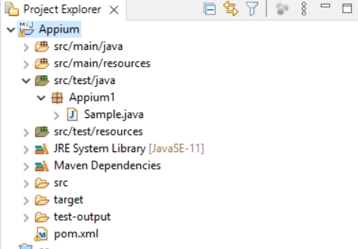
Step 8:Create a Maven Project

Slide 18
Example
package Appium1;
import java.net.MalformedURLException;
import java.net.URL;
import java.util.concurrent.TimeUnit;
import org.openqa.selenium.By;
import org.openqa.selenium.WebElement;
import org.openqa.selenium.remote.CapabilityType;
import org.openqa.selenium.remote.DesiredCapabilities;
import org.testng.annotations.Test;
import io.appium.java_client.android.AndroidDriver;
public class Sample {
private static AndroidDriver<WebElement> driver;
@Test
public static void main (String[] args) throws MalformedURLException, InterruptedException {

Slide 19
DesiredCapabilities capabilities = new DesiredCapabilities();
capabilities.setCapability(CapabilityType.BROWSER_NAME, "");
capabilities.setCapability("deviceName", "Pixel_2_API_30");
capabilities.setCapability("platformVersion", "11.0");
capabilities.setCapability("platformName", "Android");
capabilities.setCapability("appPackage", "io.selendroid.testapp");
capabilities.setCapability("appActivity", "io.selendroid.testapp.HomeScreenActivity");
capabilities.setCapability("autoGrantPermissions",true);
driver = new AndroidDriver(new URL("http://127.0.0.1:4723/wd/hub"), capabilities);
driver.manage().timeouts().implicitlyWait(5, TimeUnit.SECONDS);
driver.findElement(By.id("com.android.permissioncontroller:id/continue_button")).click();
driver.findElement(By.id("android:id/button1")).click();
driver.findElement(By.xpath("//android.widget.EditText[@content-desc='my_text_fieldCD']")).sendKeys("Mukesh Selenium Appium");
driver.findElement(By.id("io.selendroid.testapp:id/startUserRegistration")).click();
// close the application
// driver.quit();
}}

Slide 20
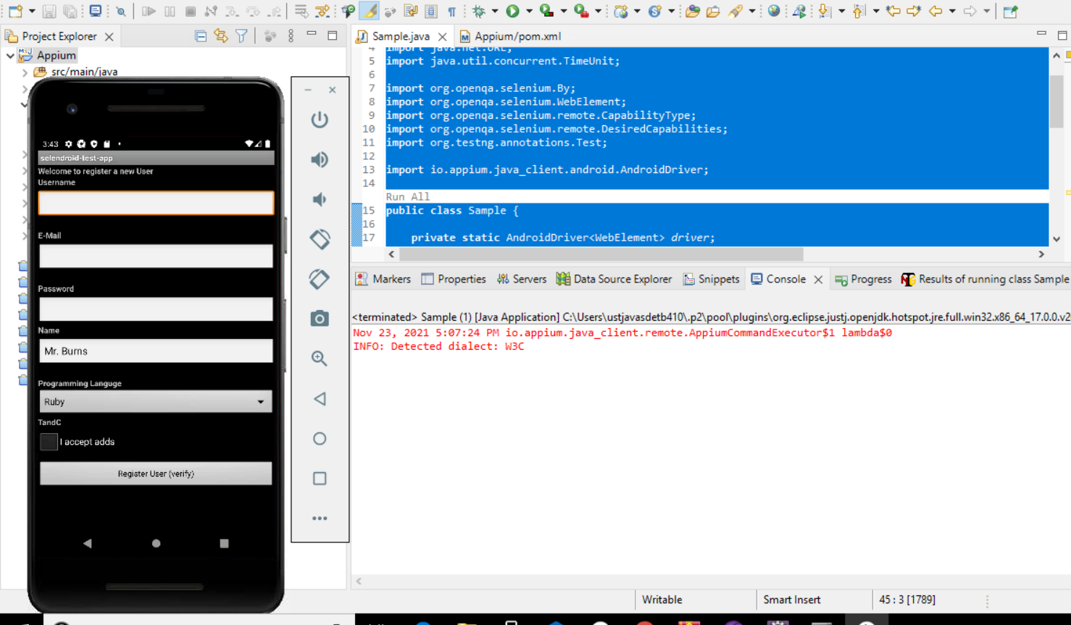
Result

