Slide 1
Weave our own Code
Vimal Joseph
SPACE
www.space-kerala.org

Slide 2
From "Programmers at Work" by Microsoft Press"....
Interviewer:
"Is studying computer science the best way to prepare to be a programmer?"
Bill Gates:
"No, the best way to prepare is to write programs, and to study great programs that other people have written. In my case, I went to the garbage cans at the Computer Science Center and I fished out listings of their operating system."

Slide 3
Free as in Freedom
Free Software has
Freedom to use on any number of machines
Freedom to share with your friends, neighbours, anyone
Freedom to study and modify
Freedom to share the modified version
KNOWLEDGE SHOULD BE FREE

Slide 4
GNU/Linux Operating System
You wont be called Pirate
  Feel free to Copy.
Open Source code.
A great learning resource
Powerful
  Wide range of capabilities
  Flexible user interface
Wide range of tools
  Development, publishing, networking, desktop
Can be as geeky/good/friendly as you are
Community

Slide 5
Why GNU/Linux
The source has to be made available freely
Tens of thousands of programmers get to see the source code
Therefore:
Bugs are easily detected and corrected
Security issues are quickly fixed
New ideas come in quickly and are implemented
One can install on any number of computers
Software becomes available without payment,
but without support or warranty
Companies selling Free Software charge only for services

Slide 6
Free Software Development
Community oriented
Maintainer of code
Repositary
Bug tracking software
Mailing list
  Developers (devl)
  Users
License

Slide 7
Free Software Licenses
GPL
  Copyleft
  widely used (GNOME,KDE,Linux Kernel)
  http://www.gnu.org/copyleft/gpl.html
BSD
  Free BSD
  http://debian.org/misc/bsd.license
Artistic
  Perl
  http://language.perl.com/misc/Artistic.html
http://www.gnu.org/licenses/

Slide 8
GNU Development Tools
GCC -GNU Compiler Collection
  Support several Languages
    C, C++, Fortran, Java
  Portable
GDB – GNU Debugger
GNU Make
GNU Autotools
  Autoconf, Automake
  generate makefiles dynamically for target systems

Slide 9
More Development Tools
Python
  Object oriented
  intrepreted
  vast amount of libraries available
Perl
Ruby
TCL
Shell

Slide 10
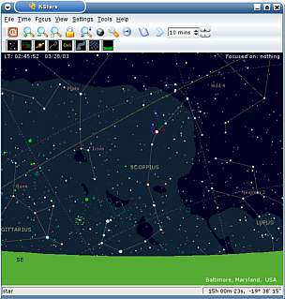
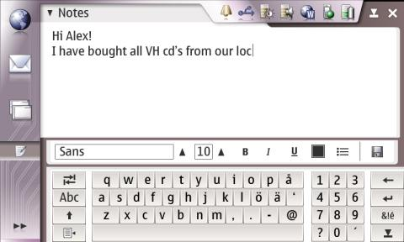
GUI
Widget Libraries
  GTK
    GNOME, Nokia 770 internet tablet (memo.org)
    C, C++, Python, Perl, Ruby
  QT
    KDE, Qtopia
    C++, Python

Slide 11
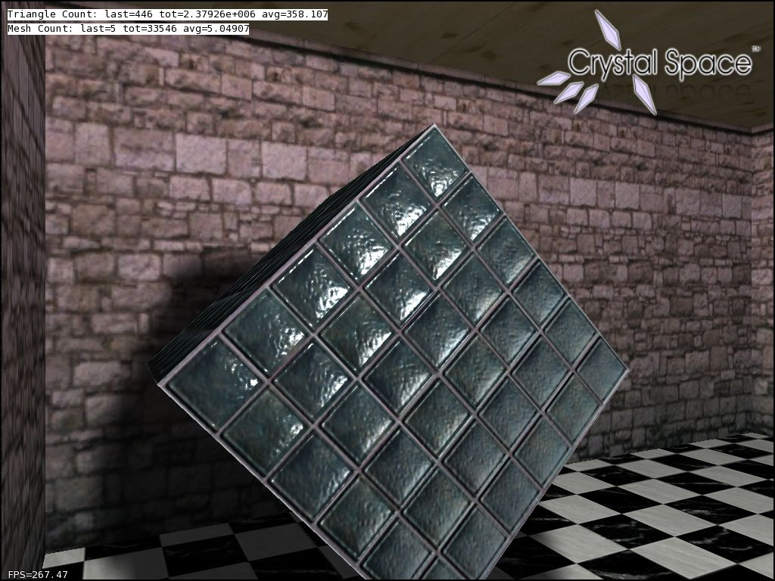
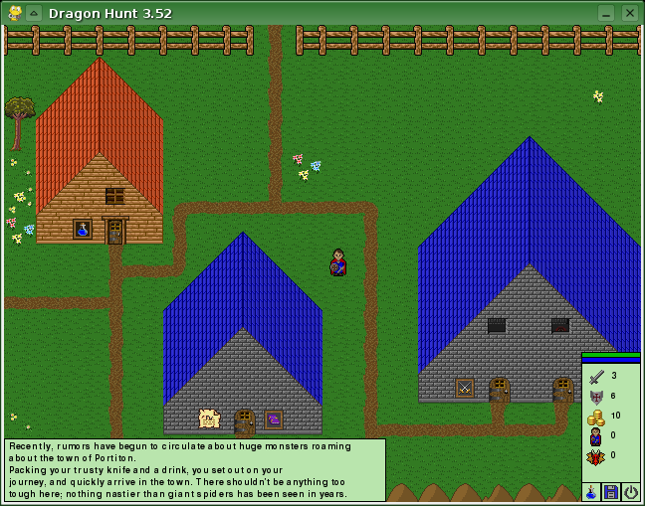
Game Development
Pygame
  use libsdl + python
OpenGL
libsdl

Slide 12
IDEs
Kdevelop
  C, C++, Qt
  KDE
Anjuta
  Development Environment for GNOME
Eclipse
  IDE + Framework in Java
    Supports java, c, c++
    Plugins

Slide 13
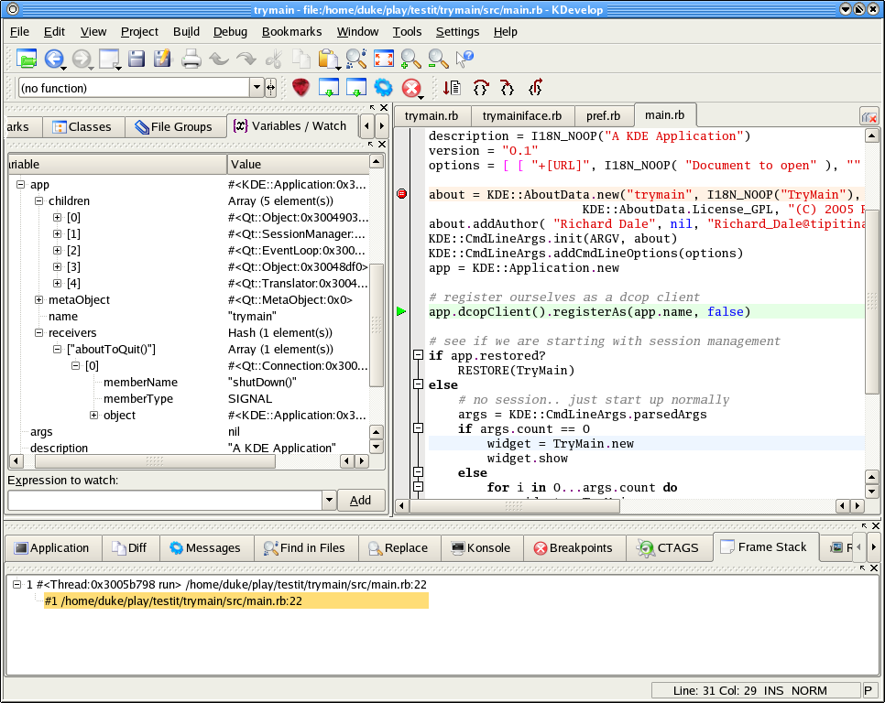
KDevelop

Slide 14
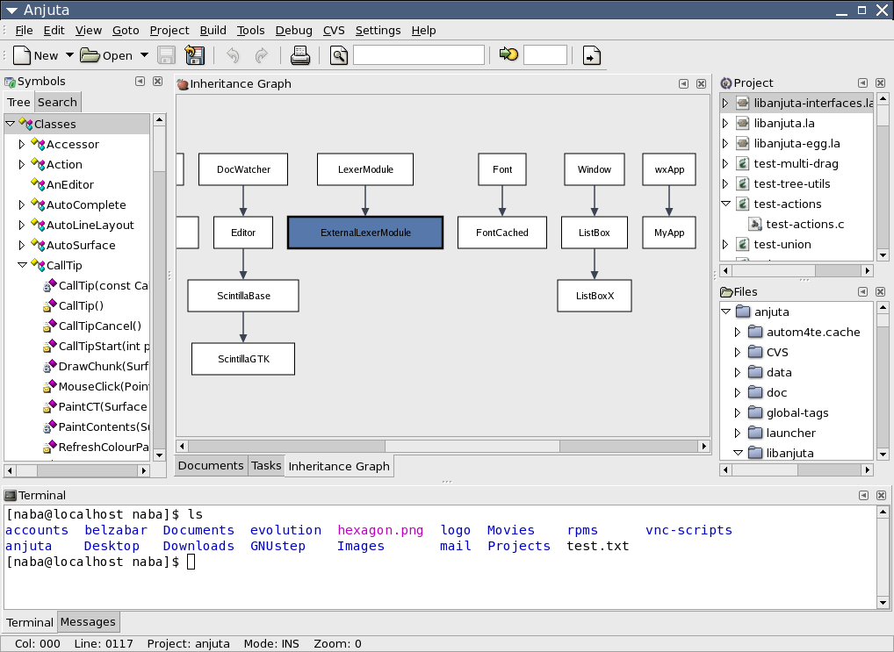
Anjuta

Slide 15
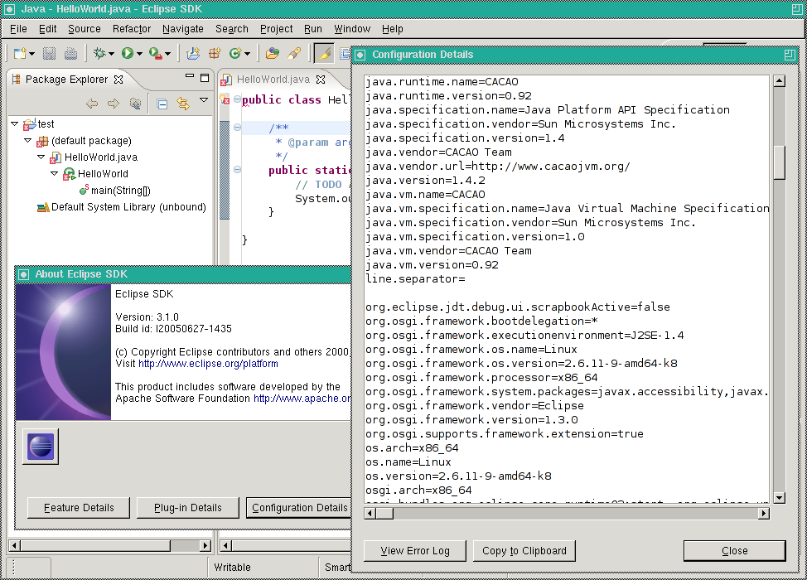
Eclipse

Slide 16
How to Contribute?
Fixing Bugs
Adding new features
Write documentation
Package the code to your favourate distribution

Slide 17
BUGS
Bug tracking system
  bugzilla
Bugsquad, Bugday, Bug Squashing party
Dev section
bugs.gnome.org, bugs.kde.org
  Catagorizing bugs
    http://developer.gnome.org/projects/bugsquad/
  Junior Jobs in KDE
  freshmeat.net

Slide 18
Make
A file called Makefile contains instructions for how to compile/build a program
Make analyzes the rules, determines what is out of date and needs to be rebuilt
Make compares file time stamps: if file.c is newer than file.o, file.c must need to be recompiled

Slide 19
Basics of Make
A “target” is something to be built (usually the executable program)
A “dependency” is something needed to build the target (usually a source file)
A “rule” is a set of commands for building the target (or an intermediate target) out of a source file, i.e., for updating the target
Many rules are built into Make

Slide 20
A simple Makefile
foo: foo1.o foo2.o foo3.o foo4.o
gcc foo1.o foo2.o foo3.o foo4.o -o foo
foo1.o: foo1.c bar2.h bar3.h
gcc -c foo1.c
foo2.o: foo2.c bar1.h
gcc -c foo2.c
foo3.o: foo3.c bar1.h bar2.h
gcc -c foo3.c
foo4.o: foo4.c bar3.h
gcc -c foo4.c

Slide 21
Autotools
Automake
Autoconf
configure script

Slide 22
Example
`hello.c'
#include <stdio.h>
main()
{
printf("Hello Free world!\n");
}
`Makefile.am'
bin_PROGRAMS = hello
hello_SOURCES = hello.c
`configure.in'
AC_INIT(hello.c)
AM_INIT_AUTOMAKE(hello,1.0)
AC_PROG_CC
AC_PROG_INSTALL
AC_OUTPUT(Makefile)

Slide 23
Autotools (cont.)
$ touch README AUTHORS NEWS ChangeLog
$ autoreconf --install
$ configure
$ make
$ make distcheck

Slide 24
CVS
copy of the source code kept in a repository
repository records the history of code
developers keep a local copy of their code
developers can update their local copy to get changes others committed to the repository
commit changes to the repository

Slide 25
CVS Environment Variables
CVSROOT tells CVS the location of your repository
CVS_RSH tells CVS how to connect to remote repositories
  you want to use ssh
CVSEDITOR the program CVS invokes for editing commit messages
  CVS will use EDITOR if CVSEDITOR is not defined
  defaults to vi if neither defined

Slide 26
Setup your own cvs repositary
do not work in the repository, it is simply where your source code is stored
create a new repository with:
cvs -d ~/projects init
to import files to your project run the following in your programmes directory:
cvs import programe username base

Slide 27
Checkin Checkout
get a new copy of the repository with:
cvs checkout programe
you make changes to your local copy and then commit them to the repository
to commit a file:
cvs commit file
to commit changes inside a directory and all it’s subdirectories:
cvs commit directory

Slide 28
CVS (cont.)
import from a remote cvs server
  cvs -d :pserver:user@host:/cvs/dir
  cvs co proj_name
Online CVS documentation
  http://cvsbook.red-bean.com

Slide 29
Hosting Your Project
http://savannah.gnu.org/
http://sourceforge.net
http://sarovar.org

Slide 30
Get Funding
Small Research Grant Programme of SPACE
  www.space-kerala.org
  up to Rs. 50000/-
  Focus area
    locallized software
    Educational tools
    localized games
  SARAI fellowship
    www.sarai.net

Slide 31
Free Software Cells
Monthly meetings
SPACE provide CDs and other resourse materials
FS cell can take up research projects
more information contact contact@space-kerala.org

Slide 32
'Where the mind is without fear and
the head is held high
Where knowledge is free
Into that heaven of freedom,
let my country awake'
Rabindranath Tagore

Slide 33
Questions?

