Slide 1
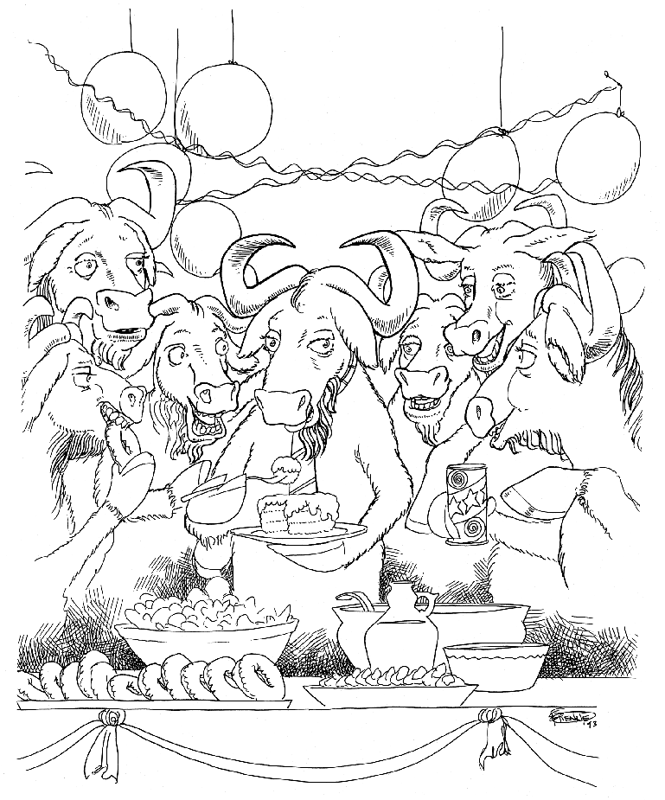
Free as in Freedom
Notes:
Note Page by Willem van der Plaat

Slide 2
Computer
An electronic device
A multipurpose machine
What runs this machine?

Slide 3
Software
You cannot touch or feel software.... but can use it :)
Software is a set of instructions that tells the machine what to do
It has no physical existence
It is possible to make a copy of it
You cannot copy a monitor or rice or bread...
You need a factory or farm to manufacture it
But in case of Software, the factory is a Computer...

Slide 4
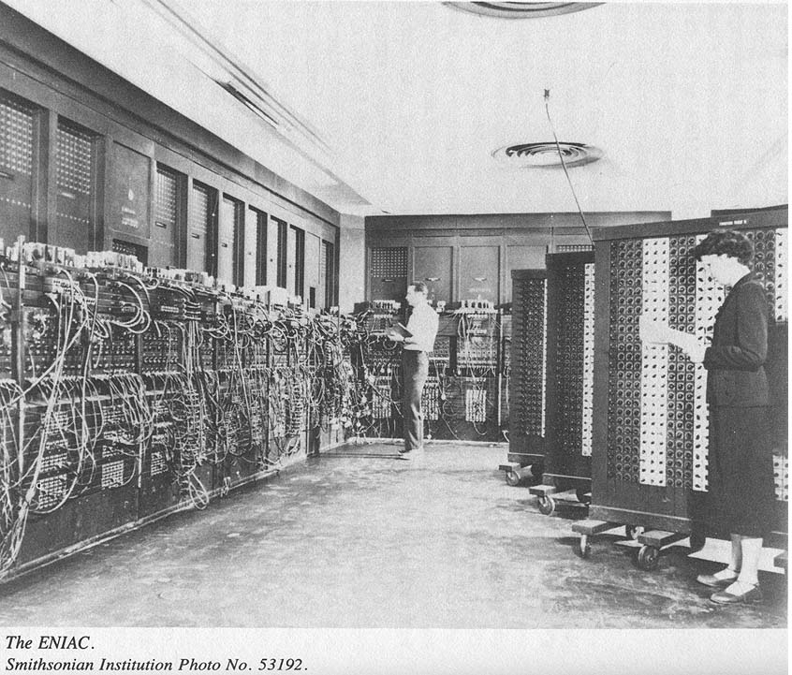
In the beginning

Slide 5
Sharing Software is Sharing Knowledge
Software are instructions
Just like mathematical formulas
It is a kind of knowledge
"If you have an apple and I have an apple and we exchange these apples then you and I will still each have one apple. But if you have an idea and I have an idea and we exchange these ideas, then each of us will have two ideas."
-- George Bernard Shaw

Slide 6
The evil of proprietary software
Proprietary software is software with an owner.
The users are only licensed to use it in a very restricted manner
  You can only use this in your computer
  You cannot give/share it
  You do not try to understand the code (instructions)
  ... and more

Slide 7
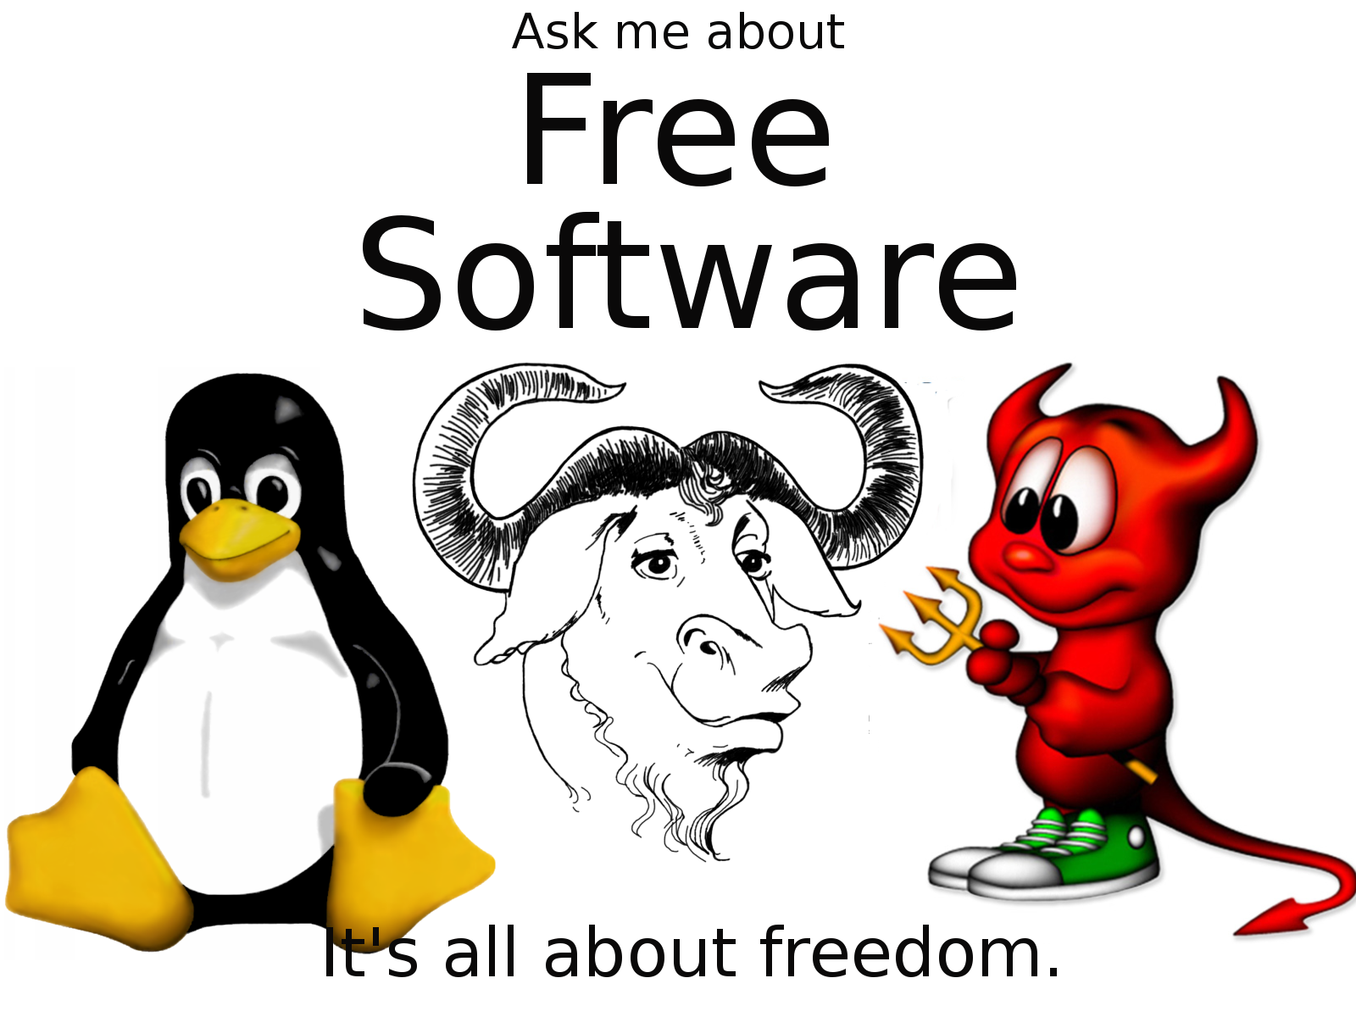
Free as in Freedom

Slide 8
Freedom Matters
Free Software gives you
Freedom to USE
Freedom to Study
Freedom to Redistribute
Freedom to Modify and redistribute
It does not mean it is free of cost
Think of Free speech, not free masala dosha

Slide 9
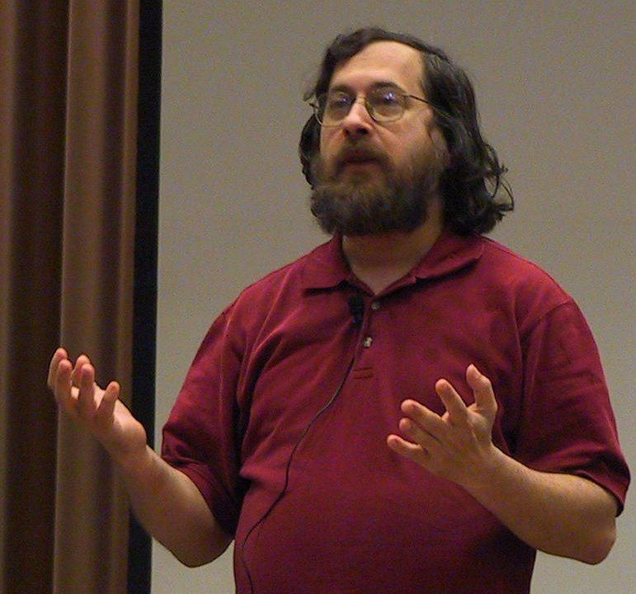
Richard M. Stallman

Slide 10

GNU
Project to build a complete Free Operating System
www.gnu.org
GNU is Not UNIX

Slide 11
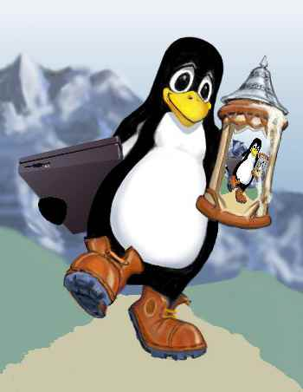
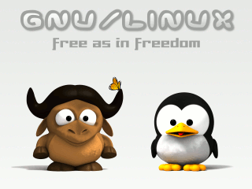

GNU/Linux
GNU + Linux Kernel
Linus Torwalds

Slide 12






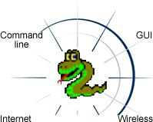




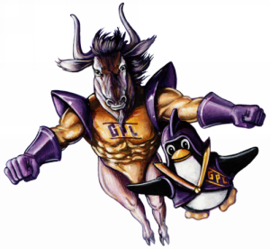
Software

Slide 13



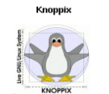



Distributions
Application Programs
GUI
GNU Tools
Kernel

Slide 14
Why choose free software
If you choose to use Free Software,
  You can free your computers and your mind...
  You can save money
  You can learn new software
It's a new world full of possibilities..
....let's go exploring

Slide 15
Thanks...
Any questions??

