Slide 1

ICT
Information
Communication
Technology

Slide 2
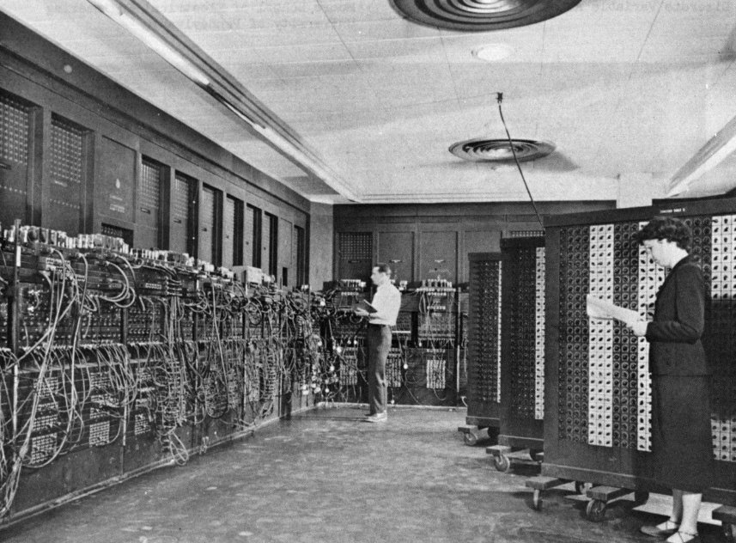
In the beginning...

Slide 3
Free as in Freedom
Free Knowledge & Free Software

Slide 4
Internet
A (very) brief history

Slide 5
Internet
Why it clicked?

Slide 6
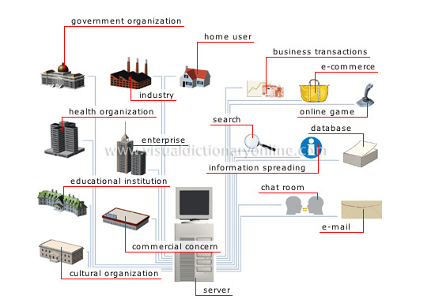
Internet

Slide 7
Required Components
      A device for accessing the web
      A connection from an ISP
      A modem
      A web browser

Slide 8
WWW
What's there on the web?
      Information (Almost everything imaginable)‏
      Utility Services
      Means of Communication
      Means of collaboration

Slide 9
Information
      URL (www.kerala.gov.in)‏

Slide 10
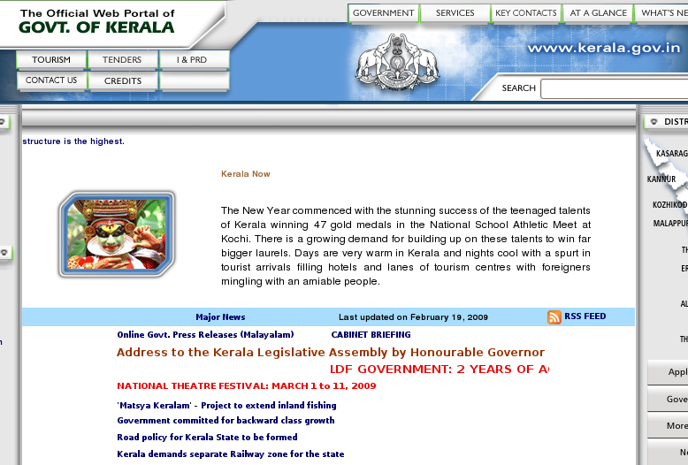
Information

Slide 11
Information
      Using a Search Engine (eg. Google)‏

Slide 12
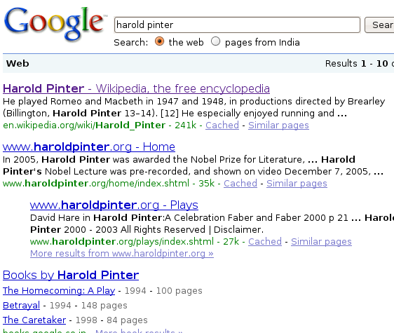
Information

Slide 13
Information
      Large sites – Own Search tools

Slide 14





Information

Slide 15






News

Slide 16



News (spl)‏

Slide 17




News (spl)‏

Slide 18

Wiki

Slide 19
Email
      Communication Redifined
      Barriers of Distance & Cost broken
      Luxury of choosing a convinient time for communication
      Length of text not a barrier
      Attachments
      Multiple recepients

Slide 20



Email

Slide 21
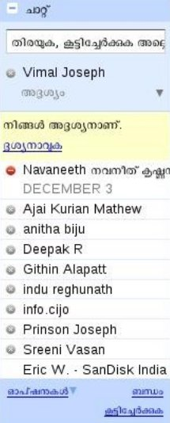
Chat

Slide 22
Blogs
      Freedom of expression
      Pitfalls
      Photoblogs
      Videoblogs

Slide 23


Feed Reader

Slide 24
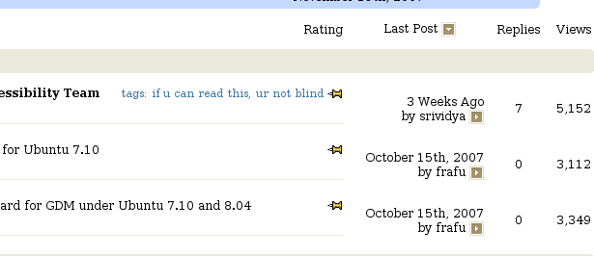
Mailing Lists/ Forums

Slide 25
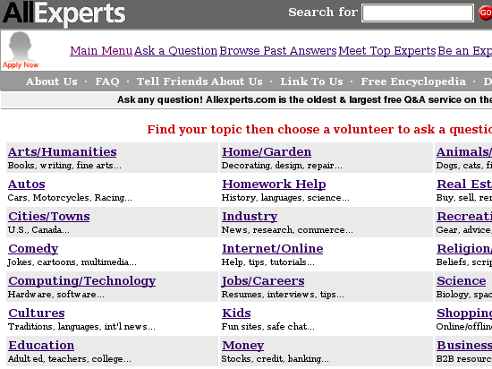
Asking an Expert

Slide 26


Social Networking

Slide 27
Social Networking
      Friends
      Who share similar interests

Slide 28

Open Access
      plosone.org
      doaj.org
      http://ccsenet.org/journal/index.php/elt/

Slide 29


Textbooks

Slide 30
OER
      OER Commons (oercommons.org)‏
      MIT OCW
      CMU OLI

Slide 31

OER

Slide 32


Video & Photo Sharing

Slide 33
ICT in Education
Finding Information
Storing
Sharing
Collaborating

Slide 34
Finding Information
Search, Search and Search

Slide 35
Storing
Scrapbook plugin for firefox!!
Delicious

Slide 36
Sharing
Email
Delicious

Slide 37
Collaborating
Wiki
Google Docs

Slide 38
Links : http://delicious.com/vimaljoseph/ict
Questions?
Adapted from a presentation by James Mathew, SPACE

