Slide 1

Society for Promotion of Alternative Computing and Employment
http://www.space-kerala.org
Notes:
Note Page by Willem van der Plaat

Slide 2
Introduction
SPACE is a non-profit society working in the field of Information Communication Technologies (ICT) and New media
SPACE board has members from academia, the IT industry, professional societies such as IEEE and Computer Society of India, and the IT Administration of the Government of Kerala.
We believe that all kind of knowledge should be accessible to all and we choose Free Software as our tool
Our Vision is to make the benefits of ICT reach a larger section of the society and promotes employment and development through Free and Open Source Software (FOSS)
SPACE also addresses special needs of Kerala in FOSS by promoting local language computing, use of ICT for differently abled, new media etc..

Slide 3
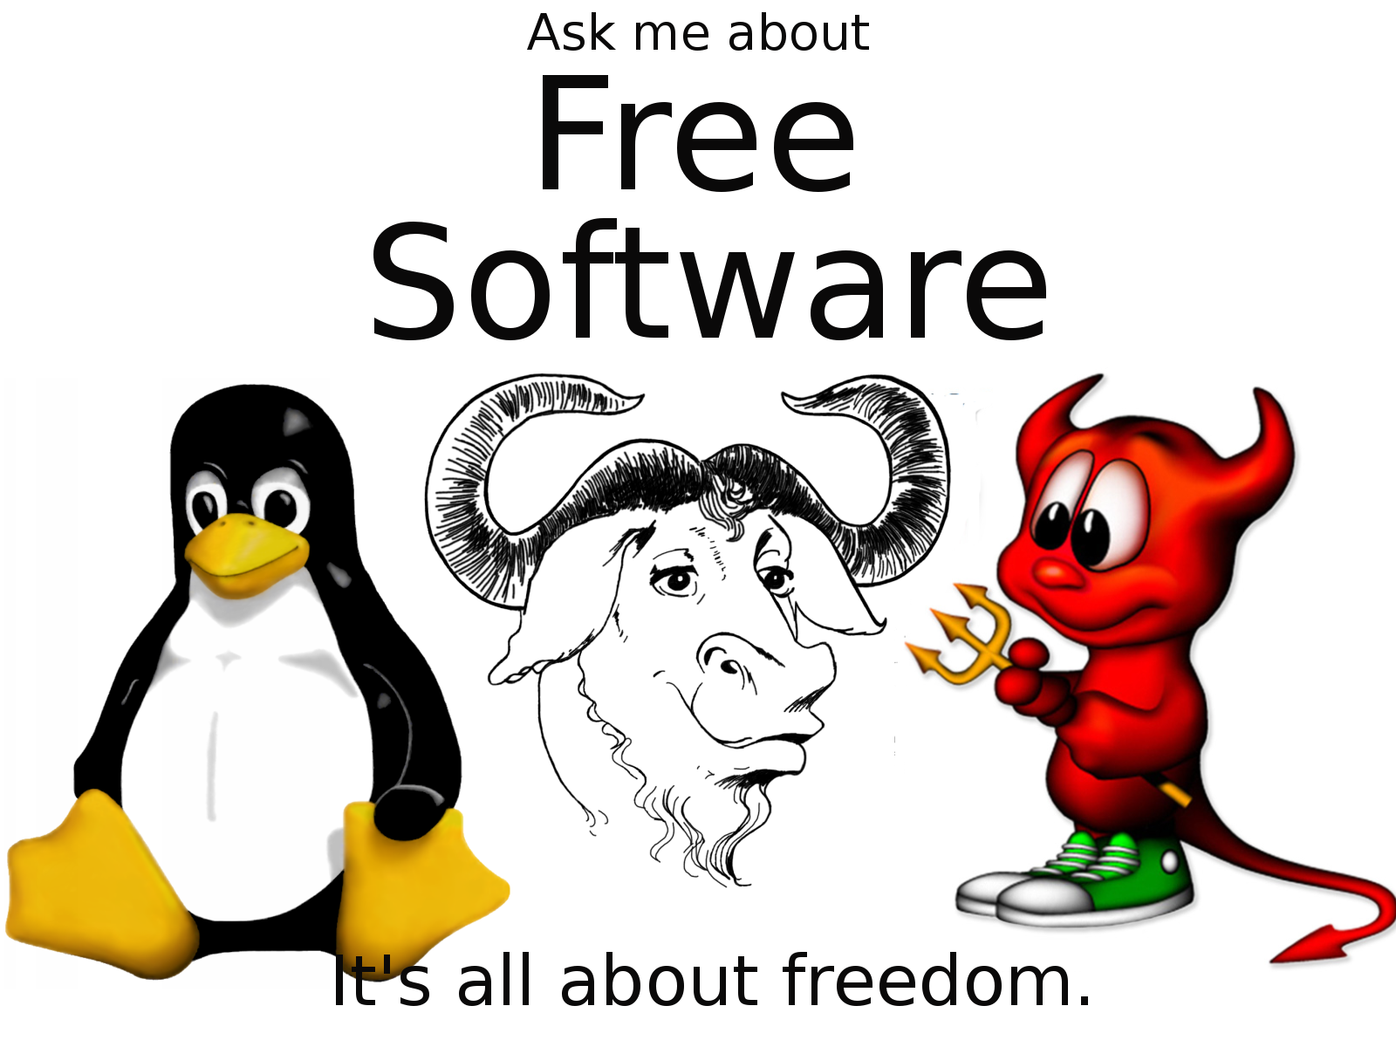
Focus areas
Freedom in Computing
Community Media
E-governance and Free Software
Technology for Differently Abled
Language Computing – for a multicultural world
ICT for Women
Knowledge Sharing

Slide 4

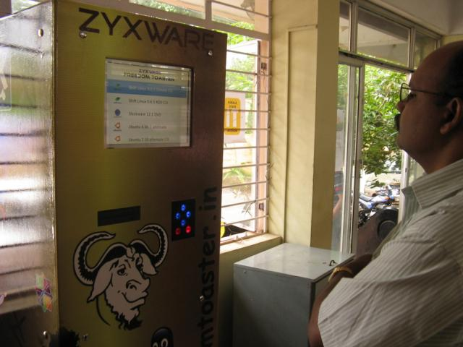
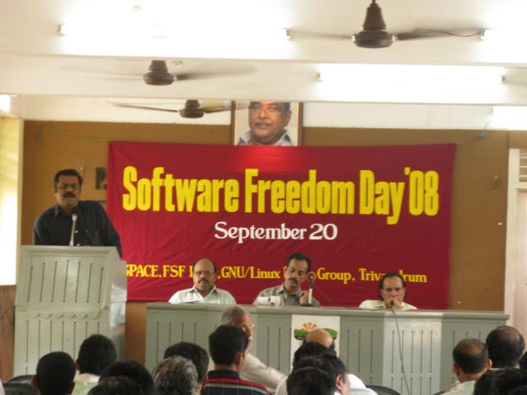
Freedom in Computing
Conferences and Awareness seminars
  Software Freedom Day 2008
  International Conference on Free Software http://fsfs.in

Slide 5
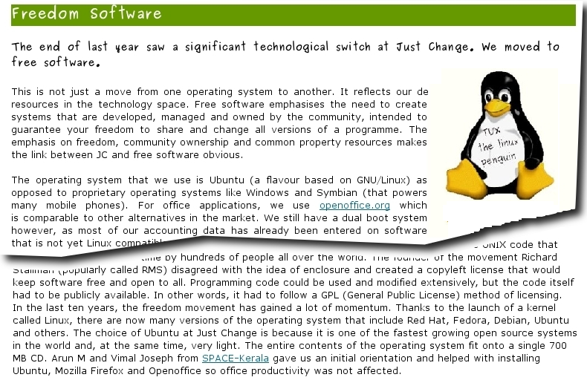
Advocacy among civil society and NGO's
The Accord Experience - http://www.adivasi.net/

Slide 6

Major organizations that use Free Software in Kerala
IT@School - Around 3000 govt./aided schools
Kerala State Electricity Board
Kerala State Khadi and Village Industries Board

Slide 7
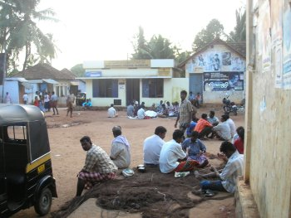
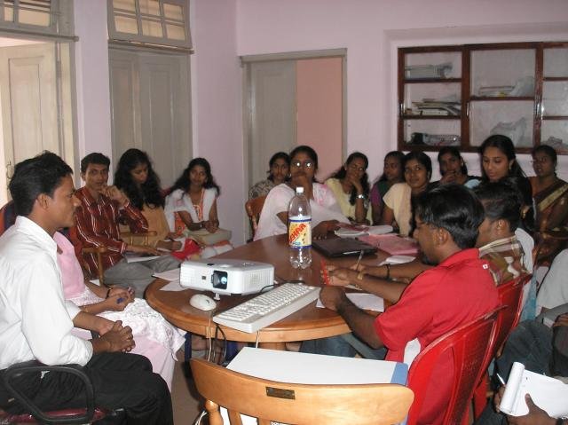
SPACE for My Voice
Web4all
Entegramam
Community radio initiatives

Slide 8

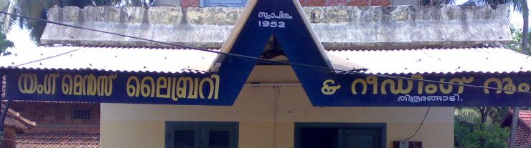
Web4all

Slide 9
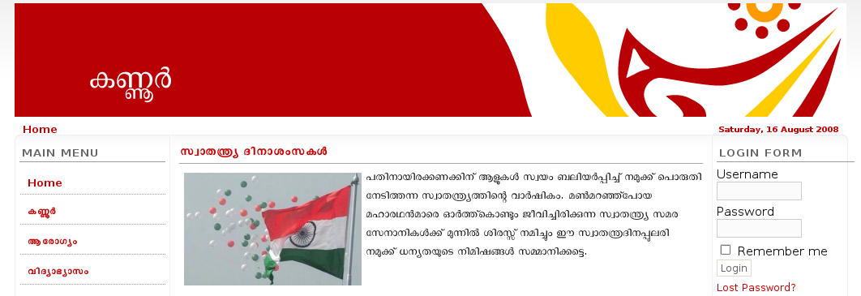
Entegramam
http://entegramam.gov.in

Slide 10

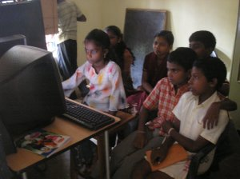
Community Radio Initiatives
Radio Alakal - http://alakal.org

Slide 11

SPACE for Differently Abled
http://insight.kerala.gov.in

Slide 12
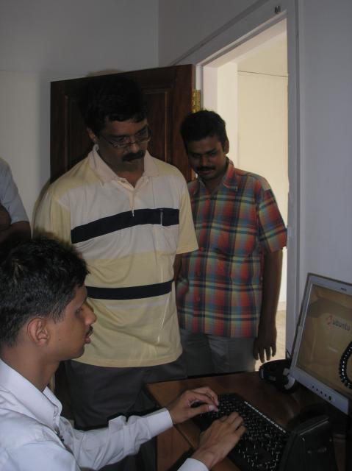
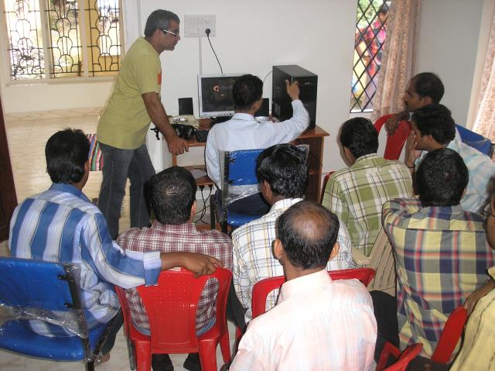
Insight
The first ever ICT center for disabled
Started in April 2007
Resource Center
  2 Support Staff
  5 Internet enabled computers
Training
15 visually challenged Master Trainers.

Slide 13
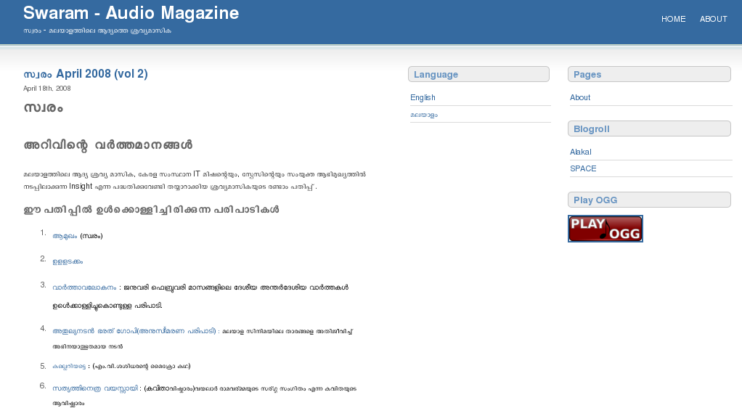
Swaram
SPACE launched Swaram, an audio magazine for the visually challenged in January 2008
http://swaram.web4all.in

Slide 14
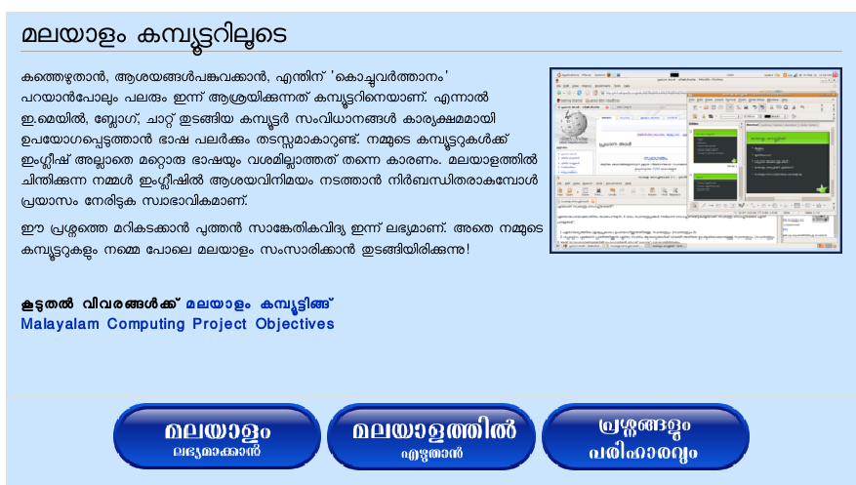
SPACE for multicultural world
An information booklet and campaign logo developed by SPACE for the Malayalam Computing Campaign were released by the noted Malayalam poet, Sri Madhusoodhanan on World Languages Day on February 21.

Slide 15
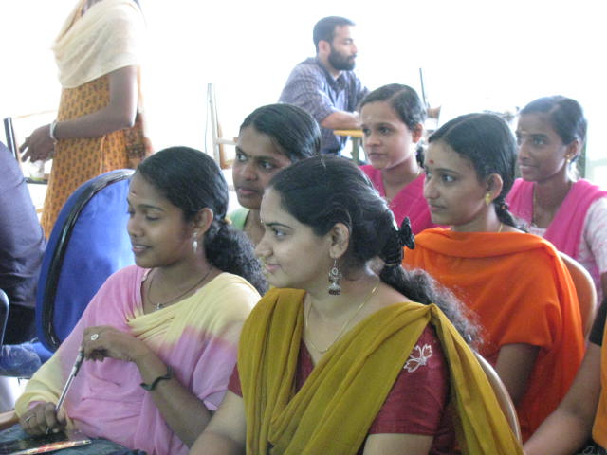
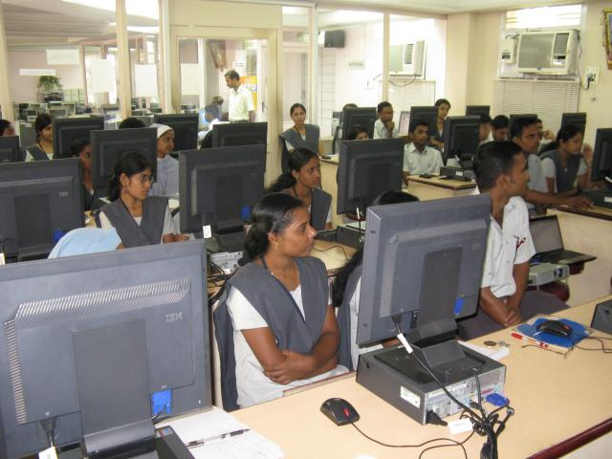
SPACE for both Men and Women
Awareness and use of ICT among students
Impact of IT@School
ICT use in women organizations

Slide 16
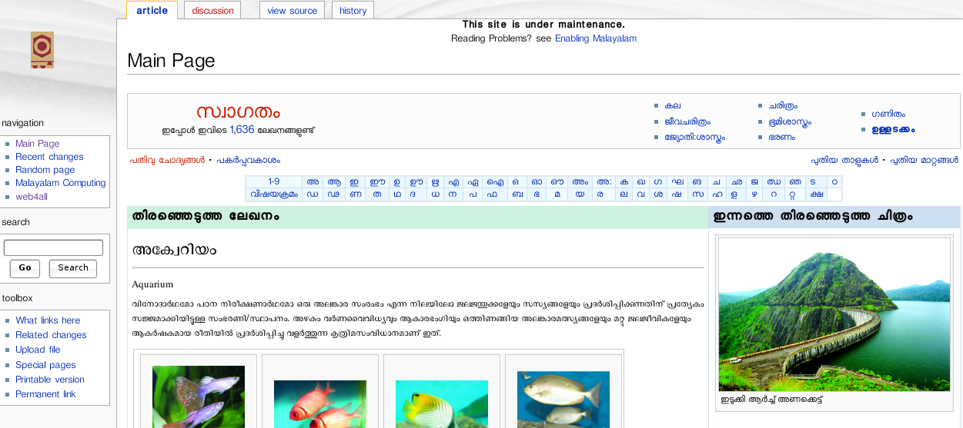
SPACE for knowledge sharing
Digitization of malayalam encyclopedia
  SPACE successfully championed its political position regarding knowledge sharing in its advocacy with the State Institute of Encyclopaedia Publications (SIEP) this year.
  http://ml.web4all.in

Slide 17
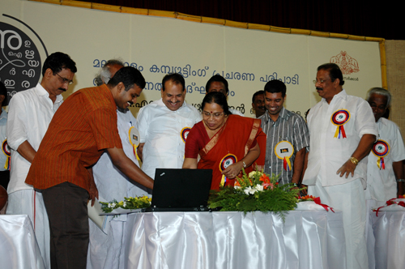
Gallery
Inauguration of Malayalam Computing Campaign - http://malayalam.kerala.gov.in

Slide 18
Gallery
Community Radio Workshop by Radio Alakal team

Slide 19
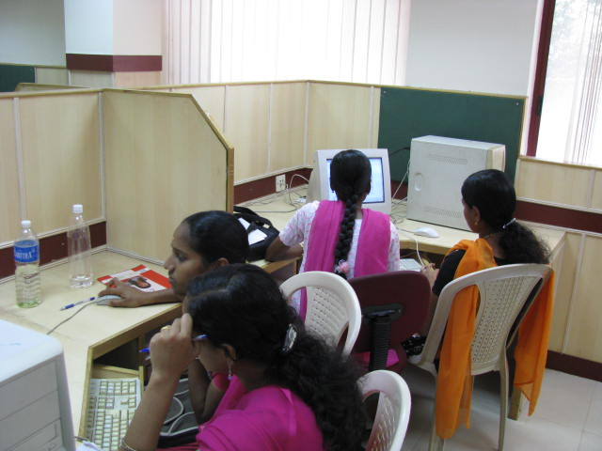
Gallery
ICT and Women Training - Kannur

Slide 20
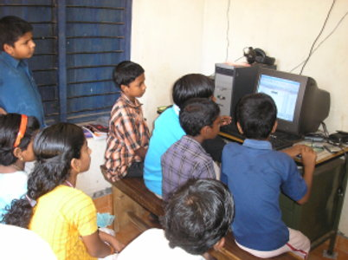
Village Knowledge Center, Vizinjam

Slide 21
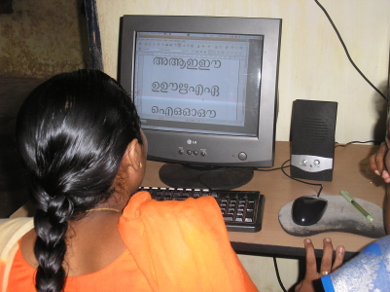
Village Knowledge Center, Vizinjam

Slide 22
Village Knowledge Center, Vizinjam

Slide 23
Thanks
http://space-kerala.org

