Slide 1
Web4all
Introduction to the web

Slide 2
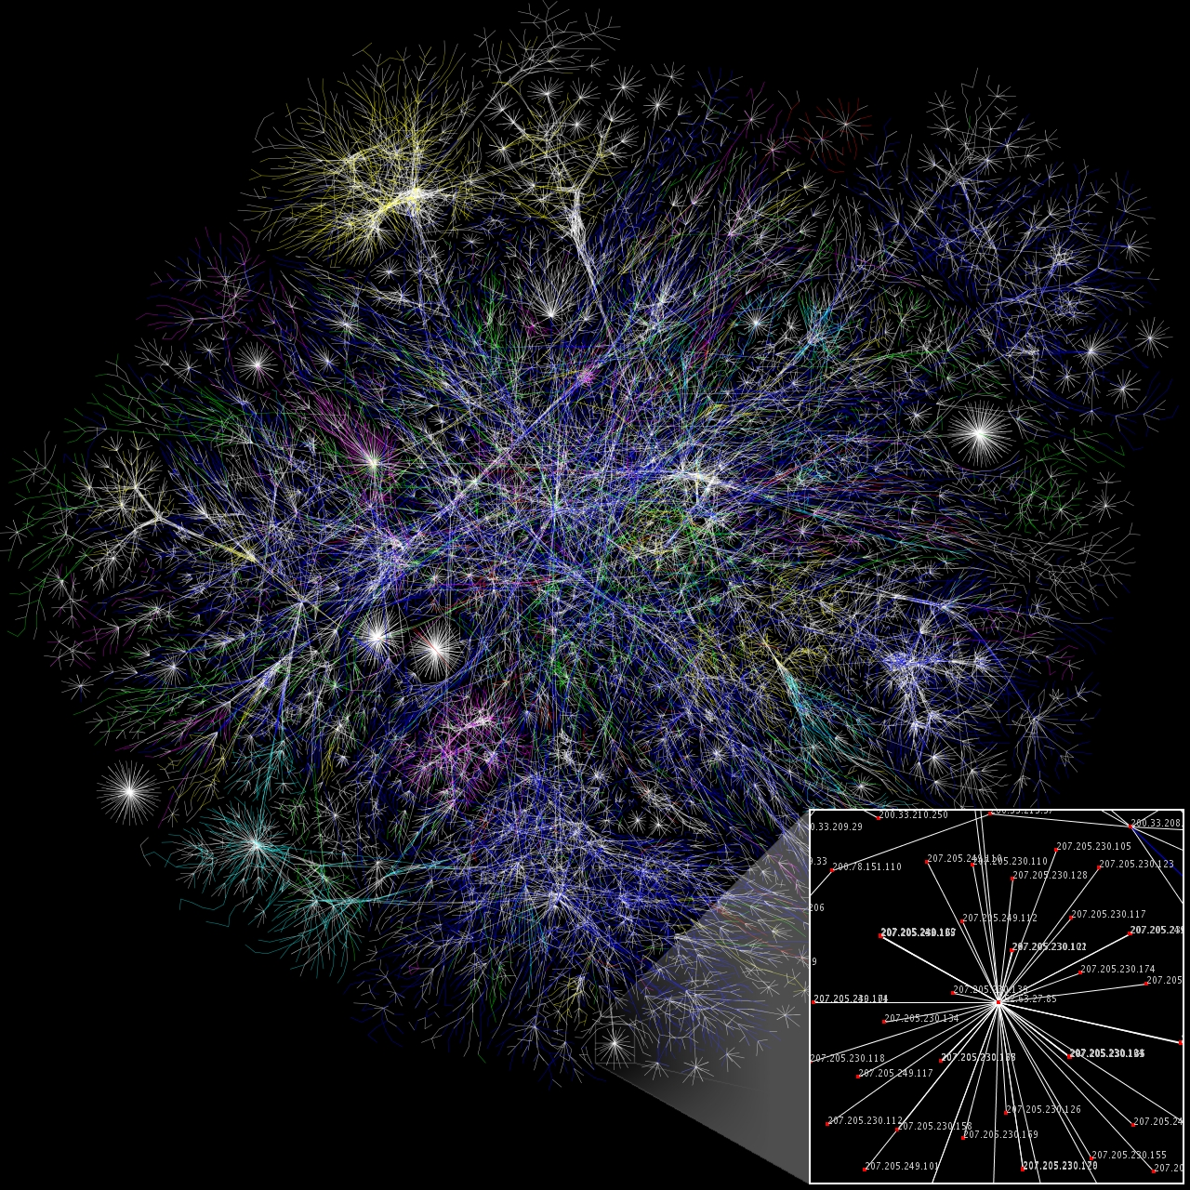
Internet
A Huge network of computers
Every computer connected to the internet have a unique identifier

Slide 3

World Wide Web (www)
A huge network of information / content / websites
Each website has a unique address (domain name)
Content are interconnected with hyperlinks

Slide 4
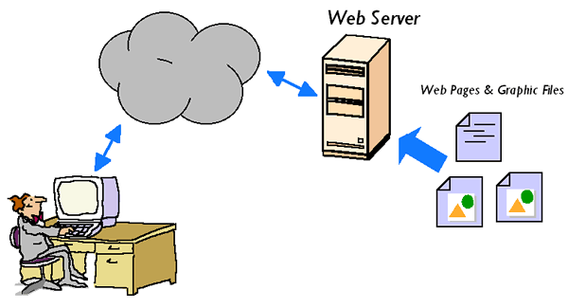
The WWW Content
Webserver is a computer installed with a special software

Slide 5
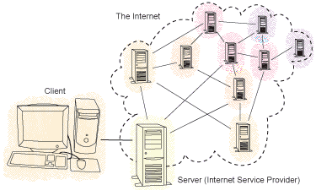
How we connect to the Net?
Dial to the ISP server via Phone, DSL, Cable, GPRS...
We'll get a unique IP address

Slide 6
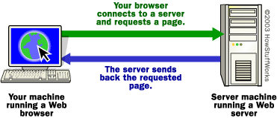
Accessing www content

Slide 7
Webhosting
Web space (disk space in server)
  Web4all project provide required disk space for schools free of cost
Domian Name (name to identify the site)
  Web4all project provides subdomain under web4all.in
  For own domain name like gghssmalappuram.in you have to buy the domain seperatly

Slide 8
Website
HTML
Dynamic websites
Wordpress

Slide 9
Wordpress
A free software Content Management System
Dynamic websites
Themes

Slide 10
Installation
Basic Requirements for a wordpress installation
  Server username
  Server password
  Database username
  Database password
After installation you should note the Username and Password generated by the system.

