Slide 1
Digital Portfolio
Student Name:M.Vimalraj Register No And Nmld: astvu20520524u18039 Department: B.Sc. Computer science College: Indo-american college, cheyyar. University: Thiruvalluvar university

Slide 2
Project Title:
Digital Portfolio Website

Slide 3
Agenda: ➤ Problem Statement ➤ Project Overview > End Users > Tools and Technologies ➤ Portfolio Design and Layout > Features and Functionality > Results and Screenshots ➤ Conclusion > Agenda
Agenda: ➤ Problem Statement ➤ Project Overview > End Users > Tools and Technologies ➤ Portfolio Design and Layout > Features and Functionality > Results and Screenshots ➤ Conclusion > Github Link

Slide 4
Problem statement:
In today’s digital world, individuals need a professional online presence to showcase their skills, achievements, and projects. Traditional resumes are often limited in presenting creativity and interactivity.

Slide 5
Project overview:
This project is a personal portfolio website designed to showcase an individual’s skills, background, and projects in a professional and interactive way. The website is structured into four main sections Home, About, Projects, and Contact – to provide visitors with a complete understanding of the developer’s profile.

Slide 6
End users:
➤ Recuiters ➤ Professor’s ➤ Clients > Network people > The owner of the portfolio (used to organize their achievement properly)

Slide 7
Tools And Techniques:
➤ HTML5 – For structuring the content of the website. > CSS3 – For styling, layout, responsive design, and animations. JavaScript – For interactivity (navbar highlighting, fade-in effects, smooth scrolling). Text Editor / IDE – (e.g., VS Code, Sublime Text, or Notepad++) for writing code. Web Browser – (e.g., Chrome, Edge, Firefox) for testing and running the website.

Slide 8
Portfolio Design And Layout :
> Section includes home about project and contact. Home About Projects Contact ➤ Home menu contains information about me > About menu containsmy photo and my personal information. > Project my portfolio contains2 Project (digital portfolio and service based application). ➤ Contact it includes name, email and message it wasBuilt using Javascript for dynamic Website.

Slide 9
Features And Functionality:
. Fixed Navigation Bar – Easy movement between sections. Responsive Design – Works well on mobile, tablet, and desktop. Fade-in Animations – Sections appear smoothly while scrolling. Projects Showcase – Big images with hover effects. Contact Form – Users can send messages directly.

Slide 10
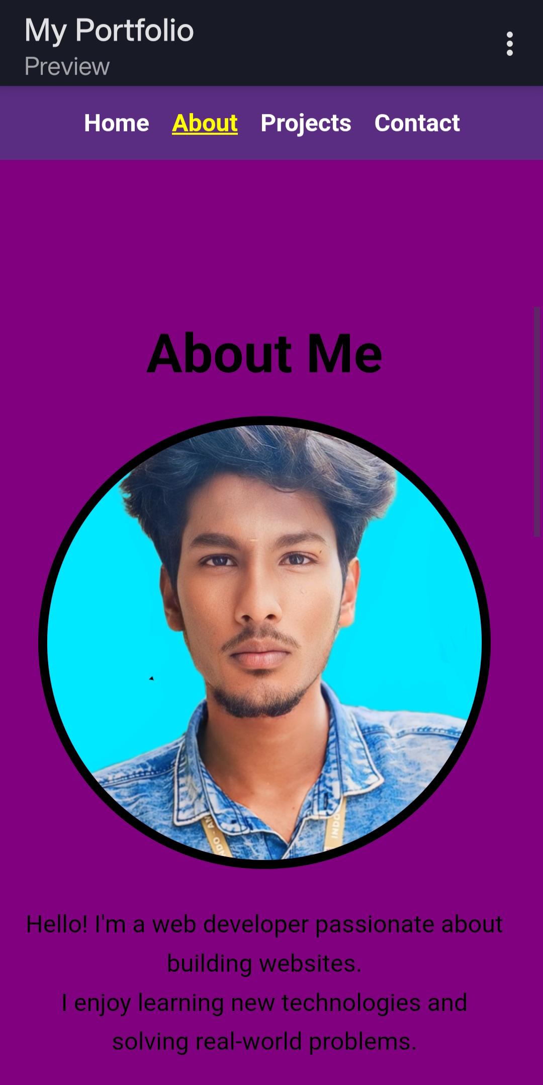
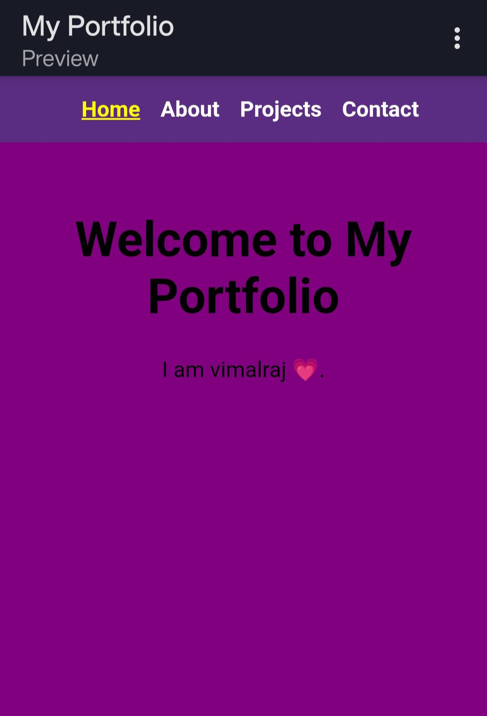
Results and Screenshot :

Slide 11
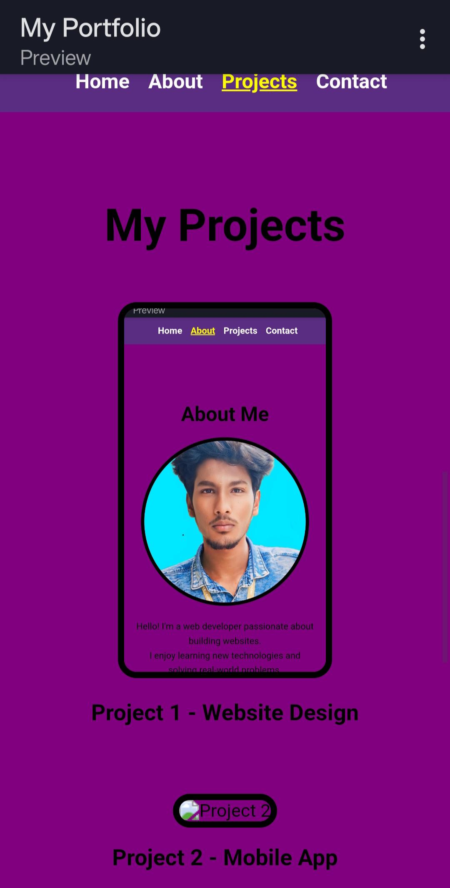
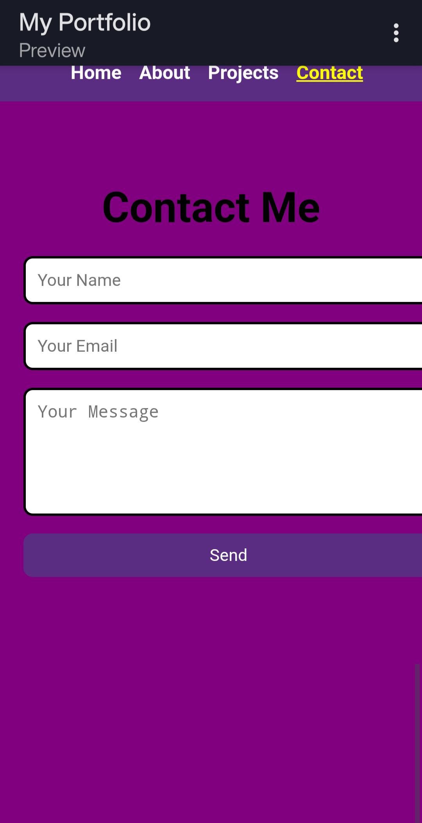
Result and Screenshot

Slide 12
Conclusion:
> Built using HTML, CSS and Javascript. > Clean and userfriendly design. ➤ Responsive layout (Workson mobile phone and desktops) ➤ Organized section (home,about, projects and contact). ➤ Acts as an online resume/portfolio. Showcases academicPlus technical achie.

