Slide 1
IoT-Based Smart Intrusion Detection System
Presented By,
Vimal Raj A (24MSCAI09)
Guide, Dr. T. DHEEPAK

Slide 2
ABSTRACT
IoT networks are increasingly vulnerable to cyber attacks
A hybrid ML model (Bayesian Optimization + Logistic Regression + Random Forest) is proposed
Detects DDoS, malware, and abnormal attacks
Provides real-time threat prediction
Improves accuracy, precision, and recall

Slide 3
INTRODUCTION
Rapid growth of IoT devices
Increased security challenges in IoT environments
Traditional methods are not effective
Difficult to detect zero-day attacks
Hybrid ML-based IDS is proposed as a solution

Slide 4
EXISTING SYSTEM
Uses signature-based intrusion detection systems
Firewalls with rule-based security
Anomaly detection techniques
Single ML models like SVM, KNN, Decision Trees

Slide 5
DRAWBACK OF EXISTING SYSTEM
Cannot detect new or unknown attacks
High false positive rates
No real-time detection
Single model reduces accuracy
Lack of hyperparameter optimization

Slide 6
PROPOSED SYSTEM
Hybrid ML model is implemented
Bayesian Optimization for tuning
Logistic Regression for probability prediction
Random Forest for classification
Enables real-time attack detection
Scalable and adaptive system

Slide 7
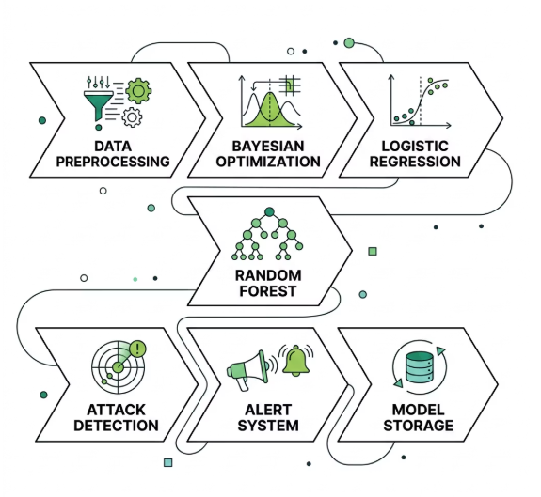
SYSTEM ARCHITECTURE

Slide 8
MODULE
Data Preprocessing – Cleans and prepares raw network data for analysis.
Bayesian Optimization – Optimizes model parameters to improve accuracy.
Logistic Regression – Predicts whether traffic is normal or malicious.
Random Forest – Classifies data using multiple decision trees for better accuracy.
Attack Detection – Identifies and classifies different types of cyber attacks.
Alert System – Generates alerts when suspicious activity is detected.
Model Storage – Stores trained models for future use and updates.

Slide 9
RESULT
Detection rate improved (10%)
Precision increased (12%)
Accuracy improved (15%)
Successfully detects DDoS, malware and Anomaly attacks
Reduced false alarms

Slide 10
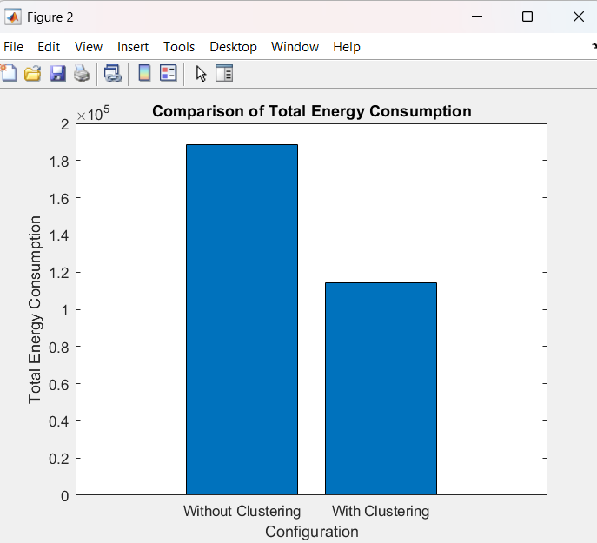
RESULT ANALYSIS

Slide 11
CONCLUSION
Hybrid ML model improves IoT security
Provides accurate and real-time detection
Efficient and scalable solution
Can be enhanced with deep learning in future

Slide 12
THANK YOU

