Slide 1
HANGMAN
Vimal Raj, Dubai Gem Private School

Slide 2
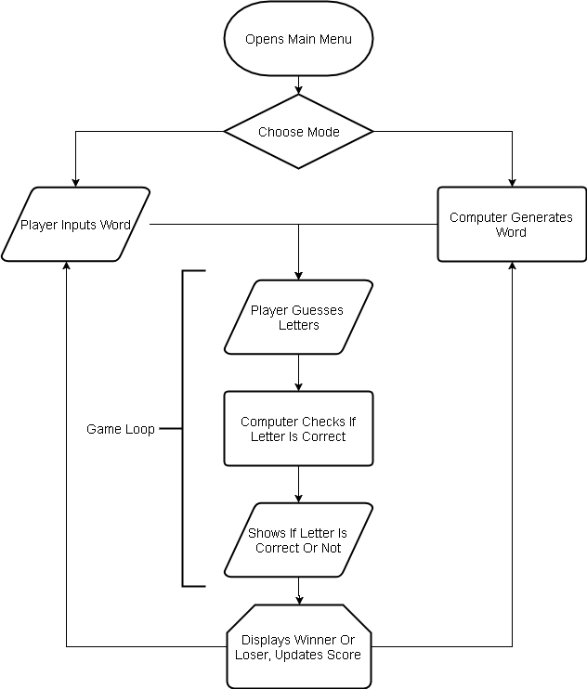
Overview

Slide 3
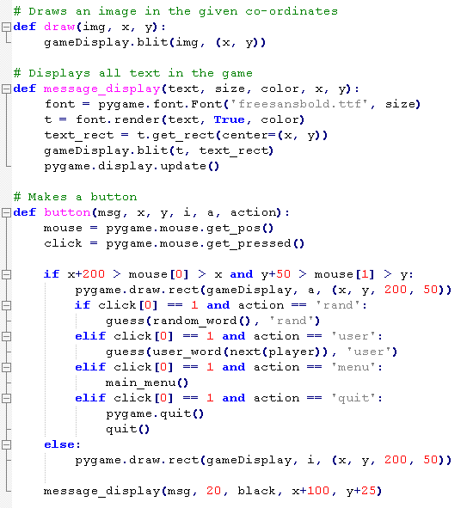
Helper Functions
Draw
Message Display
Button

Slide 4
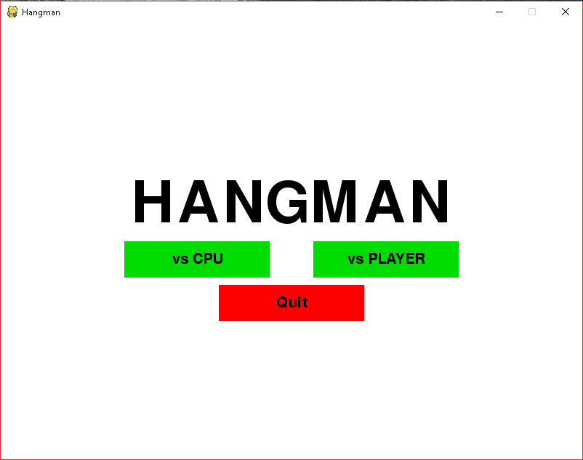
Main Menu
Message Display
Buttons

Slide 5
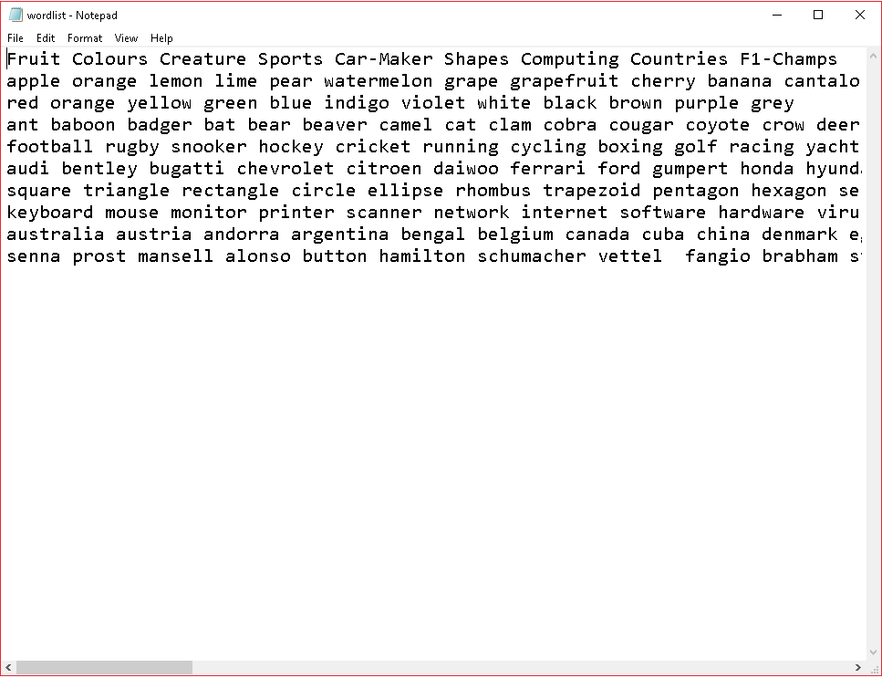
Getting Words
Against CPU: generates random word from list, with category
Against PLAYER: uses input library to get a word from each of the players turn by turn

Slide 6
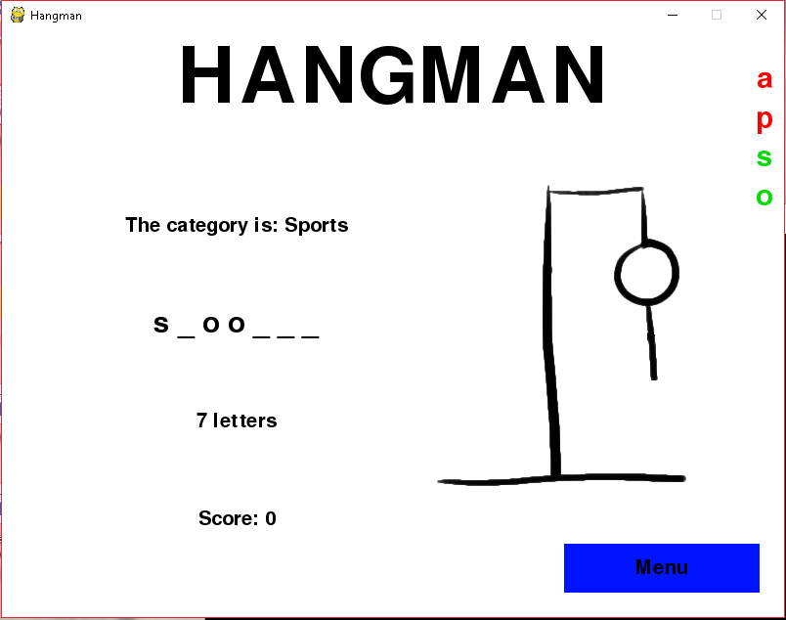
Game Loop
Makes a list of the word
Checks if guess typed is in the word list
If yes, prints the word instead of the dash
If no, draws part of the hangman
If letter is already guessed, displays message
When tries over or word guessed, sends information to outcome function

Slide 7
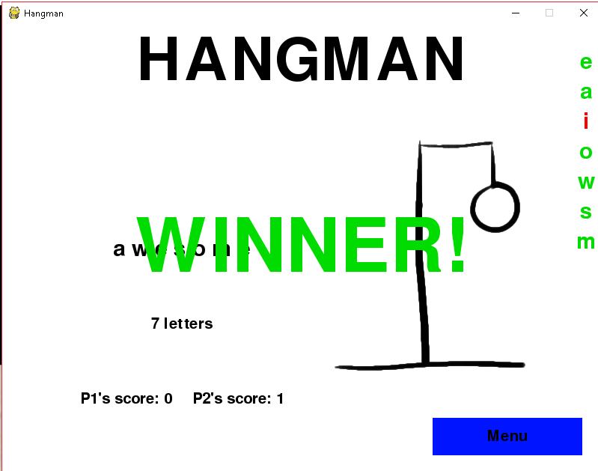
Outcomes
If player wins, displays “WINNER!” and updates score, goes back into game loop
If player loses, displays “LOSER!” along with correct word, resets score and goes back into the game loop

Slide 8
HANGMAN
Vimal Raj, Dubai Gem Private School

