Slide 1
REAL-TIME MAP-BASED POLLUTION MONITORING AND DATA MANAGEMENT SYSTEM

Slide 2
PRESENTED BY
VIMAL SHEORAN
SNEHAL RAJ
MADHUR VERMA

Slide 3
MENTORED BY
Dr. RUPENDRA PACHAURI

Slide 4
WHAT IS REAL-TIME MAP BASED…….?
Real-Time Map-Based Pollution Monitoring And Data Management System is a complete package that allows you to visualize pollution in real time and generate statistics of the same.

Slide 5
Why do we need a pollution monitoring system ?
Monitoring pollution is an important process that plays a major role in the pollution control.
If I can monitor it I can devise better plans to avert it or prevent it.
The need for pollution control can be explained by a simple analogy
Let’s say I have a friend who always takes my scooter for a ride but, I don’t know whether he is getting the tank filled or not. So I start monitoring the fuel gauge every time he borrows my scooter.
I take down data like, the fuel before and after the ride and also the days on which he borrowed the scooter.
Using this data I can realize whether he is being a ‘good friend’ or not and accordingly I can set rules for the next time he asks for the scooter
This is a simple pen and paper based monitoring system that helped me to determine how ‘generous’ my friend is

Slide 6
THE history …………..
We had gone through 32 papers addressing the idea of pollution monitoring. But, there were a few areas that caught our interest and we decided to explore these questions that weren’t raised before.
Firstly, there were a lot of papers that had ‘Urban Pollution Monitoring’ as a module in the entire project. Also the ideas were to propose better sensors and collect data overtime.
Once the data was collected it was then processed and the outcome of this procedure helped the aggregators to amend existing environmental laws and regulations.
These systems were not permanent. They were there for a period of time and they were removed once enough data was collected.
At present pollution needs to be monitored in real-time so that we can control it while it is still at lower levels

Slide 7
How does our system work ?
Our main goal is to provide a platform that will provide effective pollution monitoring to local authorities.
There are two major aspects to the platform.
1. Data Visualization
2. Statistics
And this system will be driven by three major components
1. The Raspberry Pi Module
2. Python Web Server
3. Web Application
Lets have a look at them one-by-one

Slide 8
Raspberry pi module – brain of our system
The Raspberry Pi module will be a circuit comprising of a Raspberry Pi microcomputer and three different sensors that will be interfaced with the module.
The sensors we will be using are
MQ-7 For Detecting and Measuring Carbon Monoxide Levels
MQ-135 For Detecting and Measuring SO2 and NO2 levels
DSM501A For Detecting and Measuring Particulate Matter

Slide 9
Python web-server – The heart
Python webserver is the heart of the system. It will handle data flow from the Raspberry Pi Module and this data can be rendered on the web-application for data visualization and generating statistics

Slide 10
Web application – the eyes
‘ If you can see it you can fight it ‘
What good is a monitoring system if it cannot show you what it is monitoring
The web-application will be the place where we will be creating a map using Google Maps API and perform data visualization.
You can also see statistics and graphs on the web application. Furthermore you will also be able to download the data from the application for future reference

Slide 11
Process flow
DATA VISUALIZATION
SENSORS
PYTHON
WEB
SERVER
RASPBERRY PI
WEB APPLICATION
STATISTICS
DATABASE

Slide 12
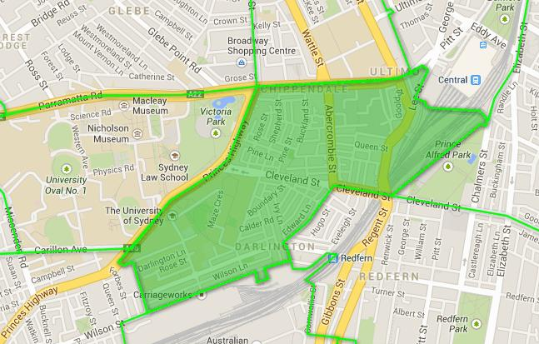

Slide 13

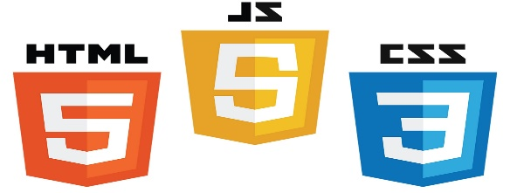



technologies USED

Slide 14
THANK YOU AND QUESTIONS PLEASE

