Slide 1
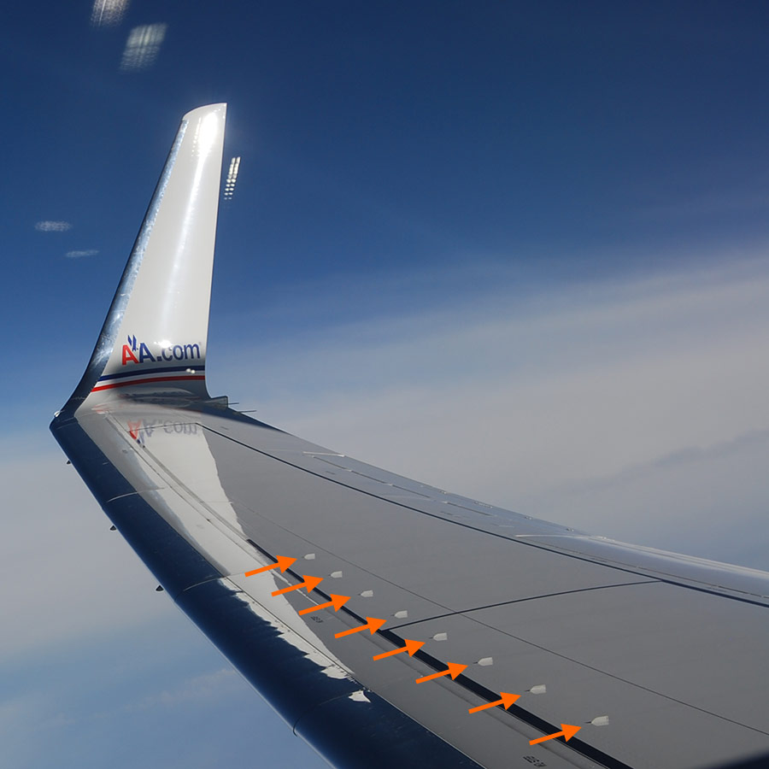

EAGLE_3 SENSOR_BOARD
AIM : Checking Nut is Tight or Lose
1.Data Processing
2.Training and testing
3.Executing

Slide 2



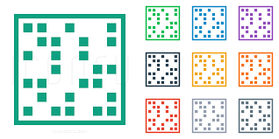

Import Package
1.Pandas(read and write excal sheet)
2.Glob [access floder and taking all speical format file(floder/ *.files)]
3.numpy (array and matrix)
4.Matplotlib [Plotting]

Slide 3

Import Pakages
5. Natsort {(storing 0 to n Number)
[(0,10,2,20) (0,2,10,20)]}
6.Logistical Regression[BinaryClassifications(0 or 1)]
7.Train_Test_Split [Spliting Data [8:2]]
8. Pickle[.bin/.csv/.yaml(save , load operartion)]

Slide 4

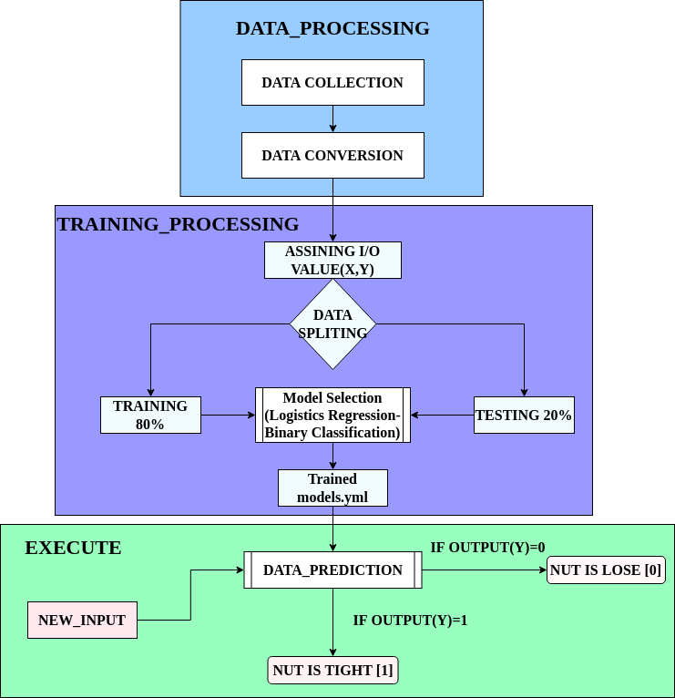

Overall Flow_Chart :

Slide 5
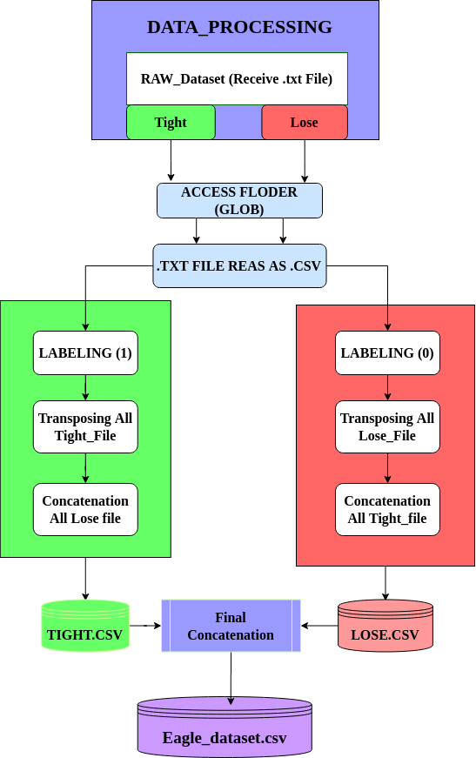
1.Data_Processing_FlowChart

Slide 6
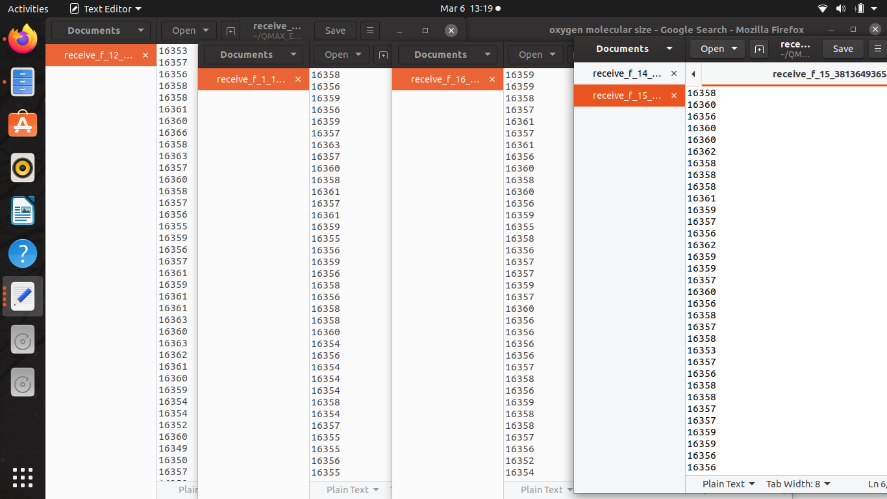
Raw_Inputs: (Recevie_data)

Slide 7
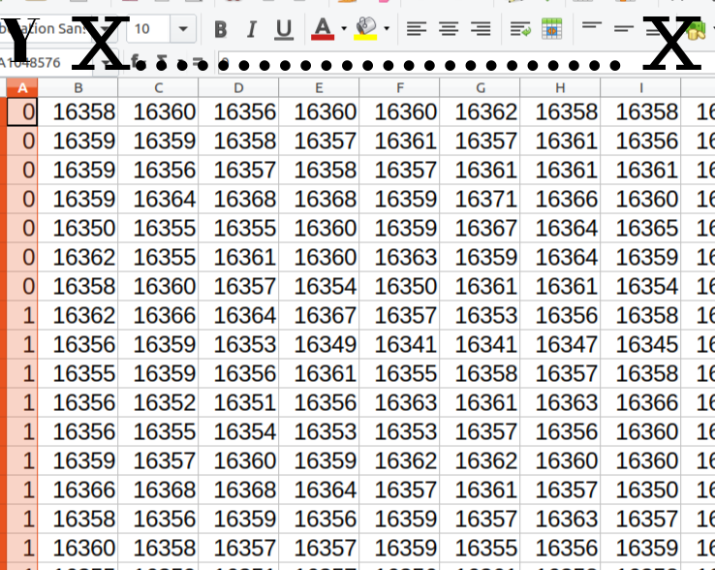
1.Data_Processing :
Output : 0 refer to Lose and 1 refer Tight

Slide 8
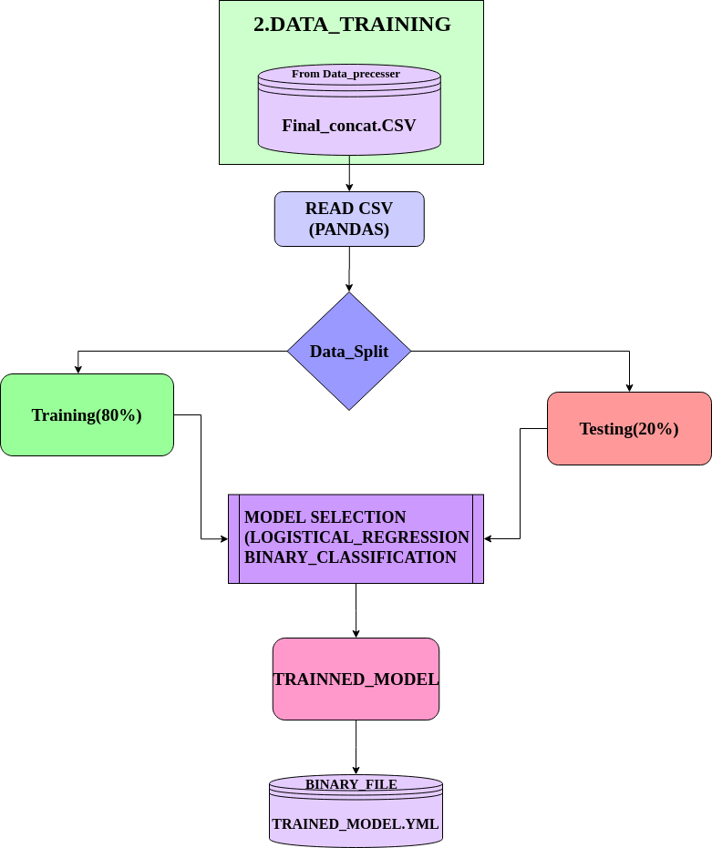
2.Training And Testing Model Flow_Chart

Slide 9
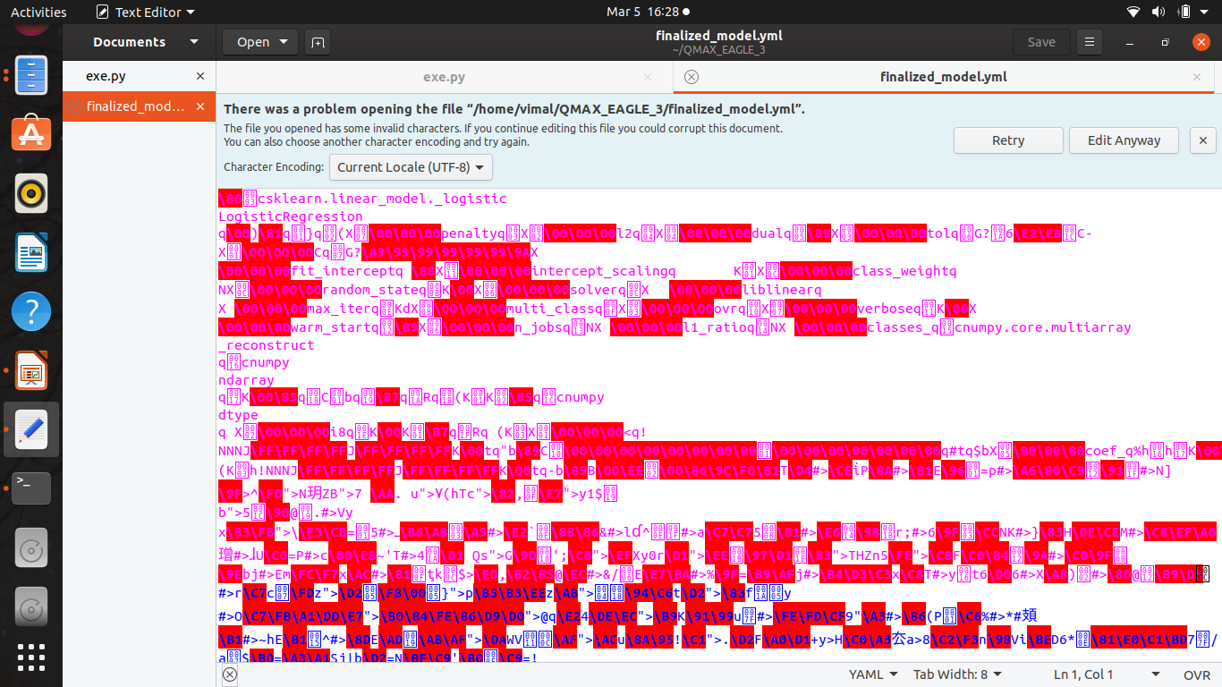
2.Training And Testing Model Ouput(.yaml)
csv

Slide 10
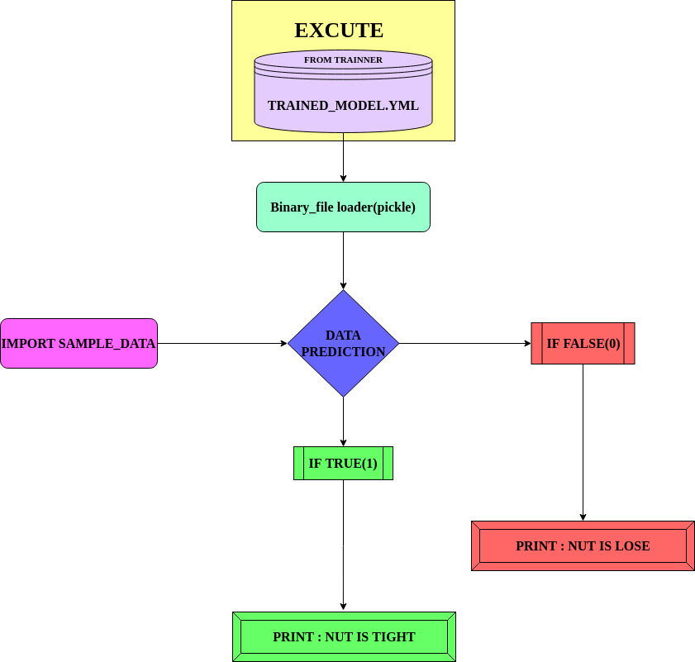
3.Execute Flow_Chart

Slide 11
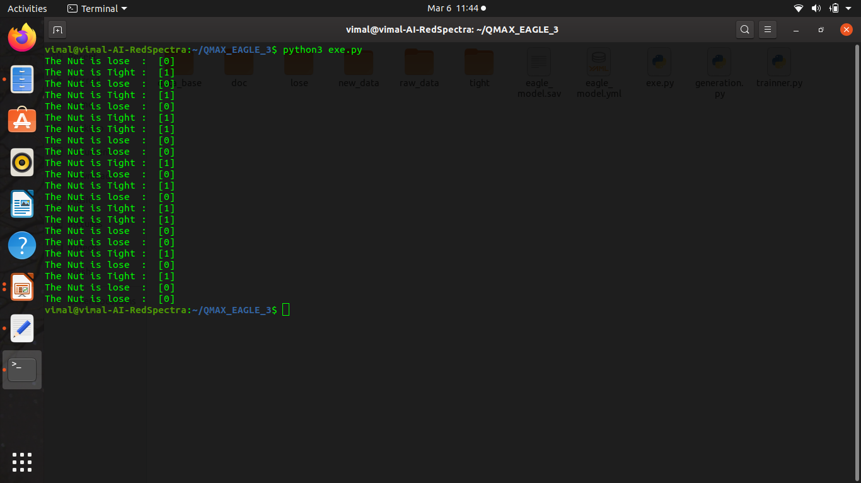
3.Execute Output
csv

