Slide 1
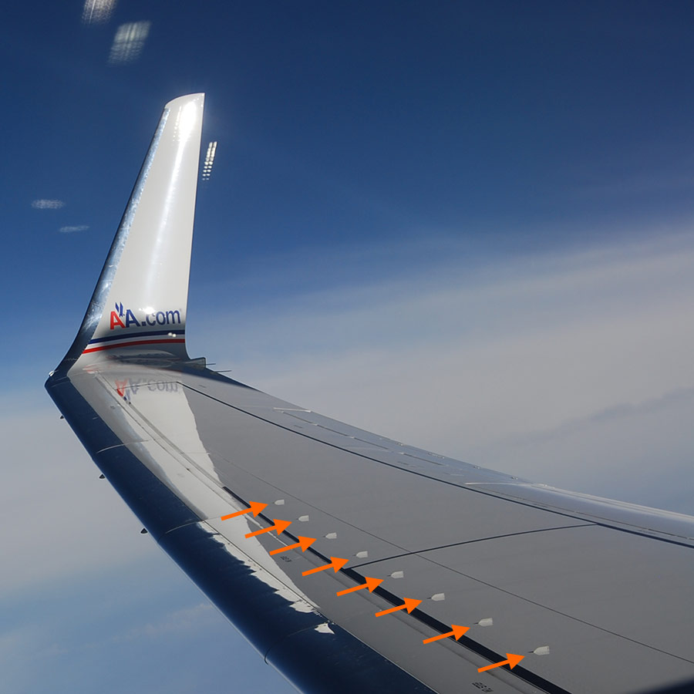

EAGLE_3 SENSOR_BOARD
AIM : Checking Nut is Tight or Lose
1.Data Processing
2.Training and testing
3.Executing

Slide 2




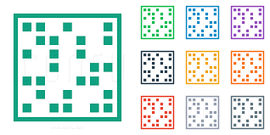

Import Package
1.Padas(read and write excal sheet)
2.Glob [access floder and taking all speical format file(floder/ *.files)]
3.OS [acces dir_floder(floder/ )]
4.numpy (array and matrix)
5.Matplotlib [Plotting]

Slide 3

Import Pakages
6. Natsort {(storing 0 to n Number)
[(0,10,2,20) (0,2,10,20)]}
7.Logistical Regression[BinaryClassifications(0 or 1)]
8.Train_Test_Split [Spliting Data [8:2]]
9. Pickle[.bin/.csv/.yaml(save , load operartion)]

Slide 4

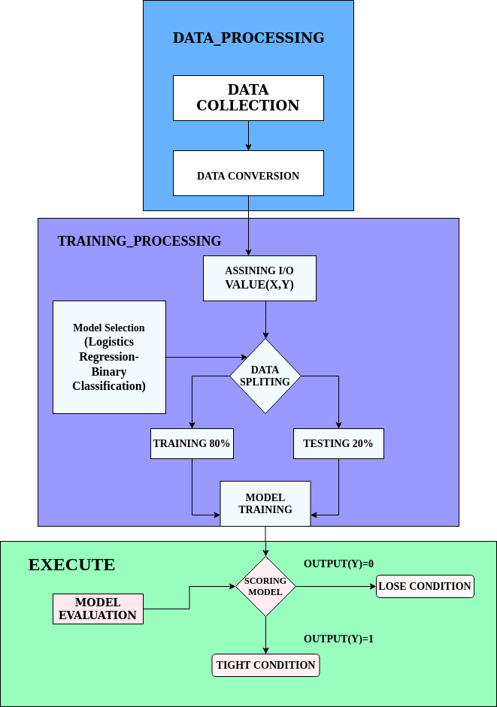

Overall Flow_Chart :

Slide 5
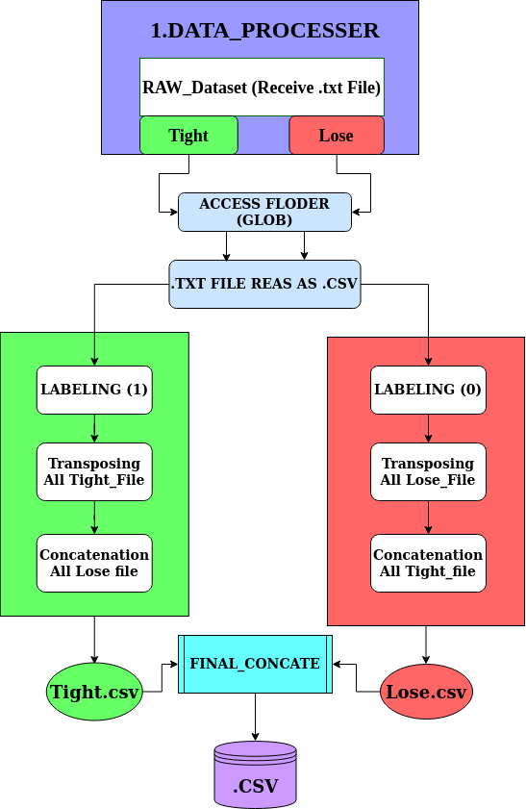
1.Data_Processing_FlowChart

Slide 6
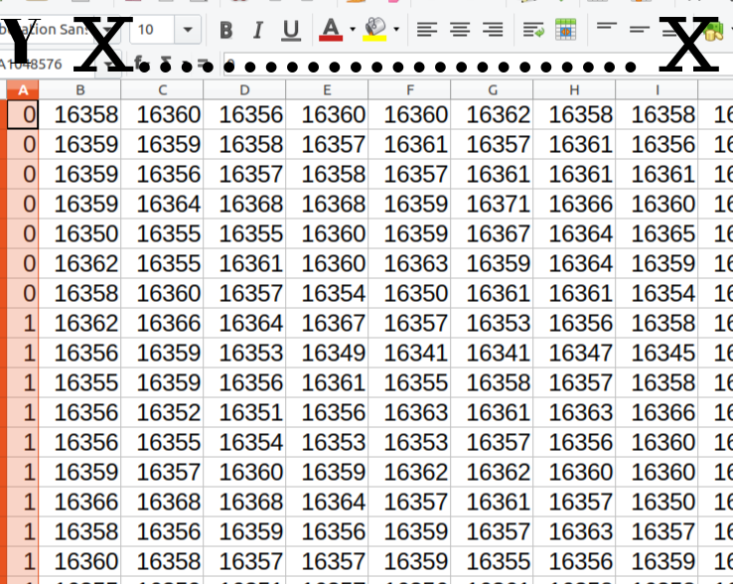
1.Data_Processing
Output : 0 refer to Lose and 1 refer Tight

Slide 7
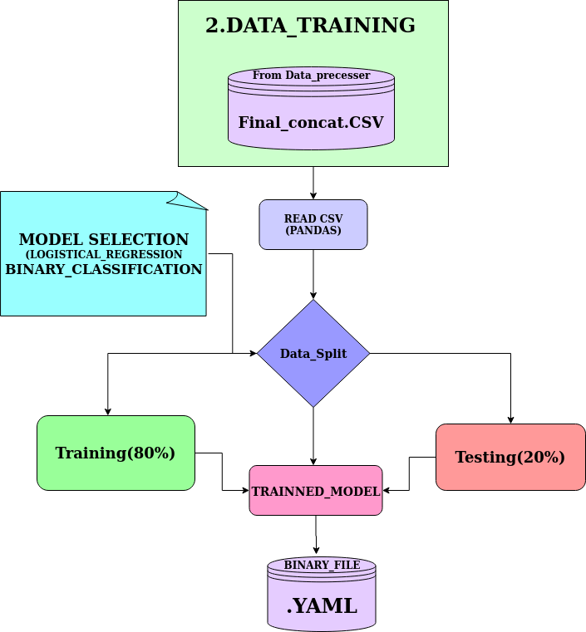
2.Training And Testing Model Flow_Chart

Slide 8
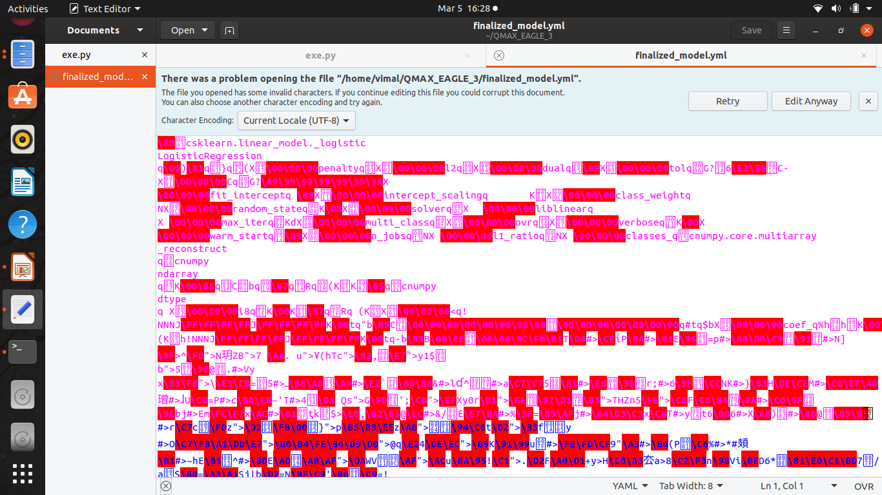
2.Training And Testing Model Ouput
csv

Slide 9
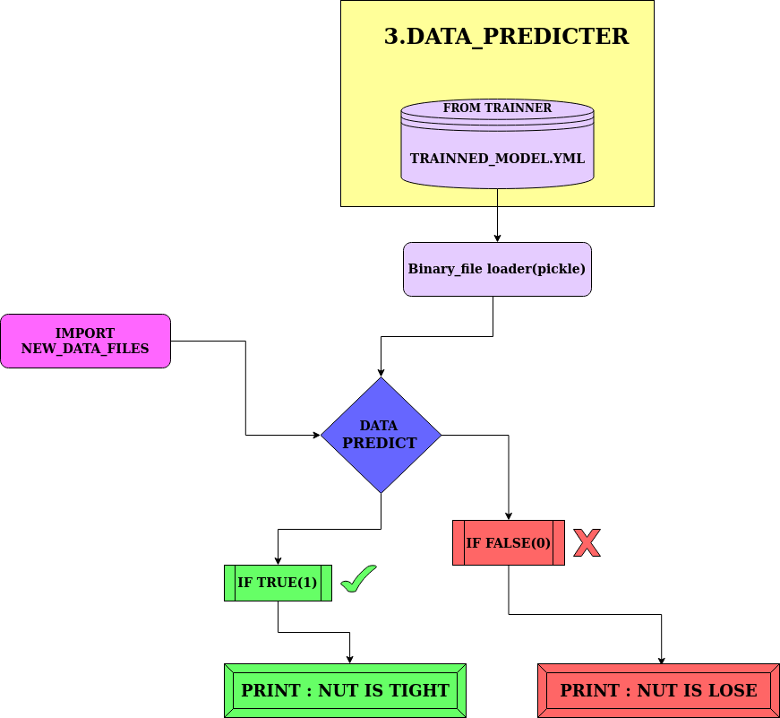
3.Execute Flow_Chart

Slide 10
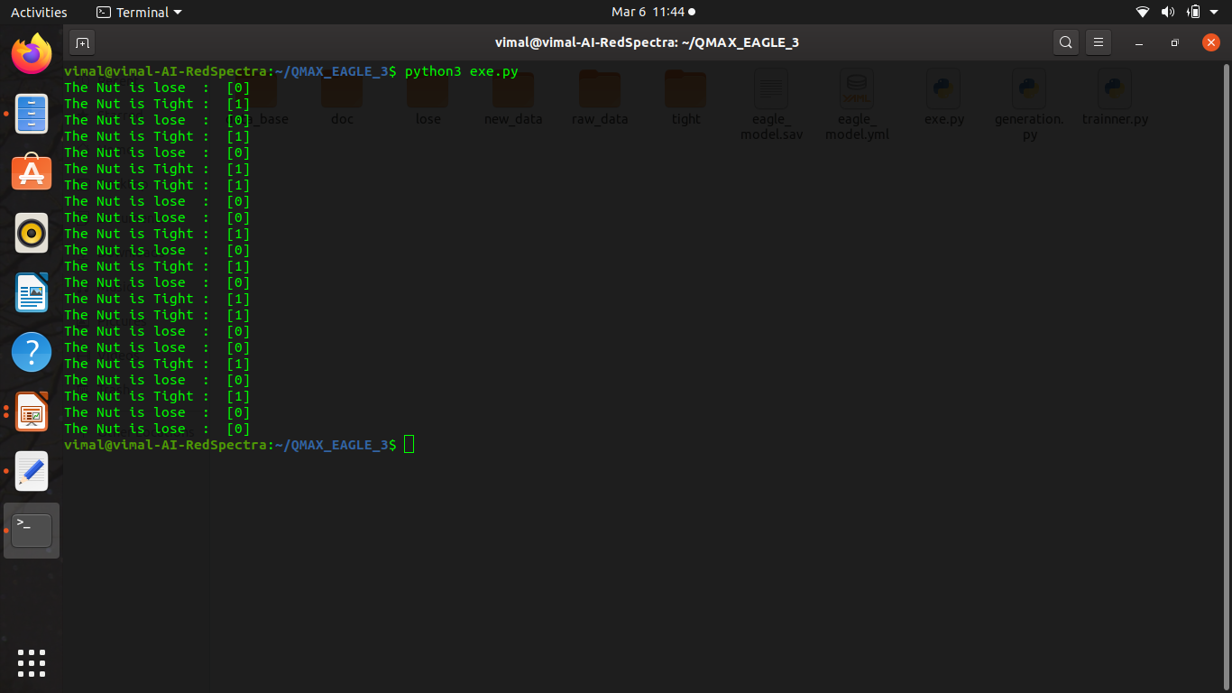
3.Execute Output
csv

