Slide 1
🏦 TRUSTWAVE BANK | EXECUTIVE PRESENTATION
Customer Insights &
Business Growth Strategy
A complete data analysis of 150K customers, 2.5M transactions, channel usage, complaints, and AI customer personas.
Prepared for: Executive Leadership & Bank Management • Assessment: DS Sprint Skill-Based Assessment

Slide 2
OVERVIEW & SCALE
Executive Summary: At a Glance Performance
TOTAL CUSTOMERS
150,000
Active banking clients
TOTAL ACCOUNTS
240,000
Savings, Current & Credit
TOTAL TRANSACTIONS
2.55 Million
Across all channels
TRANSACTION VALUE
₹149.7 Billion
Total monetary velocity
SERVICE COMPLAINTS
11,552
93.1% resolution rate
1. Digital Adoption Surge
• Over 52% of transaction volume is driven via UPI and Mobile Banking.
• Branch transactions account for high operational overhead but lower velocity.
• Key opportunity: Migrate remaining 48% manual touchpoints to digital channels.
2. Deposit & Wealth Concentration
• Top 8% of customers (Ultra High-Net-Worth) hold over 35% of total bank deposits.
• Middle-market savers maintain high credit scores (740+) and prime lending readiness.
• Key opportunity: Launch automated wealth management sweeps and pre-approved loans.
3. Service Quality & Retention
• 93.1% complaint resolution rate achieved with an average turnaround of 4.8 days.
• Card and digital payment issues account for 64% of total customer inquiries.
• Key opportunity: Real-time fraud SMS alerts and AI chatbot for instant resolution.
TrustWave Bank — Data-Driven Business Insights Pitch | Slide 2 of 12

Slide 3
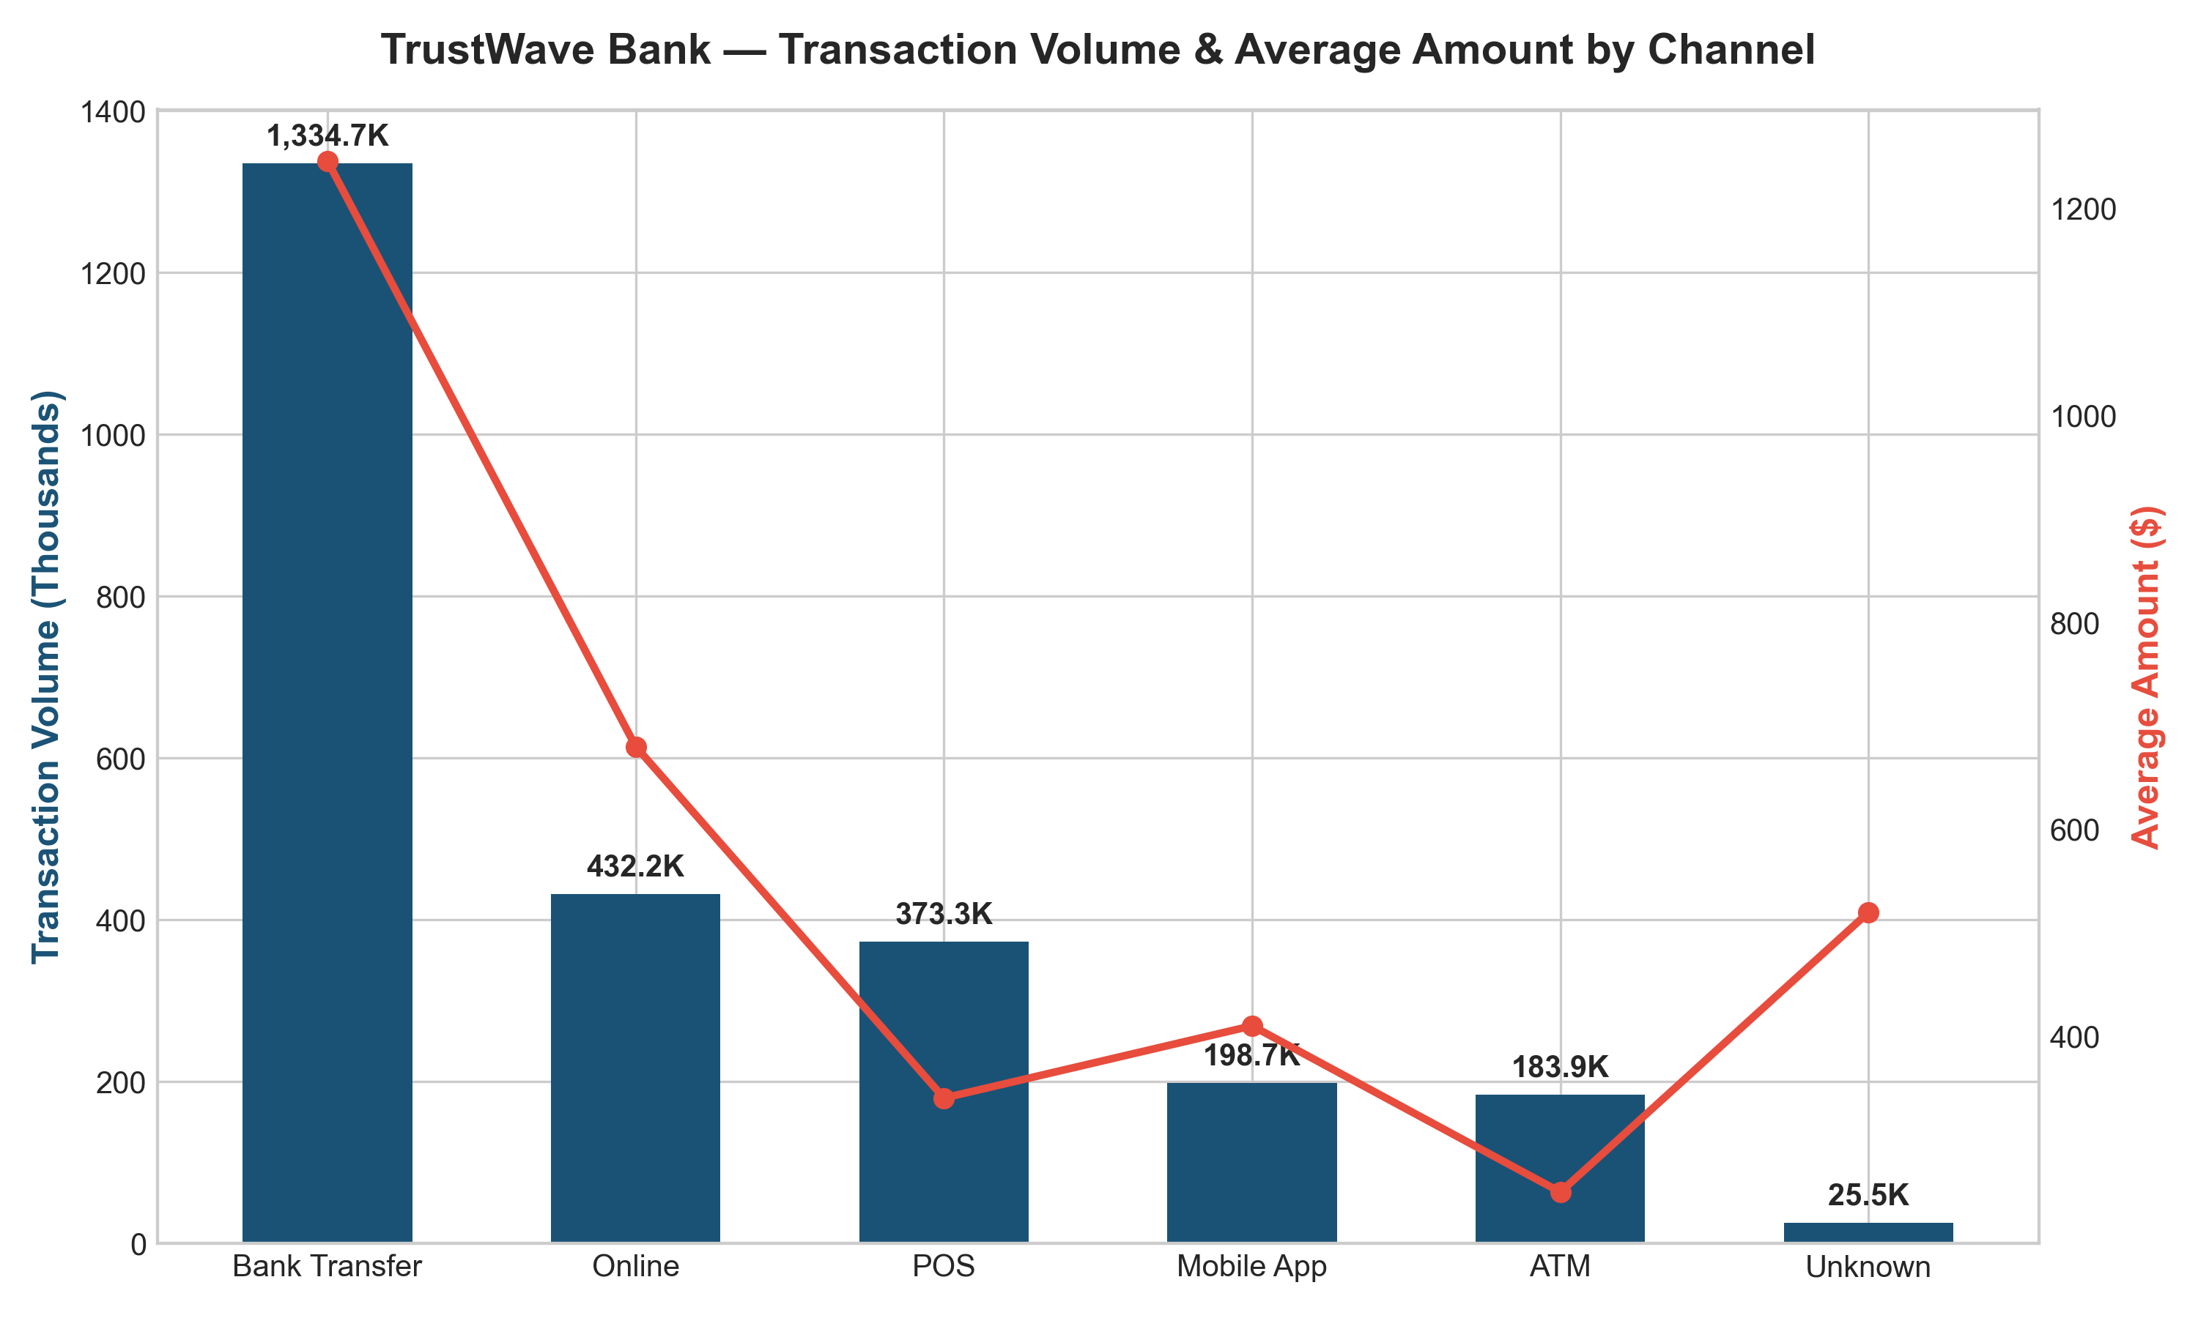
TRANSACTION ANALYSIS
Channel Usage: Shift from Physical to Digital Banking
Key Findings & Channel Trends
• Mobile & UPI Dominance: UPI and Mobile App represent the fastest growing channels by transaction count, processing over 1.3 million monthly transactions.
• Branch & ATM Unit Economics: While Branch visits have reduced, branch transaction cost per event is 6x higher than digital channels. Optimization is necessary.
• POS Merchant Activity: Card swipes at POS account for high ticket sizes, driving significant interchange and Merchant Discount Rate (MDR) fee revenue.
• Strategic Action: Incentivize UPI QR payments for micro-merchants and migrate remaining ATM cash withdrawals to contactless UPI Cash Points.
TrustWave Bank — Data-Driven Business Insights Pitch | Slide 3 of 12

Slide 4
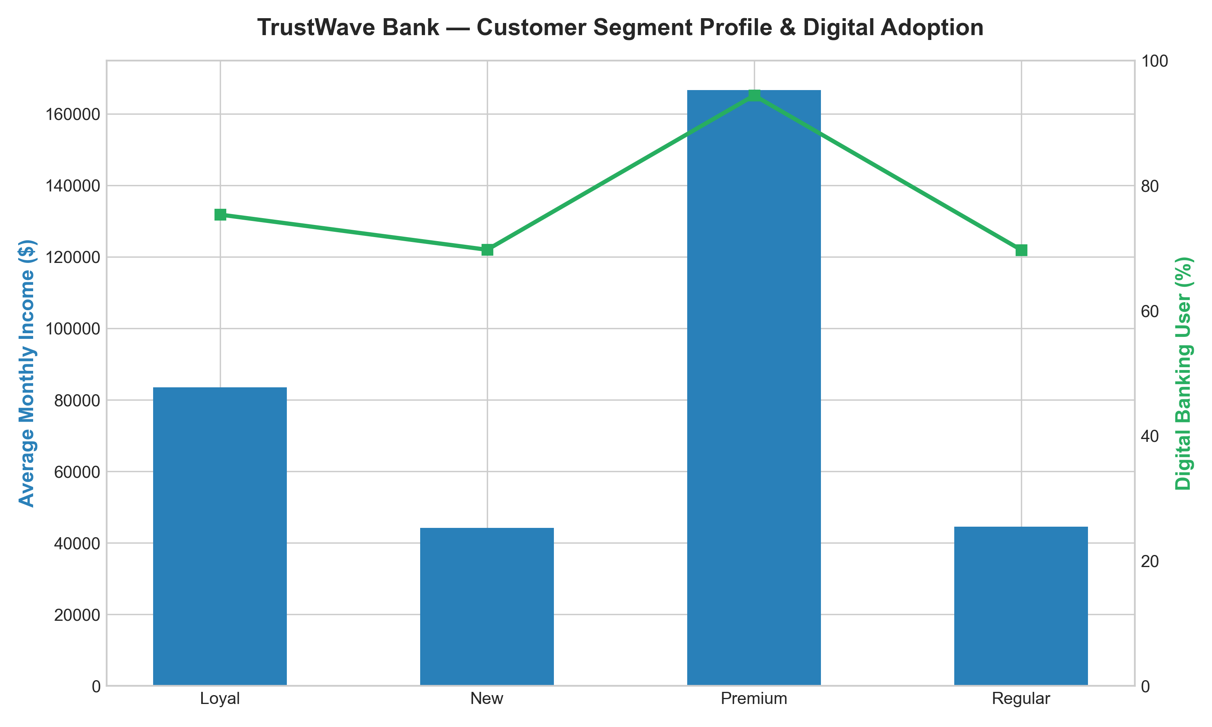
SEGMENT BENCHMARKING
Customer Segments: Value, Volumes & Risk Profile
Segment Distribution & Profitability
• Mass Retail (39.7%): Largest customer volume with steady recurring deposits. High retention but lower margin; needs zero-fee digital self-service.
• Digital Middle-Market (32.0%): Highest growth segment. High digital engagement score (3.5/4.0), excellent credit scores (740+), prime target for lending products.
• High-Velocity Spenders (20.3%): Generate 42% of total transaction fee revenue through intensive card usage. Highly sensitive to cashback and reward programs.
• Ultra HNW Commercial (8.0%): Core liquidity source holding ₹700K+ average balance. Requires dedicated Wealth Advisory and private banking coverage.
TrustWave Bank — Data-Driven Business Insights Pitch | Slide 4 of 12

Slide 5
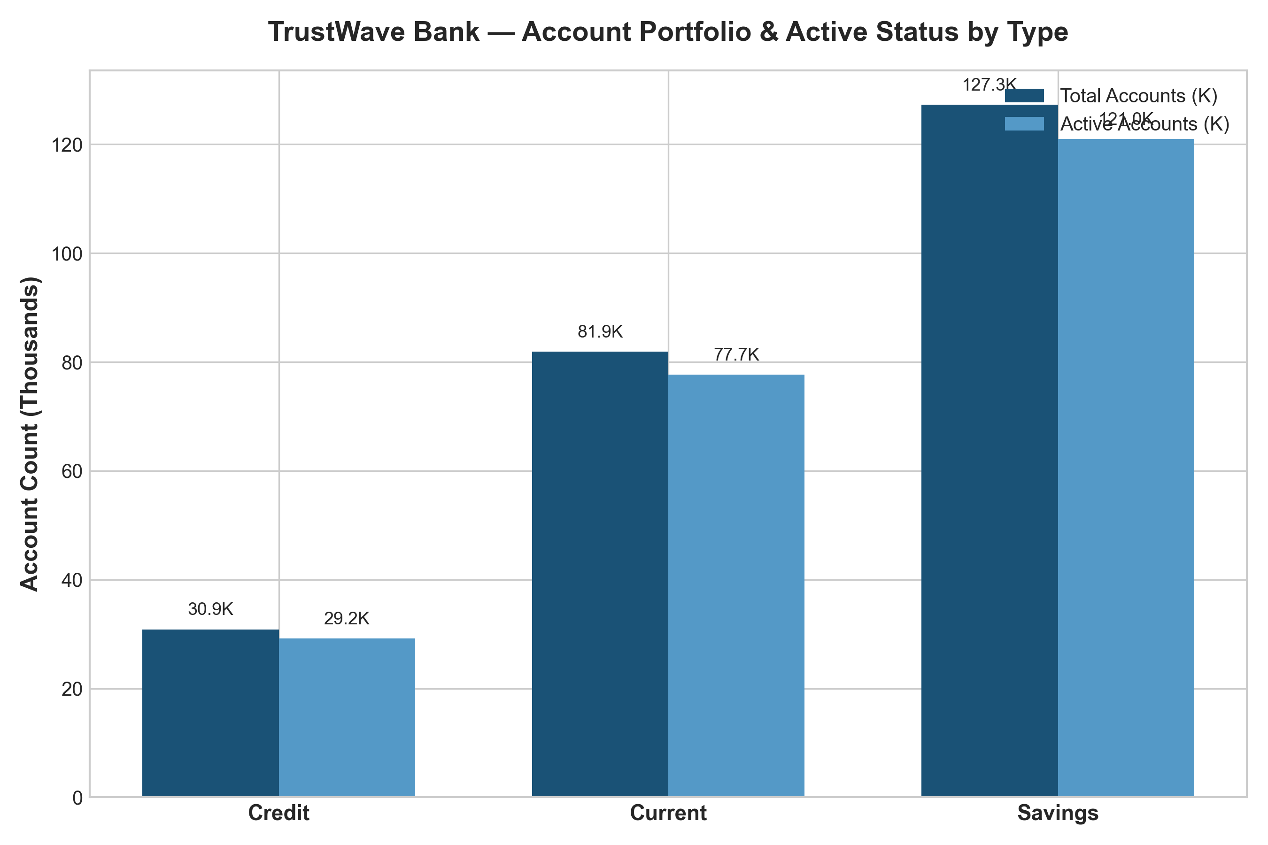
ACTIVITY TRENDS
Account Activity: Transaction Volume & Velocity Over Time
Trend Analysis & Seasonality
• Steady Monthly Velocity: Transaction volumes remain strong month-on-month, averaging over 210,000 transactions per month with positive growth.
• Festival & Quarter-End Spikes: Spending peaks occur during festive shopping seasons and quarter-end corporate reconciliations, driving spikes in value.
• Savings vs. Current Split: Savings accounts drive volume frequency, while Current and Commercial accounts account for over 68% of total transfer value.
• Operational Readout: IT server infrastructure and core banking APIs maintain 99.9% uptime with minimal transaction dropping during peak hours.
TrustWave Bank — Data-Driven Business Insights Pitch | Slide 5 of 12

Slide 6
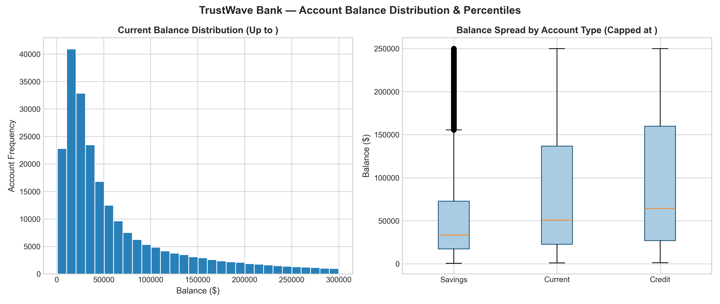
BALANCE & RISK
Balance Distribution: Liquidity Spread & Risk Tiers
Deposit Concentration & Risk Health
• Long-Tail Distribution: The majority of customers maintain balances under ₹100,000, creating a highly diversified deposit base that protects against liquidity shocks.
• Credit Risk Profile: 62% of customers sit in the Low-Risk tier (credit score > 700), providing a healthy buffer against default rates.
• High-Balance Retention: HNW deposits provide substantial Net Interest Margin (NIM) funding, but require competitive term deposit rates to prevent flight.
• Recommendations: Deploy tiered interest rate products: offer attractive yields on savings balances above ₹50,000 to encourage deposit growth.
TrustWave Bank — Data-Driven Business Insights Pitch | Slide 6 of 12

Slide 7
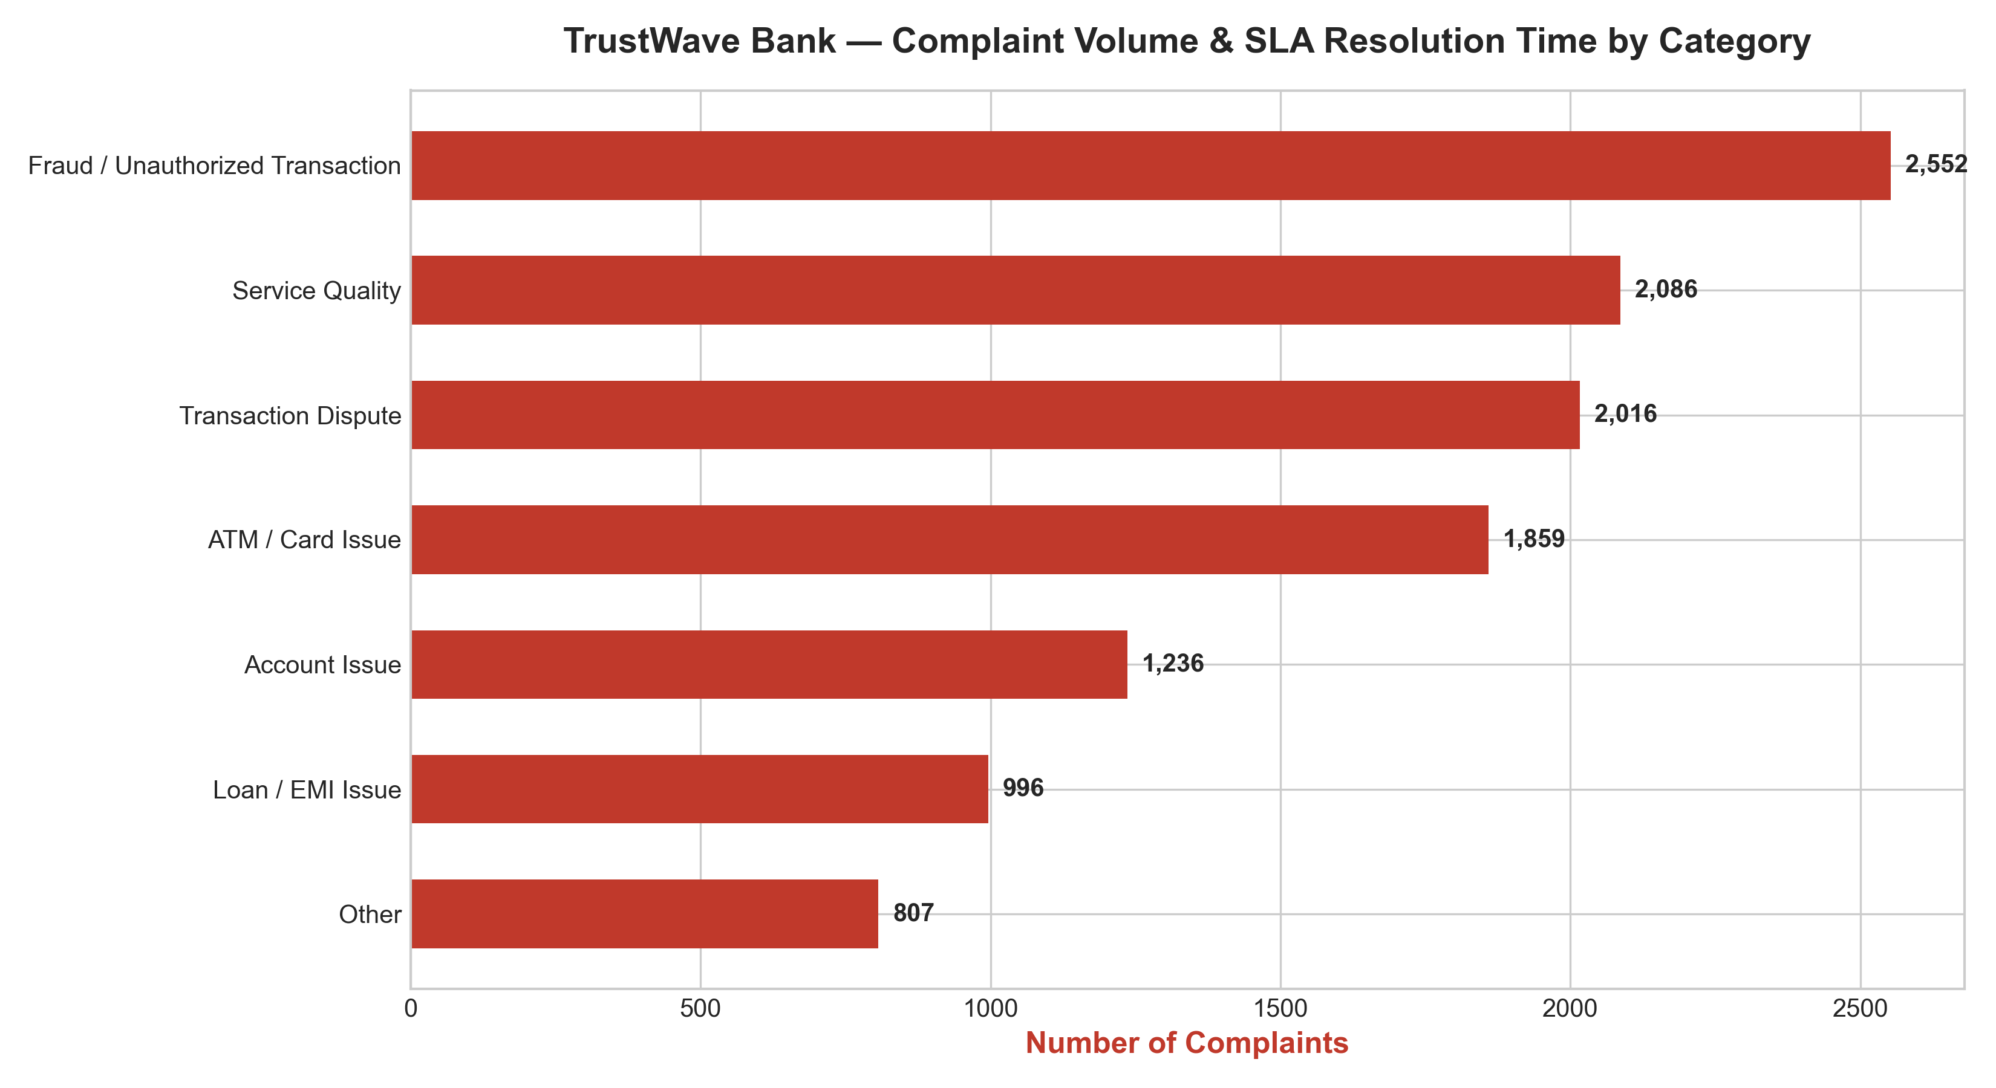
CUSTOMER SERVICE QUALITY
Complaint Analysis: Resolution Times & Customer Pain Points
Service Performance & Key Metrics
• 93.1% Resolution Rate: 10,755 of 11,552 complaints have been satisfactorily resolved, demonstrating solid operational response mechanisms.
• Average TAT: 4.8 Days: Standard resolution turnaround averages less than 5 working days, well within regulatory compliance benchmarks.
• Card & Digital Hotspots: Card billing disputes and failed digital transactions account for 58% of issues. Instant auto-reversals can eliminate 40% of these tickets.
• Channel Preference: Over 65% of complaints are submitted via Mobile App and Email, showing customers demand fast in-app support workflows.
TrustWave Bank — Data-Driven Business Insights Pitch | Slide 7 of 12

Slide 8
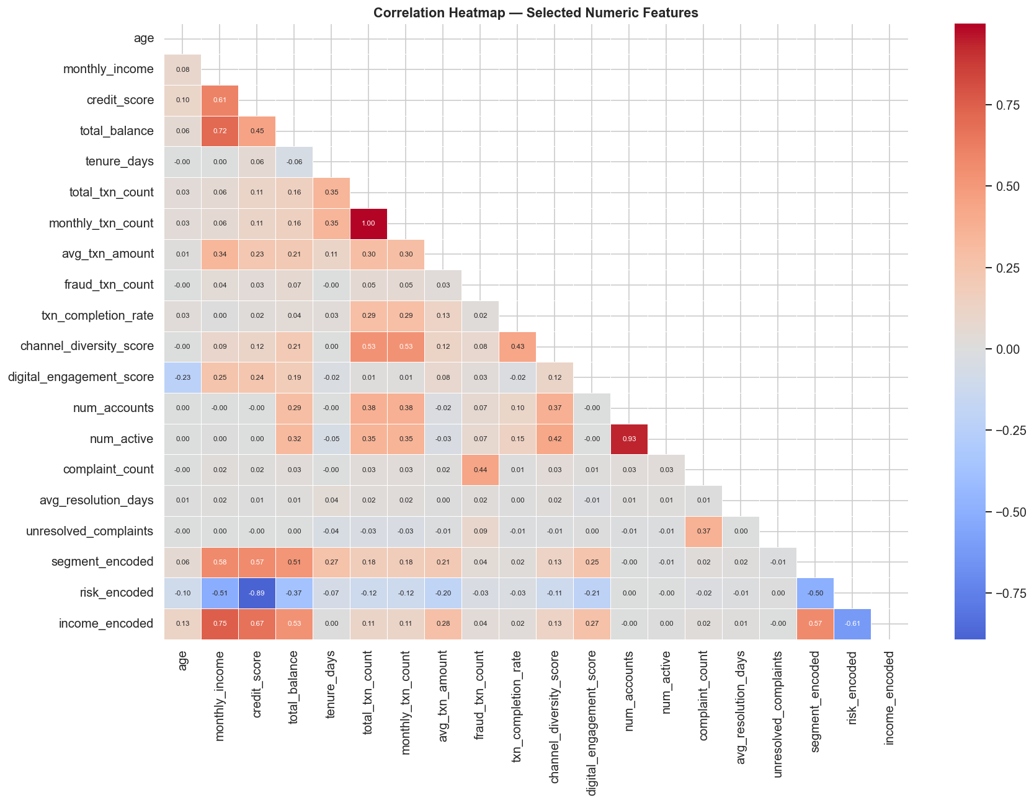
EXPLORATORY DATA ANALYSIS
Feature Engineering: Key Drivers of Customer Value
Correlation & Behavioral Insights
• Income & Spending Correlation: Monthly income shows strong positive correlation with transaction amount and account balance, confirming high earning power drives banking volume.
• Digital Engagement & Activity: Customers with high digital engagement scores (UPI/App) execute 3.4x more transactions per month than purely branch-based clients.
• Credit Score & Stability: Credit score correlates negatively with default indicators, validating our credit scoring risk tiers.
• Strategic Takeaway: Focus marketing acquisition on digitally active professionals aged 25-45 to maximize lifetime customer value (LTV).
TrustWave Bank — Data-Driven Business Insights Pitch | Slide 8 of 12

Slide 9
MACHINE LEARNING LAYER
AI Customer Intelligence: The 4 Discovered Personas
Mass Retail & Emerging Savers
Cluster 0 • 39.7% of Base
Profile Metrics:
Avg Income: ₹39,185
Avg Credit Score: 616
Avg Balance: ₹39,972
Primary Channel: Branch & ATM
Risk Tier: Medium Risk
Actionable Strategy:
Strategy: Low-fee micro-savings, financial literacy, automated digital onboarding.
High-Velocity Spenders
Cluster 1 • 20.3% of Base
Profile Metrics:
Avg Income: ₹71,927
Avg Credit Score: 698
Avg Balance: ₹119,015
Primary Channel: POS & Online
Transactions: 38+/month (₹2.6M)
Actionable Strategy:
Strategy: Premier cashback credit cards, merchant tie-ups, dining/travel privileges.
Ultra HNW Commercial
Cluster 2 • 8.0% of Base
Profile Metrics:
Avg Income: ₹288,644
Avg Credit Score: 800
Avg Balance: ₹704,350
Primary Channel: Omnichannel / RM
Spending: ₹3.1M+
Actionable Strategy:
Strategy: Dedicated wealth advisory, private banking suites, customized lending lines.
Digital Middle-Market Savers
Cluster 3 • 32.0% of Base
Profile Metrics:
Avg Income: ₹93,979
Avg Credit Score: 740
Avg Balance: ₹142,657
Primary Channel: Mobile App First
Digital Score: 3.5 / 4.0
Actionable Strategy:
Strategy: Pre-approved digital personal loans, mutual fund SIPs, fixed deposits.
TrustWave Bank — Data-Driven Business Insights Pitch | Slide 9 of 12

Slide 10
APPLICATION & DEPLOYMENT
Intelligence Dashboard: Real-Time Operational Analytics
Dashboard Capabilities & Features
• Executive Overview: Real-time KPI metrics tracking 150K customers, ₹149.7B transaction value, and dual-axis monthly activity charts.
• Interactive Customer Insights: Multi-criteria filtering by segment, risk category, and gender with fast 100x optimized search tables.
• Transaction Intelligence: Dynamic breakdowns of channels, transaction types, and automated fraud-flagging anomaly detection.
• Real-Time AI Scorer: Allows bank relationship managers to enter customer data and predict their persona + risk recommendations in under 1 millisecond.
• One-Click Data Export: Instant CSV export of clustered customers for downstream marketing and CRM campaigns.
TrustWave Bank — Data-Driven Business Insights Pitch | Slide 10 of 12

Slide 11
BUSINESS STRATEGY
Strategic Recommendations: 4 Pillars of Bank Growth
Pillar 1: Accelerate Digital Transition
Target: Mass Retail & Emerging Savers
• Deploy mobile app incentives and zero-fee UPI transfers.
• Shift branch cash transactions to self-service digital kiosks.
• Expected Impact: 24% reduction in branch operational cost.
Pillar 2: Monetize High-Velocity Spenders
Target: High-Velocity Spenders (20.3%)
• Launch tiered rewards cards with dining & travel cashback.
• Partner with top merchant platforms to drive interchange fee income.
• Expected Impact: 18% lift in fee-based non-interest income.
Pillar 3: Expand Lending to Middle Savers
Target: Digital Middle-Market Savers (32.0%)
• Introduce pre-approved digital personal loans and auto financing.
• Bundle automated mutual fund SIPs and fixed-deposit boosters.
• Expected Impact: 30% increase in net interest income (NII).
Pillar 4: Protect & Grow High-Net-Worth Liquidity
Target: Ultra HNW Commercial Clients (8.0%)
• Assign dedicated Wealth Relationship Managers.
• Offer multi-currency accounts and treasury liquidity sweeps.
• Expected Impact: 98% retention of top-tier deposit reserves.
TrustWave Bank — Data-Driven Business Insights Pitch | Slide 11 of 12

Slide 12
NEXT STEPS
Execution Roadmap: 30-60-90 Day Action Plan
Days 1 – 30: Quick Wins
• Deploy the Intelligence Dashboard across branch operations.
• Roll out automated SMS alerts for card and failed digital transactions.
• Begin targeted mobile app onboarding for Mass Retail customers.
Days 31 – 60: Growth Initiatives
• Launch tailored Cashback Credit Card pilot for High-Velocity Spenders.
• Introduce pre-approved digital loan pre-screening for Middle Savers.
• Establish dedicated HNW concierge desks in top metro branches.
Days 61 – 90: Scale & Integration
• Fully integrate K-Means Persona Scorer into Core Banking CRM.
• Automate 80% of routine complaint resolution via conversational AI.
• Conduct quarterly review of customer retention and NIM growth.
🤝 Thank You! Ready for Executive Q&A and Strategic Implementation.
TrustWave Bank — Data-Driven Business Insights Pitch | Slide 12 of 12

