Slide 1
SESSION 21 · FINAL DEVOPS PROJECT
Typeahead,
commit to cluster
A search-suggestion app taken through CI/CD, DevSecOps, Kubernetes, Helm, monitoring and GitOps
Vimal Kumar Yadav · 24BCS10273 · October 2026
Notes:
Introduce the project in one line: my own Typeahead application, taken from a commit on GitHub all the way to a monitored Kubernetes deployment managed through GitOps. Everything shown later was actually run. The cloud part is the one piece that was designed and planned but not applied.

Slide 2
One app with three jobs
THE APPLICATION
01
02
03
Suggest
Manage
Learn
Ranked prefix suggestions as you type, from an in-memory trie with a Redis cache in front.
A query catalog with create, edit and delete, stored in PostgreSQL with Flyway migrations.
Each search becomes a Kafka event that raises its count, so suggestions refresh within seconds.
Adapted from my own repository vimalyad/typeahead · Spring Boot, JUnit and Flyway in place of FastAPI, pytest and Alembic (approved)
Notes:
I reused my own Typeahead project instead of the starter app. It has two Spring Boot services, a React frontend, PostgreSQL, Kafka and Redis, so it gives the DevOps layers something real to carry. For the capstone I added the catalog CRUD and its tests. The Java stack was confirmed as allowed in place of FastAPI.

Slide 3
Two services, three stores, one Ingress
ARCHITECTURE
React frontend ×2
PostgreSQL
/ → static UI on Nginx
catalog and counts, PVC
Browser
Ingestion + CRUD API ×2
Kafka
/api/queries · /api/search
search events, PVC
NGINX Ingress
routes by path
Suggestion API ×2
Redis
/api/suggest
suggestion cache
Images come from GHCR, Argo CD deploys them from Git, and Prometheus scrapes every backend replica for Grafana.
Notes:
Walk left to right. The Ingress sends the root path to the frontend, catalog and search calls to the ingestion service, and suggestion calls to the suggestion service. Every application service runs two replicas. PostgreSQL and Kafka keep their data on persistent volumes; Redis is only a cache and can be rebuilt.

Slide 4
Seven routes, fifteen tests
API AND TESTS
Method | Route | Behaviour
GET | /api/queries | List catalog entries
GET | /api/queries/{id} | Read one; 404 if absent
POST | /api/queries | Create; 201, 409 if duplicate
PUT | /api/queries/{id} | Update text and count
DELETE | /api/queries/{id} | Delete; 204
POST | /api/search | Publish a search event
GET | /api/suggest?q= | Ranked suggestions
15
JUnit tests: 12 controller cases, 2 hash-ring tests, 1 concurrency test
Plus a smoke test over real PostgreSQL, Kafka and the trie
Notes:
The rubric asks for at least four REST endpoints with GET, POST, PUT and DELETE; the catalog covers all four, and the service also has search and suggest. Validation returns 400 for blank or oversized input and 409 for duplicates. The controller tests mock the database and Kafka; the smoke script is what proves the real path end to end.

Slide 5
Every push runs four gated stages
CI/CD · GITHUB ACTIONS
01
02
03
04
Test
Scan
Build
Deploy
Java tests and the frontend build
Semgrep, dependency gate and secret scan
Three non-root images, Trivy gate, push to GHCR by commit SHA
Helm install on a temporary kind cluster, smoke test, delete
A failed stage stops everything after it, so an image that fails a scan is never published or deployed.
Green release: run 37588149332 · commit 0f8f27c
Notes:
The workflow is session21.yml. Images are tagged with the full commit SHA, never latest, so the cluster always runs exactly what was tested and scanned. The deploy stage creates a throwaway kind cluster inside the runner, installs the Helm chart, runs the smoke test and deletes the cluster even when a step fails.

Slide 6
The security gates blocked two real releases
DEVSECOPS
DEPENDENCY GATE
IMAGE GATE
Critical Spring MVC CVE
8 HIGH/CRITICAL in the base image
No fix existed on Spring 6, so I upgraded to Spring Boot 4.1.1, then patched Tomcat and Jackson.
Unfixed Debian libraries, so I switched to the Temurin 21 Alpine JRE and kept the non-root user.
Nothing was suppressed: both fixes passed the same gates.
Notes:
Tools: Semgrep for SAST on Java and TypeScript, Trivy for dependencies and all three runtime images, and Gitleaks over the Git history. Both Trivy gates fail on any HIGH or CRITICAL finding and there is no ignore file. The failed scan runs are kept as evidence that the gate really blocks publishing. The CVE was CVE-2026-47884.

Slide 7
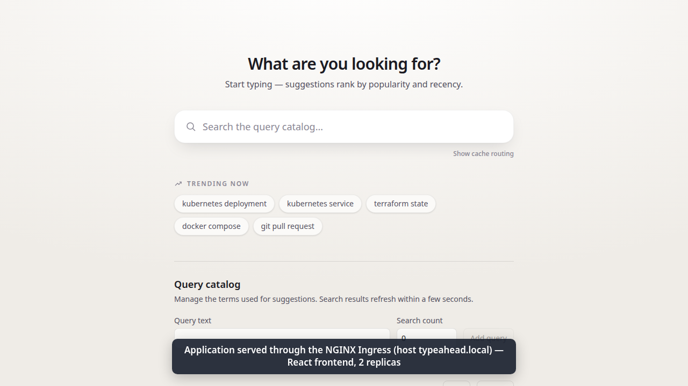
One Helm chart deploys the whole stack
KUBERNETES + HELM
2 replicas of each app service
Startup, readiness and liveness probes
HPA on CPU, 2 to 3 replicas
ConfigMap and external Secret
Ingress for / and /api
PVCs for PostgreSQL and Kafka
Non-root, read-only filesystems
The app reached through the NGINX Ingress on local Minikube
Notes:
The same chart is used by the CI kind cluster, by Minikube, and by Argo CD. Passwords are never chart values: bootstrap generates a random database Secret outside Git. The screenshot is the live app reached through the Ingress host typeahead.local.

Slide 8
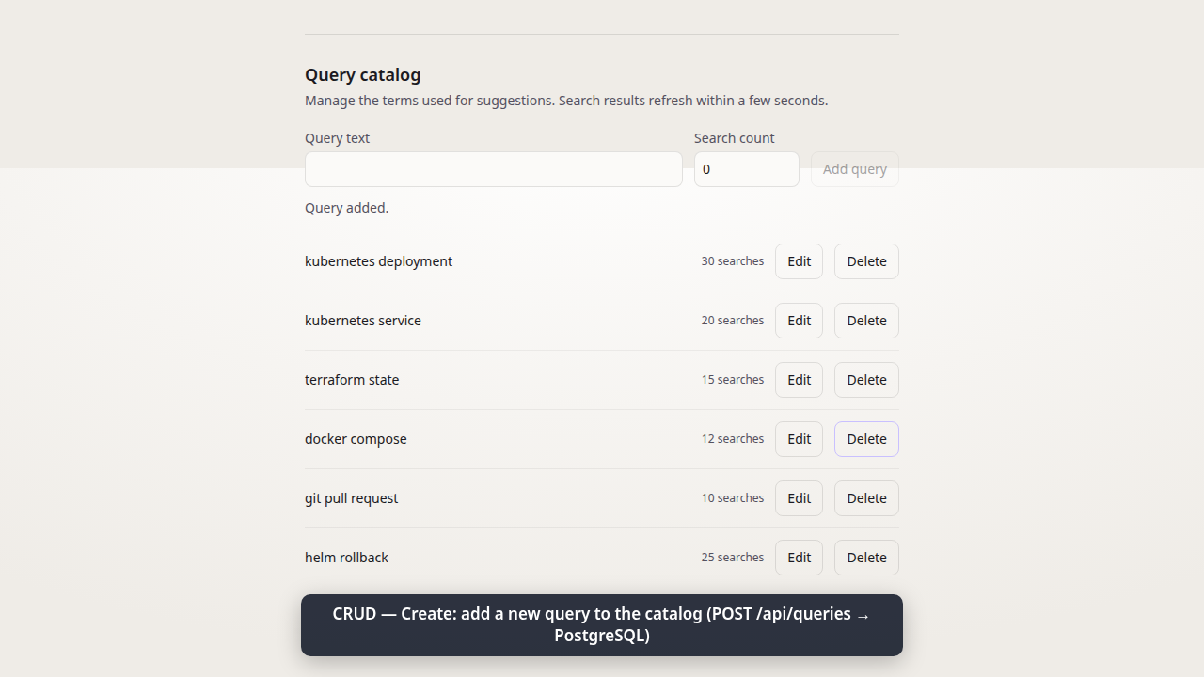
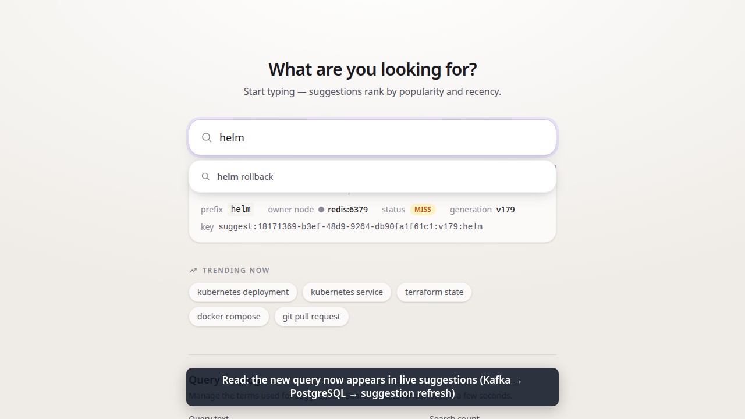
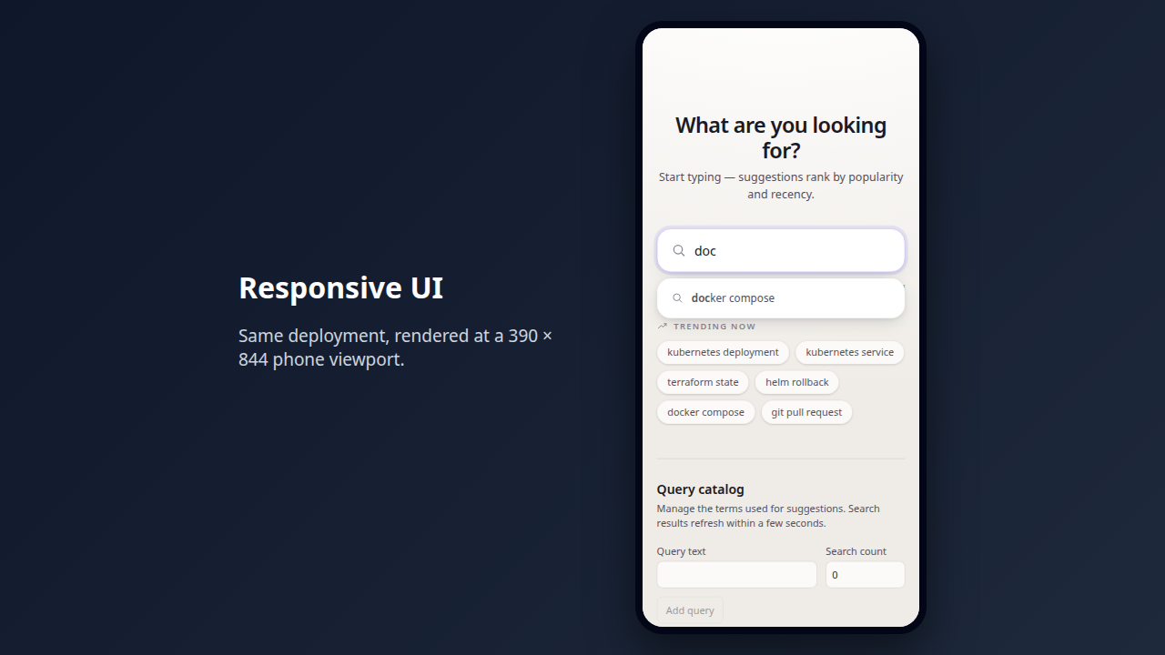
Add a query and it shows up in search
LIVE DEMO
1 · Create
2 · Suggested
3 · Responsive
“helm rollback” added through the catalog form, then edited
Seconds later it appears as a live suggestion
Same deployment at a 390 × 844 phone width
Frames from the 90-second browser walkthrough: demo/browser-walkthrough.mp4
Notes:
If time allows, play the 90-second browser walkthrough here instead of the stills. The point to make is that the frontend really calls the API: the entry is written to PostgreSQL, and the suggestion service picks it up and serves it from its trie. The entry was deleted again at the end of the run.

Slide 9
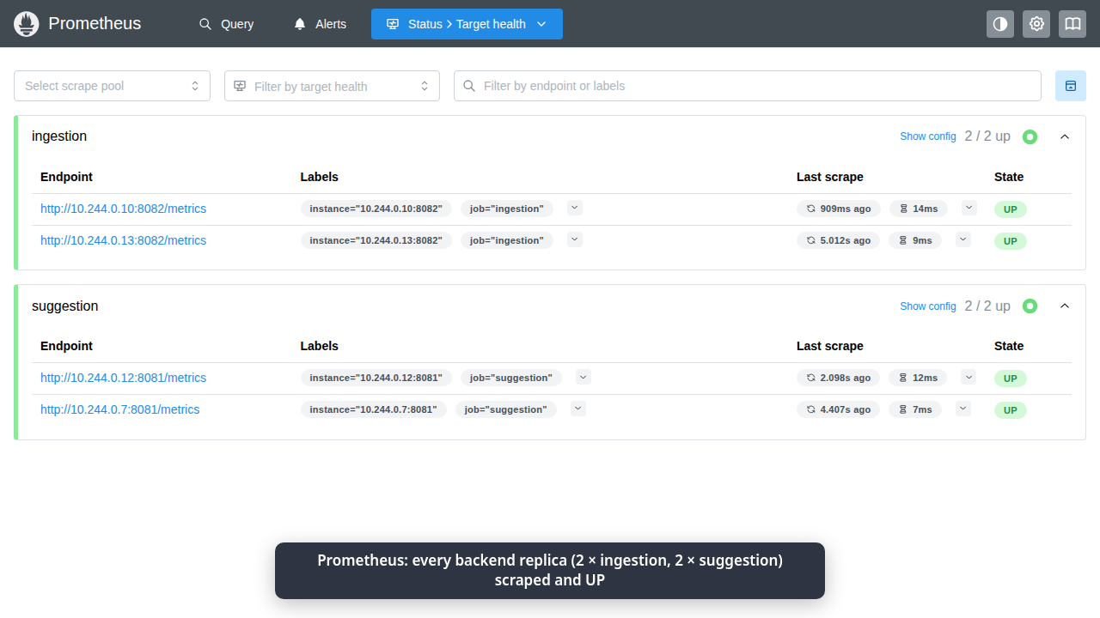
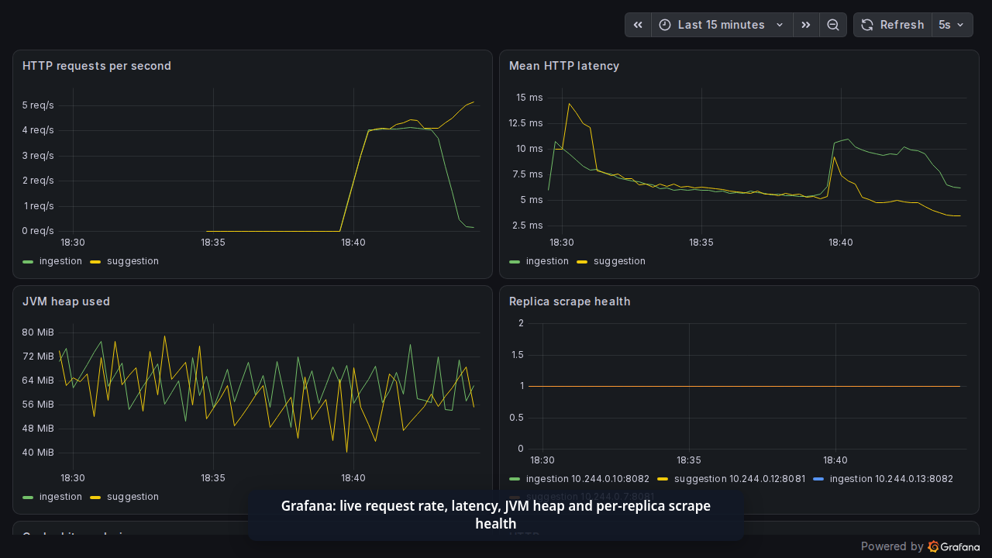
Every replica scraped, every request counted
MONITORING
120,415 requests from 16 clients in 80 s with zero failures · the suggestion HPA scaled 2 → 3 → 2
Left: Prometheus targets, 4 of 4 UP · Right: Grafana dashboard
Notes:
Prometheus finds each backend replica through headless metrics Services, so a new HPA replica is scraped automatically. The Grafana dashboard is provisioned from the chart and shows request rate, latency, JVM heap and scrape health. There is also an alert rule for a backend going down. The load figures come from a real run; it shows autoscaling works, it is not a production benchmark.

Slide 10
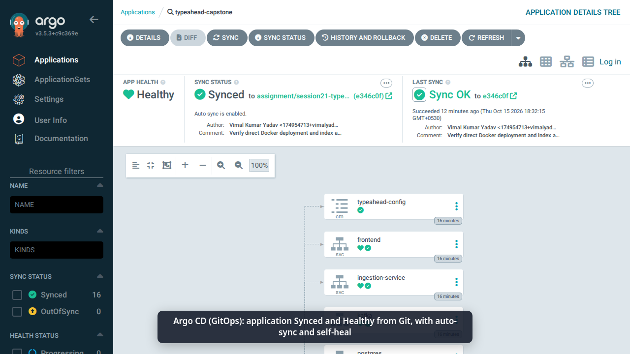
Git decides what runs, Argo CD enforces it
GITOPS · ARGO CD
1
CI publishes images tagged with the commit SHA
2
A promotion commit sets that SHA in gitops/values.yaml
3
Argo CD syncs it automatically, with prune and self-heal
4
The app’s /info endpoint reports the same SHA
A hand-edited Service selector was reverted to Git in 2.09 s
Notes:
The AppProject only allows this one repository and the assignment-s21 namespace. The recorded release went commit 0f8f27c, then promotion commit 044fcd9, and Argo CD reported Synced and Healthy at that exact revision. For the drift test I changed the frontend Service selector by hand; Argo CD noticed and restored the Git version without anyone running a repair command.

Slide 11
Four faults, injected and fixed
TROUBLESHOOTING CHALLENGE
Fault | What I saw | Root cause and fix | Verified
Kafka DNS missing at startup | No resolvable bootstrap URLs | Worker thread died; added a bounded retry | Recovered with no restart
Wrong Service selector | Ingress 503, no endpoints | Selector matched no pods; restored the label | Same route back to 200
PostgreSQL pod deleted | StatefulSet made a new pod | Checked it mounted the same PVC | Saved row still read 17
Hand edit drifted from Git | Selector changed live | Argo CD self-heal applied Git | Restored in 2.09 s
Each one followed the same loop: identify, check logs and resources, find the root cause, fix, verify.
Notes:
These match the six steps the brief asks for. The Kafka one is the most interesting because it was a real bug in the reused app: the consumer thread exited forever if broker DNS was missing at startup. After the fix, the same container recovered on its own once DNS came back. An earlier attempt with a wrong targetPort did not cause a visible failure, so I did not count it.

Slide 12
The cloud design is planned, not applied
TERRAFORM · AWS
What it builds
Where it stands
VPC with two public subnets
EKS 1.36 cluster, one managed worker
Encrypted gp3 storage via Pod Identity
No NAT gateway or load balancer, to keep cost low
init and validate pass
plan: 21 resources to add
apply and destroy not run: no AWS access
Real AWS create/destroy done in Sessions 18–19
Notes:
Be upfront here. The Terraform is complete and produces a clean plan, but I did not have AWS access to apply it, so the whole platform was demonstrated on local Kubernetes instead. The design avoids a NAT gateway and load balancer to keep a short demo cheap, and only the operator's IP can reach the Kubernetes API. In Sessions 18 and 19 I did create and destroy real AWS resources with Terraform.

Slide 13
What the project taught me
LESSONS LEARNED
Readiness can deadlock
Background workers must retry
Kafka could not resolve its own name until Ready. publishNotReadyAddresses broke the loop.
A consumer that gives up on one DNS error silently stops the whole event path.
Scans pay for themselves
Tag by SHA, promote by commit
Two releases were blocked, and both were fixed at the source instead of ignored.
I can always say exactly which build is running and how it got there.
Notes:
The first two lessons came from the first real Kubernetes launch failing, which local Docker Compose never showed. The third is the security story from slide six. The last is the reason GitOps felt worth it: the Git history is the deployment history.

Slide 14
Thank you
Questions?
github.com/vimalyad/typeahead-devops-capstone
demo/ holds this deck, its PDF and the 90-second browser walkthrough
README · browser walkthrough video · commit-to-deploy recording
Vimal Kumar Yadav · 24BCS10273
Notes:
Point to the README for the full evidence: every screenshot, the CI runs, the 10-minute commit-to-deployment terminal recording and the 90-second browser walkthrough.

