Slide 1

Django Web Framework
Framework 2.1

Slide 2
Django
High-level Python Web Framework
Develop fast
Automate the repetitive stuff
Follow best practices

Slide 3
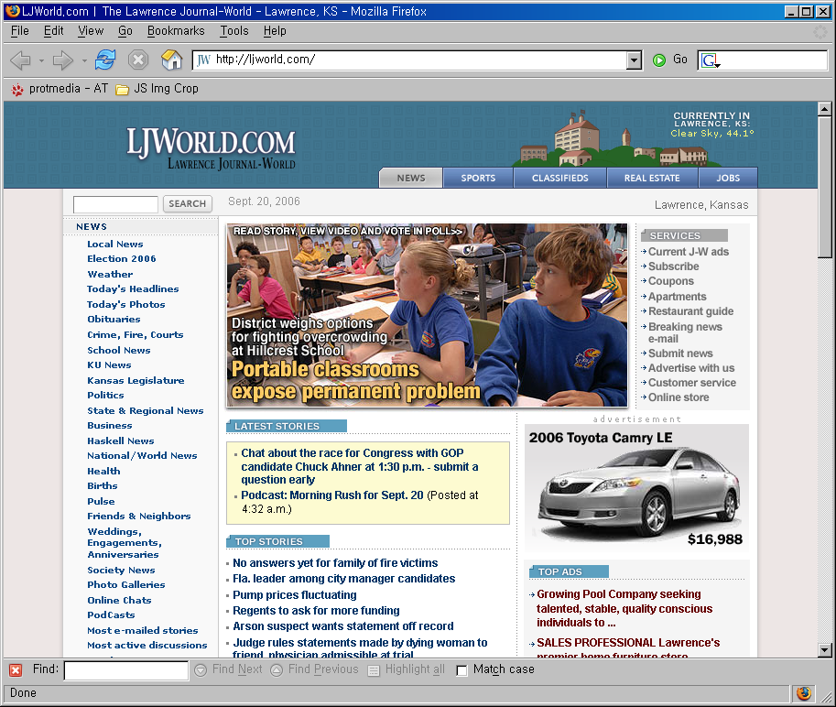
History
Lawrence Journal-World (http://www.ljworld.com)
by World Online
Developers
(A...)
LJWorld.com
Lawrence.com
KUsports.com
Notes:
World Online의 개발자들이 Django를 만듦.
2년 동안 위 사이트들과 다른 프로젝트를 만드는데 Django를 사용함.
위 사이트들은 newspaper 사이트.
Andrian Holovaty
Jacob Kaplan-Moss
Simon Willison
Wilson Miner

Slide 4
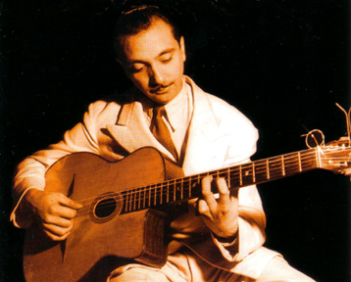
“Django”?
Django Reinhardt
Notes:
장고 개발자 andrian이 기타 치는걸 좋아함.
아마 Django Reinhardt의 기타 연주법을 좋아하는것에서 이름이 유래됐을것이라고 함.
djangoproject.com 에서 이름의 유래에 대해서 해명(?) 안하고 있음
Django Reinhardt: 본명 Jean Baptiste Reinhardt. 벨기에 리벨시 출생. 18세 때 화상을 입어 왼손 손가락 두 개의 기능을 상실하였으나, 유랑생활을 하는 동안 기타를 독습하여 1931년 프랑스 재즈계에 등장, 1934년 파리에서 S.그라펠리와 함께 ‘핫클럽 5중주단(Quintette du Hot Club de France)’을 조직하고 독특한 기교와 광시곡 스타일의 기타 솔로로, 미국에까지 알려졌다. 1946년 미국으로 건너가 D.에린튼악단과 공연하였으며, 《구름》 등의 작곡으로 뛰어난 재능을 보였다.

Slide 5
Installation
Python 2.3+
Database: PostgreSQL, MySQL, SQLite3
Python DB Interface: psycopg,
MySQLdb, pysqlite
Django

Slide 6
Install Python
http://www.python.org/download/releases/2.4/
http://www.python.org/download/releases/2.5/
Windows.. PATH
  c:\python24
  c:\python24\scripts (django-admin.py)
Notes:
윈도우 사용자라면 next, next, next, ..
MacOSX는 아마 기본적으로 깔릴테고
Linux/BSD에서는 패키지로 제공
기타 Unix는 ./configure; make; make install
2.5 에서는 테스트해보지 못했음.
(joke): 사용해보고 잘 되면 알려주세요~ =3=3

Slide 7
Install SQLite3, pysqlite2
SQLite3
http://www.sqlite.org/download.html
pysqlite2
  http://pysqlite.org/
  python setup.py install
Notes:
SQLite3: 윈도우라면 zip 파일을 PATH 상의 디렉토리에 풀어주는 것으로 끝.
pysqlite2
- 윈도우라면 .exe 파일 다운받고 클릭
- 기타 : python setup.py install

Slide 8
Install Django (0.95)
http://www.djangoproject.com/download/
  tar xvzf Django-0.95.tar.gz
  cd Django-0.95
  sudo python setup.py install

Slide 9
Tutorial

Slide 10
Project (site) : framework21
Database
Application : admin
Application : admin
Application : admin
/admin/
Application : blog
/blog/
Application : phonebook
/phonebook/

Slide 11
startproject
django-admin.py framework21
framework21
  __init__.py
  manage.py ← scripts/*
  settings.py ← config/*
  urls.py ← routes.rb
Django
RoR
Notes:
django-admin.py
- 프로젝트/어플리케이션 생성
- DB 관리 커맨트
- 개발용 웹서버 시작
- 테스트 구동
manage.py: django-admin.py과 같은 기능 (DJANGO_SETTINGS_MODULE 설정할 필요 없음) (루비의 scripts/*)
settings.py: project의 전반적인 설정 (DB, Root URL, Application, ..) (Ruby의 conf/database.yml, conf/environment.rb)
urls.py: URL mapping (Ruby의 routes.rb 보다 세세하게 ...)

Slide 12
startapp
cd framework21
./manage.py startapp blog
framework21/phonebook
__init__.py
models.py ← app/models/*
templates ← app/views/*
views.py ← app/controllers/*
urls.py
RoR
Notes:
models.py - ORM
views.py - controller , Python callback function for a particular URL
MVC - MTV

Slide 13
Create Model
from django.db import models
class Person(models.Model):
name = models.CharField(maxlength=20)
phone_number = PhoneNumberField()
note = TextField()
def __str__(self):
return self.name
class Admin:
pass
Notes:
PhoneNumberField, EmailField, URLField 같이 DB차원의 Low-level ….이 아닌 사용자입장에서 모델링 가능..
적절한 validation도 자동으로 됨

Slide 14
Activating model(Application)
settings.py → INSTALLED_APPS
manage.py syncdb

Slide 15
Play with Model API
from phonebook.models import *
p = Person(name=u’김형용’, phone_number=‘010-123-4567’, note=u‘안녕하세요.’)
p.save() # insert
p = Person(name=u’이정민’, phone_number=‘010-123-1234’, note=u‘9000+일 솔로인생’)
p.save() # insert
Person.objects.all() # ‘김형용’, ‘이정민’
p = Person.objects.get(name=‘김형용’)
p.note += u’여자친구 구합니다.’
p.save() # update

Slide 16
admin interface.
settings.py → INSTALLED_APPS
manage.py syncdb
manage.py runserver
http://localhost:8000/
http://localhost:8000/admin/
Notes:
startproject
startapp
settings.py, urls.py
models.py 복사
manage.py syncdb
manage.py runserver
http://localhost:8000/admin/

Slide 17
URL design
urls.py
project-level URL configuration
application-level URL configuration
URL -> view(callback)

Slide 18
View
request, response
decide which data is presented ,
delegate to template how the data is presented

Slide 19
Stub view
from django.http import HttpResponse
def listing(request):
objects = Post.objects.all()
… template… ← pass context (dict)
return HttpResponse(…)

Slide 20
Template
how the data is presented
Notes:
A template is simply a text file. It can generate any text-based format (HTML, XML, CSV, etc.).
A template contains variables, which get replaced with values when the template is evaluated, and tags, which control the logic of the template.

Slide 21
Template
{{ variable }}
{{ variable|filter }} (O)
{% tag %}
  {% if … %} … {% endif %}
  {% for .. in .. %} … {% endfor %}
{% extends “base.html %}

Slide 22

Notes:
앞부분은 전반적 개념에 대한 설명이었다……
…
데이터의 흐름…

Slide 23
URL
Resolver

Slide 24
URL
Resolver
blog/urls.py
urlpatterns = patterns(‘blog.views',
…
(r'^blog/$', ‘post_list'),
(r'^blog/new/$', ‘post_new'),
(r'^blog/(?P<post_id>\d+)/$', ‘post_detail'),
…

Slide 25
URL
Resolver
blog/urls.py
urlpatterns = patterns('blog.views',
…
(r'^blog/$', ‘post_list'),
(r'^blog/new/$', ‘post_new'),
(r'^blog/(?P<post_id>\d+)/$', ‘post_detail'),
…

Slide 26
URL
Resolver
view
blog/urls.py
urlpatterns = patterns('blog.views',
…
(r'^blog/$', ‘post_list'),
(r'^blog/new/$', ‘post_new'),
(r'^blog/(?P<post_id>\d+)/$', ‘post_detail'),
…
blog.views.post_detail

Slide 27
URL
Resolver
view
blog/urls.py
urlpatterns = patterns('blog.views',
…
(r'^blog/$', ‘post_list'),
(r'^blog/new/$', ‘post_new'),
(r'^blog/(?P<post_id>\d+)/$', ‘post_detail'),
…
blog.views.post_detail(post_id=‘2’)

Slide 28
URL
Resolver
view
blog/views.py
def post_detail(request, post_id):
post = Blog.objects.get(pk=post_id)
…
blog.views.post_detail(post_id=‘2’)

Slide 29
model
URL
Resolver
view
blog/views.py
def post_detail(request, post_id):
post = Post.objects.get(pk=post_id)
…

Slide 30
URL
Resolver
view
Django
template
blog/views.py
def post_detail(request, post_id):
post = Blog.objects.get(pk=post_id)
t = loader.get_template(‘blog_detail.html’)
…
blog/templates/blog_detail.html

Slide 31
URL
Resolver
view
Django
template
blog/views.py
def post_detail(request, post_id):
post = Blog.objects.get(pk=post_id)
t = loader.get_template(‘blog_detail.html’)
c = Context({‘post’: post})
html = t.render(c)
…
blog/templates/blog_detail.html

Slide 32
URL
Resolver
view
Django
template
blog/templates/blog_detail.html
<h1> {{ post.title }} </h1>
<p> {{ post.content|restructuredText }} </p>
Comments:
<ul>
{% for comment in post.comments %}
<li> {{ comment.who }}:
{{ comment.content }} </li>
{% endfor %}
</ul>
Context({‘post’: post})
Notes:
. -> attribute, method, index, key-value

Slide 33
URL
Resolver
view
Django
template
blog/templates/blog_detail.html
<h1> {{ post.title }} </h1>
<p> {{ post.content|restructuredText }} </p>
Comments:
<ul>
{% for comment in post.comments %}
<li> {{ comment.who }}:
{{ comment.content }} </li>
{% endfor %}
</ul>
<h1> 여자친구 구함 </h1>
<p> 20세 이상 신체건강한 대한민국…</p>
Comments:
<ul>
<li> 이정민: 좋은 결과 있길바랍니다. </li>
</ul>

Slide 34
URL
Resolver
view
blog/views.py
def post_detail(request, post_id):
post = Blog.objects.get(pk=post_id)
t = loader.get_template(‘blog_detail.html’)
c = Context({‘post’: post})
html = t.render(c)
return HttpResponse(html)

Slide 35
URL
Resolver
view
blog/views.py
def post_detail(request, post_id):
post = Blog.objects.get(pk=post_id)
t = loader.get_template(‘blog_detail.html’)
c = Context({‘post’: post})
html = t.render(c)
return HttpResponse(html)
OR

Slide 36
URL
Resolver
view
blog/views.py
def post_detail(request, post_id):
post = Blog.objects.get(pk=post_id)
t = loader.get_template(‘blog_detail.html’)
c = Context({‘post’: post})
html = t.render(c)
return HttpResponse(html)
OR
def post_detail(request, post_id):
post = Blog.objects.get(pk=post_id)
return render_to_response(‘blog_detail.html’,
{‘post’: post})

Slide 37
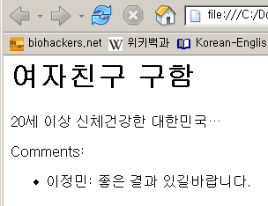

Slide 38
model
URL
Resolver
view
Django
template

Slide 39
Where is MIDDLEWARE?
mid.process_view(request, view_func, view_args, view_kwargs)
mid.process_request(request)
model
URL
Resolver
view
Django
template
mid.process_response(request, response)

Slide 40
Server arrangement
Standalone
mod_python
FastCGI
SCGI
Twisted

Slide 41
Conclusion
Written in python
Easy admin page
Elegant URL design
Template
Fast, easy, powerful web development with Django

Slide 42
이런저런 이야기
Guido’s preference
Korean Django Community
GAVI : Genome Ajax Viewer
GMP study
http://code.djangoproject.com/ticket/2613

Slide 43
Getting Involved
http://djangoproject.com/documentation/
http://code.djangoproject.com/
http://groups.google.com/group/django-user
http://groups.google.com/group/django-developers
Notes:
Main site http://djangoproject.com/
code site (trac) http://code.djangoproject.com/

