Slide 1
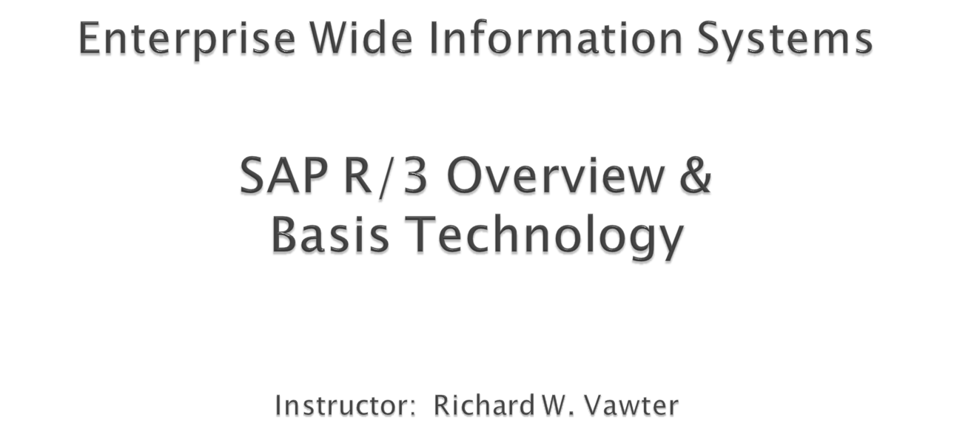

Slide 2

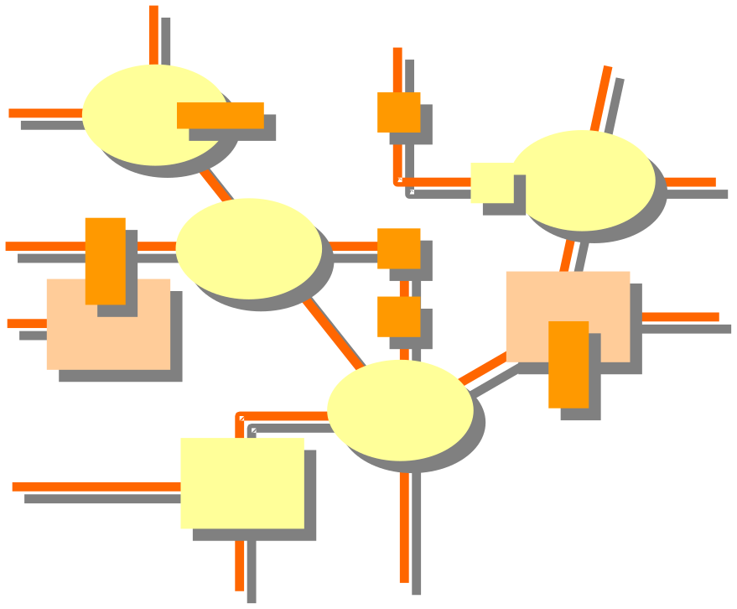
The R/3 Basis System
  Client/Server Architecture
  Application Architecture
  System Communication
Technical Architecture
  Client/Server Overview
  Resource Management
  Technical Configurations
  Object Migration
  The “Database” Client

Slide 3

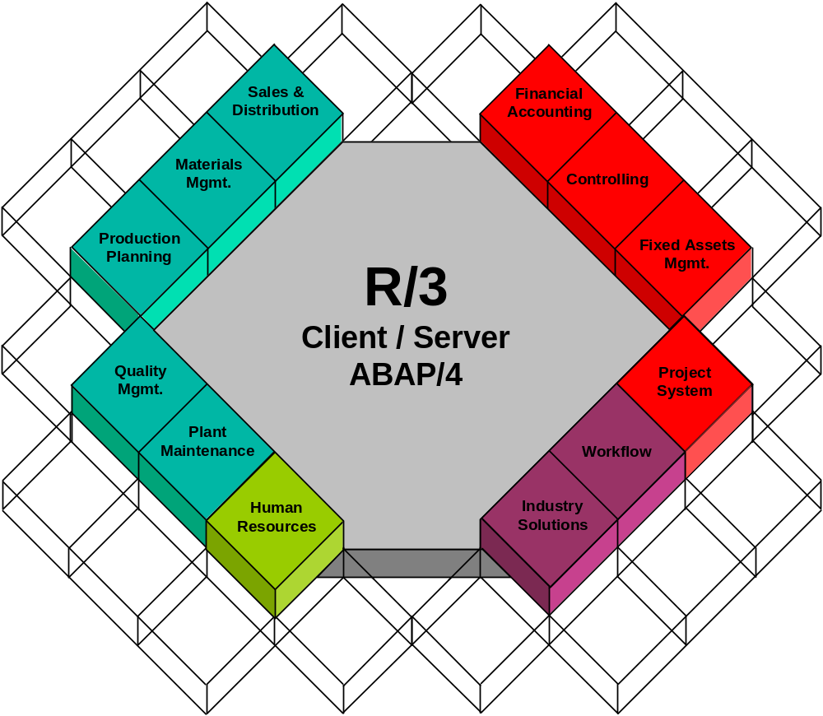
Logistical
Financial

Slide 4

Central Database
(Storage of all data)
Access to Dataase:
(Read / Write data)
Database
Input / Output
of data to users
Application
Processing of data
using application logic
Presentation of the
processed data to
the user
Presentation

Slide 5

Presentation
Application
Database
Central System
Two - tier
Distributed System
Two - tier
Client/Server
Three - tier
Client/Server
Multi-layer
Cooperative
Client/Server
(w/ release 4.0B)

Slide 6




Hardware
UNIX systems
Bull HP SNI
Digital IBM SUN
AT&T Data General SNI
Bull/Zenith HP Sequent
Compaq IBM Digital
IBM
AS/400
Operating
Systems
AIX SINIX
HP-UX SOLARIS
Digital UNIX
Windows NT
OS/400
ADABAS D,
DB2, INFORMIX,
ORACLE 7.1
ADABAS D, Oracle 7.1,
MS SQL Server 6.0
Databases
DB2/400
Dialog
SAPGUI
Windows 3.1, Windows 95, Windows NT, OSF/Motif,
Presentation Manager, Macintosh
Windows ‘95
OS/2
Languages
ABAP/4, C, C++

Slide 7

Remote
Function Call
Application
Link Enabling
Electronic Data
Interchange
R/ 3
Program Interface
Communication
Object Linking
and Embedding
Web
Interface

Slide 8
The R/3 Basis System
  Client/Server Architecture
  Application Architecture
  System Communication
Technical Architecture
  Client/Server Overview
  Resource Management
  Technical Configurations
  Object Migration
  The Client

Slide 9

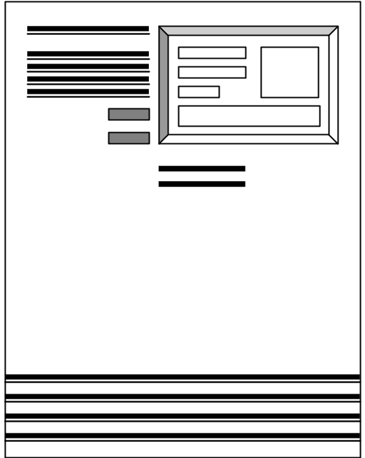

Server
LAN
TCP / IP
Client

Slide 10

Server
Data Storage
Application
Logic
Client
Presentation

Slide 11





Presentation
SAP GUI
Application
Communications
Dispatcher
Work
Process
Work
Process
Work
Process
Buffers
Data base

Slide 12



Presentation
SAP GUI
Terminal
Process
1
7
Application
Dispatcher
2
Request queues
3
SAP Memory Buffer
6
Work
Process
Roll
Page
4
5
Data base
Relational data base system

Slide 13


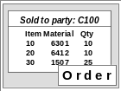

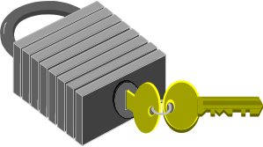
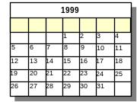

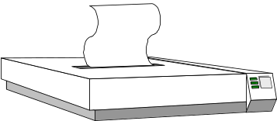
A
B
Dialog
Update
Message
M
SAP Dispatcher
Background Jobs
Enqueue
C
Gateway
Spool
R/3
R/2
G

Slide 14
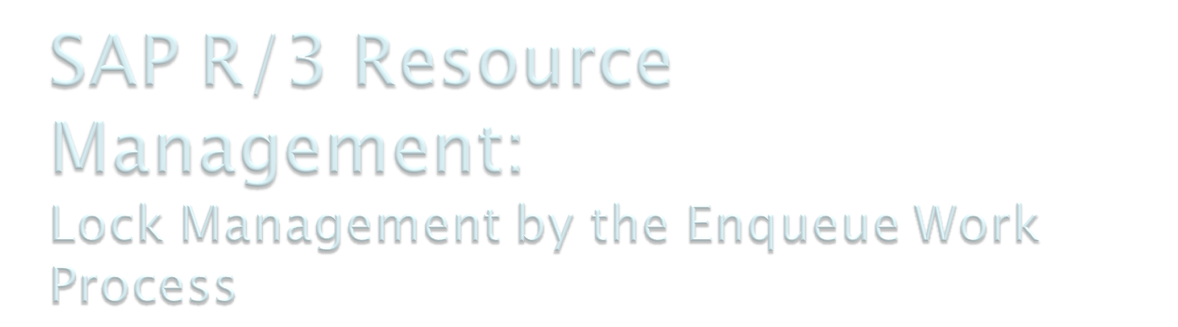
Instance A
Dispatcher
Message
Server
Work
Process
Update
Work
Process
Enqueue
Instance B
Dispatcher
Lock table in
Work
Process
Update
Work
Process
Enqueue
main storage

Slide 15

Database
Instance
Instance Profiles
(parameters)
Message
Server
SAP
Gateway
Dispatcher
Dialog
. . . .
Update
Spool
Back-
ground
Enqueue
SAP Buffers
Instance
Start
or
Stop
Central

Slide 16

Instance 03
Instance 02
Dispatcher
Dispatcher
Dialog
Back-
ground
Enqueue
Enqueue
Dialog
. . .
Instance 01
Dispatcher
Mess-
age
Gate-
way
Dialog
Update
Enqueue
Spool

Slide 17



Development
Testing
Production
Database
Servers
Application
Servers
Presentation
Servers
Notes:
SAP R/3 Technical Configuration
An SAP R/3 System can consist of one or more instances (e.g. a central instance or a distributed SAP R/3 System).
Multiple instances are represented by the configuration of a database server and one or more application servers.
Only one database and dictionary will exist for an SAP R/3 System.
Note: with R/4, you can have multiple database instances.
To isolate each distinct phase of an implementation, a typical or recommended configuration for an SAP R/3 System implementation will consist of three separate systems:
Development: for configuration of SAP applications with user specific data and user development.
Quality Assurance Testing: to isolate development from final testing and user training for production.
Production: of live business transactions and company data.

Slide 18

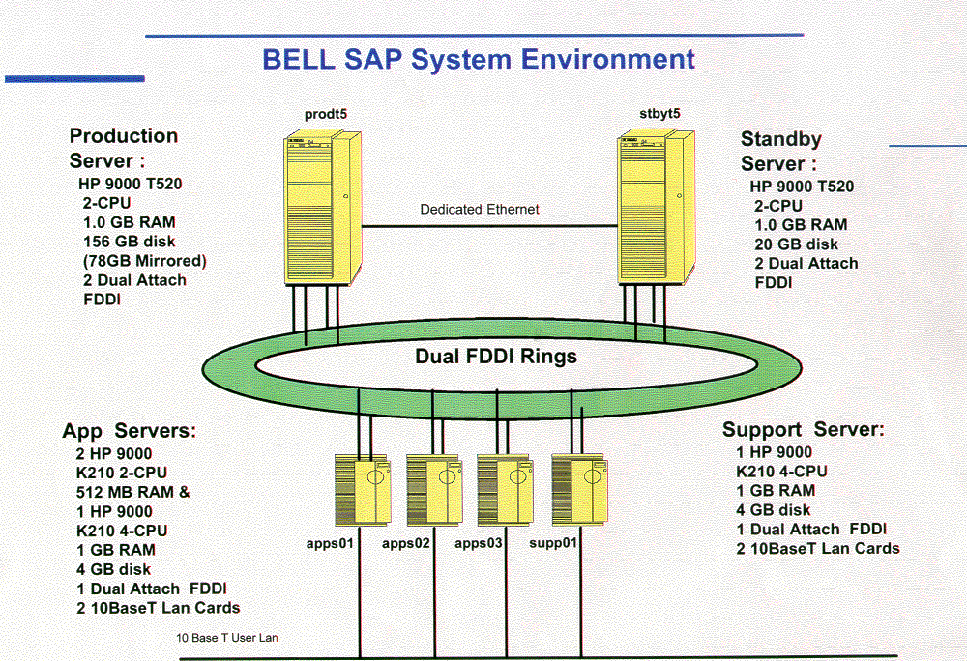

Slide 19

Corrections and Transport
Development
QA Testing
Production
Program A
Program A
Program A
Table A
Table A
Table A
Screen A
Screen A
Screen A
Export
Import
Export
Import

Slide 20
Corrections
and
Transport
Development
QA Testing
Program A
Version 1
Program A
Version 1
?
Program A
Version 2
Program A
Version 2
?
Program A
Version 3
Program A
Version 3
Originals

Slide 21

America Client 010
Europe Client 020
Japan Client 030
R/3
Europe
R/3
America
R/3
Japan

Slide 22

Configuration
Development
Quality Assurance
Interface Testing
User Training

