Slide 1
ISTQB Foundation Programme
31 Aug 2015

Slide 2
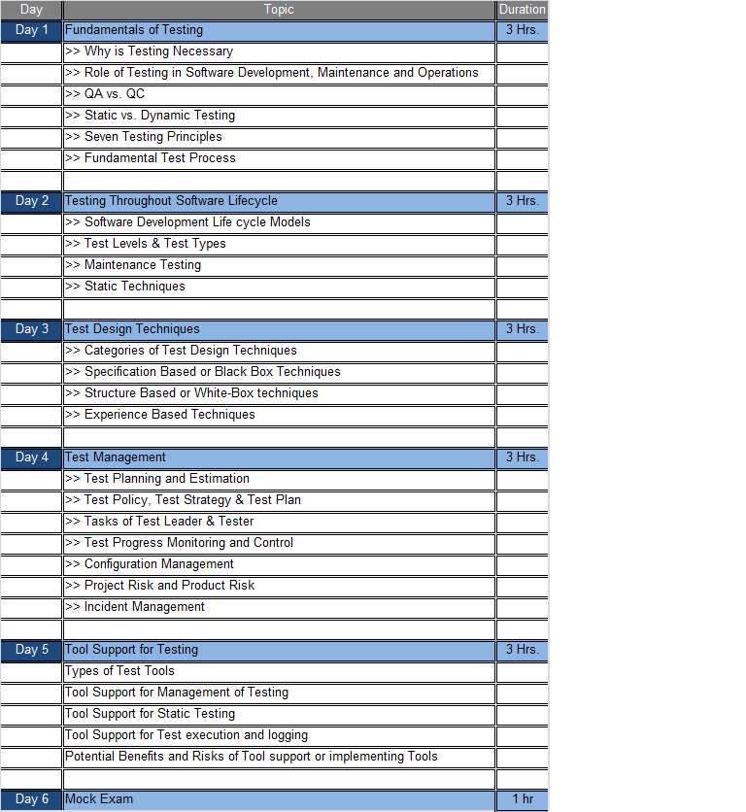
ISTQB Programme

Slide 3
Testing Basic Concepts

Slide 4
CONTENTS
Why testing is necessary?
Exhaustive Testing
How much testing is enough?
Test Objectives
Testing Principles
Prioritisation of tests
Fundamental Testing Process
3

Slide 5
What is a bug?
Error: a human action that produces an incorrect result
Fault: a manifestation of an error in software
also known as a defect or bug
if executed, a fault may cause a failure
Failure: deviation of the software from its expected delivery or service
Failure is an event; fault is a state of
the software, caused by an error
4

Slide 6
Error - Fault - Failure
A person makes
an error ...
… that creates a fault in the software ...
… that can cause a failure in operation
5

Slide 7
So why is testing necessary?
because software is likely to have faults
to learn about the reliability of the software
to fill the time between delivery of the software and the release date
to prove that the software has no faults
because testing is included in the project plan
because failures can be very expensive
to avoid being sued by customers
to stay in business
6

Slide 8
Exhaustive testing?
What is exhaustive testing?
when all the testers are exhausted
when all the planned tests have been executed
exercising all combinations of inputs and preconditions
How much time will exhaustive testing take?
infinite time
not much time
impractical amount of time
7

Slide 9
How much testing is enough?
it’s never enough
when you have done what you planned
when your customer/user is happy
when you have proved that the system works correctly
when you are confident that the system works correctly
it depends on the risks for your system
8

Slide 10
Test Objectives
Different Test Objectives:
Finding defects
Gaining confidence about the level of quality and providing information
Preventing Defects.
9

Slide 11
Testing Principles
Principle 1 – Testing shows presence of defects.
Principle 2 – Exhaustive testing is impossible.
Principle 3 – Early Testing
Principle 4 – Defect clustering
Principle 5 – Pesticide Paradox
Principle 6 – Testing is Context Dependent
Principle 7 – Absence-of-errors Fallacy
10

Slide 12
Prioritising tests
We can’t test everything
There is never enough time to do all the testing you would like
So what testing should you do?
11

Slide 13
Q n A
Q1: In prioritizing what to test, the most important objective is to:
a) find as many faults as possible.
b) test high risk areas.
c) obtain good test coverage.
test whatever is easiest to test.
12

Slide 14
Q n A
Q2 Enough testing has been performed when:
a) time runs out.
b) the required level of confidence has been achieved.
c) no more faults are found.
the users won’t find any serious faults.
13

Slide 15
Q n A
Q3: A failure is:
a) found in the software; the result of an error.
b) departure from specified behavior.
c) an incorrect step, process or data definition in a computer program.
a human action that produces an incorrect result.
14

Slide 16
Q n A
Q4: Which of the following characterizes the cost of faults? a) They are cheapest to find in the early development phases and the most expensive to fix in the latest test phases. b) They are easiest to find during system testing but the most expensive to fix then. c) Faults are cheapest to find in the early development phases but the most expensive to fix then. d) Although faults are most expensive to find during early development phases, they are cheapest to fix then.
15

Slide 17
Q n A
Q5: The main focus of acceptance testing is:
A finding faults in the system
B ensuring that the system is acceptable to all users
C testing the system with other systems
D testing from a business perspective
16

Slide 18
Fundamental Test Process
17

Slide 19
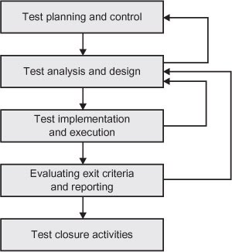
Fundamental Test Process
Test Planning and Control - Test planning is the activity of defining the objectives of testing and the specification of test activities in order to meet the objectives and mission.
Test control is the ongoing activity of comparing actual progress against the plan, and reporting the status, including deviations from the plan. It involves taking actions necessary to meet the mission and objectives of the project.
18

Slide 20
Fundamental Test Process (Contd …)
Test Analysis and Design - Test analysis and design is the activity during which general testing objectives are transformed into tangible test conditions and test cases.
This activity has the following major tasks -
- Reviewing the test basis (such as requirements, software integrity level1 (risk level), risk analysis reports etc.
- Evaluating testability of the test basis and test objects
- Identifying and prioritizing test conditions based on analysis of test items, the specification & behavior of the software etc.
- Designing and prioritizing high level test cases
- Identifying necessary test data to support the test conditions and test cases
- Designing the test environment set-up and identifying any required infrastructure and tools
Test Implementation and Execution - Test implementation and execution is the activity where test procedures or scripts are specified by combining the test cases in a particular order and including any other information needed for test execution, the environment is set up and the tests are run.
19

Slide 21

Fundamental Test Process (Contd …)
Evaluating Exit Criteria and Reporting - Evaluating exit criteria is the activity where test execution is assessed against the defined objectives.
Evaluating exit criteria has the following major tasks:
- Checking test logs against the exit criteria specified in test planning
- Assessing if more tests are needed or if the exit criteria specified should be changed
- Writing a test summary report for stakeholders
Test Closure Activities - Test closure activities occur at project milestones such as when a software system is released, a test project is completed, a milestone has been achieved, or a maintenance release has been completed.
Test closure activities include the following major tasks:
- Checking which planned deliverables have been delivered
- Closing incident reports or raising change records for any that remain open
- Documenting the acceptance of the system
- Finalizing and archiving testware, the test environment and the test infrastructure for later reuse
- Handing over the testware to the maintenance organization
- Analyzing lessons learned to determine changes needed for future releases and projects
- Using the information gathered to improve test maturity
20

Slide 22

Any Questions

