Slide 1
Testing Throughout Lifecycle ISTQB Foundation : Day 2 Training
19 JANUARY 2015
Ritu Marsh - Sydney
Presenter Title
Location

Slide 2
Testing Throughout Lifecycle

Slide 3
CONTENTS
Applications Domains
Software Development Models
Test Levels and Test Types
Software Maintenance
2
Notes:
2

Slide 4
APPLICATION DOMAIN
Collection of applications with similar characteristics.
PC-Based
Mainframe
Client-Server
Web-Based
3
Notes:
3

Slide 5
PC-Based Domain
Designed to run on a single PC (Or any other stand-alone desktop, laptop or notebook architecture down to and including all mobile devices that use Windows or similar operating system).
Examples – MS Office, Games Software, Accounting packages etc.
Applications run on a small general purpose computer with relatively simple operating system.
Software written for stand-alone PC’s may have sophisticated user interface, while specialized software will be needed to enable PC’s to act as Web Servers.
Applications may need to be tested - for compatibility with both PC and Macintosh architectures and with a variety of operating systems.
Ability to work alongside other applications
Resource requirements, to ensure that they are not ‘resource hungry’, taking up more system resources than expected or desired.
Challenges of PC-Based Domain
4
Notes:
4

Slide 6
Mainframe-Based Domain
Physically large
Significant processing capability in terms of volume and speed of processing of data
Used as general purpose computing engines running variety of applications.
High availability
High security
High Scalability
Limited User Interface
Not always support GUI, so testing may need to be via a command line or textual interface.
Creating required test environments, which may be large and complex and may require very large databases or co-ordination between users in dispersed locations.
Creating and maintaining large regression test suites to support significant maintenance changes over a long time-frame may be expensive and Time consuming
Creating the large-scale test data that may be required
Security testing may require specialist skills and test data
Testing for robustness and fault tolerance may require specialist skills
Challenges of Mainframe-Based Domain
5
Notes:
5

Slide 7
Client-Server Domain
Collection of ‘Client’ computers that request services from a ‘Server’ computer
Clients and Servers are remote from each other and connected by a network.
Clients may be simple ‘dumb’ terminals, with no functionality of their own and acting solely as communication between client and server.
Clients may carry out local data processing – they can be characterized as ‘Fat’ or ‘Thin’, depending on the amount of data processing being carried out – a PC is a typical ‘Fat’ client.
Clients are active components that initiate requests and wait for a response; they may be all the same or they may be differences between clients for particular users. Different clients may have access to different services.
Servers are passive and respond to requests.
Servers are associated with the resource used to provide the service; this could be a large database, the Internet, a group of applications, a collection of files etc.
Tier structured with the server as one Tier and the clients as a separate tier. Main advantage of increasing the number of tiers in a client-server architecture is that the tiers separate out layers of processing to better balance the load on individual servers, but the price of this is increased network traffic and therefore greater load on the n/w.
Client-Server systems are ‘always on’ with both clients and servers running continuously and servers awaiting some kind of ‘event’ generated by a client often described as an ‘event-driven’ architectures.
6
Notes:
6

Slide 8
Client-Server Domain – Contd ..
Important Characteristics
Improved Usability – by separating out the user interface into the client computers the usability can be enhanced at a local level
Greater Flexibility – Servers or clients can be updated without affecting overall system operation
Scalability – the architecture allows additional servers or clients to be added relatively easily
Greater Interoperability – the connections between systems can be managed at server level.
Testing a client-server system requires the creation of ‘events’ to exercise the event-driven architecture. This involves setting up or simulating client events, such as a request for data from a database, and then checking that the system responds correctly to each event.
The requirement that client-server systems run continuously gives rise to new problems such as memory leaks and other dynamic effects that may cause degradation of performance over time.
Since such systems contain multiple computers and networks, testing may become complicated in terms of number of combinations of system components and interfaces to be tested.
Security and performance must be given due consideration under such scenario.
Regression Testing can be more difficult to automate because it can be harder to manipulate system behavior at a local level (e.g. Creating a ‘server busy’ condition leading to new kind of defects e.g. communication problem and performance.
Challenges of Client-Server Domain
7
Notes:
7

Slide 9
Web-Based Domain
A Web-based application provides its services via a website.
In some respects a web-based application is a client-server system, with a local terminal and its web browser considered as thin client and the web server as the server.
A Web-server architecture uses a high-level communication layer called HTTP.
Web applications generate documents in standard formats, such as HTML/XHTML, which are supported by all common browsers, making it very easy to update applications on the server without impact on clients.
Web servers can be dynamically updated (e.g. when DB content changes) so that user access to servers extracts the latest updated information.
Servers are even more remote from the clients, which may cause issues when trying to initiate events at different tiers.
Clients are remote from each other and may be geographically widespread.
Client hardware architectures may have a wide variation in capability.
Client architectures may be using a variety of operating systems and browser versions, which may increase the scope of testing.
Increased performance testing will be required
Increased security testing will be required
Increased usability testing.
Challenges of Web-Based Domain
8
Notes:
8

Slide 10

Test Level Vs. Test Types
9
Notes:
9

Slide 11
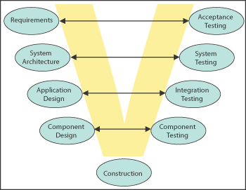
Test Levels and Test Types
Test Levels – Group of activities that are organized and managed together.
Point in the life cycle where the testing occurs.
In an Iterative Life cycle, test levels would occur at the end of time box, where all the functionality developed in that time box is tested together.
Example -
Component Testing
Integration Testing
Top Down
Bottom Up
System Testing
Functional
Non- Functional
Acceptance Testing
Alpha
Beta
10
Notes:
10

Slide 12
Test Levels and Test Types (Contd ..)
Test Types – Test activities directed towards achieving a particular test objective.
Functional Testing and Performance Testing are the best examples.
Any Test type can occur at any test level and may occur at more than one test level. Functional testing is likely to occur at every test level, where as Performance testing can occur at some test levels than others e.g. more at system test level than at component test level.
Example
Testing of Function (Functional Testing)
Black Box Testing (Specification Based Testing)
Testing of Software Product characteristics (Non - Functional Testing)
Performance Testing
Load Testing
Stress Testing
Testing of Software Structure/Architecture (Structural Testing)
White Box Testing
Testing related to confirmation of changes
Confirmation Testing
Regression Testing
11
Notes:
11

Slide 13
Software Development Models
12
Notes:
12

Slide 14
Software Development Life Cycle (SDLC)
Phases in SDLC: Every SDLC model has the following phases -
Requirement gathering and analysis
Design
Implementation or coding
Testing
Deployment
Maintenance
13
Notes:
13

Slide 15
Software Development Models
Water fall model/ Linear Sequential/ Classic Life Cycle Model
This is the most common and classic of life cycle models, also referred to as a linear-sequential life cycle model.
In this, each phase must be completed in its entirety before the next phase can begin.
At the end of each phase, a review takes place to determine if the project is on the right path and whether or not to continue or discard the project.
Well suited to projects that has low risk in the areas of user interface and performance requirements, but high risk in budget and schedule predictability and control.
Requirements Specification
System design
Coding
Testing
Delivery
14
Notes:
14

Slide 16
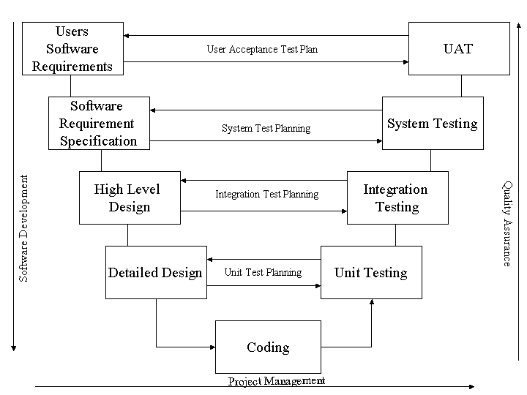
V Model

Slide 17
Software Development Models (Contd..)
V-Model – Provides a clear and simple way to describe the relationship between Testing and Development, by showing that each development activity has an associated Testing activity.
Demonstrate that tests can and should be specified at the same time as the associated development deliverable is created.
A full implementation of this model have reviews at each stage and test specifications created before the module coding begins.
V model is the classic software development model. It encapsulates the steps in Verification and Validation phases for each step in the SDLC. For each phase, the subsequent phase becomes the verification (QA) phase and the corresponding testing phase in the other arm of the V becomes the validating (Testing) phase.
In practice, this model has some fundamental problems, since whole model depends on the quality and completeness of the requirements as both the testing and development activities stem from this single deliverable. Requirements usually do not remain stable throughout a software project, so this model is usually compromised in practice.
Verification vs Validation:
Verification is the process of evaluating products of a development phase to find out whether they meet the specified requirements. Verification is done at the starting of the development process. It includes reviews and meetings, walkthroughs, inspection, etc. to evaluate documents, plans, code, requirements and specifications. It will answer question like: Am I building the product right?
Validation is the process of evaluating software at the end of the development process to determine whether software meets the customer expectations and requirements. Validation is done at the end of the development process and takes place after verifications are completed. It answers the question like: Am I building the right product?
16
Notes:
16

Slide 18
Software Development Models (Contd..)
Iterative Model – In this, Development is split into a series of short timeframes, during which a subset of the requirements is developed and tested.
Project progresses as a series of short development cycles.
Aim of Iterative development is to ensure that the highest priority requirements are developed first .
It removes the dependence on stable requirements by not attempting to define them fully at the beginning of the project. Instead it identifies a set of objectives for the project and prioritizes these.
Examples – Rapid Application Development (RAD), Prototyping, Agile etc.
The major challenge in this case is associated with Timeboxed approach and minimal documentation available (Usually outline requirements) to built a product.
17
Notes:
17

Slide 19
Software Development Models (Contd..)
Incremental Model – In incremental model the whole requirement is divided into various builds. Multiple development cycles take place here, making the life cycle a “multi-waterfall” cycle.
Each module passes through the requirements, design, implementation and testing phases..
A working version of software is produced during the first module, so you have working software early on during the software life cycle. .
Each subsequent release of the module adds function to the previous release. The process continues till the complete system is achieved.
Examples – Rapid Application Development (RAD), Prototyping, Agile etc.
The major challenge in this case is associated with Timeboxed approach and minimal documentation available (Usually outline requirements) to built a product.
18
Notes:
18

Slide 20
Software Development Models (Contd..)
Agile model – Agile development model is also a type of Incremental model..
Each module passes through the requirements, design, implementation and testing phases..
A working version of software is produced during the first module, so you have working software early on during the software life cycle. .
Each subsequent release of the module adds function to the previous release. The process continues till the complete system is achieved.
Examples – Rapid Application Development (RAD), Prototyping, Agile etc.
The major challenge in this case is associated with Timeboxed approach and minimal documentation available (Usually outline requirements) to built a product.
19
Notes:
19

Slide 21
Maintenance Testing
20
Notes:
20

Slide 22
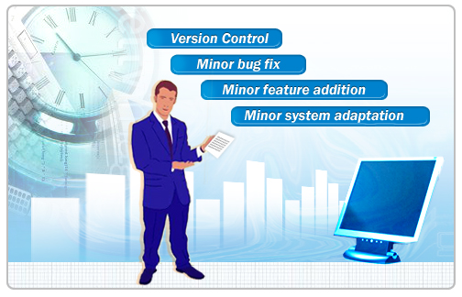
MAINTENANCE TESTING
Maintenance Testing is done on the already deployed / delivered software. The deployed software needs to be enhanced, changed or migrated to other hardware. The Testing done during this enhancement, change and migration cycle is known as maintenance testing.
In maintenance testing, tester should consider 2 parts -
- Any changes made in software should be tested thoroughly.
- The changes made in software does not affect the existing functionality of the software, so regression testing is also done.
It can vary from simple defect correction arising from user routine reporting, through to emergency defect correction when something goes seriously wrong in a critical area, to major enhancements of core functionality.
21
Notes:
21

Slide 23

Any Questions

