Slide 1
ISTQB Foundation Programme
2 Sep 2015

Slide 2
Test Analysis and Design

Slide 3

CONTENTS
Approaches to Testing
Fundamentals of Test Analysis and Design
Test Design techniques and Test Types
Test Coverage
Scenario Analysis

Slide 4

APPROACHES TO TESTING

Slide 5
APPROACHES TO TESTING
There are many ways to test a software component or system, including approaches such as static testing, dynamic testing.
Static Testing: Static testing is the term used for testing a component or code level without execution of the software. The benefit of static testing is the detection of defects as early in the life cycle as possible, where they should be cheaper to fix, as well as reducing the possibility of fault multiplication downstream.
Dynamic Analysis and Testing: Dynamic testing and analysis involves execution of the software under test. It seeks to uncover defects in the system while it is running.
Error Guessing/ Exploratory Testing: In error guessing, a list of errors may be produced prior to test execution. In exploratory testing, the tester explores system behavior at will, but the test steps should be recorded for future use, especially if a defect is detected.

Slide 6
FUNDAMENTALS OF TEST ANALYSIS AND DESIGN
5

Slide 7
TEST ANALYSIS AND DESIGN
Test Analysis : Test analysis begins with the analysis of the test basis in order to identify the test objectives (or test conditions and test scenarios).
Creation of a Test Basis: All documents from which the requirements of a component or system can be inferred. The documentation on which the test cases are based. These may be constructed from existing documentation, such as a user manual for an earlier version of the system or from documents used to explore requirements, including relevant emails, memos or other fragments of information.
Analysis of Test Basis: Analysis identifies the test conditions that form the definition of the test basis from which tests will be constructed. It recognizes where the test basis is not adequately defined to enable unambiguous and complete test conditions to be identified, and thus contributes to enhancing the quality of the test basis.
Generation of Test Cases: A set of input values, execution preconditions, expected results and execution post conditions, developed for a particular objective or test condition, such as to exercise a particular program path or to verify compliance with a specific requirement. Test cases identify the nature of the inputs and expected results needed to verify a given test condition, and so form the framework for test scripts.
Construction of Test Procedures: A document specifying a sequence of actions for the execution of a test. Also known as test script or manual test script. A test script may be run once or many times with each run using a different data set. In some cases the tests may be progressive, so that the post conditions of one test match the preconditions for the next test.
Test Environment Requirements: The purpose of a test environment is to facilitate the successful execution of a test, and at the intended level. At unit and integration test levels, the test environment would be expected to include the necessary test harnesses, stubs and drivers. At system test level, the environment would be expected to facilitate end-to-end testing. At acceptance test level the test environment may be required to be as ‘like live’ as possible.

Slide 8
QUIZ TIME
Which of the following best describes the purpose of a test environment?
To ensure that all stubs and drivers are available for unit and integration testing.
To ensure that all data copied from the live environment has been made anonymous.
To ensure that the testers can carry out testing as quickly as possible.
To facilitate the testing of a component or system against its requirements.
Answer: D

Slide 9
TEST DESIGN TECHNIQUES
Test design techniques fall into three main categories:
Specification-based
Structure-based
Experience based
Specification-based and Experience-based techniques, taken together, are collectively known as Black-box techniques and structure-based techniques are known as white-box techniques.
Specification Based Techniques
Equivalence partitioning
Boundary value analysis
Decision table testing
State transition testing
Use case testing.
Structure Based Techniques
Statement testing
Decision testing
Other techniques like LCSAJ

Slide 10
Equivalence partitioning (EP)
Divide (partition) the inputs, outputs, etc. into areas which are the same (equivalent)
assumption: if one value works, all will work
one from each partition better than all from one
invalid
valid
invalid
0
1
100
101

Slide 11
Boundary value analysis (BVA)
faults tend to lurk near boundaries
good place to look for faults
test values on both sides of boundaries
invalid
valid
invalid
0
1
100
101

Slide 12
Q n A
Q1: Order numbers on a stock control system can range between 10000 and 99999
inclusive. Which of the following inputs might be a result of designing tests for
only valid equivalence classes and valid boundaries:
a) 1000, 5000, 99999
b) 9999, 50000, 100000
c) 10000, 50000, 99999
d) 10000, 99999
e) 9999, 10000, 50000, 99999, 10000
Q2: One of the fields on a form contains a text box which accepts numeric values in the range of 18 to 25. Identify the invalid Equivalence class.
a) 17 b) 19 c) 24 d) 21

Slide 13
Q n A
Q3: In an Examination a candidate has to score minimum of 24 marks in order to clear the exam. The maximum that he can score is 40 marks. Identify the Valid Equivalence values if the student clears the exam.
a) 22,23,26 b) 21,39,40 c) 29,30,31 d) 0,15,22
Q4:One of the fields on a form contains a text box which accepts alpha numeric values. Identify the Valid Equivalence class a) BOOK b) Book c) Boo01k d) Book
Q5: The Switch is switched off once the temperature falls below 18 and then it is turned on when the temperature is more than 21. When the temperature is more than 21. Identify the Equivalence values which belong to the same class.
a)12,16,22
b) 24,27,17 c) 22,23,24 d) 14,15,19

Slide 14
Q n A
Q6: A program validates a numeric field as follows: values less than 10 are rejected, values between 10 and 21 are accepted, values greater than or equal to 22 are rejected. Which of the following covers the MOST boundary values?
a. 9,10,11,22 b. 9,10,21,22 c. 10,11,21,22 d. 10,11,20,21
Q7: In a system designed to work out the tax to be paid: An employee has £4000 of salary tax free. The next £1500 is taxed at 10%. The next £28000 after that is taxed at 22%. Any further amount is taxed at 40%.
To the nearest whole pound, which of these groups of numbers fall into three DIFFERENT equivalence classes? a) £4000; £5000; £5500 b) £32001; £34000; £36500 c) £28000; £28001; £32001 d) £4000; £4200; £5600

Slide 15
State Transition Testing
Uses a model that shows:
States the software may occupy
Transition between the states
Events which cause the transitions
Actions that result from the transitions
Invalid PIN
Card inserted
Beep
Ask for PIN
Wait for card
Wait for PIN
Cancel
Valid PIN
Return card
Ask amount

Slide 16
Decision Table Testing
Decision table testing
Helps in condition where there are number of logical decisions to be made
Example:

Slide 17
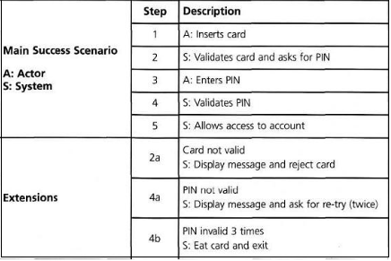
Use Case Testing
Use cases are a sequence of steps that describe the interactions between the actor and the system. Use cases are defined in terms of the actor describing what the actor does and what the actor sees.
E.g.: The ATM PIN example is shown below in Figure 4.3. We show successful and unsuccessful scenarios. In this diagram we can see the interactions between the A (actor – in this case it is a human being) and S (system). From step 1 to step 5 that is success scenario it shows that the card and pin both got validated and allows Actor to access the account.

Slide 18
Test Design Techniques
White Box Techniques
Statement Testing
Exercises statements – based on percentage of statements executed
Branch / Decision Testing
Exercises decision points – based on percentage of decisions covered
100% decision testing covers 100% statement testing but not vice versa
Other Techniques
Branch Condition Testing
Linear code sequence and Jump
Date Flow Testing

Slide 19
Statement Coverage
Percentage of executable statements exercised by a test suite
number of statements exercised
=
total number of statements
Example:
program has 100 statements
tests exercise 87 statements
statement coverage = 87%
?

Slide 20
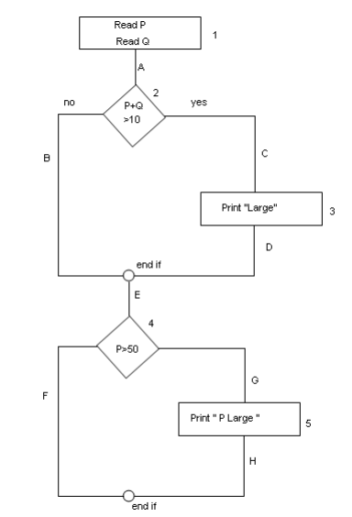
Statement Coverage
Example:
Read P
Read Q
IF P+Q > 100 THEN
Print “Large”
ENDIF
If P > 50 THEN
Print “P Large”
ENDIF
SC=1
BC=2
PC=4

Slide 21
Decision Coverage (Branch Coverage)
Percentage of decision outcomes exercised by a test suite.
number of decisions outcomes exercised
total number of decision outcomes
Example:
program has 120 decision outcomes
tests exercise 60 decision outcomes
decision coverage = 50%
=

Slide 22
Path Coverage
In this the test case is executed in such a way that every path is executed at least once.
All possible control paths taken, including all loop paths taken zero, once, and multiple (ideally, maximum) items in path coverage technique, the test cases are prepared based on the logical complexity measure of a procedural design. In this type of testing every statement in the program is guaranteed to be executed at least one time

Slide 23
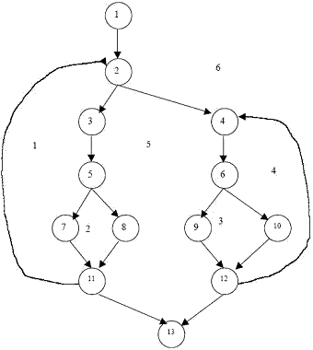
Cyclomatic Complexity
Cyclomatic Complexity for a flow graph is computed in one of three ways:
The numbers of regions of the flow graph correspond to the Cyclomatic complexity.
Cyclomatic complexity, V(G), for a flow graph G is defined as V(G) = E – N + 2 where E is the number of flow graph edges and N is the number of flow graph nodes.
Cyclomatic complexity, V(G), for a graph flow G is also defined as V(G) = P + 1 Where P is the number of predicate nodes contained in the flow graph G.
Example: Consider the following flow graph
Region, R= 6 Number of Nodes = 13 Number of edges = 17 Number of Predicate Nodes = 5
Cyclomatic Complexity, V( C) :
V( C ) = R = 6; Or
V(C) = Predicate Nodes + 1 =5+1 =6 Or
V( C)= E-N+2 = 17-13+2

Slide 24
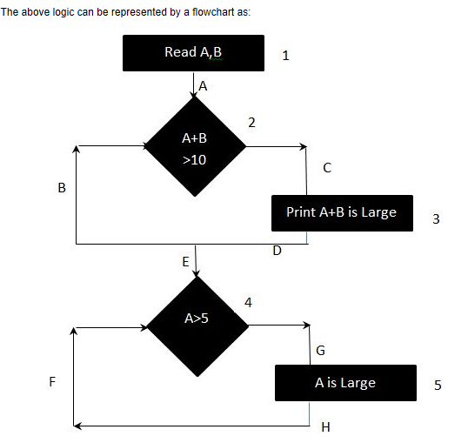
Examples
Read A
Read B
IF A+B > 10
THEN Print "A+B is Large"
ENDIF
If A > 5
THEN Print "A Large"
ENDIF

Slide 25
Statement, Branch and Path coverage
Statement Coverage (SC):
To calculate Statement Coverage, find out the shortest number of paths following which all the nodes will be covered. Here by traversing through path 1A-2C-3D-E-4G-5H all the nodes are covered. So by traveling through only one path all the nodes 12345 are covered, so the Statement coverage in this case is 1.
Branch Coverage (BC):
To calculate Branch Coverage, find out the minimum number of paths which will ensure covering of all the edges. In this case there is no single path which will ensure coverage of all the edges at one go. By following paths 1A-2C-3D-E-4G-5H, maximum numbers of
edges (A, C, D, E, G and H) are covered but edges B and F are left. To covers these edges we can follow 1A-2B-E-4F. By the combining the above two paths we can ensure of traveling through all the paths. Hence Branch Coverage is 2.
Path Coverage (PC):
Path Coverage ensures covering of all the paths from start to end.
All possible paths are-
1A-2B-E-4F
1A-2B-E-4G-5H
1A-2C-3D-E-4G-5H
1A-2C-3D-E-4F
So path coverage is 4.
Thus for the above example SC=1, BC=2 and PC=4.
Memorize these….
100% LCSAJ coverage will imply 100% Branch/Decision coverage
100% Path coverage will imply 100% Statement coverage
100% Branch/Decision coverage will imply 100% Statement coverage
100% Path coverage will imply 100% Branch/Decision coverage
Branch coverage and Decision coverage are same.
*LCSAJ = Linear Code Sequence and Jump

Slide 26
Examples
Q8: Minimum Test Required for Statement Coverage: Disc = 0 Order-qty = 0 Read Order-qty If Order-qty >=20 then Disc = 0.05 If Order-qty >=100 then Disc =0.1 End if End if
A. Statement coverage is 4 B. Statement coverage is 1 C. Statement coverage is 3 D. Statement Coverage is 2
Q9: Given the following: Switch PC on Start "outlook" IF outlook appears THEN Send an email Close outlook
A. 1 test for statement coverage, 1 for branch coverage B. 1 test for statement coverage, 2 for branch coverage C. 1 test for statement coverage. 3 for branch coverage D. 2 tests for statement coverage, 2 for branch coverage E. 2 tests for statement coverage, 3 for branch coverage

Slide 27
Examples
Q10 : Consider the following statements:
i.100% statement coverage guarantees 100% branch coverage.
ii.100% branch coverage guarantees 100% statement coverage.
iii.100% branch coverage guarantees 100% decision coverage.
iv.100% decision coverage guarantees 100% branch coverage.
v.100% statement coverage guarantees 100% decision coverage.
a)ii is True; i, iii, iv & v are False
b)i & v are True; ii, iii & iv are False
c)ii & iii are True; i, iv & v are False
d)ii, iii & iv are True; i & v are False

Slide 28
Examples
Q11: If the pseudocode below were a programming language ,how many tests are
required to achieve 100% statement coverage?
If x=3 then
Display_messageX;
If y=2 then
Display_messageY;
Else
Display_messageZ;
Else
Display_messageZ;
a. 1
b. 2
c. 3
d. 4

Slide 29
Examples
Q12: One of the fields on a form contains a text box which accepts alphabets in lower or upper case. Indentify the invalid Equivalance class value.
a. CLASS
b. cLASS
c. CLass
d. CLa01ss
Q13: What is the smallest number of test cases required to
Provide 100% branch coverage?
If(x>y) x=x+1; else y=y+1;
while(x>y)
{
y=x*y; x=x+1;
}
A. 1
B. 2
C. 3
D. 4

Slide 30
Examples
Q14: Analyse the following highly simplified procedure:
Ask: “What type of ticket do you require, single or return?”
IF the customer wants ‘return’
Ask: “What rate, Standard or Cheap-day?”
IF the customer replies ‘Cheap-day’
Say: “That will be £11:20”
ELSE
Say: “That will be £19:50”
ENDIF
ELSE
Say: “That will be £9:75”
ENDIF
Now decide the minimum number of tests that are needed to ensure that all
the questions have been asked, all combinations have occurred and all
replies given.
a) 3
b) 4
c) 5
d) 6

Slide 31
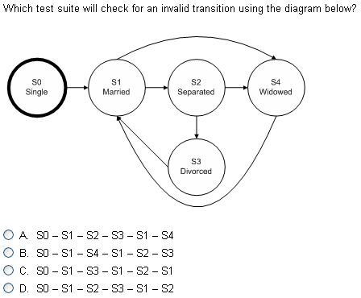
Examples

Slide 32
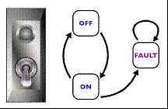
Examples
Q16: Consider the state transition diagram of a switch.
Which of the following represents an invalid state transition?
a) OFF to ON
b) ON to OFF
c) FAULT to ON

Slide 33
Examples
Q17: Structural Testing
a.same as black box testing
b.same as white box testing
c.same as functional testing
d.none of the above.
Q18: An input field takes the year of birth between 1900 and 2004
The boundary values for testing this field are
a. 0,1900,2004,2005
b. 1900, 2004
c. 1899,1900,2004,2005
d. 1899, 1900, 1901,2003,2004,2005
Q19: What can static analysis NOT find?
a) the use of a variable before it has been defined
b) unreachable (“dead”) code
c) memory leaks
d) array bound violations

Slide 34
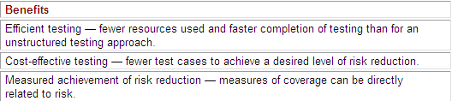
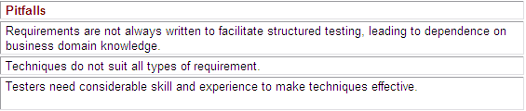
TEST DESIGN TECHNIQUES (Contd ..)
Experience Based Techniques
Error Guessing
Exploratory Testing
Experience-based techniques are also known as Black-box techniques, together with specification-based techniques.
Uses the knowledge and experience of users, testers or developers to generate test cases based on likely areas of failure.
Benefits and Pitfalls of Test Design Techniques

Slide 35
TEST COVERAGE
34

Slide 36
TEST COVERAGE
Test coverage is a way of defining the extent of testing and is usually driven by the level of risk that needs to be mitigated.
Can be defined as the degree, expressed as a percentage, to which a specified coverage item has been exercised by a test suite.
Coverage items can be anything for which coverage can be measured.

Slide 37
QUIZ TIME
Which of the following are test coverage measures and which are test progress measures?
Percentage of equivalence partitions tested.
Percentage of decisions tested.
Percentage of tests passed.
Percentage of statements tested.
Answer : A, B and D are test quality measures, while answer C is a test progress measure.

Slide 38

Any Questions

