Slide 1
Static ISTQB Foundation : Day 3 Training
19 JANUARY 2015
Ritu Singh
Mercer - Noida

Slide 2
Testing Techniques
Static Testing
Dynamic Testing
Static Testing Techniques include:
Informal Reviews
Walkthroughs
Technical Reviews
Inspection
Static Analysis- includes Data Flow and Control Flow

Slide 3
Static Testing Techniques
The primary objective of static testing is to improve the quality of software products by assisting engineers to recognize and fix their own defects early in the software development process
Static testing is the testing of the software work products manually, or with a set of tools, but they are not executed.
Starts early in the Life cycle and so it is done during the verification process
Uses of Static Testing
Static testing can start early in the life cycle so early feedback on quality issues can be established
Since defects are found early, rework cost is low
Types of defects found in Static Testing
Deviation from standards
Missing requirements
Design Defects

Slide 4

CONTENTS
Introduction to Reviews
The Principles of Reviews
Types of Review
Using Different Review Types
Performing a Formal Review

Slide 5
INTRODUCTION TO REVIEWS
A Review is an evaluation of a product or project status to ascertain discrepancies from planned results and to recommend improvements. Examples include management review, informal review, technical review, inspection, and walkthrough.
Static testing, including reviews, can provide a cost-effective way of preventing defects downstream, where, as is generally accepted, they would be more expensive to fix than if they were addressed earlier in the life cycle.

Slide 6

PRINCIPLES OF REVIEWS
The Review Process
Planning
Preparation
Review Meeting
Rework and Follow-up

Slide 7
The Review Process
Two aspects of review process :
  Phases of Formal Review
  Roles and Responsibilities

Slide 8
Review Phases
Planning :
The first phase of the formal review is the Planning phase. In this phase the review process begins with a request for review by the author to the moderator (or inspection leader).
A moderator has to take care of the scheduling like date, time, place and invitation of the review.
For the formal reviews, the moderator performs the entry check and also defines the formal exit criteria.
The entry check is done to ensure that the reviewer’s time is not wasted on a document that is not ready for review.
Once, the document clear the entry check the moderator and author decides that which part of the document is to be reviewed.
Major Tasks : Selecting the personal, allocating roles, defining entry and exit criteria for more formal reviews etc.

Slide 9
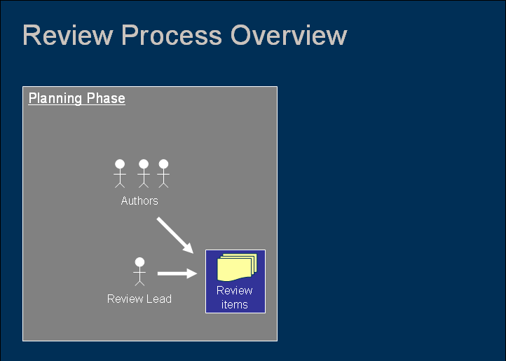
Planning Phase

Slide 10
Review Phases (Contd ..)
Preparation:
In this step the reviewers review the document individually using the related documents, procedures, rules and checklists provided.
Each participant while reviewing individually identifies the defects, questions and comments according to their understanding of the document and role.
After that all issues are recorded using a logging form. The success factor for a thorough preparation is the number of pages checked per hour. This is called the checking rate. Usually the checking rate is in the range of 5 to 10 pages per hour.
Major Tasks : Work done by each of the participants on their own work before the review meeting, questions and comments.

Slide 11
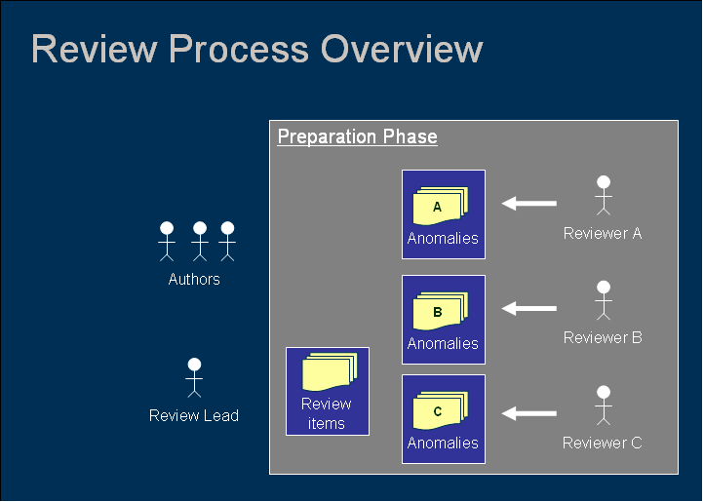
Preparation Phase

Slide 12
Review Phases (Contd ..)
Review Meeting : The meeting typically consists of the following elements (partly depending on the review type): Logging phase, Discussion phase and Decision phase.
Logging phase: In this phase the issues and the defects that have been identified during the preparation step are logged page by page. The logging is basically done by the author or by a scribe. During the logging phase the moderator focuses on logging as many defects as possible within a certain time frame.
Discussion phase: If any issue needs discussion then the item is logged and then handled in the discussion phase. As chairman of the discussion meeting, the moderator takes care of the people issues and prevents discussion from getting too personal and calls for a break to cool down the heated discussion. The outcome of the discussions is documented for the future reference.
Decision phase: At the end of the meeting a decision on the document under review has to be made by the participants, sometimes based on formal exit criteria. Exit criteria are the average number of critical and/or major defects found per page (for example no more than three critical/major defects per page). If the number of defects found per page is more than a certain level then the document must be reviewed again, after it has been reworked.
Major Tasks : Discussion or logging, make recommendations for handling the defects, or make decisions about the defects.

Slide 13
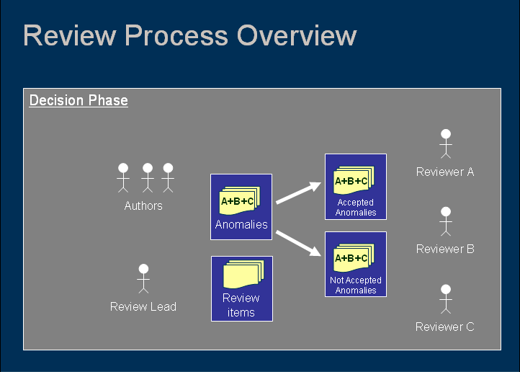
Decision Phase

Slide 14
Review Phases (Contd ..)
Rework and Follow-Up :
Rework : Based on the defects detected, the author will improve the document under review step by step. Not every defect that is found leads to rework. It is the author’s responsibility to judge if a defect has to be fixed. If nothing is done about an issue for a certain reason, it should be reported to at least indicate that the author has considered the issue. Changes that are made to the document should be easy to identify during follow-up. Therefore the author has to indicate where changes are made.
Major Tasks : Fixing defects found, typically done by the author Fixing defects found, typically done by the author.
Follow-up : In this step the moderator check to make sure that the author has taken action on all known defects. The most important thing in terms of follow-up is to ensure that actions identified are completed to an agreed timetable.
Major Tasks : Checking the defects have been addressed, gathering metrics and checking on exit criteria.

Slide 15
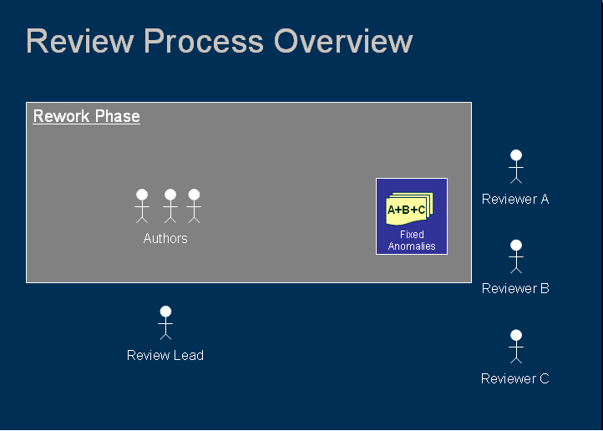
Rework Phase

Slide 16



Slide 17

Roles and Responsibilities
Manager: Decides on execution of reviews, allocates time in projects schedules, and determines if the review objectives have been met.
Moderator: Leads the review, including planning, running the meeting, follow-up after the meeting.
Author: The writer or person with chief responsibility of the document(s) to be reviewed.
Reviewers: Individuals with a specific technical or business background. Identify defects and describe findings.
Scribe (recorder): Document all the issues, problems.

Slide 18


Slide 19
TYPES OF REVIEWS
Walkthrough
Technical Review
Inspection
Management Review
Informal Reviews

Slide 20
REVIEWS TYPES (Contd ..)
Walkthrough :
Meeting led by author.
May take the form of scenarios, dry runs, peer group participation
Open-ended sessions
  Optional pre-meeting preparation of reviewers
  Optional preparation of a review report including list of findings
Optional scribe (who is not the author)
May vary in practice from quite informal to very formal
Main purposes: learning, gaining understanding, finding defects

Slide 21
REVIEWS TYPES (Contd ..)
Technical Review :
Documented, defined defect-detection process that includes peers and technical experts with optional management participation
May be performed as a peer review without management participation
Ideally led by trained moderator (not the author)
Pre-meeting preparation by reviewers
Optional use of checklists
Preparation of a review report which includes the list of findings, the verdict whether the software product meets its requirements and, where appropriate, recommendations related to findings
May vary in practice from quite informal to very formal
Main purposes: discussing, making decisions, evaluating alternatives, finding defects, solving technical problems and checking conformance to specifications, plans, regulations, and standards

Slide 22
REVIEW TYPES (Contd ..)
Inspection :
Led by trained moderator (not the author)
Usually conducted as a peer examination
Defined roles
Includes metrics gathering
Formal process based on rules and checklists
Specified entry and exit criteria for acceptance of the software product
Pre-meeting preparation
Inspection report including list of findings
Formal follow-up process (with optional process improvement components)
Main purpose: finding defects
Walkthroughs, technical reviews and inspections can be performed within a peer group, i.e. colleagues at the same organizational level. This type of review is called a "peer review".

Slide 23
REVIEW TYPES (Contd ..)
Management Review : Management reviews are carried out by, or on behalf of, the management personnel having direct responsibility for the system. Management reviews identify consistency with and deviations from plans, or adequacies and inadequacies of management procedures. This examination may require more than one meeting. The examination
need not address all aspects of the product.
A management review can be an informal process, but generally requires a formal structure and rules of conduct, such as those advocated in the IEEE standard, which are:
Evaluate entry
Management preparation
Plan the structure of the review
Overview of review procedures
Preparation
Examination
Rework/follow-up
Exit evaluation

Slide 24
TYPES OF REVIEWS
Informal Review :
Informal reviews are not a review type in their own right
Conducted on an as-needed i.e. Informal agenda
The date and the time of the agenda for the Informal Review will not be addressed in the Project Plan
The Developer chooses a review panel and provides and/or presents the material to be reviewed
The material may be as informal as a computer listing or hand-written documentation.

Slide 26

PERFORMING SUCCESSFUL REVIEWS
Preparing for reviews
Setting up a review
Conducting a review
Following up a review
Assessing the effectiveness of a review
Using the assessment to improve review performance

Slide 27
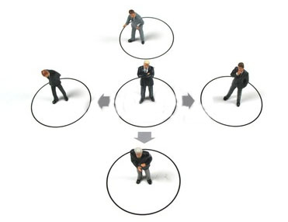
PERFORMING SUCCESSFUL REVIEWS
Preparing for Review: Reviews are much more effective if participants are properly prepared. There are several things that participants need to know, such as:
What is appropriate behavior in a review?
What is the purpose of the review?
What perspective am I expected to reflect in the review?

Slide 28
PERFORMING SUCCESSFUL REVIEWS
Setting up a Review: Two things are important at this stage: getting participants to commit to the meeting and getting them to do the necessary preparation

Slide 29
PERFORMING SUCCESSFUL REVIEWS
Conducting a Review: The two most important challenges to conducting an effective review are both about behaviour and both rely on effective leadership from the review leader.
The first challenge is about ensuring appropriate behaviour. This requires constant monitoring of the discussion for signs of personal comments, inappropriate remarks, or anything that causes or increases tension.
The second challenge is about ensuring that the review achieves its objectives by avoiding digressions and time wasting. The most significant digression likely to arise is the tendency to try to solve problems identified at the review.
At the end of the review it is also important to agree the defects found and actions planned and to ensure that these are documented, so time should be set aside to close the review in an orderly way and ensure everyone knows what is expected of them at the follow-up stage.

Slide 30
PERFORMING SUCCESSFUL REVIEWS
Following up a Review: The main activity in follow-up is usually with the author, who will be making any necessary and agreed changes. This may need support form others, and the review leader should monitor progress and be ready to offer help and support if necessary. Clear and simple reporting of defects and actions help by simplifying follow-up and may also provide valuable data on the performance of the review and the quality of the reviewed work product.

Slide 31
PERFORMING SUCCESSFUL REVIEWS
Assessing the effectiveness of a review :
What determines the effectiveness of a review? The outcome is the best measure of success, but the way the review is conducted will have an impact on performance and should be monitored.
Monitoring the way reviews are performed is relatively easy and can be both enjoyable and instructive for all those involved. Determining the effectiveness by results is a more difficult exercise, but monitoring review outputs offers many other benefits.

Slide 32

PERFORMING SUCCESSFUL REVIEWS
Using the assessment to improve review performance:
Review performance can be improved in two ways:
First and most simply by correcting any issue raised about reviews as they are conducted;
Secondly by acting on recorded data about the reviews. This could lead into process improvements in a number of areas and it is important to continue to collect the same data to reflect the changes you make to improve the process.

Slide 33
STATIC ANALYSIS TOOLS
Used by developers during component and integration testing
Compiler statically analyses code, and “knows” a lot about it, e.g. variable usage; finds syntax faults
Static Code Analysis Tools
Coding Standards
  Set of programming rules, naming conventions and layout specs.
  Saves a lot of effort since tools available for coding standards
Code Metrics
  Code metrics is basically the measurement of depth of nesting, cyclomatic number and number of lines of code
  helps us to decide between several design alternatives
Code Structure- indicated effort to write/edit or test the code
  Control flow structure: It addresses the sequence in which the instructions are executed.
  Data flow structure: It follows the track of the data item as it is accessed and modified by the code.
  Data structure: It refers to the organization of the data itself, independent of the program.

Slide 34
CYCLOMATIC COMPLEXITY
Cyclomatic complexity is a measure of the complexity of a flow graph (and therefore the code that the flow graph represents)
The more complex a program, greater the Cyclomatic Complexity
Calculated as:
For a program/algorithm -> sum the number of binary decision statements (e.g. if, while, for, etc.) and add 1 to it
Example:
IF A=360
THEN IF B>C
THEN A=B
ELSE A=C
ENDIF
ENDIF
Print A
No of conditions ie n=2
Cyclomatic Complexity= n+1=2+1=3

Slide 35
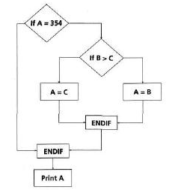
CYCLOMATIC COMPLEXITY (Contd..)
For a control flow graph -> (number of edges – number of nodes) +2
Example:
No of nodes or shapes=7
Number of edges or lines= 8
Cyclomatic Complexity= (8-7)+2=1+2=3

Slide 36
Example control flow graph
init
do
Pseudo-code:
Result = 0
Right = 0
DO WHILE more Questions
IF Answer = Correct THEN
Right = Right + 1
ENDIF
END DO
Result = (Right / Questions)
IF Result > 60% THEN
Print "pass"
ELSE
Print "fail”
ENDIF
if
r=r+1
end
res
if
pass
fail
end

Slide 37
STATIC ANALYSIS TOOLS (Contd..)
Usage of Static Analysis Tools
To calculate metrics such as cyclomatic complexity or nesting levels (which can help to identify where more testing may be needed due to increased risk).
To enforce coding standards.
To analyze structures and dependencies.
Help in code understanding.
To identify anomalies or defects in the code.

Slide 38

Any Questions

