Slide 1
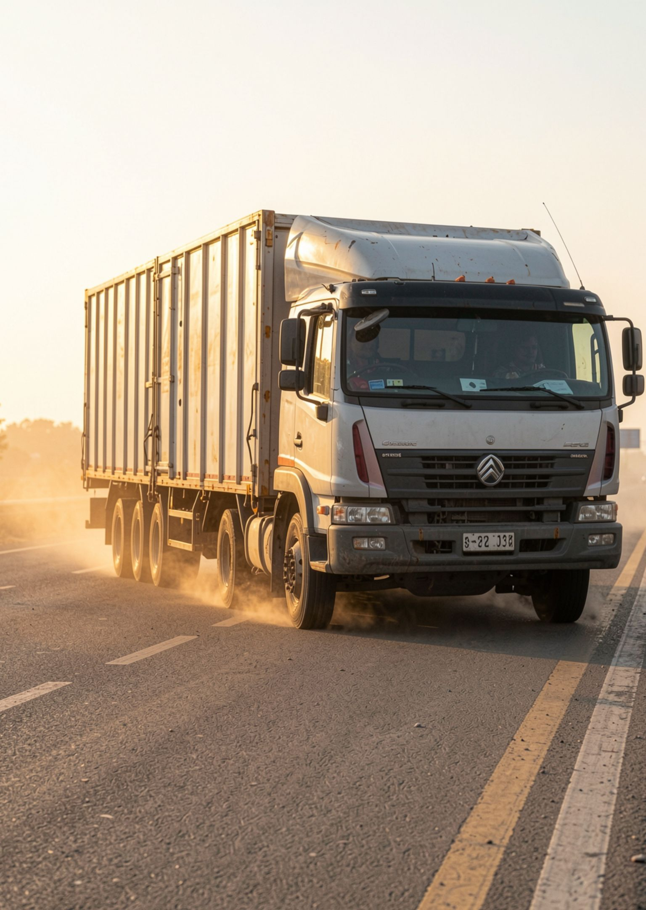

VAHANCONNECT · GROUP G2
VahanConnect targets the return-load gap for shippers and truck owners
A route-based marketplace for shippers, truck owners, and small fleets.
20–25%
3–5 days
Draft-reported share of India’s roughly 9 million trucks idle without a load
Draft-reported return-load waits on several routes
Draft-reported measures. Verify source, date, and scope before presenting. VahanConnect does not guarantee a match, safety, savings, or a return load.
Notes:
Introduce VahanConnect as a route-based marketplace for shippers, truck owners, and small fleets. The draft reports two distinct measures: 20–25% of India’s roughly 9 million trucks idle without a load, and 3–5 day return-load waits on several routes. These figures require source, date, and scope verification. The product does not guarantee a match, safety, savings, or a return load.

Slide 2

02 · DISCOVERY BEFORE NEGOTIATION
Shippers need clearer discovery before they can negotiate a trip
Make route, capacity, availability, and owner context easier to compare than informal referrals alone.
Owner lists route/capacity.
Shipper searches by route and load.
Options are compared and negotiated.
Contact or booking is completed.
PROTOTYPE TODAY
PLANNED, NOT DEMONSTRATED
Working prototype is live
· demo mode with synthetic data
Open live demo →
GST/RC/license/ID verification
Verification and any outcome guarantee remain conditional.
Notes:
The need is clearer discovery. Owners list route and capacity, shippers search by route and load, both sides compare and negotiate, and contact or booking is completed. The prototype includes Find trucks, Post a load, My trips, Owner view, Hindi/English, and synthetic demo data. GST, RC, licence, and ID verification are planned rather than demonstrated.

Slide 3
03 · MARKET CONTEXT
One route view, two customer sides
₹14.8 lakh crore
SUPPLY
DEMAND
Owners and small fleets
SMEs, manufacturers, wholesalers, and traders
Expose route availability, improve capacity utilization, and access shippers directly.
Search by route; compare available options; negotiate directly beyond opaque referrals.
Draft-cited India road freight in 2025
Geography, period, definition, and source require confirmation.
PILOT TARGET · NOT MARKET SIZE
₹3 lakh
₹60 lakh
Monthly commission at 5%
Monthly GTV target: 100 bookings/day × ₹2,000 × 30
Before expenses
Market figure: draft citation, to be validated. Pilot inputs are assumptions; outcomes remain targets until pilot data exists.
A focused route marketplace can serve both sides of the transaction.
Notes:
Separate market context from the pilot model. The draft cites ₹14.8 lakh crore of India road freight in 2025, but geography, period, definition, and source need confirmation. Supply includes owners and small fleets. Demand includes SMEs, manufacturers, wholesalers, and traders. The pilot target uses 100 bookings per day, ₹2,000 per booking, and 30 days to reach ₹60 lakh monthly GTV. At a 5% commission, that implies about ₹3 lakh monthly commission before expenses. Both inputs are assumptions.

Slide 4
04 · THE WEDGE
VahanConnect's defensible wedge is route visibility plus marketplace choice
Option | What it enables | What remains variable
Brokers / WhatsApp | Familiar relationships and flexible negotiation | Discovery and identity checks depend on the network
Digital freight or service platforms | Structured digital discovery and managed service | Pricing, assignment, and verification vary by provider
VahanConnect | Route-based marketplace where owners and shippers compare options and negotiate directly | Verification remains planned unless demonstrated
Customer choice | Focused route discovery and a trusted network built route by route | No absolute claim of superior pricing or guaranteed utilization
Comparison reflects the current concept and stated caveats; verification and outcomes require pilot evidence.
Notes:
Compare practical substitutes fairly. Brokers and WhatsApp offer familiar relationships and flexible negotiation, but discovery and identity checks depend on the network. Digital freight or service platforms offer structured discovery and managed service, with pricing, assignment, and verification varying by provider. VahanConnect’s wedge is route-based visibility plus marketplace choice. Verification remains planned unless demonstrated.

Slide 5
05 · THE ASK
USE OF FUNDS
₹25 lakh funds a measured pilot, not a guaranteed return
Line | Amount
Platform build | ₹7.0 lakh
Workforce | ₹8.6 lakh
Marketing | ₹5.0 lakh
Office | ₹2.4 lakh
Servers/tech | ₹2.0 lakh
₹25 lakh
For 20% equity
Implied ₹1.25 crore post-money valuation · ₹1 crore pre-money valuation
Forecast and return claims require a complete monthly model and diligence.
Confirm missing variable costs such as verification, support, payments, taxes, and compliance.
YEAR-WISE COST BREAKDOWN · PROJECTIONS
₹ lakh | Year 1 | Year 2 | Year 3 | Year 4
Bookings per day (avg) | 22 | 105 | 212 | 343
Revenue: commission + ads | 8.1 | 43.2 | 84.9 | 135.3
Platform build (one-time) | 7.0 | – | – | –
Workforce (platform ops) | 8.6 | 14.0 | 24.0 | 38.0
Office | 2.4 | 3.6 | 4.8 | 6.0
Servers and tech | 2.0 | 3.5 | 7.0 | 11.0
Marketing | 5.0 | 8.0 | 14.0 | 20.0
Total cost | 25.0 | 29.1 | 49.8 | 75.0
Profit / (loss) | (16.9) | 14.1 | 35.1 | 60.3
Cumulative profit / (loss) | (16.9) | (2.8) | 32.3 | 92.6
Assumptions: ₹2,000 average booking, 5% commission. Projections, not guarantees.
Break-even: Month 14 (projected monthly operating break-even, not cumulative recovery of losses).
Notes:
State the ask plainly: ₹25 lakh for 20% equity, implying ₹1.25 crore post-money and ₹1 crore pre-money. Walk through the use of funds and name the missing variable costs. The forecast uses ₹2,000 average booking and 5% commission as assumptions, with projected bookings per day rising from 22 in Year 1 to 343 in Year 4. Month 14 is projected monthly operating break-even, not cumulative recovery of losses. There is no Year-5 payback promise without a Year-5 forecast and distribution or exit policy. The next meeting is to review the pilot model and diligence checklist on the proposed date.

