Slide 1
Hospital Management System
Vimon Ponnore-134
Vishnu Sudhakar-135
Vishnu Unikrishnan-136

Slide 2
Type of Users
Admin (Receptionist)
Patient
Doctor
Blood donour
Blood Bank Admin

Slide 3
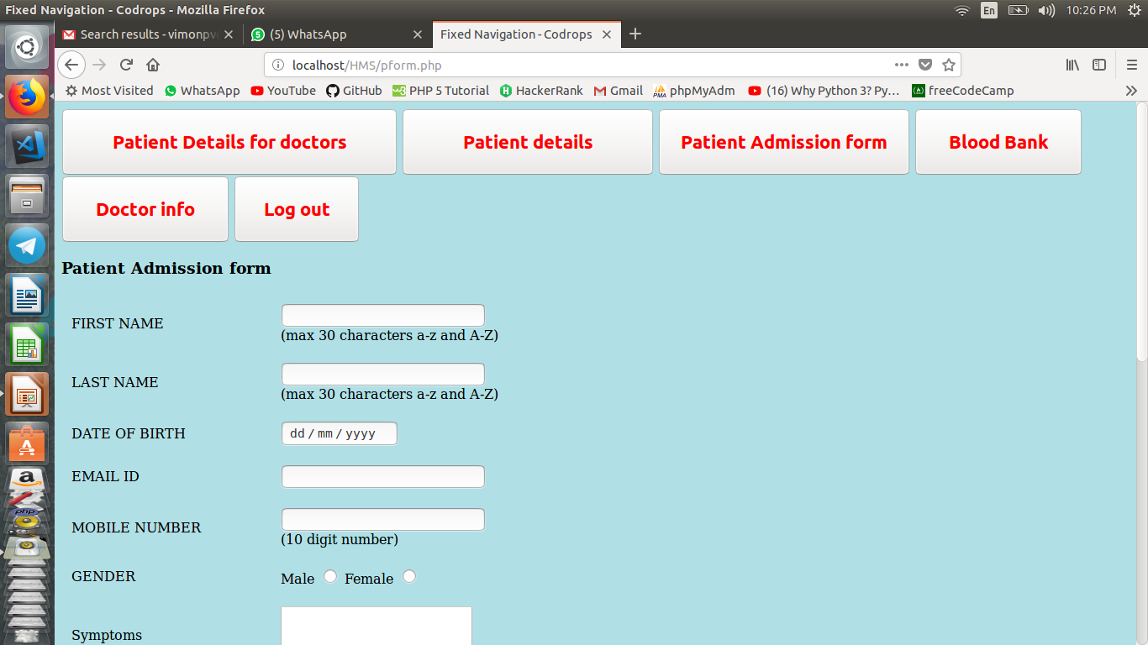
Admin view

Slide 4
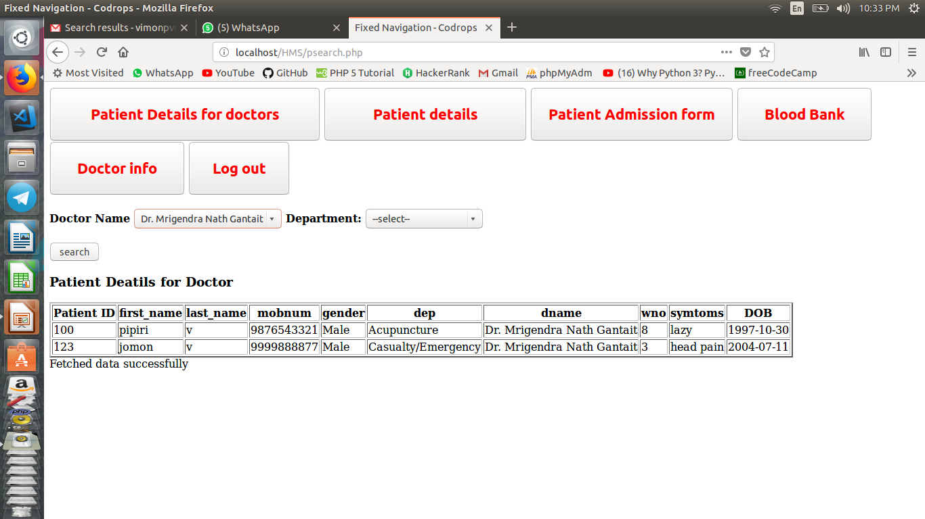
Admin Can Take Patient Details for a Doctor

Slide 5
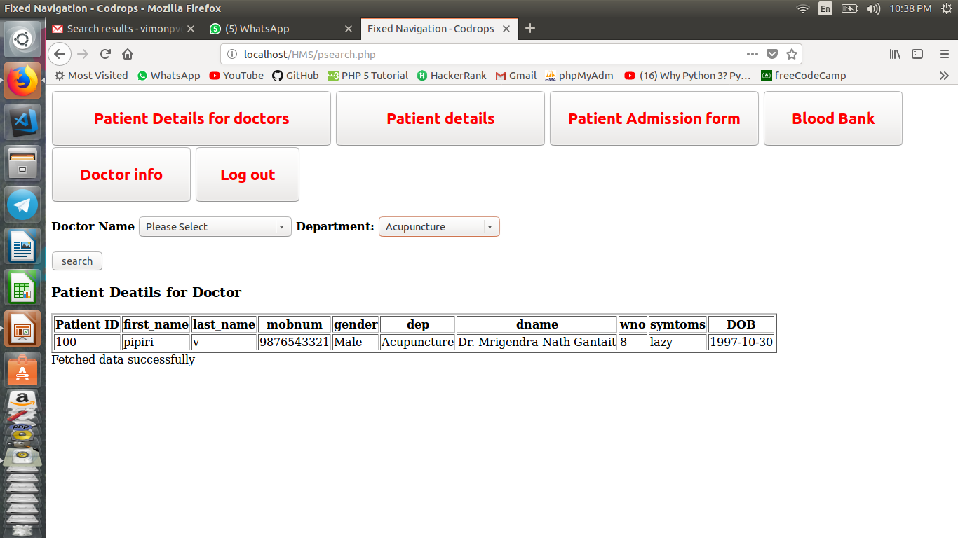
Admin Can Take Departmentwise Patient Details.

Slide 6
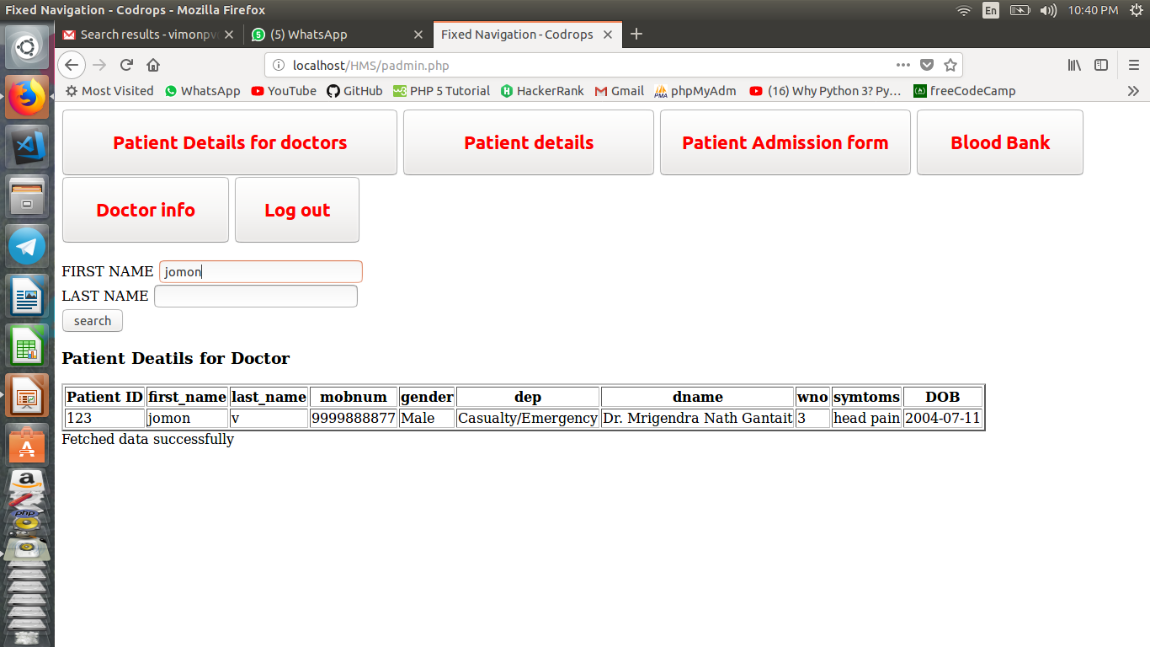
Admin Can Get Details of Patient By Searching First Name or Lastname

Slide 7
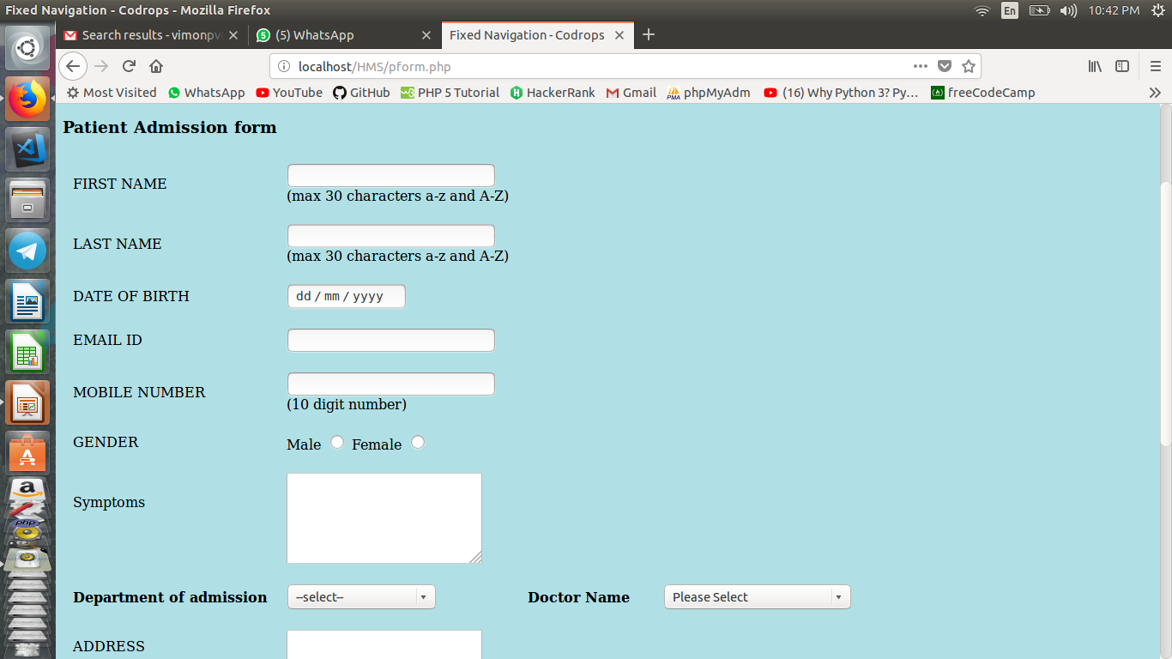
Admin Can Enter Patient Details

Slide 8
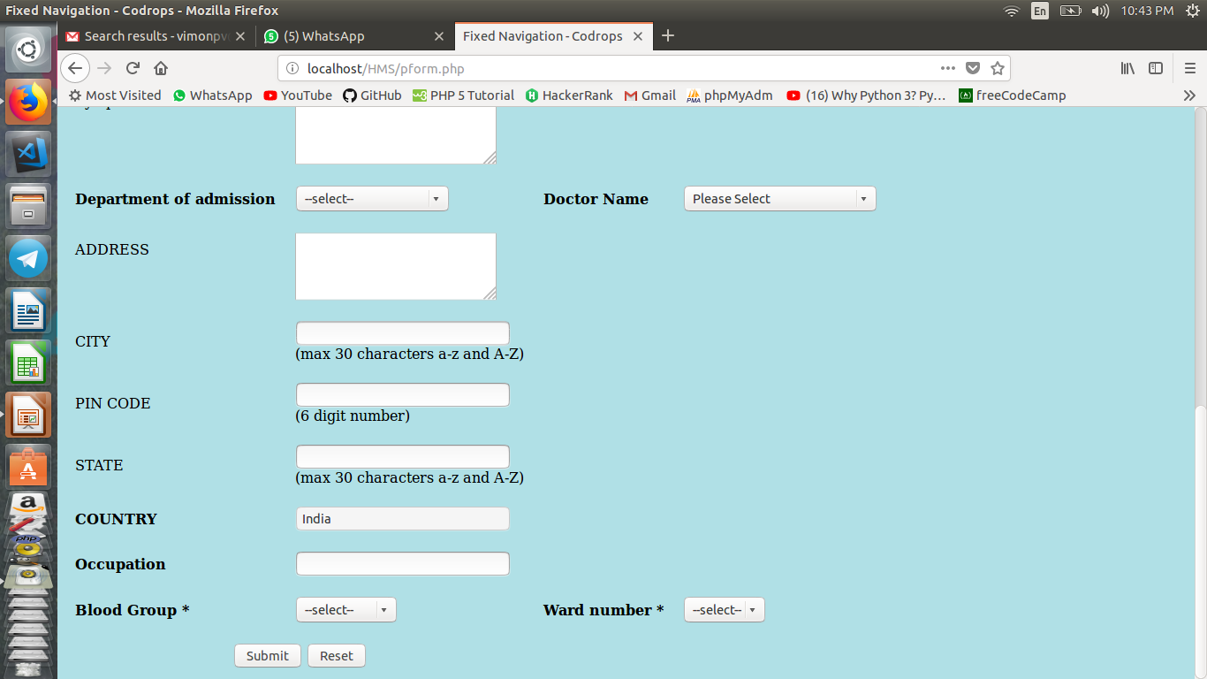
Admin Can Enter Patient Details.....

Slide 9
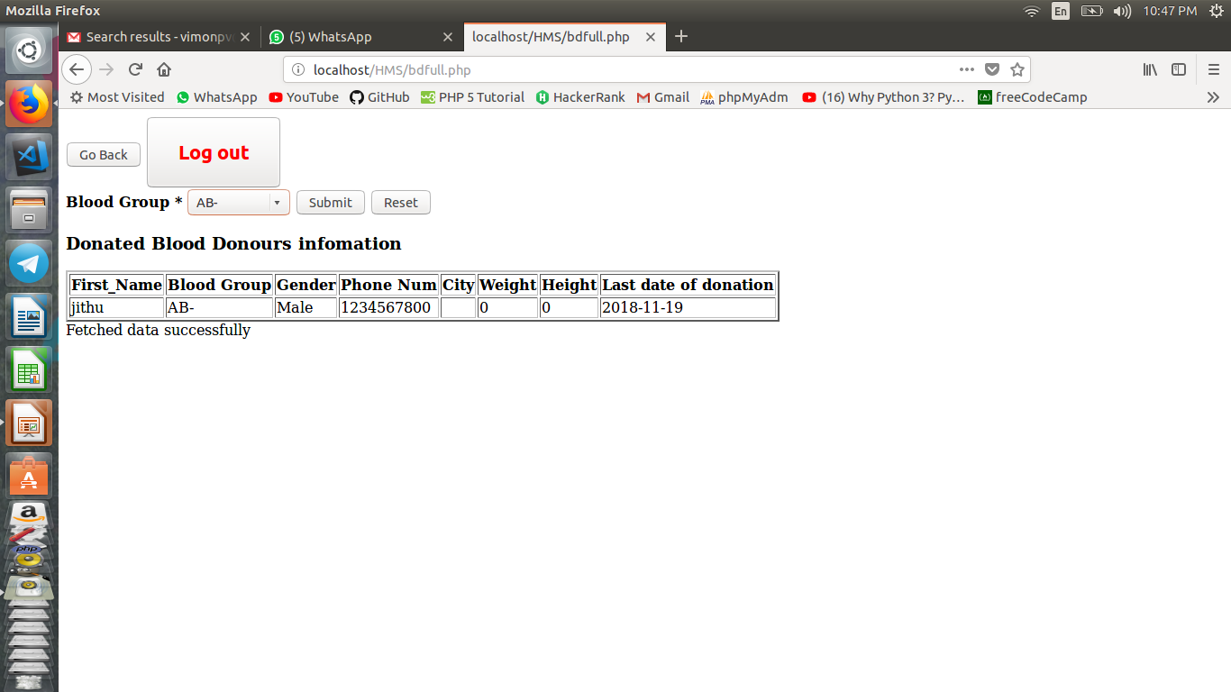
Admin Can take List of Blood Donours

Slide 10
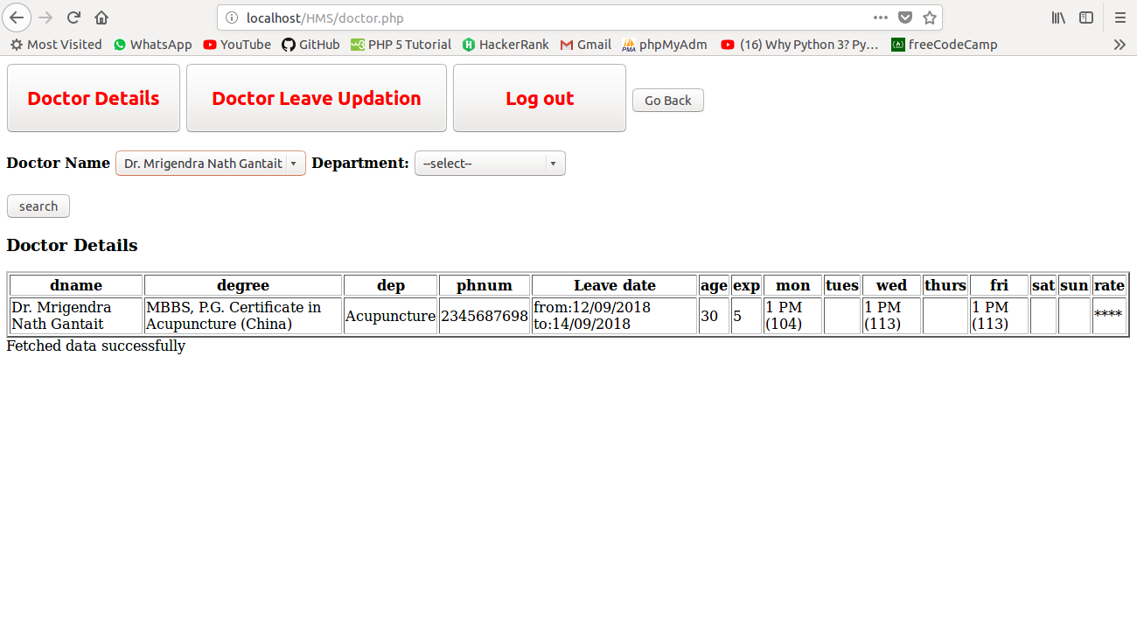
Admin Will Get Doctor Information
By Doctor Name

Slide 11
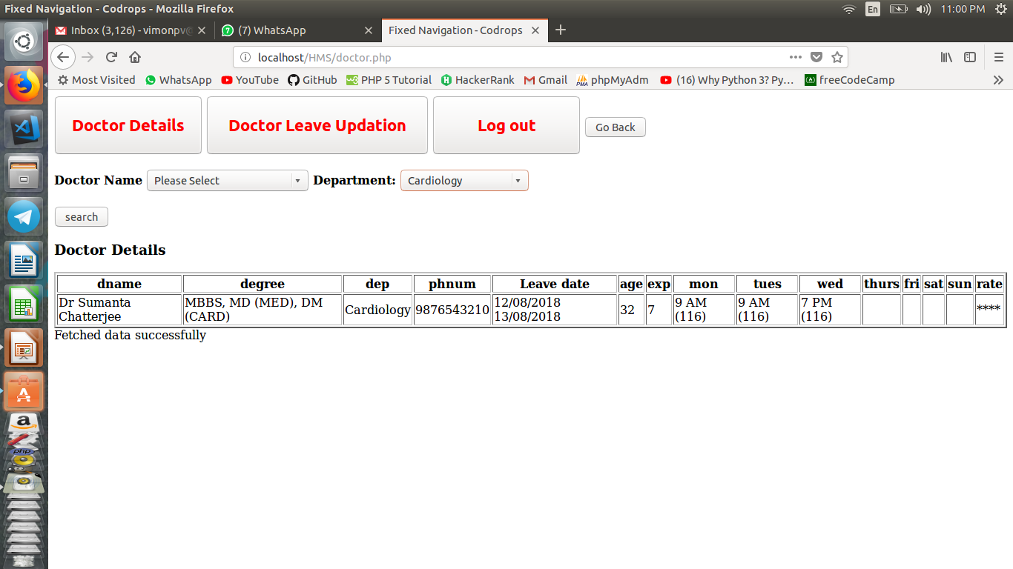
Admin Will Get Department doctors information

Slide 12
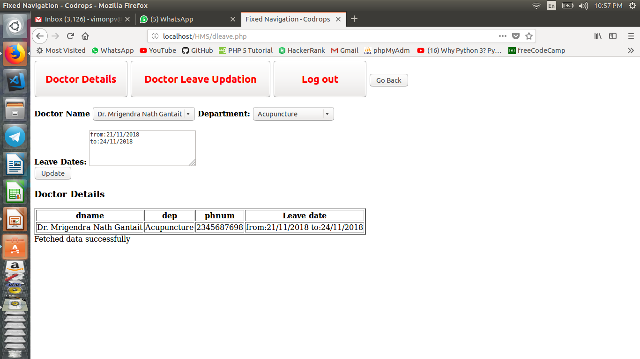
Admin can Update Doctor Leave

Slide 13
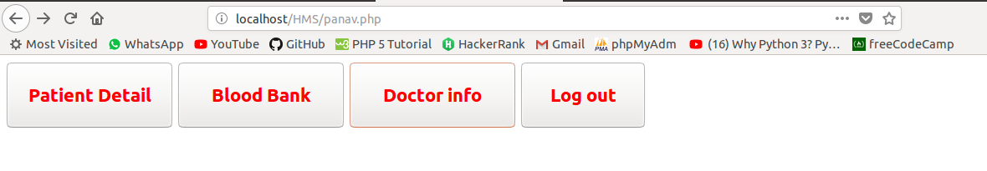
Patient
Patient Can Get Deatils via entering their Name
Patient Can take Blood Donour Details
Patient Can Also Get Details of All Doctors

Slide 14
Doctor
Doctor Can Get details of other doctors
Doctor can Update Leaves

Slide 15
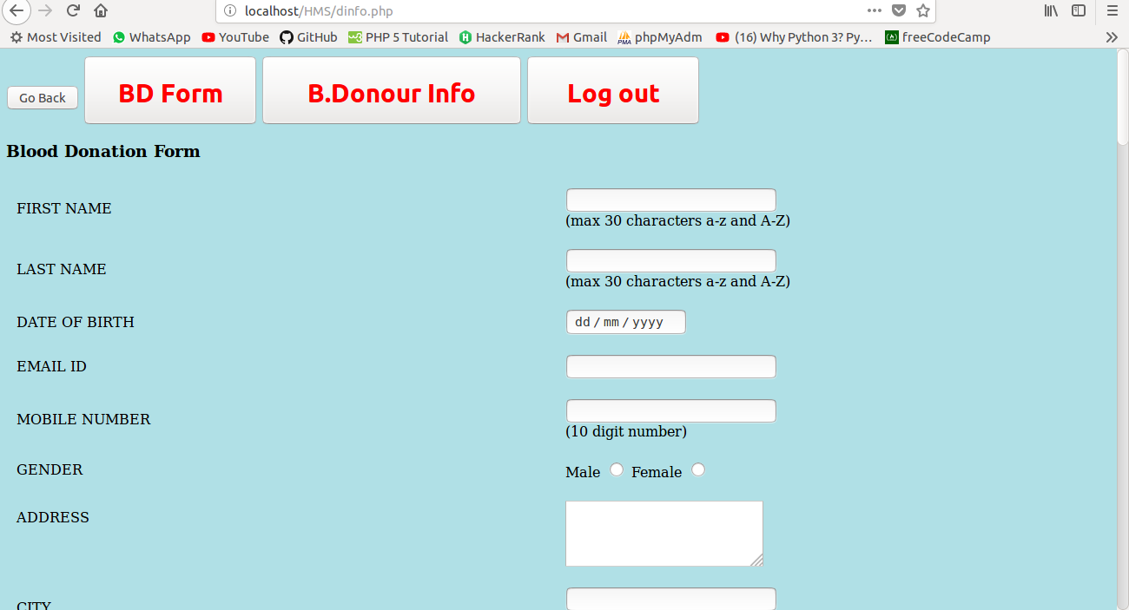
Blood Donation form
Donour Should First Fill Blood Donation Form

Slide 16
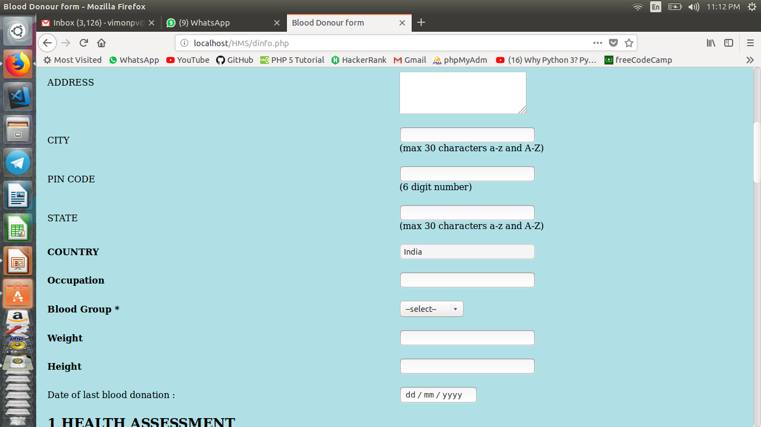
Blood Donation form ....

Slide 17
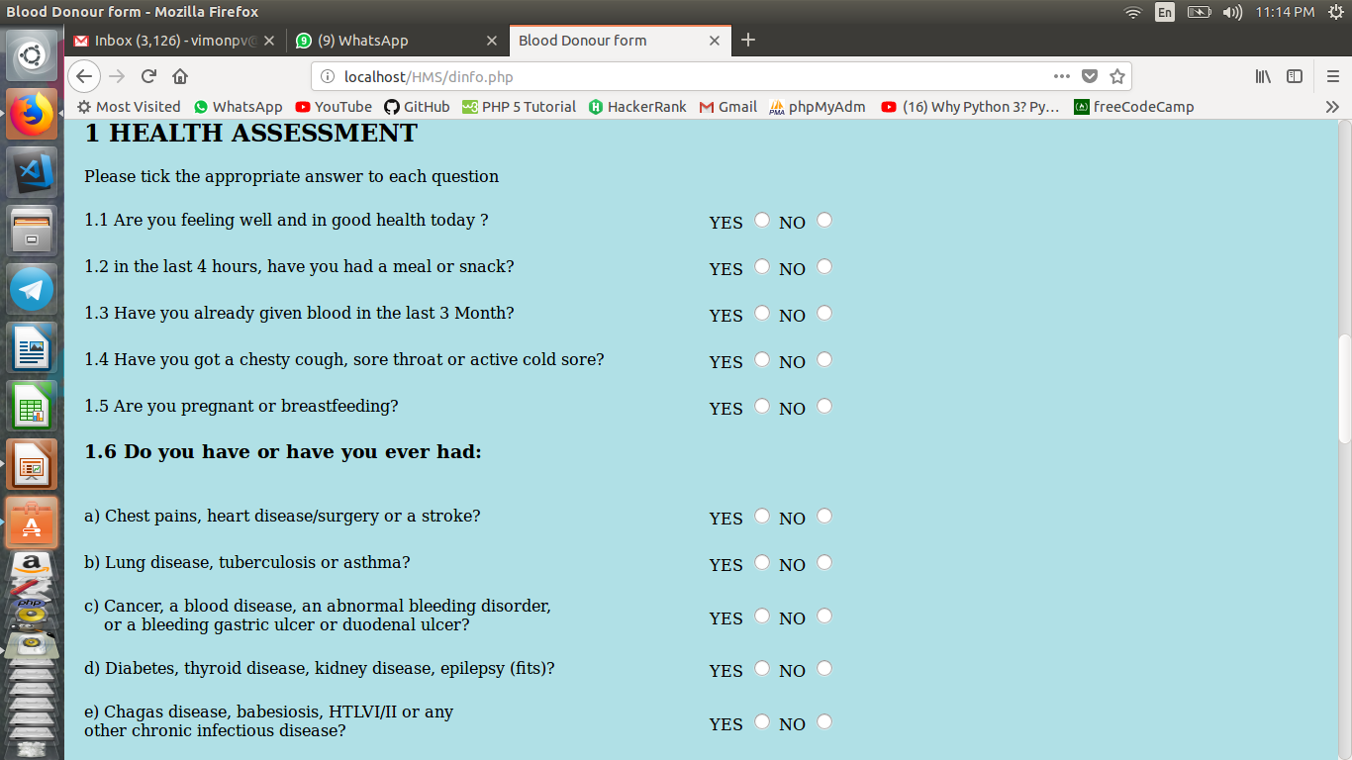
Blood Donation form......

Slide 18
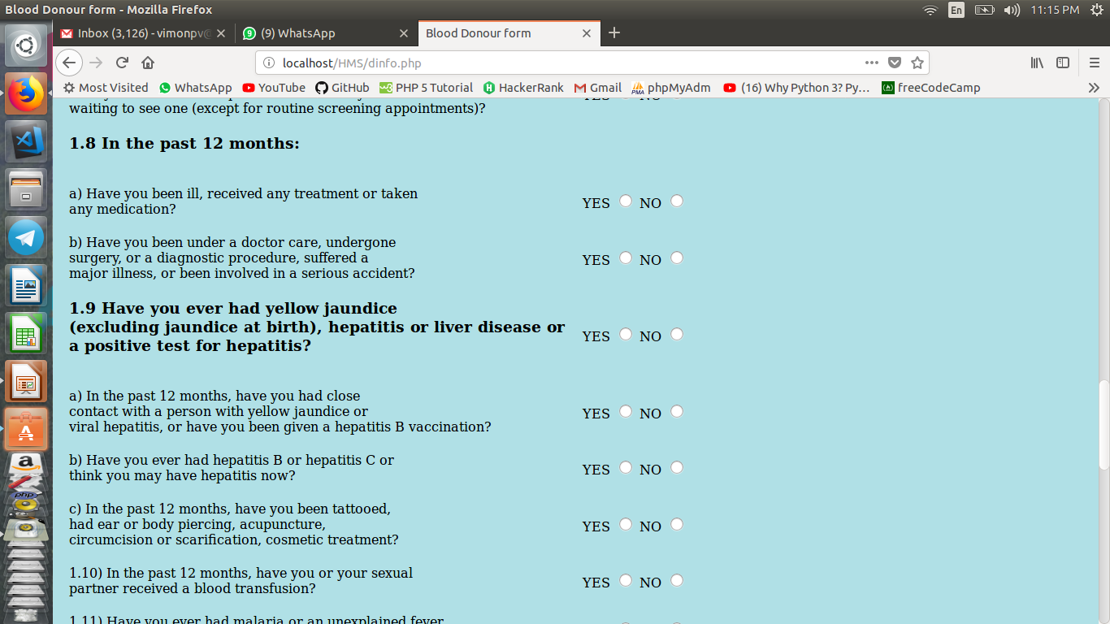
Blood Donation form.....

Slide 19
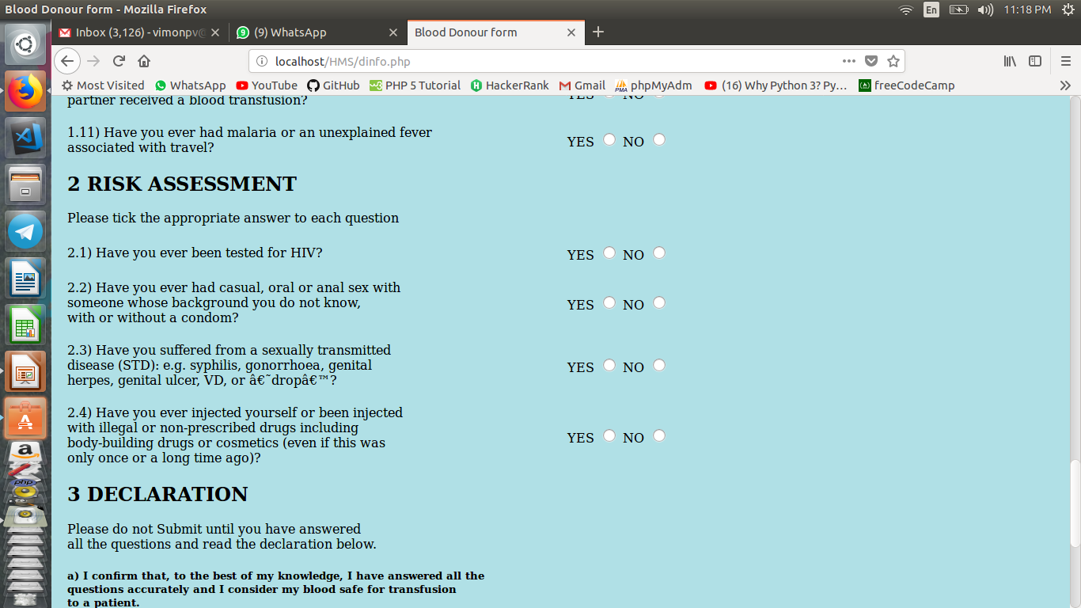
Blood Donation form.....

Slide 20
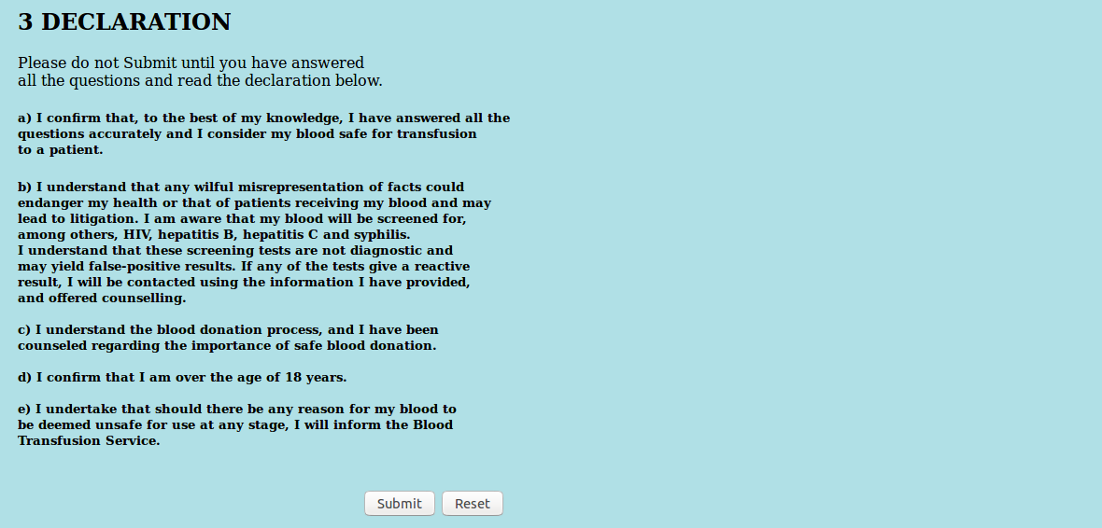
Blood Donation form end

Slide 21
Blood Bank working
Blood donour Must Enter Their Mobile Number
If Blood Donour is Eligible to donate blood as per form
a Notification will come your eligible to donate
Else your not eligible to donate blood now
if Eligible in database yes will update in the field of eligibility
After Blood Donation Badmin can updated as donated.
Then All deatils of the donour will available for the public

Slide 22
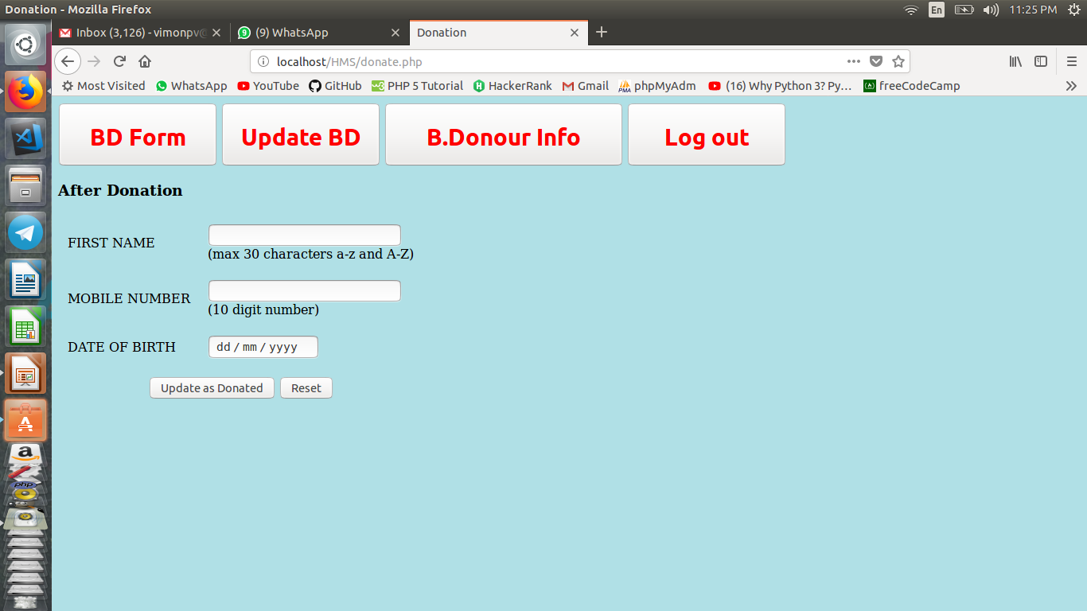
Blood bank admin
Blood Bank Admin is Updating if Donour Donated Blood
Only Eligible Donurs can update here

Slide 23
Database -MySQL
Bloodtable
Ptable
Doctor
users

Slide 24
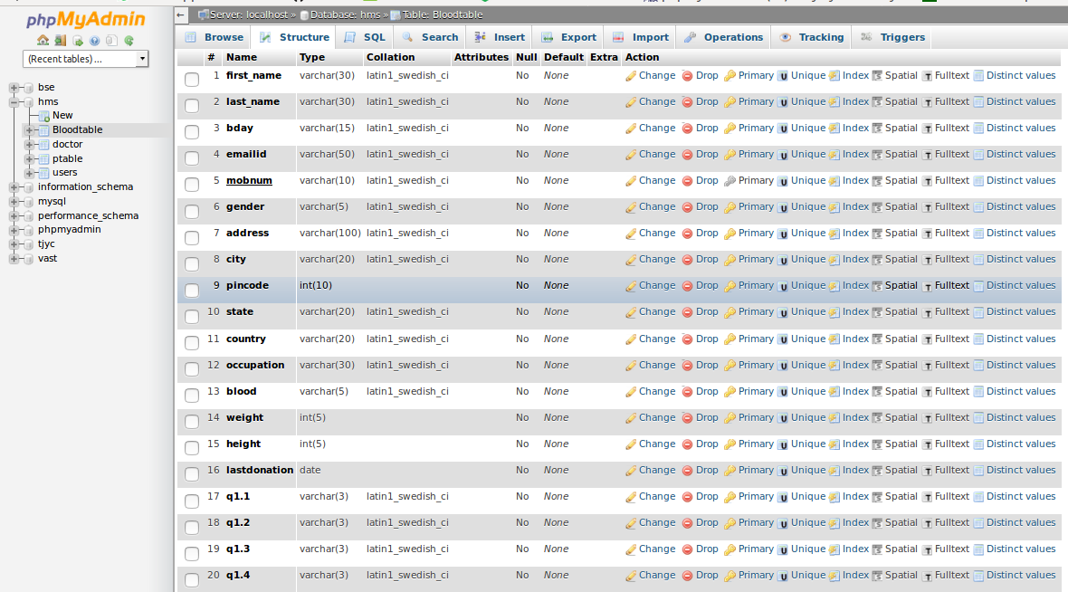
Blood table

Slide 25
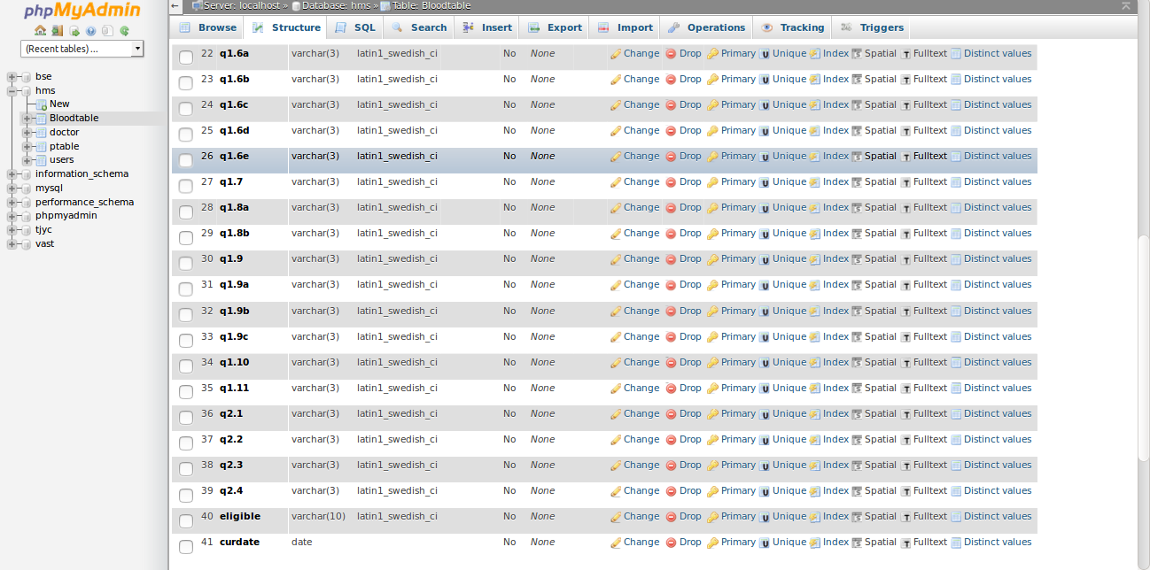
Blood table ...

Slide 26
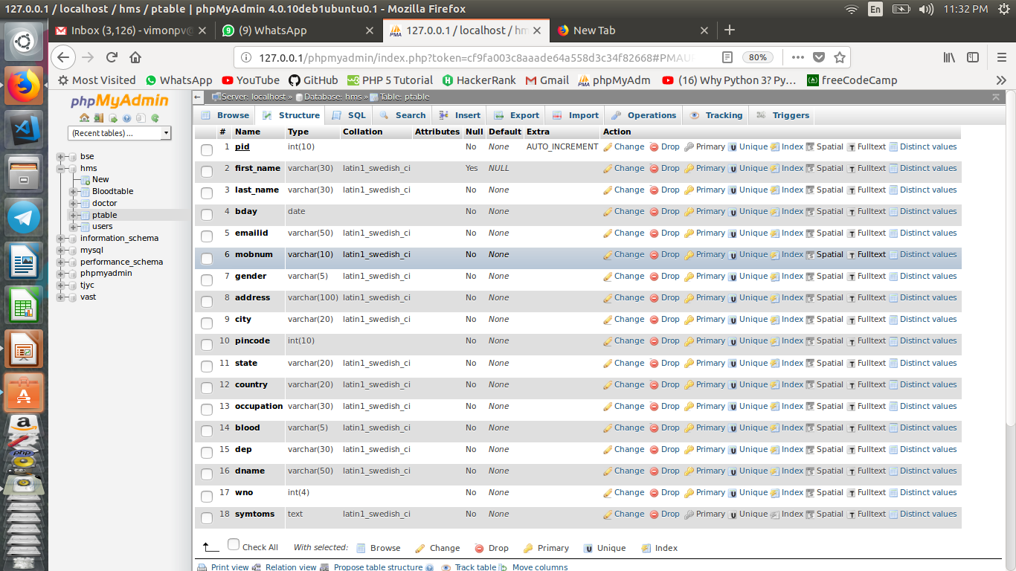
ptable

Slide 27
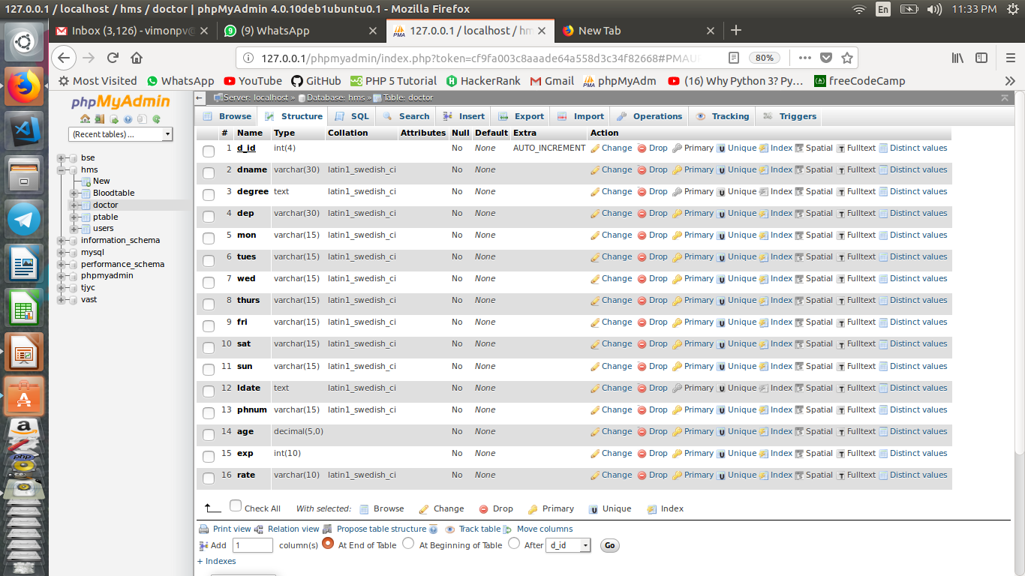
Doctor table

Slide 28
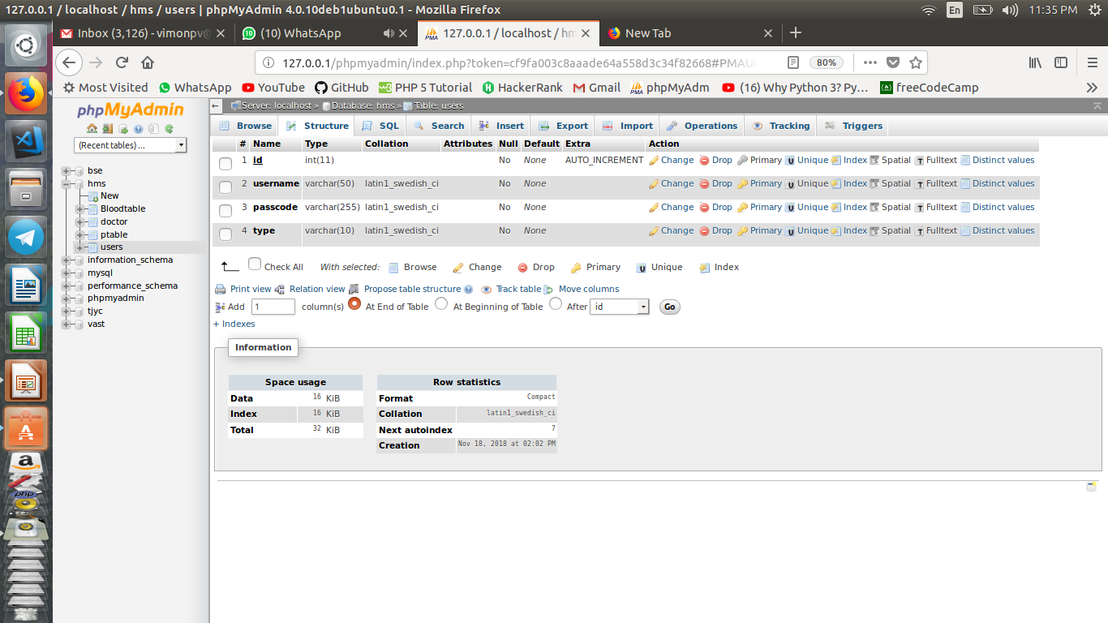
Users table

Slide 29
Platform&Tools
Apache2
PHP 7
mysql Ver 14.14 Distrib 5.5.61,
Ubuntu
GitHub
Vscode (IDE)
HTML
Mozila Firefox

Slide 30
Conclusion
Receptionist have all rights except updation of blood donation.
Only Blood Admin can update if donour donated.
Donated Blood Details acessible to all
Blood donation Form will help to know whether he/she is eligible or not to donate blood
Doctor Availability can Check by patient and Receptionist.
Doctor Leaves can upadte by doctors and Receptionist
Doctors Get their Patients List
Visitors can get details of patient from reception (Ward number)
Patient and Receptionist can view Patient Details

Slide 31
Thank you

