Slide 1
Qualified Money
Dirk Helbing
Thomas Bisig
Ostap Cherkashin
Vito Impagliazzo
Loic Jaolien
Giancarlo Scrugli

Slide 2


Slide 3
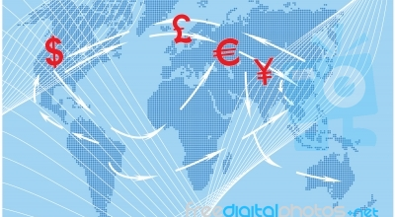

Slide 4

Qualifying Money
Treat money as nodes in a money flow network rather than as a one-dimensional entity (scalar), give it multi-dimensionality, memory, history, reputation.

Slide 5
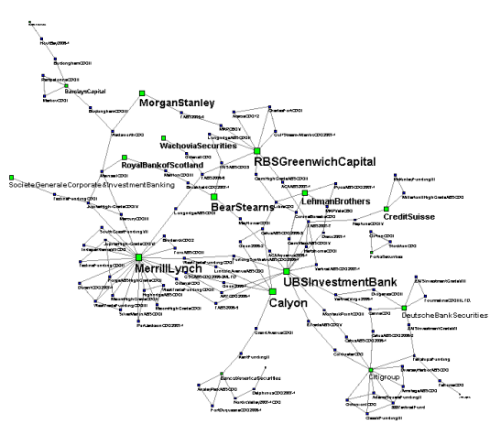
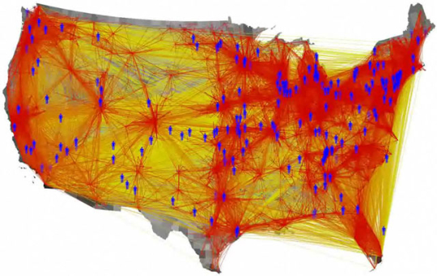
Social Money
Thanks to Frank Schweitzer
and Dirk Brockmann
Treat money as nodes
in a money flow network
rather than as a one-
dimensional entity (scalar),
give it multi-dimensionality, memory, history, reputation.

Slide 6
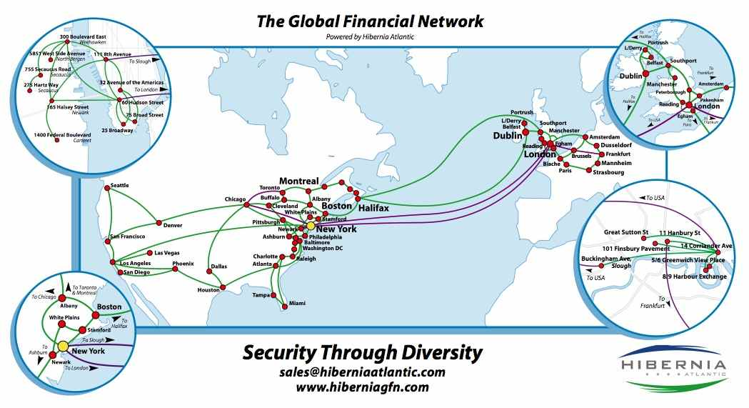
Study Money Flows

Slide 7
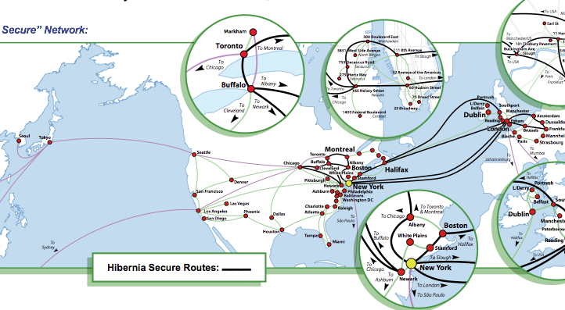

Slide 8
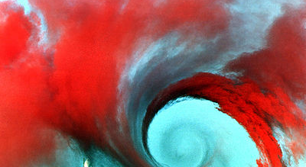

Slide 9
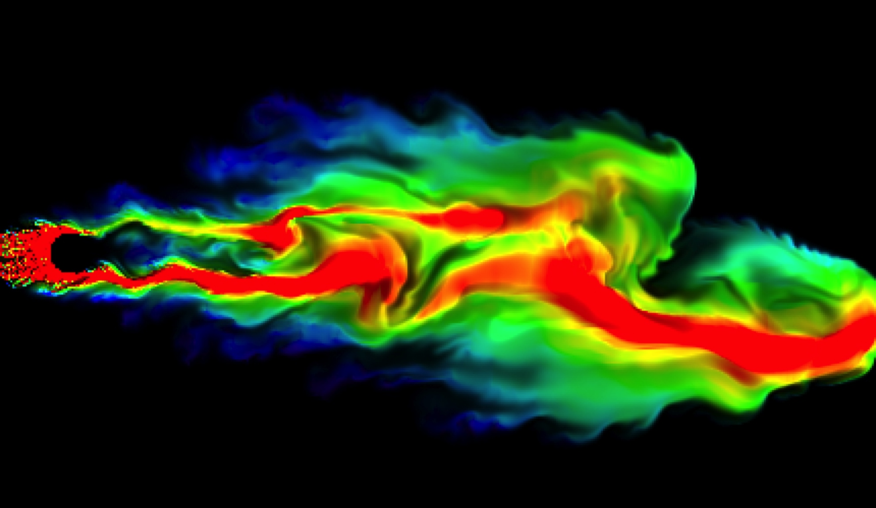
Analyzing “Poisonous” Spill

Slide 10
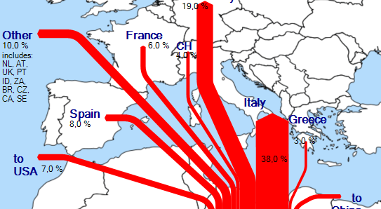
How A Country Affects Others

Slide 11
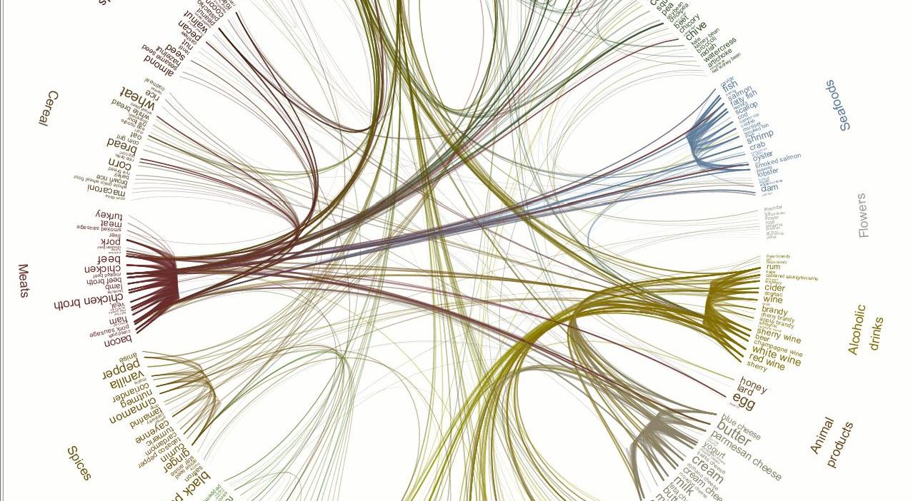

Slide 12
