Slide 1

Azure Language Service

Slide 2

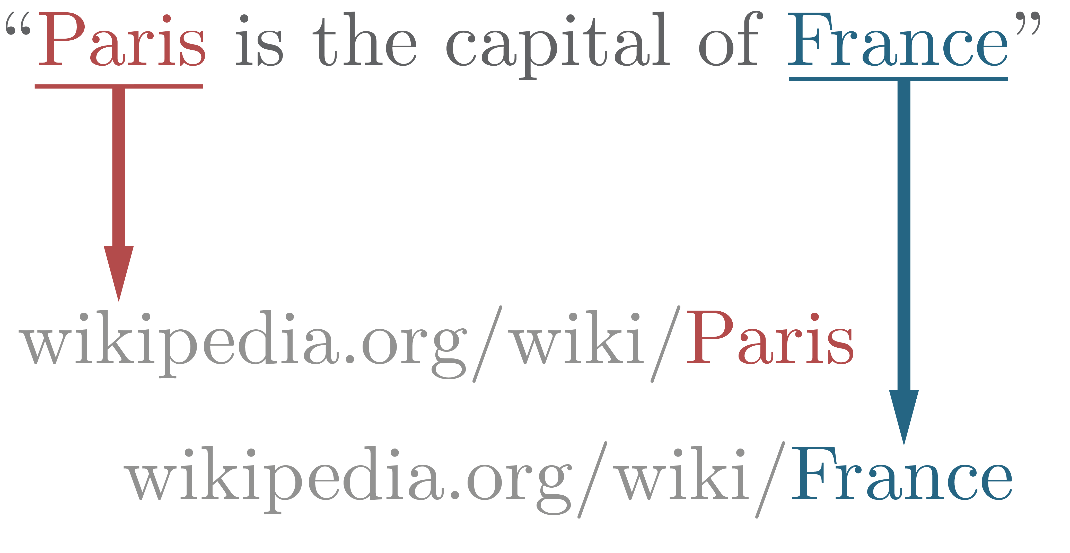
Introduction to natural language processing
Key Phrases:
“the news”,
“New York”
Entities:
Manhattan
(https://en.wikipedia.org/wiki/Manhattan)
  Use preconfigured features for:
    Language detection
    Key phrase extraction
    Sentiment analysis
    Named entity recognition
    Entity linking
    Summarization
    PII detection
    Customizable models are available for specific use cases, and are covered in another section
Language=English
Sentiment=Positive
Notes:
Add note that further modules for the customizable features are covered later in this section. Also, some of the prebuilt can be customized – info on that can be found on the docs pages

Slide 3

Azure Language resources for preconfigured features
Choose from these deployment options:
a Microsoft Foundry resource, which contains…
A Foundry Tools resource, which includes…
A Language service resource
Endpoint
https://<resource_name>.cognitiveservices.azure.com/
Authorization Key
Microsoft Entra ID
Notes:
You can choose to deploy the service resources that best suit your needs:
Use a Microsoft Foundry hub and project for comprehensive AI development scenarios that include generative AI models and multiple AI services.
Use a Foundry Tools resource when you need to combine AI services and manage endpoints and access keys/permissions centrally
Use a Language resource when you only need prebuilt capabilities or to explore/test the service using a free tier SKU.
In any case, the Language API is accessed through an endpoint using either key-based authentication or Microsoft Entra ID authentication.

