Slide 1

Foundry Tools and Endpoints

Slide 2
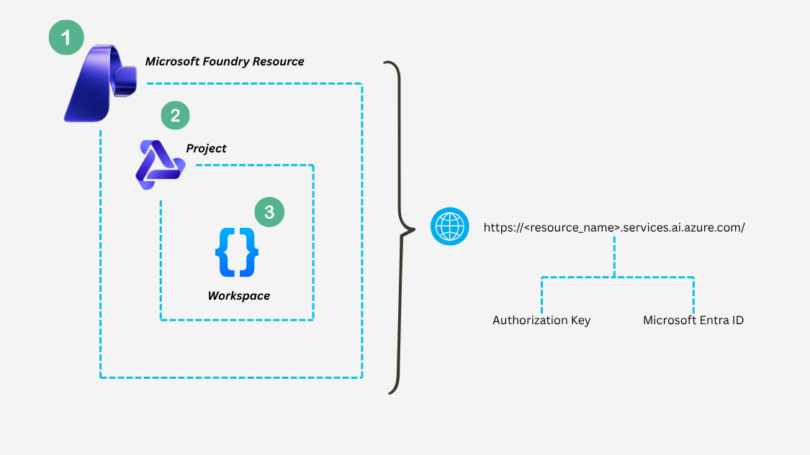
A Typical Microsoft Foundry Setup

Slide 3
