Slide 1

How LLMs Work?

Slide 2
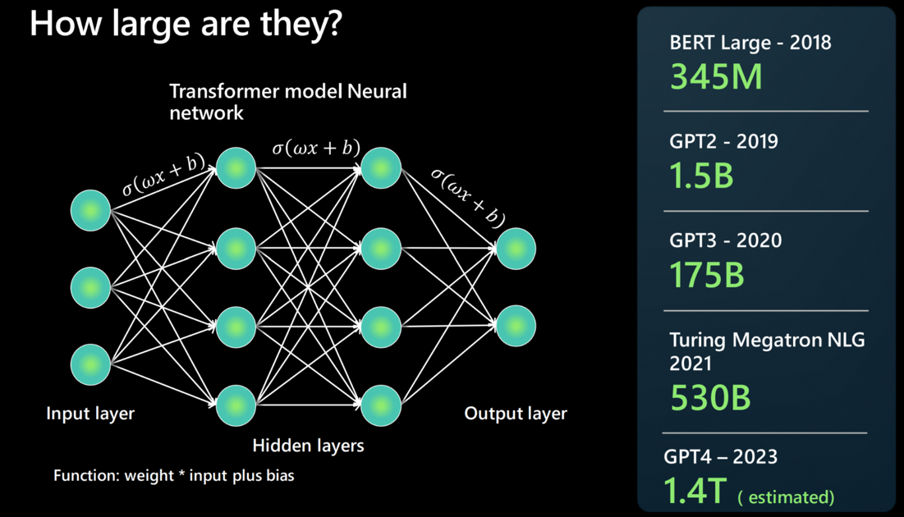
Some Quick Bullet Points
LLMs are trained using neural networks which relates to Deep Learning; This means they have a strong tendency to think exactly like humans do
LLMs are probabilistic machines that predict the next set of tokens or characters with varying probabilities. They are non-deterministic in nature
Foundational LLMs like those from OpenAI, Anthropic, Microsoft, Google etc. are exceptionally humongous and have billions of parameters that can be tuned differently to give varied outputs. These parametric values are typically learned during the training phase.

Slide 3
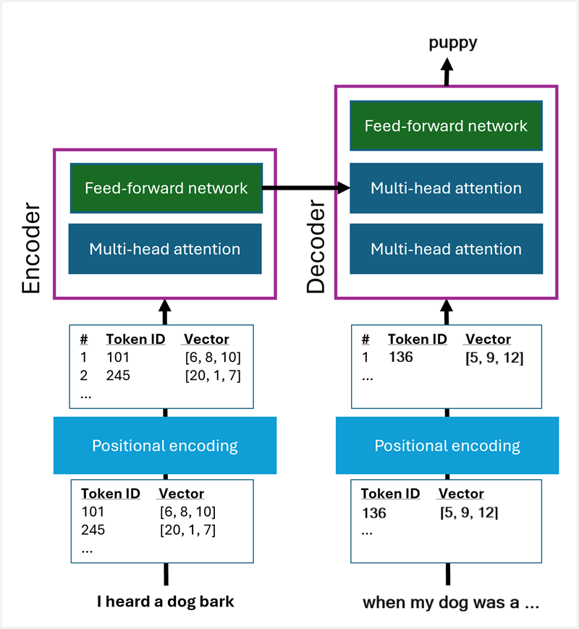
The “Transformer” Model

Slide 4
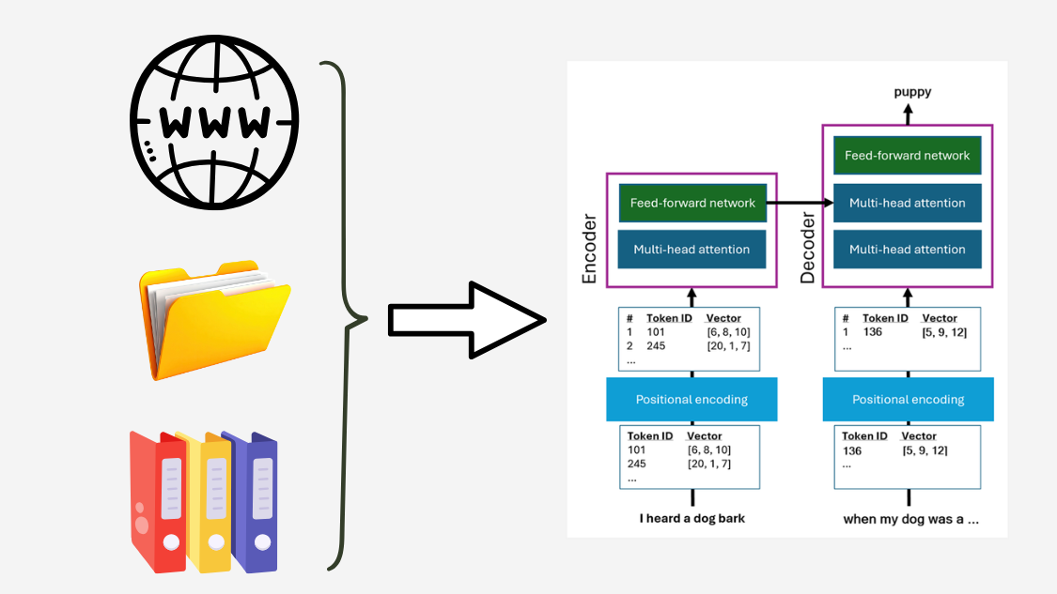
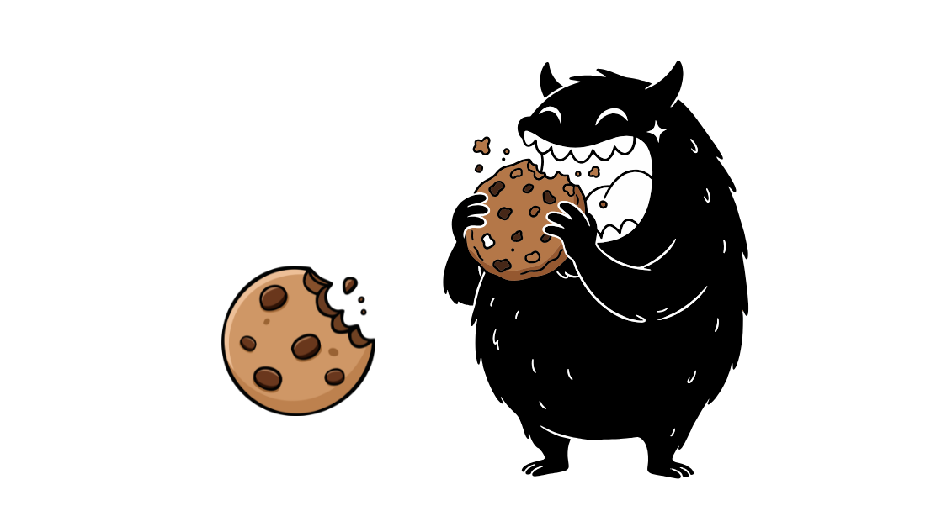
Data, Data and lots of Data…….

Slide 5
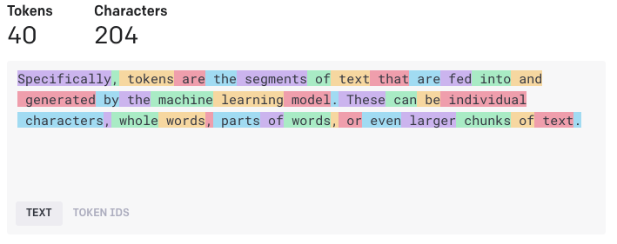
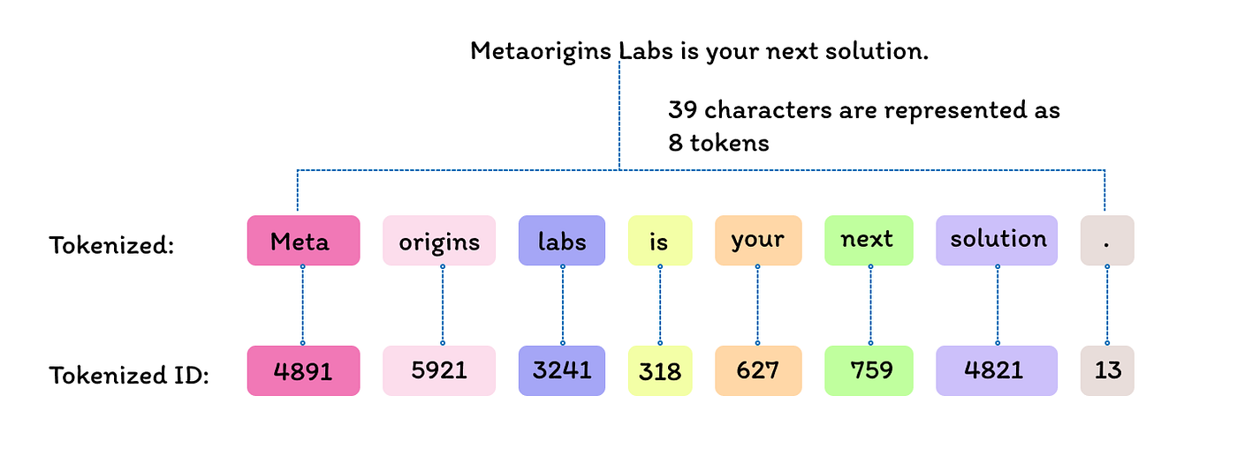
Step 1 - Tokenization
Tokens – How Models Process Text
Models don’t read text directly — they process tokens
A token is a chunk of text (character, sub-word, or whole word)
Same text can have different token counts than character counts
Tokens are the unit for input, output, cost, and limits
Long prompts = more tokens = higher cost & latency

Slide 6
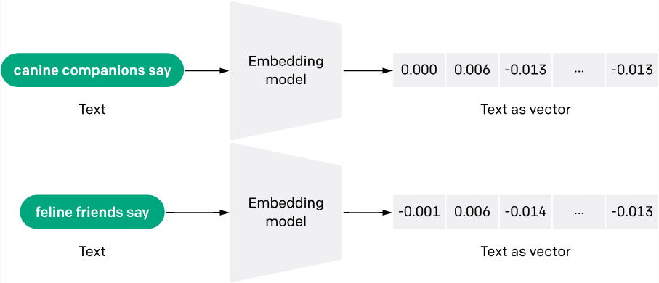
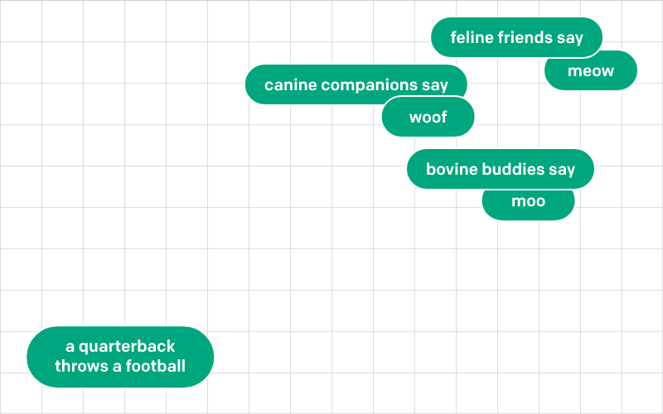
Step 2 – Generating Vector Embeddings
Vector Embeddings are numerical representations of words and phrases in a high dimensional space
You can arrange words and phrases in a high dimensional space with their vector embeddings. Semantically similar words are placed closer together

Slide 7
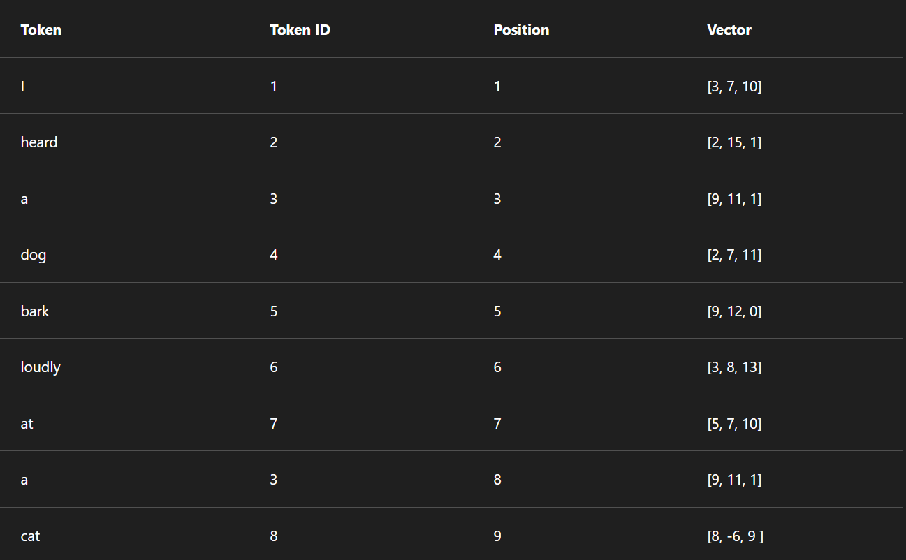
Initial Vectors and Positional Encoding
Initially, the token vector values are assigned randomly, before being fed through the transformer to create embedding vectors.
For now, the vector embeddings only denote the position of where the token appears in the sequence of training text

Slide 8
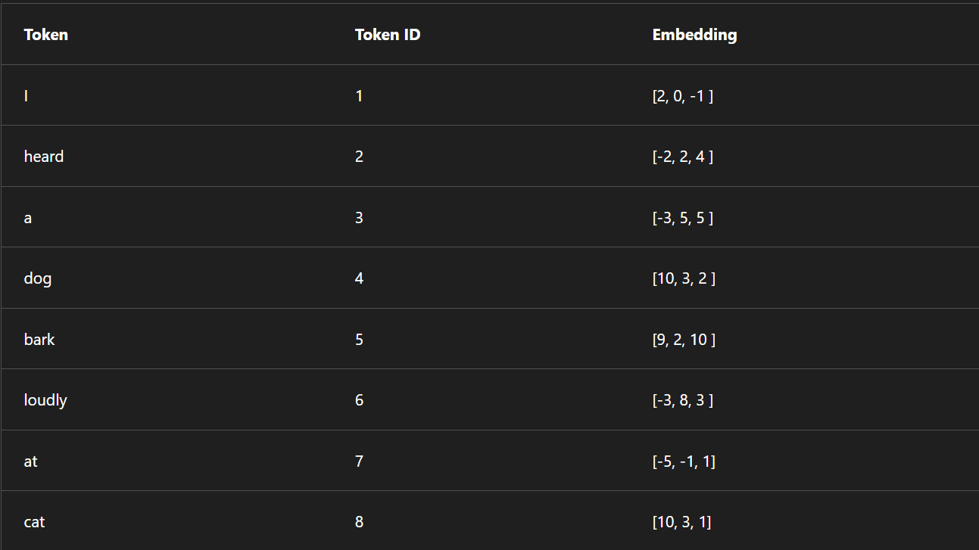
Step 3 – Tuning “Vector Embeddings”
Now the transformer model uses the “attention” mechanism to tune and change the vector embeddings in such a way that they now denote not only the positional encodings but also the semantic relationships and similarity between words and tokens

Slide 9
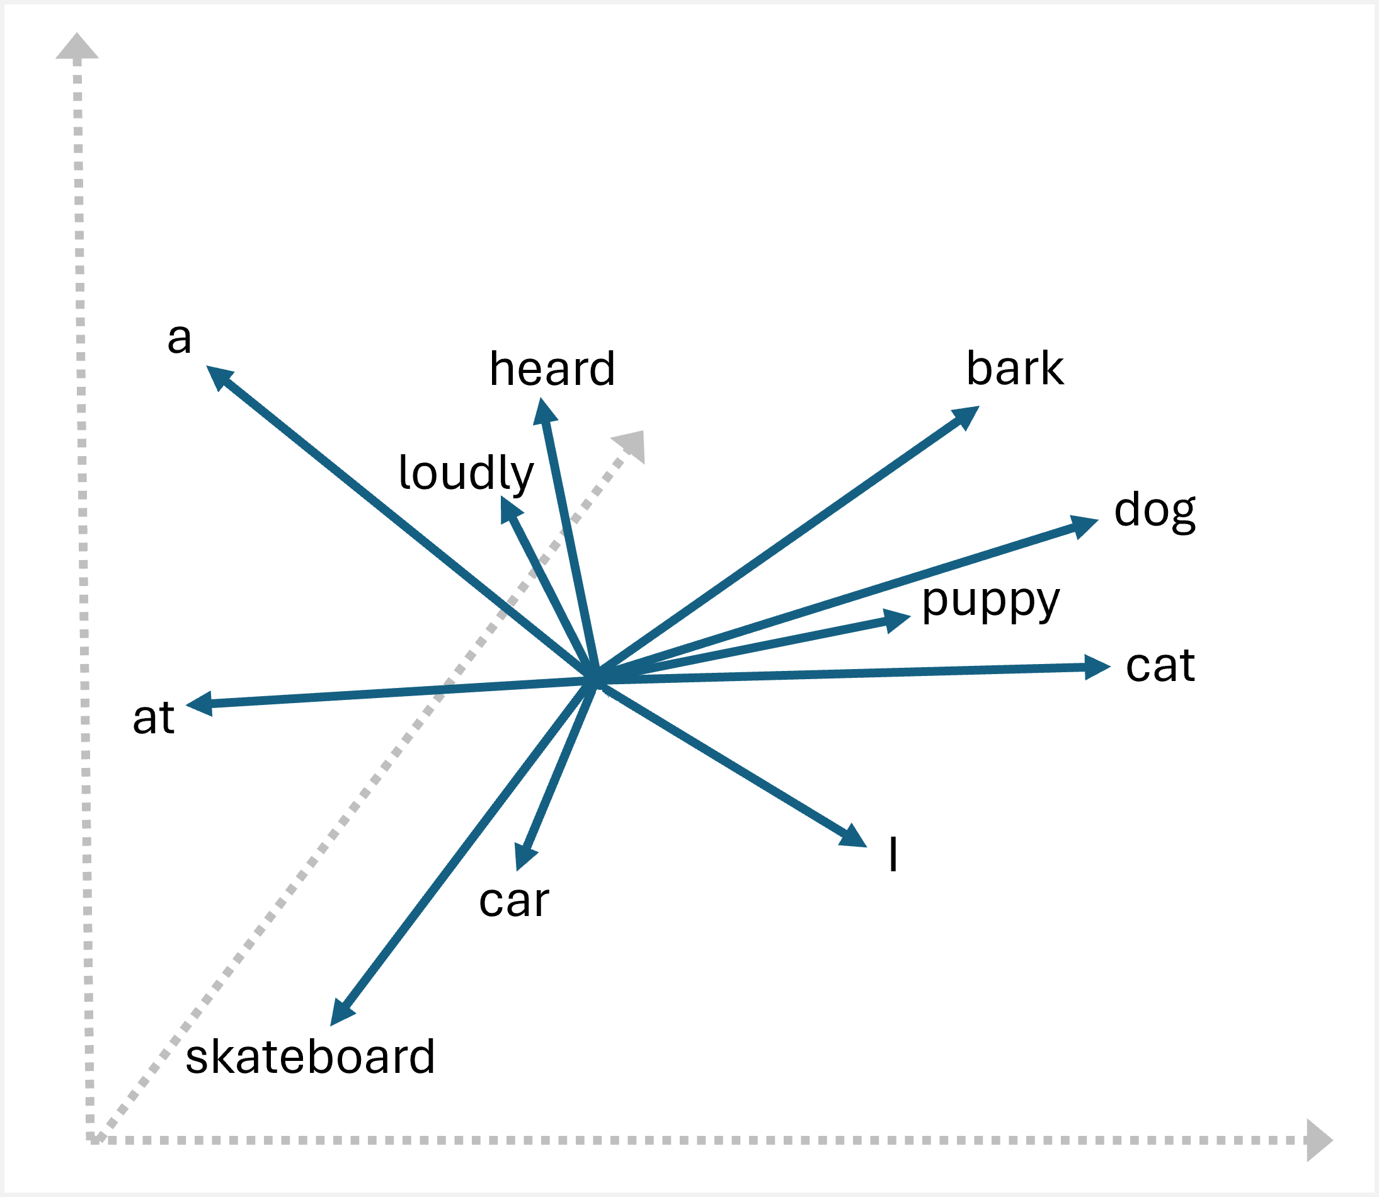
So now, we finally have…….

Slide 10
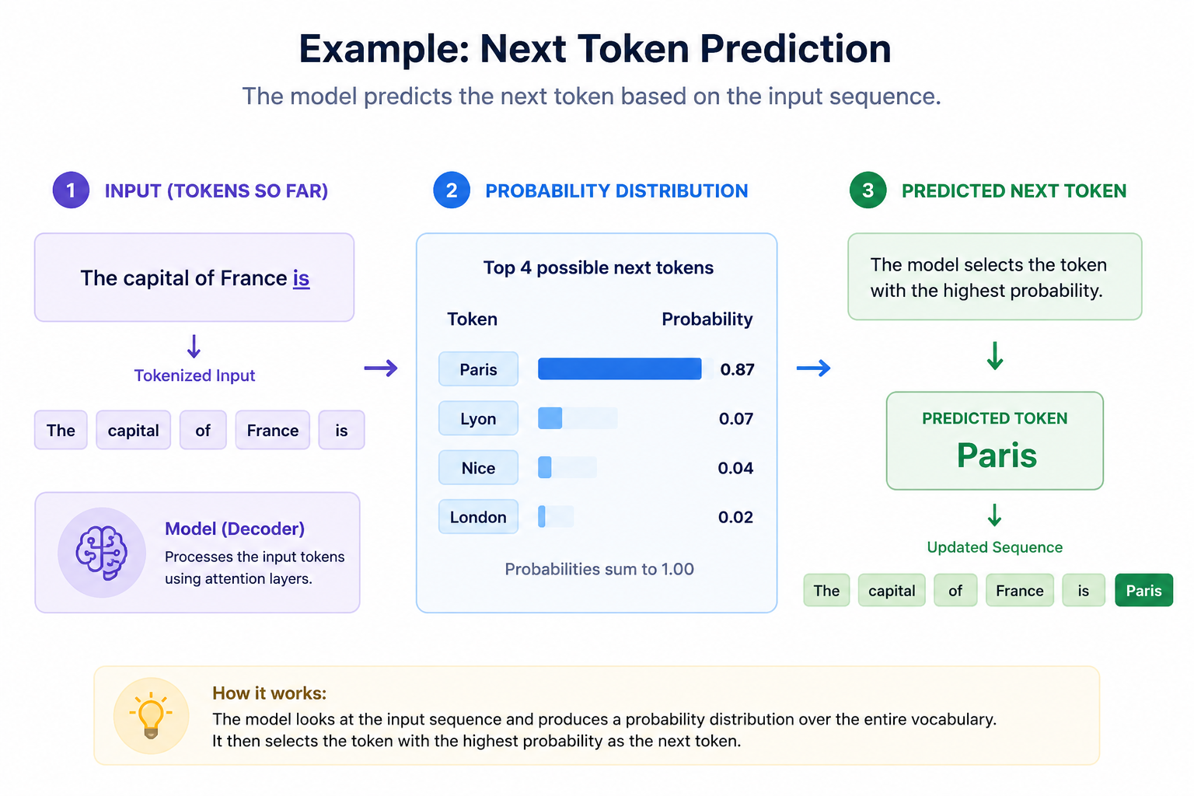
Step 4 – Predicting Tokens

