Slide 1

ML, Predictive AI and Gen AI

Slide 2
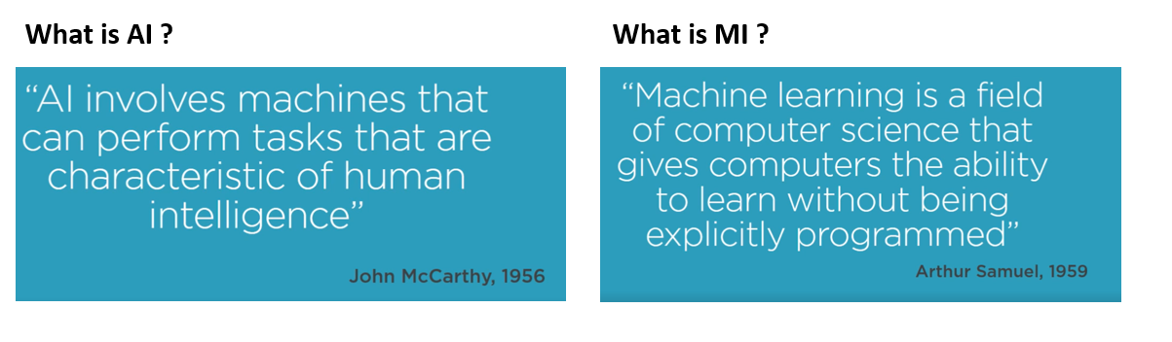
AI v/s ML
To put it simply, AI is applied ML for various human-oriented tasks

Slide 3
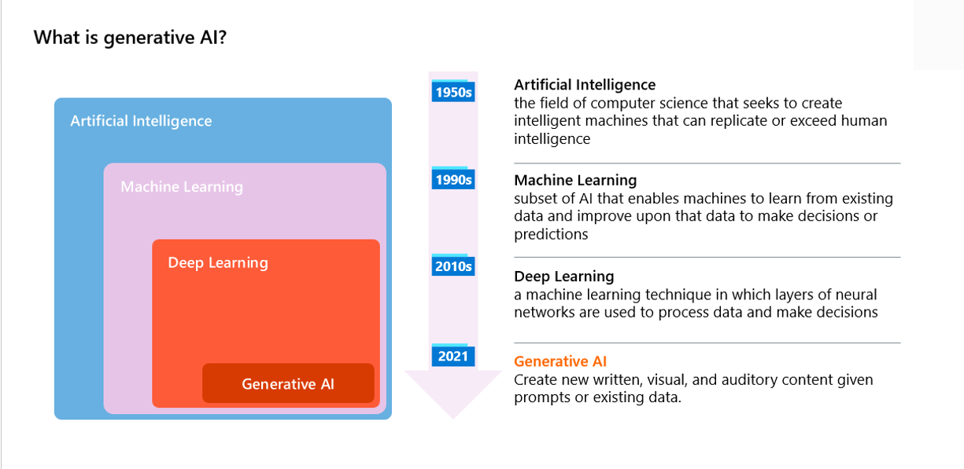

Slide 4
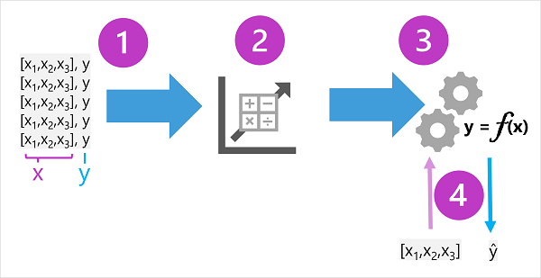
ML in a “nutshell”
Every Machine Learning model is aimed at taking some parameters or x-variables (features) to predict the target or y-variable

Slide 5
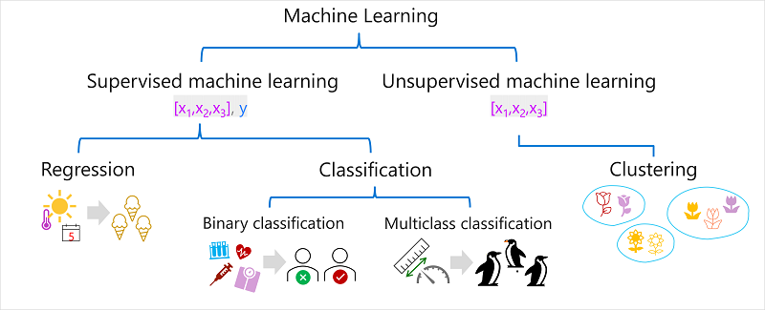
Types of Machine Learning Models
Machine Learning models are broadly classified into these different categories based on the training data given as input and the objectives they get trained for.

Slide 6
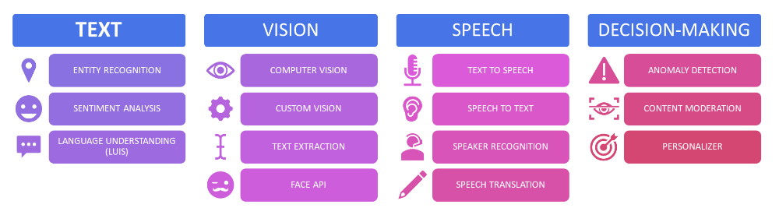
Predictive AI Services
Azure has a wide range of prebuilt predictive AI services to choose from. To integrate them in your applications, you simply have to configure some API calls

Slide 7
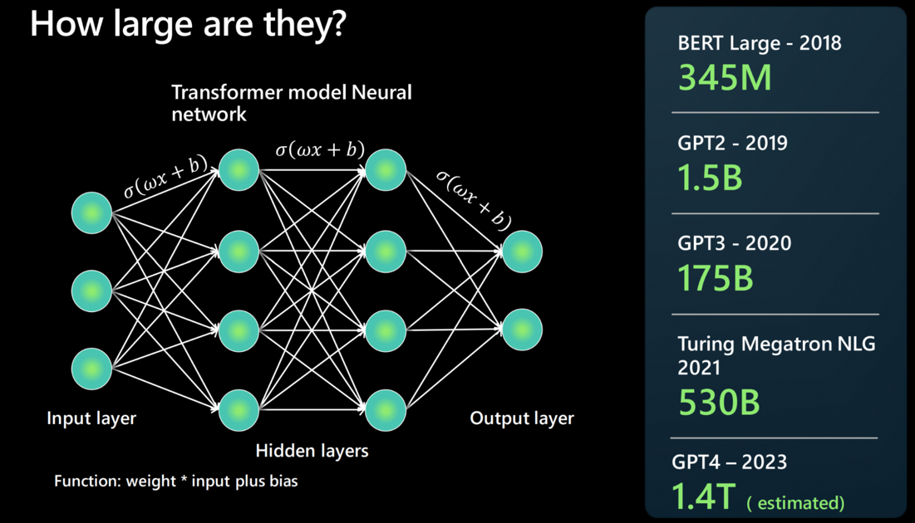
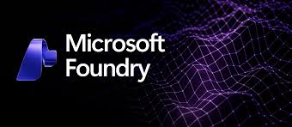
LLMs – Large Language Models
An LLM is built by using a neural network architecture. It takes an input, has several hidden layers that break down different aspects of language, and produces at the output layer.
A foundation model refers to a specific instance or version of an LLM. For example, GPT-3, GPT-4, or Codex.
The Azure ecosystem also provides LLM instances that you can simply configure API calls to integrate GenAI capabilities in your modern applications

