Slide 1

Microsoft Foundry

Slide 2
Developer needs
Rapidly prototype, build, and deploy to share concepts with customers
Easy experimentation and evaluation to quickly test prompts, models, and datasets without waiting for provisioning
Secure, scalable, production-ready AI platform to manage AI applications and agents
Microsoft Foundry is the one-stop solution to all your developer needs on a PaaS basis.
Notes:
By integrating AI capabilities into the tools they already know and love, we can enable developers to seamlessly build and manage AI applications within their existing workflows. This native integration creates a frictionless adoption path, making AI development more accessible than ever.

Slide 3
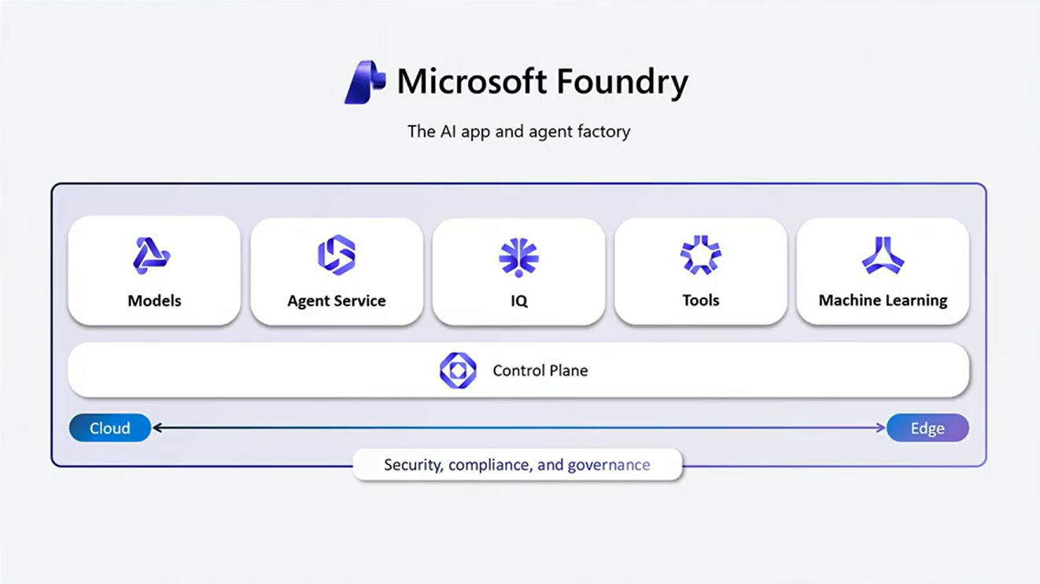
Agent Service – Agents with Tools and Knowledge Bases. Also Bring Your Own Agents as Hosted Agents
Foundry IQ – Bring Enterprise Knowledge with Agentic Retrieval Systems
Model Catalog - Deploy Models on Serverless Inferencing (Pay-Per-Token Pricing) from vendors like Meta, Claude, OpenAI, Grok etc.
Tools – Choose from a Variety of MCP Servers, Logic Apps, Vector Indices, OpenAPI Definitions etc.
Foundry Control Plane – Tracing and Observability for Agents
Fine Tuning – Make Base Models more domain centric with fine-tuning
Cloud Based Agents – Develop Cloud Native Agents to take full advantage of the Foundry Ecosystem
Entra ID – Govern Agent Identities with Microsoft Entra ID and enforce RBAC, Conditional Access Policies, PIM policies on Agent in M365
Microsoft Purview – Classify and Protect Data with Microsoft Purview and Foundry IQ
Foundry Local – Develop Fully Local Agents with Foundry Local

Slide 4
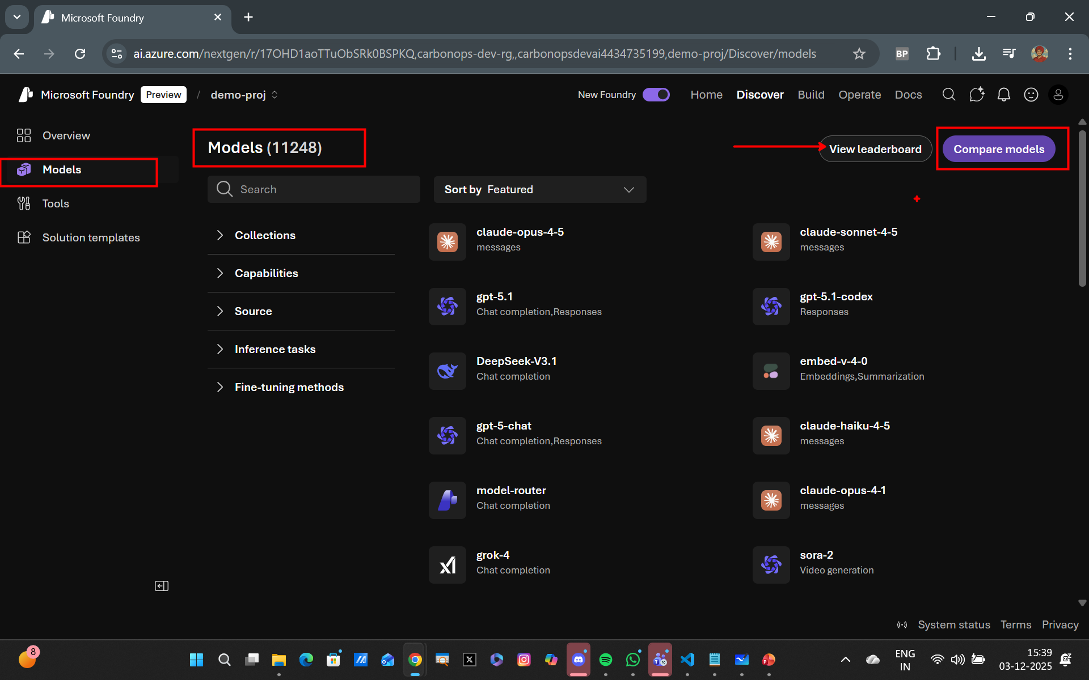
Model Catalog – Models, Models and Models

Slide 5
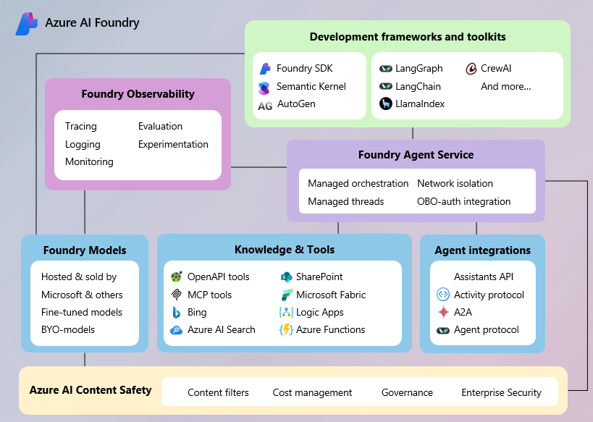
Tools and More….

Slide 6
