Slide 1

The synergistic co-existence of GenAI and Predictive AI

Slide 2
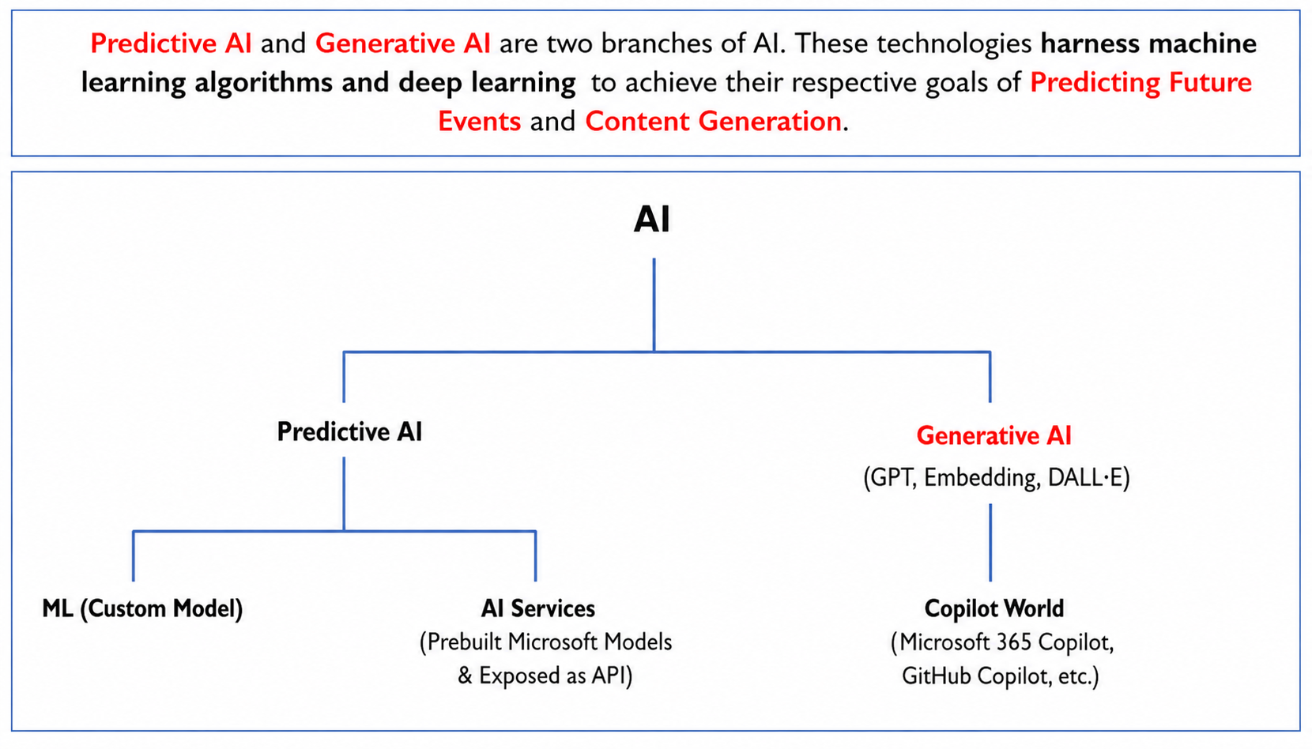

Slide 3
Custom Model (Custom AI) | AI Services (Predictive AI) | Generative AI (GPT-engine) | Co-Pilot (uses Codex Model in its essence)
Forecast Future Events | Predict present probabilities | Content generation: ( text & Images) Generative AI can be used to create new content that is similar to existing content | Uses Code generation Model, Text generation Model and Image generation Model of Generative AI
Example- Custom model for Baggage Carousel ( Luggage belt) at airport to predict maintenance and probable breakdown To predict whether Flight will be on time or not | Example – AI Vision – Immigration counter Picture of Passenger with masked face Document AI & AI vision & Sentiment Analysis—Reading handwritten Passenger’s custom clearance form. | Example - Text generation feature - Passenger asking for personalized Information like I am holding Indian Passport, stop over flight, with Valid US visa, and is looking for a over night stay inside or outside of airport with 200 USD Budget over all inclusive of transport and food | Example – GitHub Co-pilot ( code generation) Software Developer can create an application using GitHub Copilot

Slide 4


Conclusion
The company which harnesses the capabilities and qualities of custom predictive AI, AI services (pre-built offerings of predictive AI) and Generative AI is going to win the race in the long run.

