Slide 1

Understand Text Analysis

Slide 2
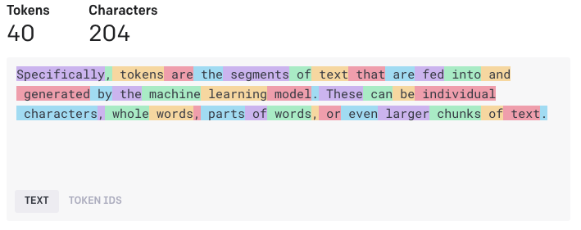
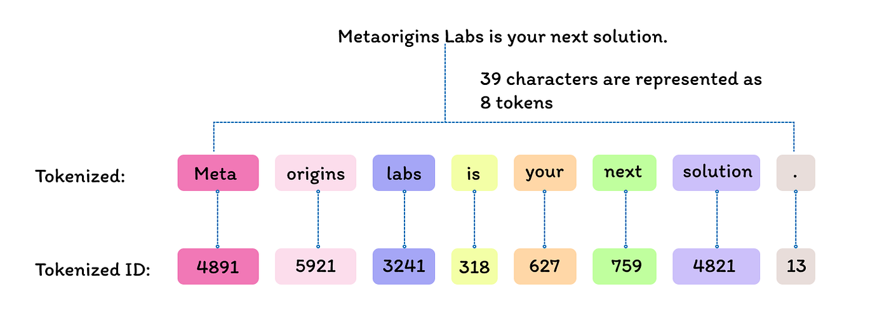
Step 1: Tokenization

Slide 3
Step 2: Text Normalization and Pre-processing
Text Normalization
Normalize the text by using punctuation and upper case to lower case conversion
Stop-word Removal
Remove words like “the”, “a” or “it” that add little to no semantic meaning to the text
N-gram extraction
Find multi-term phrases like “artificial intelligence” or “natural language processing”
Stemming and Lemmatization
Strip off ending characters from words like “s”, “ing”, “ed”. So now “powering”, “powered” and “powerful” all become “power”
Parts-of-Speech (POS) Tagging
Label each token with its grammatical category such as noun, adjective, verb or adverb

Slide 4
Step 3: Statistical Text Analysis
Statistical Algorithms
TF-IDF
Bag-of-Words
(BOW)
TextRank
Frequency Analysis
For determining the main topic of discussion of a document
For determining the most similar set of documents to the user query. Commonly used in search engines
For sentiment analysis or spam classifiers
For document summarization

Slide 5
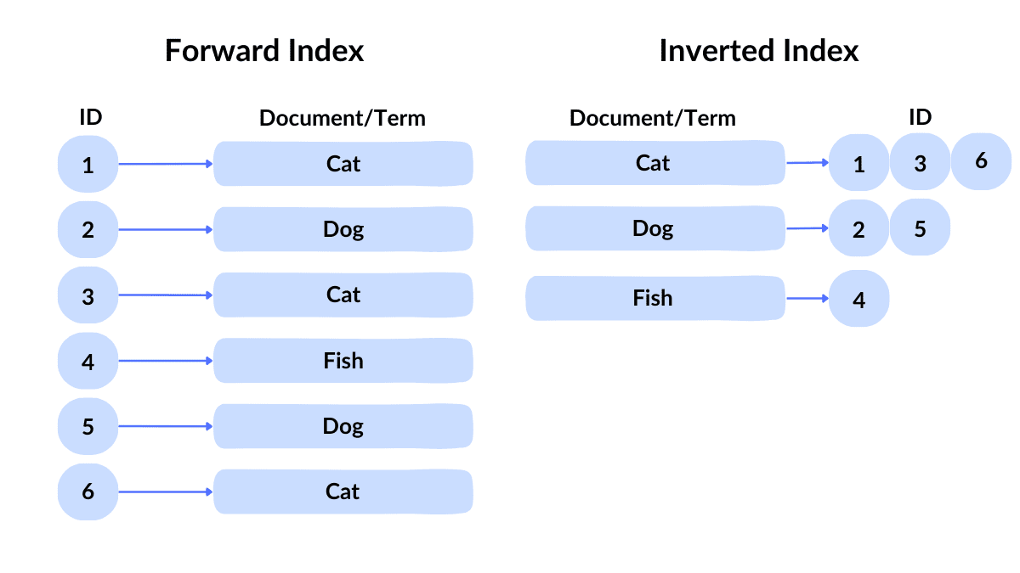
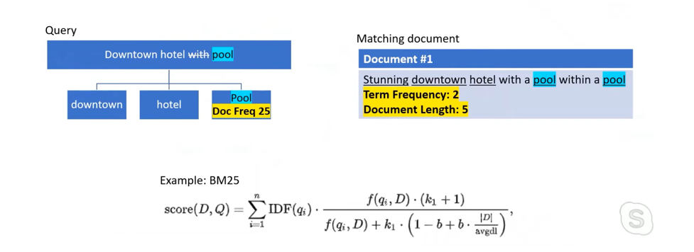
TF-IDF for Statistical Analysis
Term Frequency - Inverse Document Frequency (TF-IDF) is a technique that calculates scores based on how often a word or term appears in one document compared to its more general frequency across the entire collection of documents.
A high TF-IDF score indicates that a word appears often in one document but rarely in others. A low score indicates that word is common in many documents

Slide 6
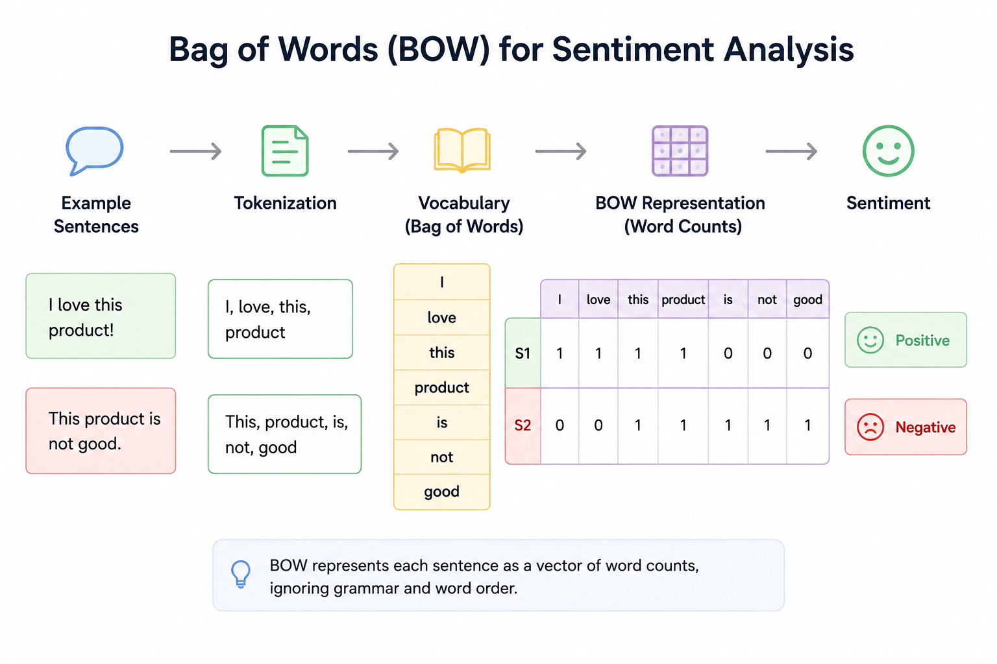
Bag-of-Words (BOW)
Bag-of-words is the name given to a feature extraction technique that represents text tokens as a vector of word frequencies or occurrences, ignoring grammar and word order.
This representation becomes the input for machine learning algorithms like Naive Bayes, a probabilistic classifier that applies Bayes’ theorem to predict the probable class of a document based on word frequency.

Slide 7
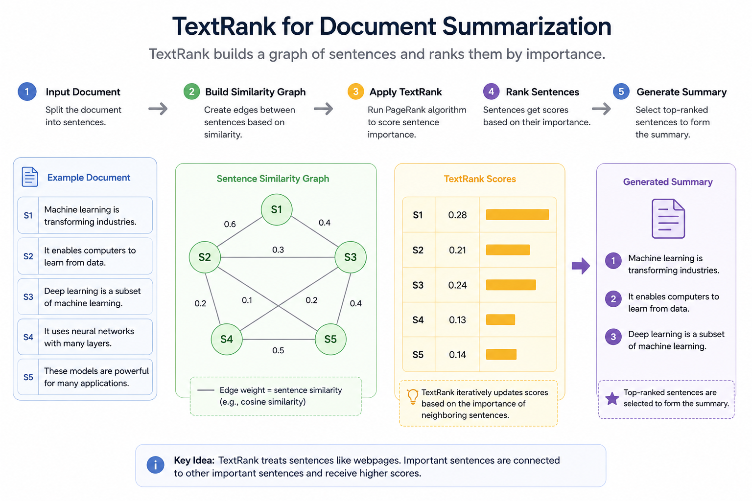
TextRank
TextRank is an unsupervised graph-based algorithm that models text as a network of connected nodes.
For example, each sentence in a document could be considered a node, and the connections (edges) between them are scored based on the similarity of the words they contain.

Slide 8
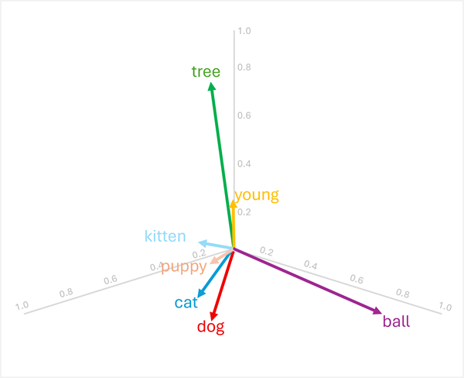
Vectorization – Recent Advancement in NLP
Text Summarization - Semantic embeddings enable extractive summarization by identifying sentences with vectors that are most representative of the overall document.
Keyword Extraction - Vector similarity can identify the most important terms in a document by comparing each word's embedding to the document's overall semantic representation.
Named Entity Recognition - Semantic models can be fine-tuned to recognize named entities (people, organizations, locations, etc.) by learning vector representations that cluster similar entity types together.

