Slide 1
Q1.
Electric potential energy and electric potential
A positively charged particle is released from rest in an uniform electric field. The electric potential energy of the charge
(A) remains a constant because the electric field is uniform.
(B) increases because the charge moves along the electric field.
(C) decreases because the charge moves along the electric field.
(D) decreases because the charge moves opposite to the electric field.
PRACTICE SET

Slide 2
Q1.
Electric potential energy and electric potential
SOLUTION
SOLUTION

Slide 3


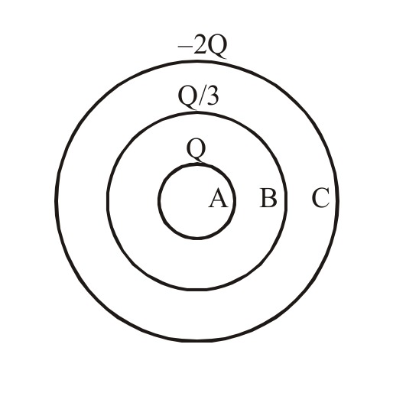
Q2.
Conductors
PRACTICE SET

Slide 4
Q2.
Conductors
SOLUTION
SOLUTION

Slide 5
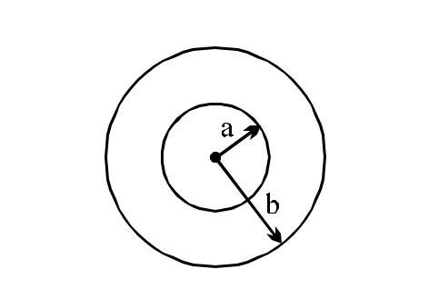
Q3.
Conductors
If the electric potential of the inner metal sphere is 10 volt & that of the outer shell is 5 volt, then the potential at the centre will be :
(A) 10 volt
(B) 5 volt
(C) 15 volt
(D) 0
PRACTICE SET

Slide 6
Q3.
Conductors
SOLUTION
SOLUTION

Slide 7
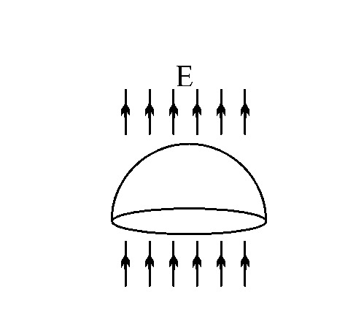
Q4.
Gauss’ law
A hemispherical surface (half of a spherical surface) of radius R is located in a uniform electric field E that is parallel to the axis of the hemisphere. What is the magnitude of the electric flux through the hemisphere surface?
(A) 0
(B) 4πR²E/3
(C) 2πR²E
(D) πR²E
PRACTICE SET

Slide 8
Q4.
Gauss’ law
SOLUTION
SOLUTION

Slide 9

Q5.
Electric field
(A) 1
(B) 2
(C) 3
(D) 4
PRACTICE SET

Slide 10
Q5.
Electric field
SOLUTION
SOLUTION

Slide 11
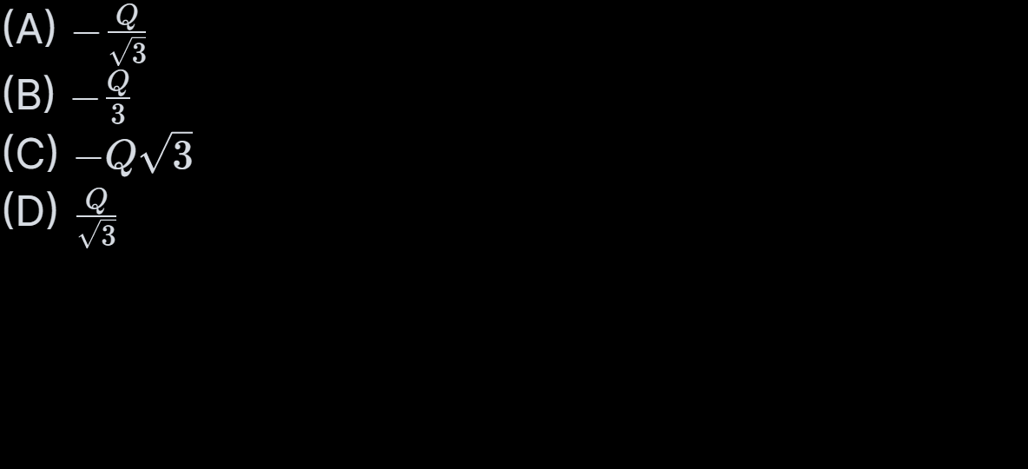
Q6.
Electric field
A charge q is placed at the centroid of an equilateral triangle. Three equal charges Q are placed at the vertices of the triangle. The system of four charges will be in equilibrium if q is equal to :-
PRACTICE SET

Slide 12
Q6.
Electric field
SOLUTION
SOLUTION

Slide 13
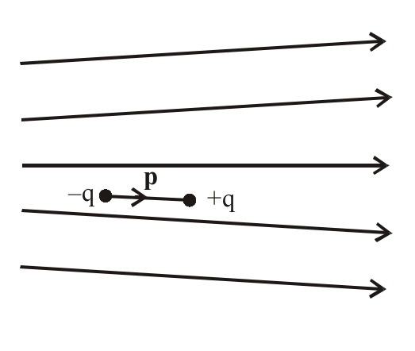
Q7.
Electric dipole
Electric field lines in which an electric dipole p is placed as shown. Which of the following statements is correct?
(A) The dipole will not experience any force.
(B) The dipole will experience a force towards right.
(C) The dipole will experience a force towards left.
(D) The dipole will experience a force upwards.
PRACTICE SET

Slide 14
Q7.
Electric dipole
SOLUTION
SOLUTION

Slide 15
Q8.
Electric potential energy and electric potential
Three positive charges of equal value q are placed at the vertices of an equilateral triangle. The resulting lines of force should be sketched as in
(A) Option A
(B) Option B
(C) Option C
(D) Option D
PRACTICE SET

Slide 16
Q8.
Electric potential energy and electric potential
SOLUTION
SOLUTION

Slide 17
Q9.
Electric potential energy and electric potential
A solid sphere of radius R is charged uniformly. At what distance from its surface is the electrostatic potential half of the potential at the centre?
(A) R
(B) R/2
(C) R/3
(D) 2R
PRACTICE SET

Slide 18
Q9.
Electric potential energy and electric potential
SOLUTION
SOLUTION

Slide 19

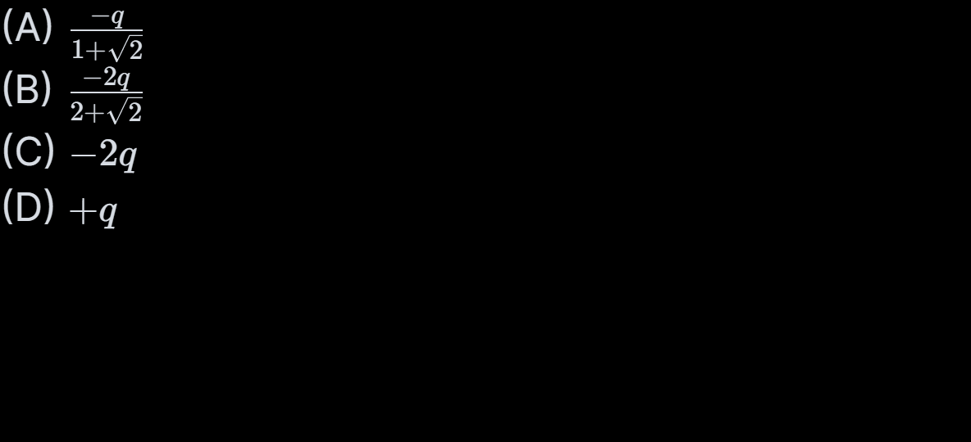
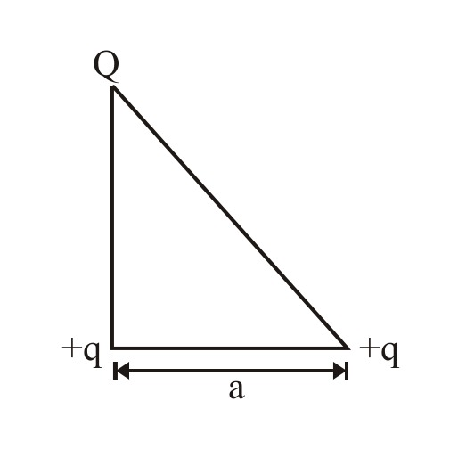
Q10.
Electric potential energy and electric potential
PRACTICE SET

Slide 20
Q10.
Electric potential energy and electric potential
SOLUTION
SOLUTION

Slide 21
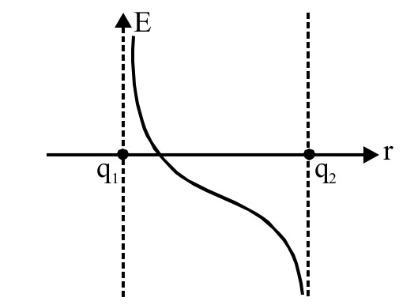
Q11.
Electric field
The variation of electric field between the two charges q1 and q2 along the line joining the charges is plotted against distance from q1 (taking rightward direction of electric field as positive) as shown in the figure. Then the correct statement is :-
(A) q1 and q2 are positive and q1 < q2
(B) q1 and q2 are positive and q1 > q2
(C) q1 is positive and q2 is negative and q1 < q2
(D) q1 and q2 are negative and q1 < q2
PRACTICE SET

Slide 22
Q11.
Electric field
SOLUTION
SOLUTION

Slide 23
Q12.
Conductors
A point charge q is placed at a point inside a hollow conducting sphere. Which of the following electric force pattern is correct?
PRACTICE SET

Slide 24
Q12.
Conductors
SOLUTION
SOLUTION

Slide 25
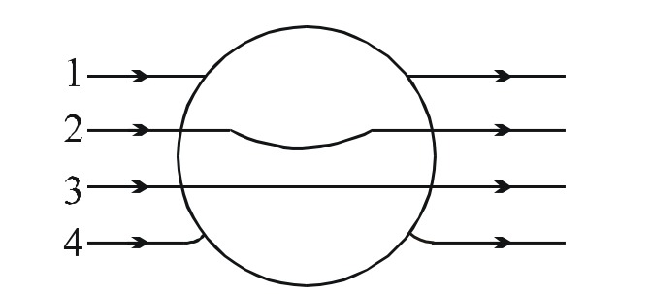
Q13.
Conductors
A metallic solid sphere is placed in a uniform electric field. The lines of force follow the path (s) shown in figure as :
(A) 1
(B) 2
(C) 3
(D) 4
PRACTICE SET

Slide 26
Q13.
Conductors
SOLUTION
SOLUTION

Slide 27

Q14.
Electric field
(A) 2
(B) 1
(C) 3
(D) None of these
PRACTICE SET

Slide 28
Q14.
Electric field
SOLUTION
SOLUTION

Slide 29
Q15.
Electric potential energy and electric potential
When a negative charge is released and moves in electric field, it moves toward a position of
(A) lower electric potential and lower potential energy
(B) lower electric potential and higher potential energy
(C) higher electric potential and lower potential energy
(D) higher electric potential and higher potential energy
PRACTICE SET

Slide 30
Q15.
Electric potential energy and electric potential
SOLUTION
SOLUTION

Slide 31

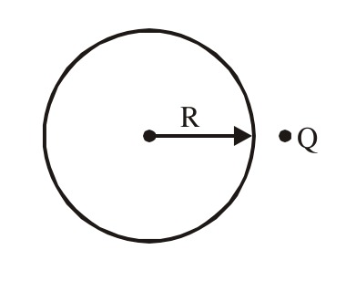
Q16.
Gauss’ law
(A) Statement-1 is true, statement-2 is true and statement-2 is correct explanation for statement-1.
(B) Statement-1 is true, statement-2 is true and statement-2 is NOT the correct explanation for statement-1.
(C) Statement-1 is true, statement-2 is false.
(D) Statement-1 is false, statement-2 is true.
PRACTICE SET

Slide 32
Q16.
Gauss’ law
SOLUTION
SOLUTION

Slide 33

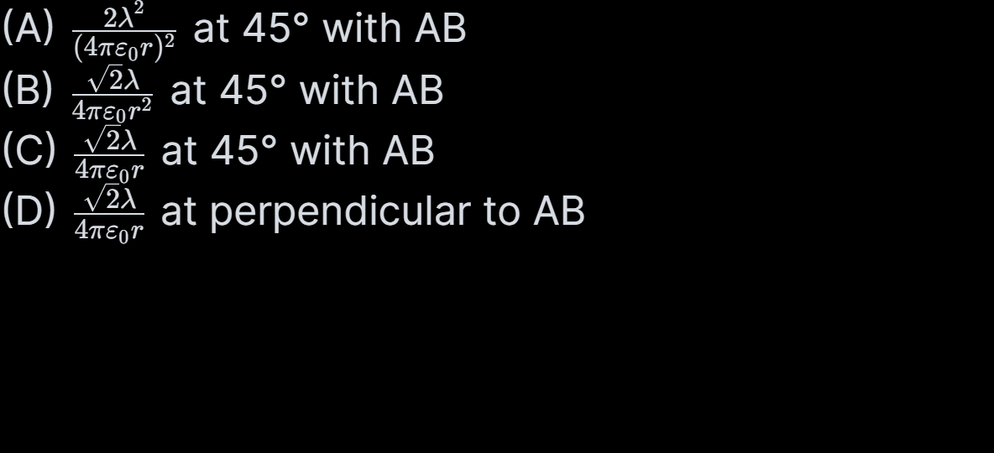
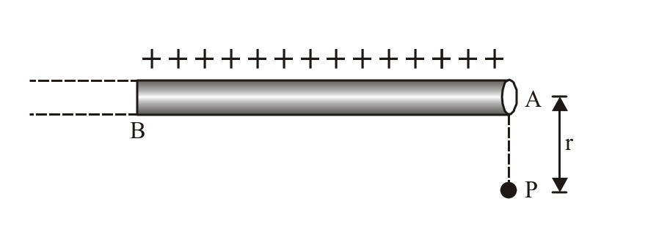
Q17.
Electric field
PRACTICE SET

Slide 34
Q17.
Electric field
SOLUTION
SOLUTION

Slide 35
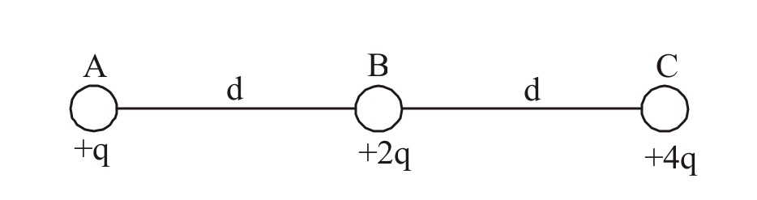
Q18.
Electric field
Three charges +q, +2q and +4q are connected by strings as shown in the figure. What is ratio of tensions in the strings AB and BC.
(A) 1 : 2
(B) 1 : 3
(C) 2 : 1
(D) 3 : 1
PRACTICE SET

Slide 36
Q18.
Electric field
SOLUTION
SOLUTION

Slide 37
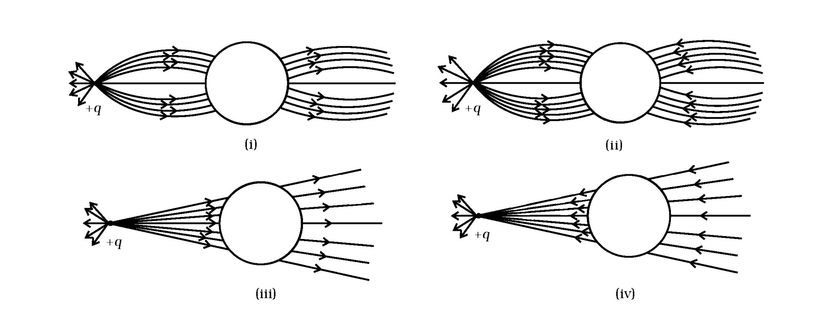
Q19.
Conductors
A point positive charge is brought near an isolated conducting sphere. The electric field is best given by
(A) Fig (i)
(B) Fig (iii)
(C) Fig (ii)
(D) Fig (iv)
PRACTICE SET

Slide 38
Q19.
Conductors
SOLUTION
SOLUTION

Slide 39
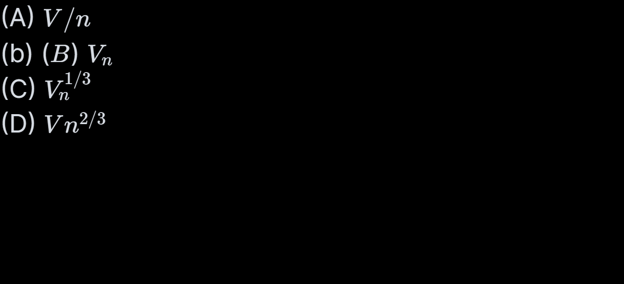
Q20.
Conductors
n small drops of same size are charged to V volts each. If they coalesce to form a signal large drop, then its potential will be :-
PRACTICE SET

Slide 40
Q20.
Conductors
SOLUTION
SOLUTION

Slide 41
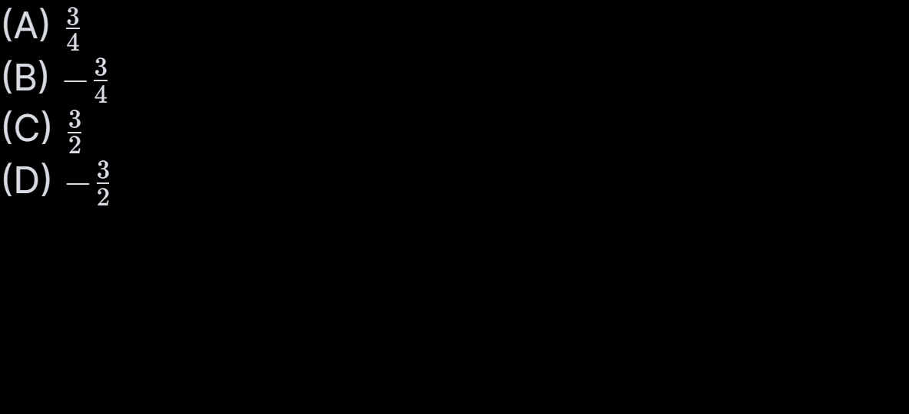
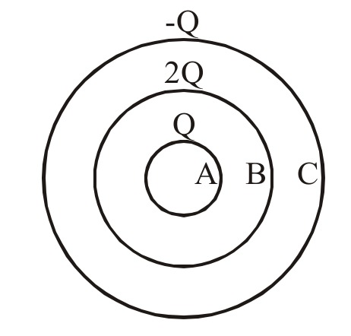
Q21.
Conductors
Charge Q, 2Q and –Q are given to three concentric conducting spherical shells A, B and C respectively. The ratio of charges on the inner and the outer surfaces of the shell ‘C’ will be :-
PRACTICE SET

Slide 42
Q21.
Conductors
SOLUTION
SOLUTION

Slide 43
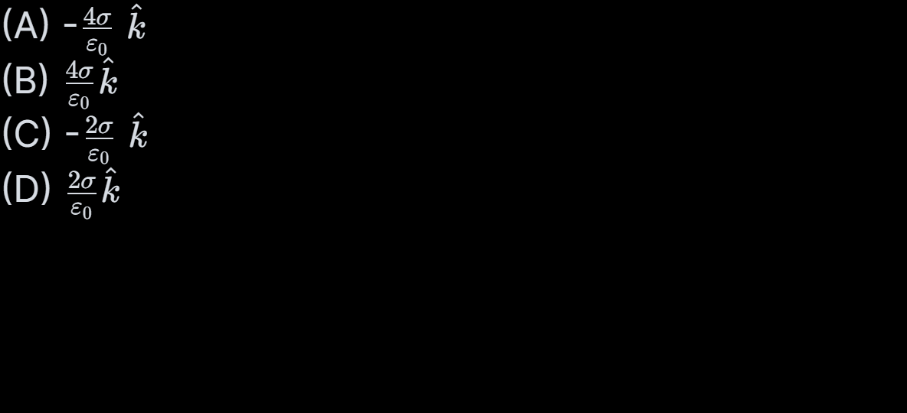
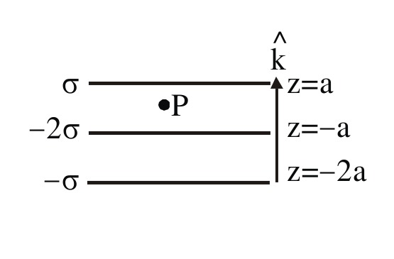
Q22.
Gauss’ law
Three large parallel plates have uniform surface charge densities as shown in the figure. What is the electric field at P?
PRACTICE SET

Slide 44
Q22.
Gauss’ law
SOLUTION
SOLUTION

Slide 45

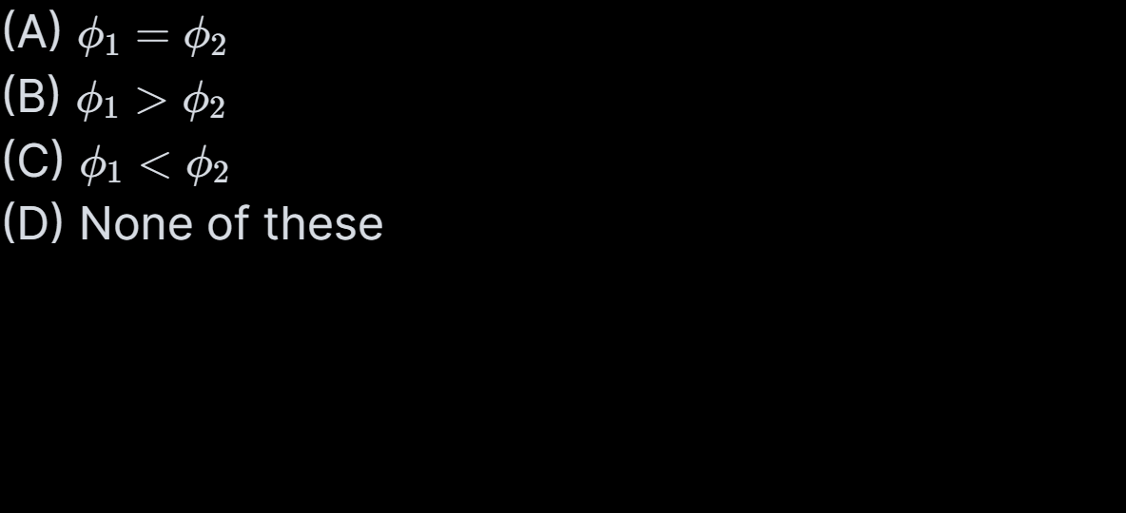
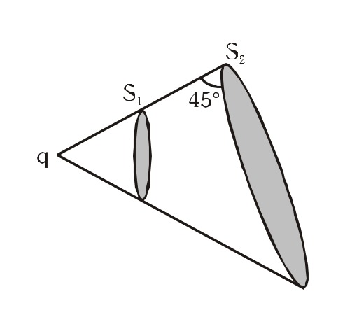
Q23.
Gauss’ law
PRACTICE SET

Slide 46
Q23.
Gauss’ law
SOLUTION
SOLUTION

Slide 47
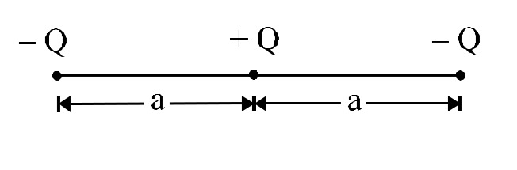
Q24.
Electric field
The fig. shows the distribution of three charges –Q, +Q and –Q on the X-axis. Which of the following figures shows the possible electric field lines for the distribution?
(A) Option A
(B) Option B
(C) Option C
(D) Option D
PRACTICE SET

Slide 48
Q24.
Electric field
SOLUTION
SOLUTION

Slide 49
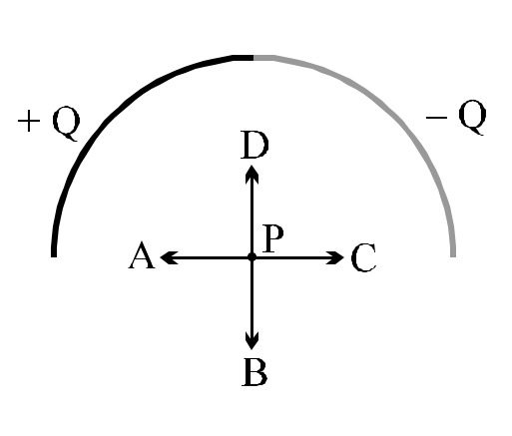
Q25.
Electric field
As shown in the figure, an insulating rod is set into the shape of a semicircle. The left half of the rod has a charge of +Q uniformly distributed along its length, and the right half of the rod has a charge of –Q uniformly distributed along its length. What vector shows the correct direction of the electric field at point P, the centre of the semicircle?
(A) A
(B) B
(C) C
(D) D
PRACTICE SET

Slide 50
Q25.
Electric field
SOLUTION
SOLUTION

