Slide 1
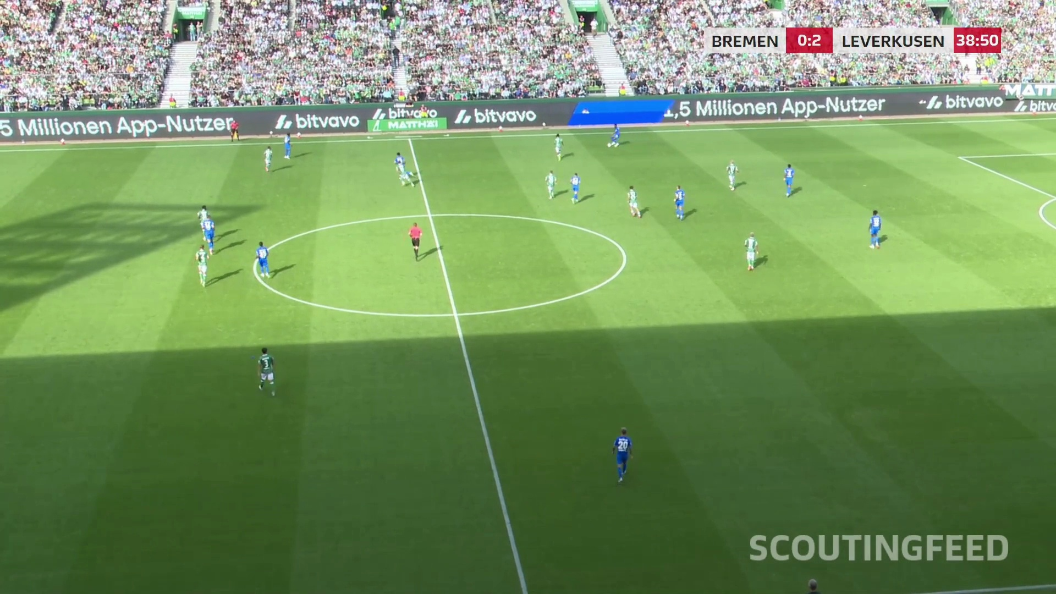
Preprocessing effects
on fixed pose models
Controlled experiments in football video
Master’s thesis
Scientific design and current status
Notes:
TARGET 20 SECONDS
This thesis studies how input processing changes pose estimation. I keep published pose checkpoints fixed and compare each processed input with the same model’s unchanged baseline. The focus is controlled evaluation, not training a different model for each condition.
SOURCES
Repository experiment.md, TODOS.md, configs/lyra-preprocessing-screen.yaml and configs/lyra-preprocessing-base.yaml at commit 21c1068.
User-supplied Master Thesis.pdf, 10 pages, especially pp. 7–9. These are research/literature notes. Latest screening results supersede older implementation-status notes on p. 9.
Photo: footage/sample_30.mov, frame 140.

Slide 2
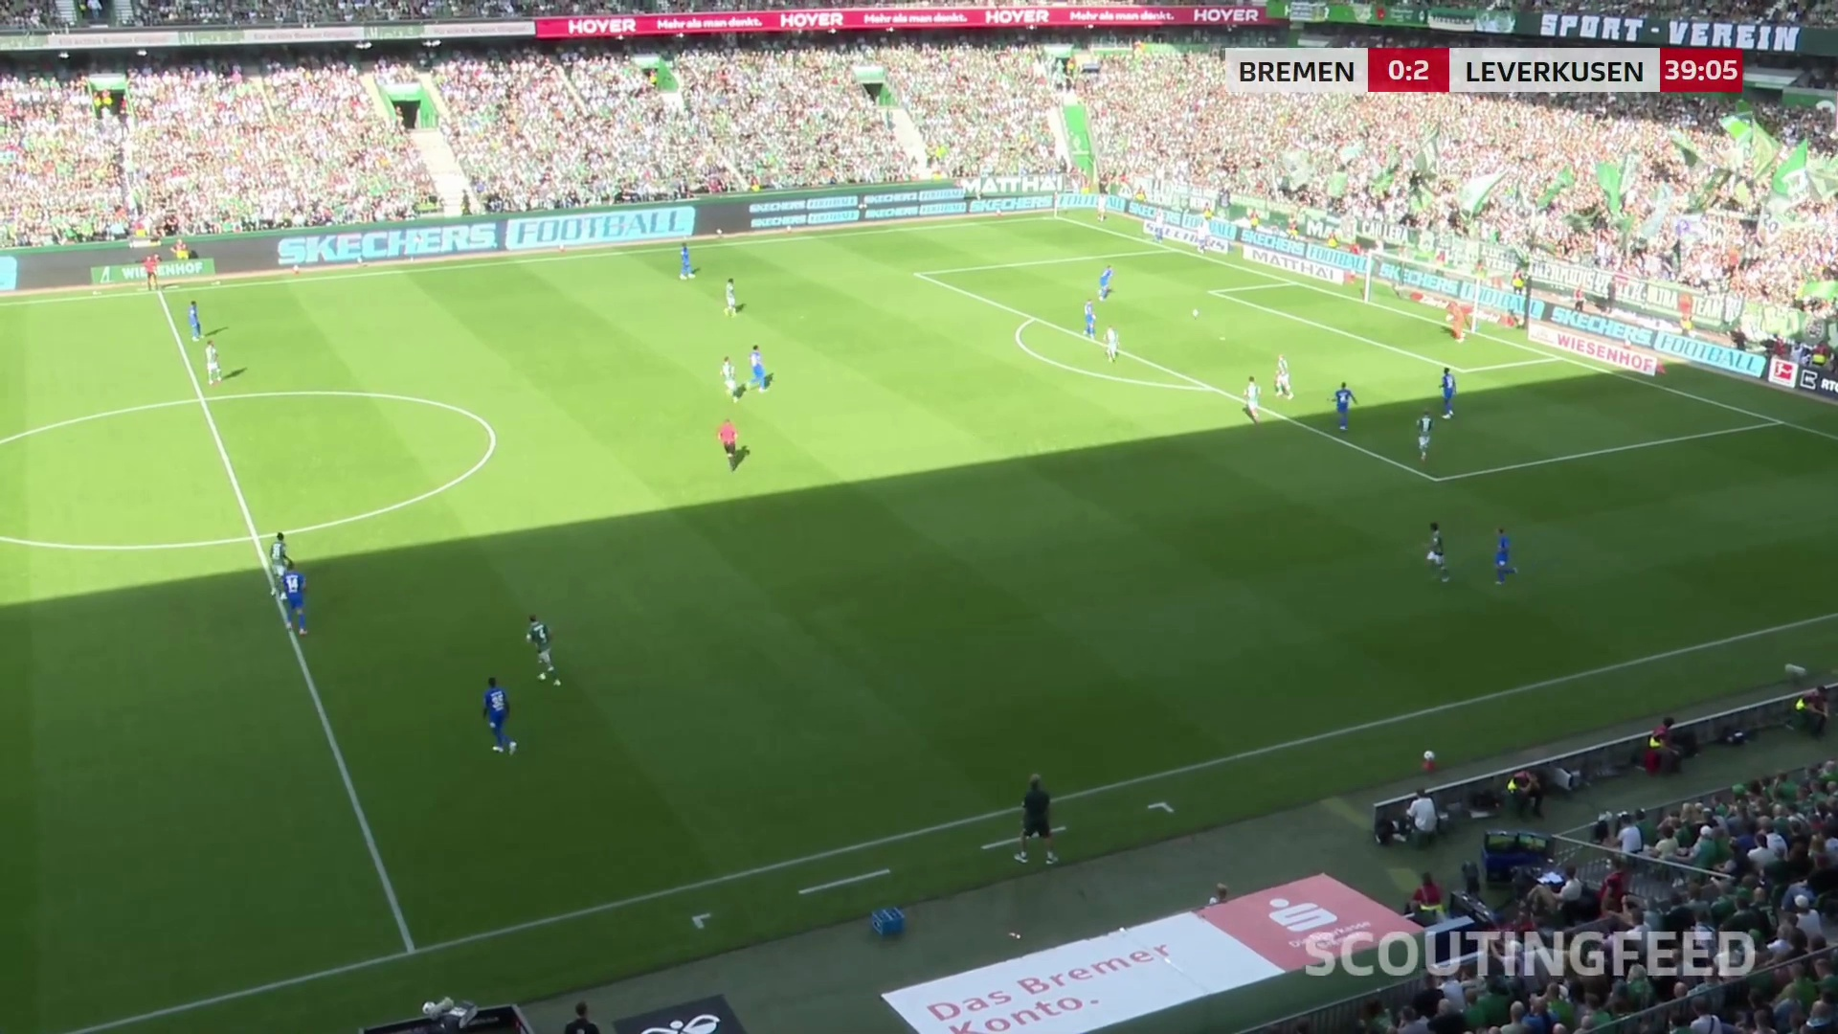
Research question
How does preprocessing change pose quality when model weights stay fixed?
Independent variable
Processing method
and its parameters
Measured outcomes
Detection coverage
Joint localization
Computational cost
Notes:
TARGET 30 SECONDS
Football video combines small players, shadows, occlusion and a moving camera. The intervention is one input transformation. We measure target detection, joint localization and computational cost. The same enhancement can help one architecture and hurt another, so each condition is compared with that model’s own baseline on the same frames.
SOURCES
Repository experiment.md, TODOS.md, configs/lyra-preprocessing-screen.yaml and configs/lyra-preprocessing-base.yaml at commit 21c1068.
User-supplied Master Thesis.pdf, 10 pages, especially pp. 7–9. These are research/literature notes. Latest screening results supersede older implementation-status notes on p. 9.
Photo: footage/sample_30.mov, frame 580.

Slide 3
Controlled comparison
Fixed published pretrained checkpoints. No training or fine-tuning within the comparison.
Baseline
Fixed pose model
Unchanged input
Same weights
Same inference settings
Same input
Paired evaluation
Same frames
Same labels
Same matching rules
Difference vs baseline
One processing step
Fixed pose model
Method + fixed parameters
Same weights
Same inference settings
Notes:
TARGET 40 SECONDS
Both branches use the same input and independent labels. Only the configured processing step changes. Pose weights and inference settings remain fixed; pretrained does not mean randomly initialized. HRNet uses our existing trained player detector. The pitch model and learned super-resolution weights also stay fixed. Consequently, the effect includes changes in detection and cropping within the complete pipeline, not only an isolated pose network.
SOURCES
Repository experiment.md, TODOS.md, configs/lyra-preprocessing-screen.yaml and configs/lyra-preprocessing-base.yaml at commit 21c1068.
User-supplied Master Thesis.pdf, 10 pages, especially pp. 7–9. These are research/literature notes. Latest screening results supersede older implementation-status notes on p. 9.
Compared pose models: YOLO26x Pose, OpenPose BODY_25 and HRNet-W32. Auxiliary football detector, pitch model and FSRCNN are existing trained components, not newly trained per condition.

Slide 4
Three routes to multi-person poses
“Multi-person” is an output capability shared by all three, not a separate architecture.
HRNet-W32
YOLO player
detector
Crop each box
HRNet joint
heatmaps
Remap each
pose
Top-down
OpenPose
Full image
features
Joint maps
+ affinity fields
Associate
body parts
Grouped
person poses
Bottom-up
YOLO26x Pose
Full image
features
Joint detection
+ pose head
Decode boxes
+ keypoints
Multi-person
pose records
Single-stage
Notes:
TARGET 60 SECONDS
Multi-person means that one image can produce several poses; it is not a third alternative to top-down and bottom-up. In our top-down pipeline, a YOLO player detector finds boxes, each crop goes through HRNet, and joint coordinates return to the source image. Missed boxes prevent poses. HRNet preserves high-resolution features with repeated cross-scale fusion. OpenPose predicts joint confidence maps and part-affinity vector fields over the image, then associates body parts into people. It has no separate person-box prerequisite. YOLO26 Pose jointly outputs person detections and their keypoints in one network pipeline; it is not a detector followed by a separate crop-wise HRNet. Different bottlenecks explain why processing affects them differently.
SOURCES
Project source: runners/hrnet/run.py, src/football_pose/hrnet_input.py, model_mapping.py and coco_evaluation.py; configs/lyra-preprocessing-base.yaml at commit 21c1068.
Sun et al., Deep High-Resolution Representation Learning for Human Pose Estimation (CVPR 2019): https://arxiv.org/abs/1902.09212
Cao et al., Realtime Multi-Person 2D Pose Estimation using Part Affinity Fields (CVPR 2017): https://arxiv.org/abs/1611.08050
Ultralytics YOLO26 architecture and pose task: https://docs.ultralytics.com/models/yolo26/ ; https://docs.ultralytics.com/tasks/pose/

Slide 5
Ground truth for distinct evaluation tasks
Reference data must describe the quantity that each metric evaluates.
Evaluation task | Independent reference | Current position
COCO pose benchmark | Official person keypoints and visibility labels | Available
Football image-plane pose | Validated DFL/Werder joints, if available Otherwise reviewed manual annotations | Format and alignment still pending
Pitch-coordinate positions | Synchronized tracking x/y with independently checked calibration | Later evaluation stage
Notes:
TARGET 35 SECONDS
Each quantity needs the right reference. COCO provides image-plane joint labels and visibility flags. Football pose accuracy needs independently validated body-joint labels, either supplied or manually reviewed. Tracking x and y coordinates instead support player ground-position error. They cannot validate all body joints. Predicted pitch geometry is not independent ground truth. Football reference alignment remains pending.
SOURCES
Repository experiment.md, TODOS.md, configs/lyra-preprocessing-screen.yaml and configs/lyra-preprocessing-base.yaml at commit 21c1068.
User-supplied Master Thesis.pdf, 10 pages, especially pp. 7–9. These are research/literature notes. Latest screening results supersede older implementation-status notes on p. 9.
Official COCO evaluator: https://github.com/cocodataset/cocoapi/blob/master/PythonAPI/pycocotools/cocoeval.py
TODOS.md: ground-truth alignment remains blocked by external format, camera/projection and synchronization details.

Slide 6
Football reference-data protocol
Proposed workflow before the final accuracy experiment
1
Define the evaluation sample
Include varied scale, lighting, occlusion and camera views
2
Align the reference to the video
Match timestamps, player identities and joint definitions
3
Review labels independently
Record visibility, uncertainty and annotation disagreements
4
Freeze development and test sets
Separate video sequences and version the approved labels
Notes:
TARGET 30 SECONDS
We first sample different scales, lighting conditions and camera views. We align timestamps, identities and joint definitions, review visibility and uncertain annotations, then freeze sequence-level development and test splits. Include missed target players in the reference population. Neighbouring frames must not leak across splits. A pitch-plane homography cannot project arbitrary elevated body joints.
SOURCES
Repository experiment.md, TODOS.md, configs/lyra-preprocessing-screen.yaml and configs/lyra-preprocessing-base.yaml at commit 21c1068.
User-supplied Master Thesis.pdf, 10 pages, especially pp. 7–9. These are research/literature notes. Latest screening results supersede older implementation-status notes on p. 9.
Proposed study protocol, not a completed annotation or quality-assurance result.

Slide 7
Pipeline, step by step
Every prediction returns to the original frame before matching against ground truth.
1 Input
2 Processing
3 Inference
4 Remapping
5 Matching
6 Evaluation
Freeze frames
and metadata
Apply one
configured step
Run unchanged
pose weights
Source pixels
Merge tile records
Reference IDs
Eligible joints
Score accuracy
and runtime
Notes:
TARGET 45 SECONDS
Freeze source frames and metadata. Apply one processor and cache the transformed inputs. Run fixed pose weights, then return all crop, resize and tile coordinates to source pixels and remove cross-region duplicates. A separate fixed pitch model supplies per-frame geometry shared by all conditions. Finally match people and joints to independent labels, score accuracy and compare against baseline. The pipeline and official COCO scoring exist; football reference alignment and accuracy scoring are still the next layer.
SOURCES
Repository experiment.md, TODOS.md, configs/lyra-preprocessing-screen.yaml and configs/lyra-preprocessing-base.yaml at commit 21c1068.
src/football_pose/screening.py, experiments.py, model_mapping.py, pitch_filter.py and coco_evaluation.py.

Slide 8
Detection: precision and recall
First match predictions to eligible reference people, one-to-one, at a declared criterion.
Outcome | Meaning
True positive (TP) | A valid prediction matched to one reference person
False positive (FP) | An unmatched extra prediction, including a duplicate
False negative (FN) | A reference person with no valid matched prediction
Precision = TP / (TP + FP)
Recall = TP / (TP + FN)
Illustration: TP = 8, FP = 2, FN = 4
8 / 10 = 80% correct predictions
8 / 12 = 66.7% recovered targets
Notes:
TARGET 40 SECONDS
Define the reference population and matching criterion first. Person detection can use box overlap, while pose evaluation uses OKS. With one-to-one matching, a valid match is a true positive, an unmatched prediction is a false positive, and an unmatched reference is a false negative. A second prediction cannot earn credit for the same ordinary target. Eight matches, two extras and four misses give eighty percent precision but only sixty-six point seven percent recall. Correct boxes do not establish correct joints. COCO additionally applies its official ignore and crowd rules.
SOURCES
Official COCO evaluator: https://github.com/cocodataset/cocoapi/blob/master/PythonAPI/pycocotools/cocoeval.py
Illustrative arithmetic, not experiment results. Person-box matching and pose-OKS matching must be reported separately.

Slide 9
OKS: turn joint errors into a pose similarity
Object Keypoint Similarity: one score for a predicted pose and a reference person.
OKS = (1 / N) Σ exp[ −dᵢ² / (2 A kᵢ²) ]
Sum only over labelled reference joints (vᵢ > 0).
Symbol | How it enters the calculation
dᵢ | Euclidean distance from predicted joint i to its reference, in pixels
A | Ground-truth person area, in square pixels
kᵢ = 2σᵢ | Fixed COCO joint-specific tolerance; not prediction confidence
N | Number of labelled reference joints contributing to this pose
Notes:
TARGET 50 SECONDS
For each labelled joint, measure pixel distance, normalize by person area and a fixed joint-specific tolerance, then apply the exponential. Average those contributions. Perfect localization approaches one; larger normalized errors approach zero. The same pixel error is more severe on a smaller person. COCO uses k equal to twice its stored sigma. Ground-truth visibility selects joints, including labelled occluded joints; prediction confidence does not weight this formula. A worked example is in the backup slides.
SOURCES
Official COCO evaluator: https://github.com/cocodataset/cocoapi/blob/master/PythonAPI/pycocotools/cocoeval.py

Slide 10
Average Precision (AP) and Average Recall (AR)
COCO keypoints uses OKS, even where the evaluator prints the label “IoU”.
Rank by person
confidence
Match at OKS
threshold t
Accumulate
precision / recall
APₜ = mean interpolated precision at 101 recall levels
AP = mean APₜ for t = 0.50, 0.55, …, 0.95
AR = mean maximum recall over the same ten thresholds
AP50 / AP75 use one threshold; COCO retains up to 20 poses per image.
Notes:
TARGET 45 SECONDS
Rank poses by person score. At each OKS threshold, match and accumulate true and false positives. AP uses the interpolated precision envelope at 101 recall levels, then averages across ten OKS thresholds. AP fifty and AP seventy-five use only their named threshold. AR averages the maximum achieved recall at those thresholds. Official keypoint evaluation limits retained predictions to twenty per image. AP is neither the average of precision and recall nor the percentage of detected joints. Backup slides show an explicit ranked example.
SOURCES
Official COCO evaluator: https://github.com/cocodataset/cocoapi/blob/master/PythonAPI/pycocotools/cocoeval.py

Slide 11
PCK: how many joints are close enough?
Percentage of Correct Keypoints; proposed scale: ground-truth person-box diagonal.
Normalized error: eᵢ = ||pᵢ − gᵢ||₂ / s
PCK(α) = count(eligible joints with eᵢ ≤ α) / N
N = all eligible GT joints; missing predictions count as incorrect.
Example: s = 200 px, α = 0.05 → tolerance = 10 px
Illustration: 8 eligible joints
6 within tolerance
PCK = 6 / 8 = 75%
7 confidently predicted
Coverage = 7 / 8 = 87.5%
Notes:
TARGET 40 SECONDS
PCK turns localization into a pass or fail at a declared normalized distance. Our proposed scale is the reference person-box diagonal. A diagonal of two hundred pixels and threshold zero point zero five allow ten pixels. Six correct joints out of eight give seventy-five percent PCK. Seven confident predictions give higher coverage, but confidence does not establish accuracy. For proposed end-to-end PCK, missed targets remain incorrect. Declare eligibility, aggregation and thresholds. The backups explain PCP, PCK-AUC and tracking-position error.
SOURCES
MMPose metric definitions (implementations vary in normalization and aggregation): https://mmpose.readthedocs.io/en/latest/_modules/mmpose/evaluation/functional/keypoint_eval.html
Supplementary football metric conventions are proposed, not yet implemented results. Numeric examples are illustrative, not experimental observations.

Slide 12
Estimating the processing effect
Paired comparisons use the same reference population in every condition.
Δ score = score(processed input) − score(baseline)
1
Fixed denominators
Count missed targets and unpredicted eligible reference joints
2
Separate error sources
Report detection, pose localization and pitch-filter errors
3
Independent confirmation
Choose settings on development clips, then test held-out sequences
Notes:
TARGET 25 SECONDS
The effect is a paired score difference against each model’s own baseline. Keep the same targets and eligible ground-truth joints in every denominator. Separate person detection, joint localization and pitch-filter errors. Choose settings on development clips, confirm on held-out sequences, and account for correlation between neighbouring video frames.
SOURCES
Repository experiment.md, TODOS.md, configs/lyra-preprocessing-screen.yaml and configs/lyra-preprocessing-base.yaml at commit 21c1068.
User-supplied Master Thesis.pdf, 10 pages, especially pp. 7–9. These are research/literature notes. Latest screening results supersede older implementation-status notes on p. 9.
Proposed statistical protocol: paired sequence-level summaries and interval estimation after sufficient independent clips are available.

Slide 13
Reproducibility safeguards
A result needs a recoverable input, configuration and execution environment.
Already recorded
Final-study verification
Input and checkpoint SHA-256
Expanded YAML and processing order
Git revision and package versions
Hardware metadata and runner logs
Raw predictions and decision archives
Pin actual container image digests
Freeze labels and evaluation settings
Repeat a reference run
Declare numerical tolerances
Measure cold and warm runtime separately
Notes:
TARGET 35 SECONDS
We record input and checkpoint hashes, expanded YAML, code revision, package versions, hardware and logs. Raw predictions and pitch decisions remain available. For the final study, also freeze reference-label versions and actual container image digests, repeat a reference run, declare numerical tolerances and separate cold from warm-cache runtime. Fixed weights reduce variation but do not guarantee bit-identical GPU arithmetic.
SOURCES
Repository experiment.md, TODOS.md, configs/lyra-preprocessing-screen.yaml and configs/lyra-preprocessing-base.yaml at commit 21c1068.
src/football_pose/provenance.py; src/football_pose/artifacts.py; src/football_pose/screening.py.
Final-study controls in the right column are proposed checks, not claims that all are currently enforced.

Slide 14
Experimental matrix
One unchanged baseline and eleven individual processing conditions
Processing family | Conditions
Scale and regions | Bicubic ×2, FSRCNN ×2, 2 × 2 tiling, detector-guided crops
Contrast and brightness | CLAHE, gamma darken, gamma brighten
Noise and restoration | Non-local means, bilateral denoising, unsharp, Wiener deblur
YOLO26x Pose
OpenPose BODY_25
HRNet-W32
Current football pilot
12 conditions × 3 models
782 identical source frames
Notes:
TARGET 25 SECONDS
The pilot uses one baseline and eleven individual methods, with three pose pipelines on 782 identical frames. Bicubic and learned super-resolution share the same enlargement factor. Start with individual processing effects; only later test selected combinations. COCO currently checks model functionality on unchanged inputs, rather than a complete preprocessing ablation.
SOURCES
Repository experiment.md, TODOS.md, configs/lyra-preprocessing-screen.yaml and configs/lyra-preprocessing-base.yaml at commit 21c1068.
User-supplied Master Thesis.pdf, 10 pages, especially pp. 7–9. These are research/literature notes. Latest screening results supersede older implementation-status notes on p. 9.
configs/lyra-preprocessing-screen.yaml.

Slide 15
Current experiment status
Exploratory detection yield on the football clip. Accuracy evaluation remains pending.
Model | Baseline on pitch | Example condition | On pitch
YOLO26 | 357 | Bilateral denoising | 2,115
OpenPose | 11,647 | CLAHE | 15,338
HRNet | 3,602 | Bicubic ×2 | 15,554
Completed: 35 of 36 model jobs
Open cases: HRNet tiling, YOLO cropping and the failed OpenPose crop job
Notes:
TARGET 50 SECONDS
Thirty-five of thirty-six jobs complete. These examples are on-pitch record yields, not accuracy gains: bilateral filtering raises YOLO records, CLAHE raises OpenPose records and doubling scale greatly raises HRNet records. We still need independent labels to learn whether added poses are correct. HRNet tiling yields one raw record, YOLO cropping zero, and OpenPose cropping fails. Those cases need investigation. Super-resolution and bicubic resizing have almost identical HRNet yield. The final claim must come from accuracy and cost, not appearance or counts alone.
SOURCES
User-supplied screening overview for 20261022T181655Z-fefcb4ec, 22 October 2026. Person-pose record counts across 782 frames, not unique players or accuracy.
Repository experiment.md, TODOS.md, configs/lyra-preprocessing-screen.yaml and configs/lyra-preprocessing-base.yaml at commit 21c1068.
Pitch reference comparison separately showed 782/782 accepted fits for Roboflow versus 306/782 for the retired nano model. Fit coverage does not establish landmark accuracy.

Slide 16
Next scientific milestones
1
Reference-data agreement
Confirm football joints, tracking timestamps and annotation fallback
2
Protocol freeze
Select the primary metric, matching rules and held-out sequences
3
Verified ablation study
Resolve runner issues, repeat baselines and score every condition
4
Confirmation and downstream use
Test selected combinations, then compare pitch positions with tracking
Notes:
TARGET 30 SECONDS
Confirm the football reference schema and annotation fallback. Agree on the primary metric, person matching, visibility rules and held-out sequences. Resolve runner anomalies, verify checkpoint identities, repeat baselines and score every condition against the same references. Then confirm selected combinations and separately evaluate synchronized player positions against tracking data.
SOURCES
Repository experiment.md, TODOS.md, configs/lyra-preprocessing-screen.yaml and configs/lyra-preprocessing-base.yaml at commit 21c1068.
User-supplied Master Thesis.pdf, 10 pages, especially pp. 7–9. These are research/literature notes. Latest screening results supersede older implementation-status notes on p. 9.
Proposed milestones.

Slide 17
Backup: on-pitch screening overview 1/2
Record count and change relative to each model’s own baseline
Processing | YOLO26 | OpenPose | HRNet
Baseline | 357 (reference) | 11,647 (reference) | 3,602 (reference)
Resize ×2 | 283 (-20.7%) | 10,934 (-6.1%) | 15,554 (+331.8%)
CLAHE | 1,156 (+223.8%) | 15,338 (+31.7%) | 3,995 (+10.9%)
Gamma darken | 315 (-11.8%) | 12,193 (+4.7%) | 3,634 (+0.9%)
Gamma brighten | 440 (+23.2%) | 11,029 (-5.3%) | 3,568 (-0.9%)
NLM denoising | 615 (+72.3%) | 8,054 (-30.8%) | 3,037 (-15.7%)
Notes:
BACKUP
Use this table for discussion. These are record counts across the pilot clip. They do not rank pose accuracy. HRNet tiling and YOLO cropping have suspicious raw outputs, while OpenPose cropping fails. Repeated-frame observations are correlated. The current report mainly has warm-cache timings, so it cannot establish total cold preprocessing cost.
SOURCES
User-supplied screening overview for 20261022T181655Z-fefcb4ec, 22 October 2026. Person-pose record counts across 782 frames, not unique players or accuracy.

Slide 18
Backup: on-pitch screening overview 2/2
Record count and change relative to each model’s own baseline
Processing | YOLO26 | OpenPose | HRNet
Bilateral denoising | 2,115 (+492.4%) | 12,581 (+8.0%) | 3,216 (-10.7%)
Unsharp | 491 (+37.5%) | 11,860 (+1.8%) | 2,675 (-25.7%)
Motion deblur | 1,627 (+355.7%) | 7,362 (-36.8%) | 214 (-94.1%)
Super-resolution ×2 | 312 (-12.6%) | 11,583 (-0.5%) | 15,565 (+332.1%)
Tiling | 3,402 (+852.9%) | 16,072 (+38.0%) | 1 (-100.0%)
Detector crop | 0 (-100.0%) | FAILED | 3,467 (-3.7%)
Notes:
BACKUP
Use this table for discussion. These are record counts across the pilot clip. They do not rank pose accuracy. HRNet tiling and YOLO cropping have suspicious raw outputs, while OpenPose cropping fails. Repeated-frame observations are correlated. The current report mainly has warm-cache timings, so it cannot establish total cold preprocessing cost.
SOURCES
User-supplied screening overview for 20261022T181655Z-fefcb4ec, 22 October 2026. Person-pose record counts across 782 frames, not unique players or accuracy.

Slide 19
Backup: PCP — Percentage of Correct Parts
Proposed strict-endpoint convention; other PCP variants must not be mixed with it.
Reference limb length: L = ||g(a) − g(b)||₂
Correct limb if BOTH endpoint errors ≤ αL
PCP = correct eligible limbs / all eligible reference limbs
Illustration: L = 40 px and α = 0.5 → 20 px tolerance
Endpoint errors 12 px and 18 px: pass
Endpoint errors 12 px and 22 px: fail
Notes:
BACKUP
For a limb connecting reference joints a and b, compute its ground-truth length L. Under this explicit strict variant, both predicted endpoints must lie within alpha times L of their corresponding labels. Average the binary outcomes over eligible limbs. Freeze a limb list; one proposed set is left and right upper arms, forearms, thighs and lower legs. Both endpoints must have usable labels and L must be nonzero. An unmatched person or missing predicted endpoint fails the limb in the proposed end-to-end score. Alpha equals 0.5 here only for illustration. PCP variants differ, so report this convention rather than implying every published PCP score is directly comparable.
SOURCES
Supplementary football metric conventions are proposed, not yet implemented results. Numeric examples are illustrative, not experimental observations.
Definition requested in the user’s research notes: both endpoint errors relative to reference limb length.

Slide 20
Backup: PCK-AUC summarizes tolerances
AUC here is the area under PCK versus distance threshold, not the precision-recall curve.
∫
αmax
Normalized AUC =
(1 / αmax) ×
PCK(α) dα
0
Threshold α | 0.00 | 0.05 | 0.10
Illustrative PCK | 0.00 | 0.50 | 1.00
Trapezoid estimate over [0, 0.10]
AUC ≈ [0.05 × (0 + 0.50)/2 + 0.05 × (0.50 + 1)/2] / 0.10
= 0.50 (50% of the maximum possible area)
Notes:
BACKUP
Sweep the PCK threshold while keeping the reference set, scale and matching fixed. Integrate the resulting PCK curve over a declared interval and divide by interval width. The normalized value is between zero and one. This three-point illustration uses trapezoidal integration: the two areas are 0.0125 and 0.0375, so their sum divided by 0.10 is 0.50. A real protocol needs a fixed sufficiently dense grid. Sampling and integration conventions differ between libraries; MMPose, for example, uses a discrete threshold average. Do not compare AUC values with different normalizers, ranges or quadrature rules. This is not AP’s precision-recall area.
SOURCES
MMPose metric definitions (implementations vary in normalization and aggregation): https://mmpose.readthedocs.io/en/latest/_modules/mmpose/evaluation/functional/keypoint_eval.html
Supplementary football metric conventions are proposed, not yet implemented results. Numeric examples are illustrative, not experimental observations.

Slide 21
Backup: coverage and tracking-position error
Completeness and ground-plane localization answer different questions.
Joint coverage
Coverage(τ) = count(matched eligible joints with cᵢ ≥ τ) / N
Use the same eligible GT joints; report the joint threshold and missing-target rule.
Player position in pitch coordinates
Eⱼ = √[(x̂ⱼ − xⱼ)² + (ŷⱼ − yⱼ)²] metres
Mean error = Σ Eⱼ / M; also report median and matched-player coverage.
Notes:
BACKUP
Coverage counts whether a matched eligible reference joint receives a finite prediction above a declared joint-confidence threshold. No localization tolerance appears, so high coverage can coexist with poor PCK. The proposed denominator includes eligible joints of missed people; joints without a reference label are excluded. For tracking, compare synchronized player identities in one metric coordinate system. For a prediction (31,20) and reference (30,18), Euclidean error is square root of five, about 2.24 metres. Average over M matched player-time pairs and report median plus match coverage; missing players are not zero-error observations. A homography maps ground-contact points only. Calibration errors contribute to this downstream error.
SOURCES
Supplementary football metric conventions are proposed, not yet implemented results. Numeric examples are illustrative, not experimental observations.
Project source: runners/hrnet/run.py, src/football_pose/hrnet_input.py, model_mapping.py and coco_evaluation.py; configs/lyra-preprocessing-base.yaml at commit 21c1068.
All numeric examples are illustrative; independent tracking alignment remains pending.

Slide 22
Backup: AP from a confidence-ranked list
Illustration at one OKS threshold: 3 reference people, 5 predictions, no ignored cases.
Rank / score | Outcome | Cum. TP / FP | Precision | Recall
1 / 0.95 | TP | 1 / 0 | 1.000 | 0.333
2 / 0.90 | FP | 1 / 1 | 0.500 | 0.333
3 / 0.80 | TP | 2 / 1 | 0.667 | 0.667
4 / 0.70 | TP | 3 / 1 | 0.750 | 1.000
5 / 0.60 | FP | 3 / 2 | 0.600 | 1.000
Precision envelope: 1.00 up to recall 1/3; then 0.75
APₜ = (34 × 1.00 + 67 × 0.75) / 101 = 0.834; Rmax,t = 1.00
Notes:
BACKUP
These illustrative outcomes assume one-to-one matching has already been performed at a fixed OKS threshold. Cumulate TP and FP in descending person-score order. Replace precision at a recall by the best precision attained at that or any greater recall. Among 101 recall levels, 34 are at or below one third and receive 1.00; the remaining 67 receive 0.75. AP at this threshold is 0.834. Maximum recall is 1.00. The late false positive does not lower the envelope here. Repeat matching at every OKS threshold before averaging; these are not measured project results.
SOURCES
Official COCO evaluator: https://github.com/cocodataset/cocoapi/blob/master/PythonAPI/pycocotools/cocoeval.py
Illustrative list and arithmetic authored for this presentation.

Slide 23
Backup: OKS scale and visibility example
Illustrative tolerances below are not the COCO sigma values for a particular named joint.
Joint error d | GT area A | Tolerance k | Contribution exp[−d²/(2Ak²)]
0 px | 10,000 px² | 0.10 | 1.000
10 px | 10,000 px² | 0.10 | 0.607
20 px | 10,000 px² | 0.10 | 0.135
For these 3 labelled joints: OKS = (1 + 0.607 + 0.135) / 3 = 0.581
GT visibility: 0 = unlabelled; 1 = labelled, occluded; 2 = labelled, visible.
Both 1 and 2 contribute. Predicted confidence is not a visibility label.
Notes:
BACKUP
The first column changes localization error while holding area and tolerance fixed. Averaging the three joint contributions gives approximately 0.581. Reducing person area increases the penalty for the same pixel error. The example uses a hypothetical k for arithmetic clarity; production COCO has fixed per-joint sigmas and k equals twice sigma. Ground-truth visibility zero is excluded, while labelled occluded and visible joints both contribute. Predicted joint confidence is neither ground-truth visibility nor a direct multiplicative weight in official OKS. Person confidence is used separately for ranking.
SOURCES
Official COCO evaluator: https://github.com/cocodataset/cocoapi/blob/master/PythonAPI/pycocotools/cocoeval.py
Numeric example is illustrative; it is not the reported accuracy of any checkpoint.

Slide 24
Backup: architecture-specific bottlenecks
All methods share an output task; their internal representations and failure modes differ.
Pipeline | Internal mechanism | Relevant limitation
HRNet top-down | Parallel high/low-resolution branches Repeated fusion → joint heatmaps | Missed detector boxes give no pose Pose work scales with crop count
OpenPose bottom-up | Joint maps + part-affinity vectors Group connected limbs into people | Tiny or occluded joint evidence Ambiguous grouping in crowds
YOLO26 single-stage | Shared image features Person boxes + keypoint predictions | Missed instances and localization Depend on scale and image features
Our comparison maps BODY_25 to the shared COCO17 joint schema.
A fixed input-size setting does not mean the three networks see identical representations.
Notes:
BACKUP
HRNet is a single-person pose network inside our multi-person detector-plus-crop system. It repeatedly fuses parallel-resolution features and predicts joint heatmaps. The project uses a COCO-trained W32 checkpoint with 256 by 192 pose input. OpenPose predicts evidence across the full image and uses part-affinity fields to associate limbs without first requiring a person detection box. Its convolutional work is largely shared, though grouping still depends on detected candidates. YOLO26 Pose jointly predicts instance boxes and keypoints using a task-specific head, without an external detector-to-HRNet pass. Preprocessing may change box detection, joint evidence or associations. None of these labels guarantees higher accuracy on this football video. BODY_25 is converted to the common COCO17 order before comparison.
SOURCES
Sun et al., Deep High-Resolution Representation Learning for Human Pose Estimation (CVPR 2019): https://arxiv.org/abs/1902.09212
Cao et al., Realtime Multi-Person 2D Pose Estimation using Part Affinity Fields (CVPR 2017): https://arxiv.org/abs/1611.08050
Ultralytics YOLO26 architecture and pose task: https://docs.ultralytics.com/models/yolo26/ ; https://docs.ultralytics.com/tasks/pose/
Project source: runners/hrnet/run.py, src/football_pose/hrnet_input.py, model_mapping.py and coco_evaluation.py; configs/lyra-preprocessing-base.yaml at commit 21c1068.

Slide 25
Backup: freeze the calculation protocol
Official COCO scoring is implemented; supplementary football scoring remains to be finalized.
Decision | Explicit rule to freeze
Targets and matching | Same reference people; box-IoU detection versus pose-OKS matching
Joint eligibility | Label visibility, uncertainty and common COCO17 joint order
PCK / PCP | Scale, threshold, limb list, ≤ versus < and micro/macro averaging
PCK-AUC | Threshold interval, sampling grid and integration convention
End-to-end versus conditional | Missed people stay in end-to-end denominators; label matched-only scores
Coverage and tracking | Joint-confidence τ; synchronized identities; metric axes; missing matches
Notes:
BACKUP
For supplementary football PCK, this deck proposes micro-averaging over eligible reference joints with reference-box diagonal normalization and a less-than-or-equal distance threshold. Missing predictions count incorrect; missing reference labels are excluded. A matched-only analysis can isolate localization, but must be labelled conditional and accompanied by detection recall. Define matching independently and freeze it across conditions. PCP needs the explicit both-endpoints rule and limb list. Confidence coverage needs a declared joint threshold. AP needs a reproducible person-score definition and must retain sufficient low-score predictions; a high inference cutoff can truncate recall. Use official ignore rules and maximum detections for COCO. Football crowd scenes need their own declared protocol rather than silently reusing the twenty-pose cap.
SOURCES
Project source: runners/hrnet/run.py, src/football_pose/hrnet_input.py, model_mapping.py and coco_evaluation.py; configs/lyra-preprocessing-base.yaml at commit 21c1068.
Supplementary football metric conventions are proposed, not yet implemented results. Numeric examples are illustrative, not experimental observations.
Official COCO evaluator: https://github.com/cocodataset/cocoapi/blob/master/PythonAPI/pycocotools/cocoeval.py
MMPose metric definitions (implementations vary in normalization and aggregation): https://mmpose.readthedocs.io/en/latest/_modules/mmpose/evaluation/functional/keypoint_eval.html

