Slide 1
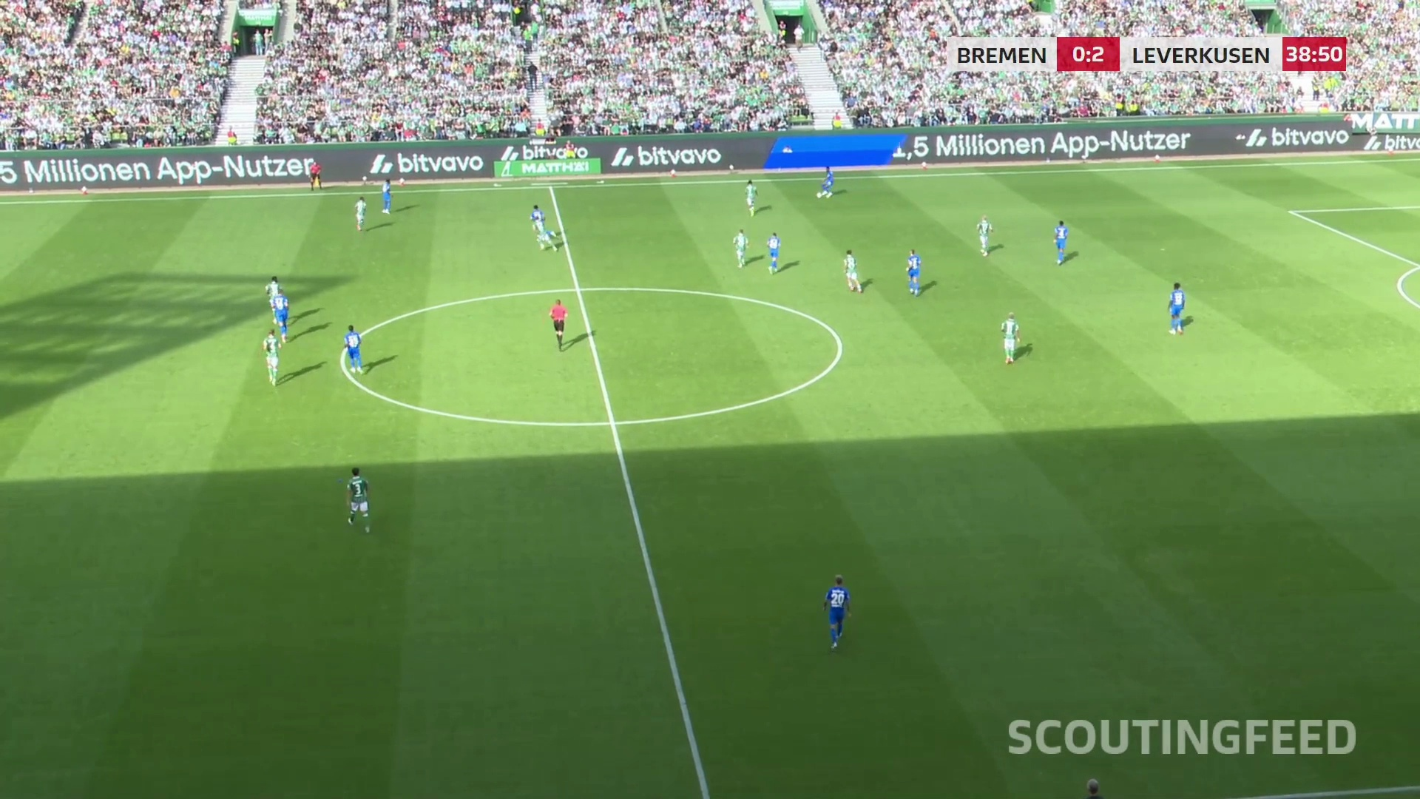
Preprocessing effects
on fixed pose models
Controlled experiments in football video
Master’s thesis
Scientific design and current status
Notes:
TARGET 20 SECONDS
My thesis investigates the effect of preprocessing on pose estimation. The scientific intervention is the input transformation. I keep the published pose-model weights unchanged and compare each processed input with its own baseline. Today I will focus on the experimental controls, reference data, evaluation protocol and reproducibility.
SOURCES
Repository experiment.md, TODOS.md, configs/lyra-preprocessing-screen.yaml and configs/lyra-preprocessing-base.yaml at commit 21c1068.
User-supplied Master Thesis.pdf, 10 pages, especially pp. 7–9. These are research/literature notes. Latest screening results supersede older implementation-status notes on p. 9.
Photo: footage/sample_30.mov, frame 140.

Slide 2
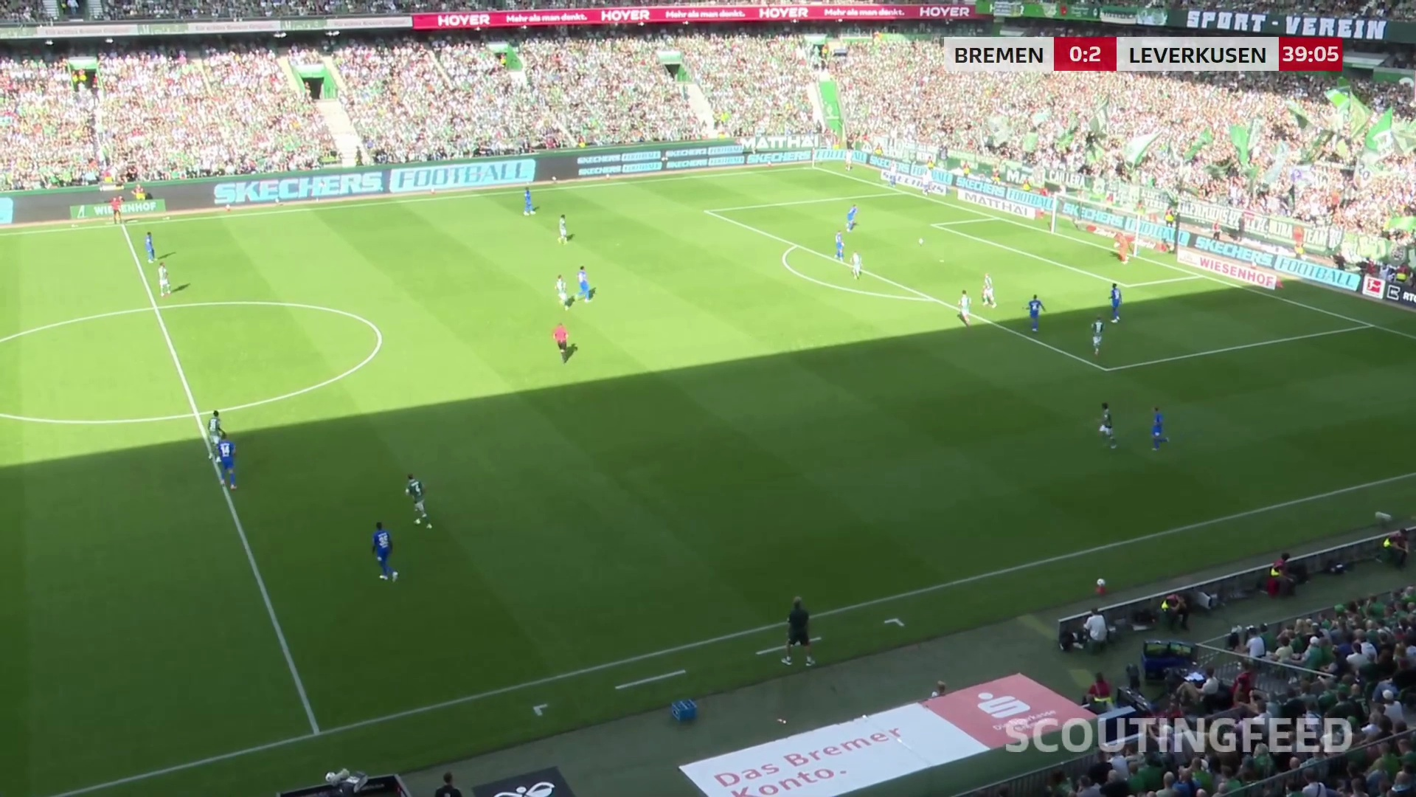
Research question
How does preprocessing change pose quality when model weights stay fixed?
Independent variable
Processing method
and its parameters
Measured outcomes
Detection coverage
Joint localization
Computational cost
Notes:
TARGET 40 SECONDS
The question is whether a defined input operation changes pose quality under a fixed model protocol. Football scouting video gives us small players, shadows and a moving camera. I compare the same images with and without processing, rather than train a model for each condition. The outputs of interest include whether we find the right people, how accurately we locate their joints, and the computational cost. A visual enhancement can help one model and hurt another. The effect we estimate therefore applies to the specified model, data and inference settings.
SOURCES
Repository experiment.md, TODOS.md, configs/lyra-preprocessing-screen.yaml and configs/lyra-preprocessing-base.yaml at commit 21c1068.
User-supplied Master Thesis.pdf, 10 pages, especially pp. 7–9. These are research/literature notes. Latest screening results supersede older implementation-status notes on p. 9.
Photo: footage/sample_30.mov, frame 580.

Slide 3
Controlled comparison
Fixed published pretrained checkpoints. No training or fine-tuning within the comparison.
Baseline
Fixed pose model
Unchanged input
Same weights
Same inference settings
Same input
Paired evaluation
Same frames
Same labels
Same matching rules
Difference vs baseline
One processing step
Fixed pose model
Method + fixed parameters
Same weights
Same inference settings
Notes:
TARGET 60 SECONDS
The central design is a paired comparison. Both branches start from exactly the same input and reference labels. One leaves the input unchanged. The other applies one processing operation with explicit parameters. Each branch uses the same published pretrained checkpoint, confidence thresholds and inference configuration. We do not update weights during this experiment and do not fine-tune a separate pose model per condition. This means off-the-shelf pretrained inference, rather than randomly initialized, untrained networks. HRNet still needs our existing trained player detector, and the pitch model and learned super-resolution also have existing trained weights. Those auxiliary checkpoints stay fixed too. The estimated effect includes downstream detector and crop changes in a complete pipeline.
SOURCES
Repository experiment.md, TODOS.md, configs/lyra-preprocessing-screen.yaml and configs/lyra-preprocessing-base.yaml at commit 21c1068.
User-supplied Master Thesis.pdf, 10 pages, especially pp. 7–9. These are research/literature notes. Latest screening results supersede older implementation-status notes on p. 9.
Compared pose models: YOLO26x Pose, OpenPose BODY_25 and HRNet-W32. Auxiliary football detector, pitch model and FSRCNN are existing trained components, not newly trained per condition.

Slide 4
Ground truth for distinct evaluation tasks
Reference data must describe the quantity that each metric evaluates.
Evaluation task | Independent reference | Current position
COCO pose benchmark | Official person keypoints and visibility labels | Available
Football image-plane pose | Validated DFL/Werder joints, if available Otherwise reviewed manual annotations | Format and alignment still pending
Pitch-coordinate positions | Synchronized tracking x/y with independently checked calibration | Later evaluation stage
Notes:
TARGET 65 SECONDS
We need different reference data for different questions. COCO already provides person keypoints and visibility labels, and the official evaluator is integrated. Football pose accuracy requires independent body-joint annotations in the source image. We first need to confirm the DFL or Werder schema, timestamps and joint definitions. If suitable joints are unavailable, a reviewed manual annotation sample is the fallback. Tracking x and y coordinates support a later player-position evaluation, but they do not provide ground truth for all body joints. Predicted poses and predicted pitch boundaries are not independent reference labels. I am showing the football annotation and alignment work as pending, rather than claiming that these references already exist in an evaluable form.
SOURCES
Repository experiment.md, TODOS.md, configs/lyra-preprocessing-screen.yaml and configs/lyra-preprocessing-base.yaml at commit 21c1068.
User-supplied Master Thesis.pdf, 10 pages, especially pp. 7–9. These are research/literature notes. Latest screening results supersede older implementation-status notes on p. 9.
Official COCO evaluator: https://github.com/cocodataset/cocoapi/blob/master/PythonAPI/pycocotools/cocoeval.py
TODOS.md: ground-truth alignment remains blocked by external format, camera/projection and synchronization details.

Slide 5
Football reference-data protocol
Proposed workflow before the final accuracy experiment
1
Define the evaluation sample
Include varied scale, lighting, occlusion and camera views
2
Align the reference to the video
Match timestamps, player identities and joint definitions
3
Review labels independently
Record visibility, uncertainty and annotation disagreements
4
Freeze development and test sets
Separate video sequences and version the approved labels
Notes:
TARGET 55 SECONDS
The proposed football reference workflow starts with an evaluation sample that covers different scales, lighting conditions, occlusion and camera views. The inclusion rule should cover actual target players, including missed detections. We then align timestamps, identities and joint names in original-frame coordinates. Independent review records visibility and uncertain joints, rather than forcing labels where the evidence is inadequate. We freeze the reviewed labels and split by sequence or match so that neighbouring frames do not leak between development and final testing. If reference joints come in three-dimensional coordinates, they require camera projection. A planar pitch homography only supports ground-plane points, not arbitrary elevated body joints.
SOURCES
Repository experiment.md, TODOS.md, configs/lyra-preprocessing-screen.yaml and configs/lyra-preprocessing-base.yaml at commit 21c1068.
User-supplied Master Thesis.pdf, 10 pages, especially pp. 7–9. These are research/literature notes. Latest screening results supersede older implementation-status notes on p. 9.
Proposed study protocol, not a completed annotation or quality-assurance result.

Slide 6
Pipeline, step by step
Every prediction returns to the original frame before matching against ground truth.
1 Input
2 Processing
3 Inference
4 Remapping
5 Matching
6 Evaluation
Freeze frames
and metadata
Apply one
configured step
Run unchanged
pose weights
Source pixels
Merge tile records
Reference IDs
Eligible joints
Score accuracy
and runtime
Notes:
TARGET 70 SECONDS
Step one fixes the source images, frame identifiers and metadata. Step two applies exactly one configured processing method and writes a lossless cached artifact. Step three runs the unchanged pose model. For HRNet, the fixed detector supplies person crops. Step four maps crop, resize and tile coordinates back to the original image and removes cross-tile duplicate records. A separate frozen pitch model operates on each original football frame and provides shared geometry for target filtering. Step five matches predictions to independent reference people and eligible joints. Step six computes the chosen metrics and the paired difference against baseline. The implementation already covers preprocessing, inference, remapping and pitch decisions. Official COCO matching and scoring exist. Football reference alignment and accuracy scoring remain the next evaluation layer.
SOURCES
Repository experiment.md, TODOS.md, configs/lyra-preprocessing-screen.yaml and configs/lyra-preprocessing-base.yaml at commit 21c1068.
src/football_pose/screening.py, experiments.py, model_mapping.py, pitch_filter.py and coco_evaluation.py.

Slide 7
Evaluation metrics
COCO AP/AR scoring is implemented. Football accuracy metrics require aligned ground truth.
Metric | Question it answers
AP / AR using OKS | How accurately and completely do we recover person poses?
PCK and PCK-AUC | How often do joints fall within a normalized distance tolerance?
PCP | Do the endpoints of a body part satisfy a fixed tolerance?
Player precision / recall | How many detections are correct, and how many targets do we find?
Detected-joint coverage | How many eligible reference joints receive confident predictions?
Pitch-position error | How far are player ground points from tracking positions, in metres?
Notes:
TARGET 65 SECONDS
The main pose benchmark uses OKS-based average precision and average recall. COCO accounts for person scale and joint-specific localization tolerances. PCK measures the rate of sufficiently close joints under a declared normalization. PCK-AUC summarizes the threshold curve. PCP adds a body-part view. Player precision and recall distinguish extra detections from missed target players. Detected-joint coverage describes completeness, so it should be interpreted alongside localization accuracy. For the later tracking task, positional error uses metres. Before evaluating football, we must freeze matching, joint eligibility, score thresholds and normalization. Raw counts from the present screening cannot substitute for these accuracy measures. The supplementary football metrics are a planned evaluation protocol, not results we have already computed.
SOURCES
User-supplied Master Thesis.pdf, 10 pages, especially pp. 7–9. These are research/literature notes. Latest screening results supersede older implementation-status notes on p. 9.
Official COCO evaluator: https://github.com/cocodataset/cocoapi/blob/master/PythonAPI/pycocotools/cocoeval.py
MMPose PCK and PCK-AUC reference: https://mmpose.readthedocs.io/en/latest/_modules/mmpose/evaluation/functional/keypoint_eval.html
Proposed football extension. Official COCO maxDets=20 and standard OKS sigmas apply to the separate benchmark. A football protocol must declare any deviation.

Slide 8
Estimating the processing effect
Paired comparisons use the same reference population in every condition.
Δ score = score(processed input) − score(baseline)
1
Fixed denominators
Count missed targets and unpredicted eligible reference joints
2
Separate error sources
Report detection, pose localization and pitch-filter errors
3
Independent confirmation
Choose settings on development clips, then test held-out sequences
Notes:
TARGET 40 SECONDS
For each model, the processing effect is a paired score difference on the same reference data. We must not evaluate only the players a method happens to detect. Missed people and frames without predictions stay in the evaluation population. We also separate pose localization errors from person detection and pitch-filter failures. Thresholds and candidate combinations should be chosen on development clips and confirmed on held-out sequences. Multiple sequences support uncertainty estimates. Adjacent frames from the current single clip are correlated, so 782 frames do not constitute 782 independent experiments.
SOURCES
Repository experiment.md, TODOS.md, configs/lyra-preprocessing-screen.yaml and configs/lyra-preprocessing-base.yaml at commit 21c1068.
User-supplied Master Thesis.pdf, 10 pages, especially pp. 7–9. These are research/literature notes. Latest screening results supersede older implementation-status notes on p. 9.
Proposed statistical protocol: paired sequence-level summaries and interval estimation after sufficient independent clips are available.

Slide 9
Reproducibility safeguards
A result needs a recoverable input, configuration and execution environment.
Already recorded
Final-study verification
Input and checkpoint SHA-256
Expanded YAML and processing order
Git revision and package versions
Hardware metadata and runner logs
Raw predictions and decision archives
Pin actual container image digests
Freeze labels and evaluation settings
Repeat a reference run
Declare numerical tolerances
Measure cold and warm runtime separately
Notes:
TARGET 50 SECONDS
The pipeline records input and checkpoint hashes, expanded YAML, processing order, code revision, package versions, hardware metadata and logs. It preserves the raw predictions as well as derived pitch decisions. Content-addressed caches separate different inputs and settings, and new invocations preserve earlier result folders. To complete the final-study reproducibility protocol, we should also pin actual container image digests, version the reference labels and evaluator, and repeat a reference run under declared numerical tolerances. A mutable development image tag is not a complete environment identifier. No retraining removes one source of variation, but it does not guarantee bit-identical GPU arithmetic. We should verify repeatability instead of assuming it.
SOURCES
Repository experiment.md, TODOS.md, configs/lyra-preprocessing-screen.yaml and configs/lyra-preprocessing-base.yaml at commit 21c1068.
src/football_pose/provenance.py; src/football_pose/artifacts.py; src/football_pose/screening.py.
Final-study controls in the right column are proposed checks, not claims that all are currently enforced.

Slide 10
Experimental matrix
One unchanged baseline and eleven individual processing conditions
Processing family | Conditions
Scale and regions | Bicubic ×2, FSRCNN ×2, 2 × 2 tiling, detector-guided crops
Contrast and brightness | CLAHE, gamma darken, gamma brighten
Noise and restoration | Non-local means, bilateral denoising, unsharp, Wiener deblur
YOLO26x Pose
OpenPose BODY_25
HRNet-W32
Current football pilot
12 conditions × 3 models
782 identical source frames
Notes:
TARGET 35 SECONDS
The current pilot evaluates twelve conditions with three model families. One condition is the unchanged baseline, followed by eleven separate methods. Tiling uses a fixed two-by-two grid with ten percent overlap. The scale comparison includes bicubic resizing and fixed FSRCNN super-resolution at the same factor, which helps distinguish enlargement from a learned restoration effect. We first study individual operations. Combinations come later, after the reference data and primary metrics are fixed. The full COCO preprocessing ablation is a later extension. The implemented COCO path currently checks the unchanged model setup.
SOURCES
Repository experiment.md, TODOS.md, configs/lyra-preprocessing-screen.yaml and configs/lyra-preprocessing-base.yaml at commit 21c1068.
User-supplied Master Thesis.pdf, 10 pages, especially pp. 7–9. These are research/literature notes. Latest screening results supersede older implementation-status notes on p. 9.
configs/lyra-preprocessing-screen.yaml.

Slide 11
Current experiment status
Exploratory detection yield on the football clip. Accuracy evaluation remains pending.
Model | Baseline on pitch | Example condition | On pitch
YOLO26 | 357 | Bilateral denoising | 2,115
OpenPose | 11,647 | CLAHE | 15,338
HRNet | 3,602 | Bicubic ×2 | 15,554
Completed: 35 of 36 model jobs
Open cases: HRNet tiling, YOLO cropping and the failed OpenPose crop job
Notes:
TARGET 60 SECONDS
The current football pilot completes thirty-five of thirty-six model jobs. These examples show why model-specific evaluation matters. Bilateral filtering increases YOLO on-pitch records from 357 to 2,115. CLAHE increases OpenPose from 11,647 to 15,338. Bicubic resizing raises HRNet from 3,602 to 15,554. These are exploratory yield observations, not validated gains in localization accuracy. The latest filtering counts changed after the configuration update, while the checkpoint hash still needs confirmation from the detailed report. Three integration cases remain unresolved: HRNet with tiling yields one raw record, YOLO cropping yields zero, and OpenPose cropping fails. Super-resolution produces almost the same HRNet yield as bicubic scaling, so any distinct restoration benefit still needs accuracy evidence. The next scientific milestone is an independently referenced comparison.
SOURCES
User-supplied screening overview for 20261022T181655Z-fefcb4ec, 22 October 2026. Person-pose record counts across 782 frames, not unique players or accuracy.
Repository experiment.md, TODOS.md, configs/lyra-preprocessing-screen.yaml and configs/lyra-preprocessing-base.yaml at commit 21c1068.
Pitch reference comparison separately showed 782/782 accepted fits for Roboflow versus 306/782 for the retired nano model. Fit coverage does not establish landmark accuracy.

Slide 12
Next scientific milestones
1
Reference-data agreement
Confirm football joints, tracking timestamps and annotation fallback
2
Protocol freeze
Select the primary metric, matching rules and held-out sequences
3
Verified ablation study
Resolve runner issues, repeat baselines and score every condition
4
Confirmation and downstream use
Test selected combinations, then compare pitch positions with tracking
Notes:
TARGET 40 SECONDS
The next milestone is agreement on the football reference data and the primary evaluation protocol. We need to confirm whether the supplied data contain suitable body joints, synchronize any tracking reference and decide the manual-annotation fallback. We then freeze metrics, matching rules and development/test sequences. After resolving the runner problems, we can repeat baselines and evaluate all conditions against the same labels. Selected combinations require a final held-out confirmation. Pitch-coordinate tracking comparison follows as a separate downstream evaluation. This makes the thesis a controlled study of input processing with fixed models, rather than a model-training project.
SOURCES
Repository experiment.md, TODOS.md, configs/lyra-preprocessing-screen.yaml and configs/lyra-preprocessing-base.yaml at commit 21c1068.
User-supplied Master Thesis.pdf, 10 pages, especially pp. 7–9. These are research/literature notes. Latest screening results supersede older implementation-status notes on p. 9.
Proposed milestones.

Slide 13
Backup: on-pitch screening overview 1/2
Record count and change relative to each model’s own baseline
Processing | YOLO26 | OpenPose | HRNet
Baseline | 357 (reference) | 11,647 (reference) | 3,602 (reference)
Resize ×2 | 283 (-20.7%) | 10,934 (-6.1%) | 15,554 (+331.8%)
CLAHE | 1,156 (+223.8%) | 15,338 (+31.7%) | 3,995 (+10.9%)
Gamma darken | 315 (-11.8%) | 12,193 (+4.7%) | 3,634 (+0.9%)
Gamma brighten | 440 (+23.2%) | 11,029 (-5.3%) | 3,568 (-0.9%)
NLM denoising | 615 (+72.3%) | 8,054 (-30.8%) | 3,037 (-15.7%)
Notes:
BACKUP
Use this table for discussion. These are record counts across the pilot clip. They do not rank pose accuracy. HRNet tiling and YOLO cropping have suspicious raw outputs, while OpenPose cropping fails. Repeated-frame observations are correlated. The current report mainly has warm-cache timings, so it cannot establish total cold preprocessing cost.
SOURCES
User-supplied screening overview for 20261022T181655Z-fefcb4ec, 22 October 2026. Person-pose record counts across 782 frames, not unique players or accuracy.

Slide 14
Backup: on-pitch screening overview 2/2
Record count and change relative to each model’s own baseline
Processing | YOLO26 | OpenPose | HRNet
Bilateral denoising | 2,115 (+492.4%) | 12,581 (+8.0%) | 3,216 (-10.7%)
Unsharp | 491 (+37.5%) | 11,860 (+1.8%) | 2,675 (-25.7%)
Motion deblur | 1,627 (+355.7%) | 7,362 (-36.8%) | 214 (-94.1%)
Super-resolution ×2 | 312 (-12.6%) | 11,583 (-0.5%) | 15,565 (+332.1%)
Tiling | 3,402 (+852.9%) | 16,072 (+38.0%) | 1 (-100.0%)
Detector crop | 0 (-100.0%) | FAILED | 3,467 (-3.7%)
Notes:
BACKUP
Use this table for discussion. These are record counts across the pilot clip. They do not rank pose accuracy. HRNet tiling and YOLO cropping have suspicious raw outputs, while OpenPose cropping fails. Repeated-frame observations are correlated. The current report mainly has warm-cache timings, so it cannot establish total cold preprocessing cost.
SOURCES
User-supplied screening overview for 20261022T181655Z-fefcb4ec, 22 October 2026. Person-pose record counts across 782 frames, not unique players or accuracy.

Slide 15
Backup: metric conventions
Proposed football conventions must be agreed and frozen before final scoring.
Metric | Convention to document
OKS / AP / AR | Standard COCO sigmas and OKS thresholds 0.50 to 0.95 for COCO
PCK | Distance threshold and reference normalization, such as GT box diagonal
PCK-AUC | Integral over an explicitly stated PCK threshold interval
PCP | Limb list and endpoint tolerance relative to reference limb length
Coverage / precision / recall | Eligible joints, target population, confidence and one-to-one matching
Position error | Timestamp, player identity, coordinate convention and distance in metres
Notes:
BACKUP
For the football extension, one proposed normalization is Euclidean joint error divided by the ground-truth box diagonal, with predeclared PCK thresholds and a declared PCK-AUC interval. That choice remains to be agreed rather than silently inferred from a library default. Define the PCP limb list and reference-length tolerance. Missing detections must remain visible in end-to-end recall. If PCK is reported only on matched people, label that conditional result and also report detection recall. Ground-truth visibility determines eligibility. Joint-confidence coverage cannot by itself establish positional correctness. Tracking error requires matched identities, timestamps and coordinate conventions. COCO uses its existing official protocol.
SOURCES
User-supplied Master Thesis.pdf, 10 pages, especially pp. 7–9. These are research/literature notes. Latest screening results supersede older implementation-status notes on p. 9.
Official COCO evaluator: https://github.com/cocodataset/cocoapi/blob/master/PythonAPI/pycocotools/cocoeval.py
MMPose PCK and PCK-AUC reference: https://mmpose.readthedocs.io/en/latest/_modules/mmpose/evaluation/functional/keypoint_eval.html

