Slide 1
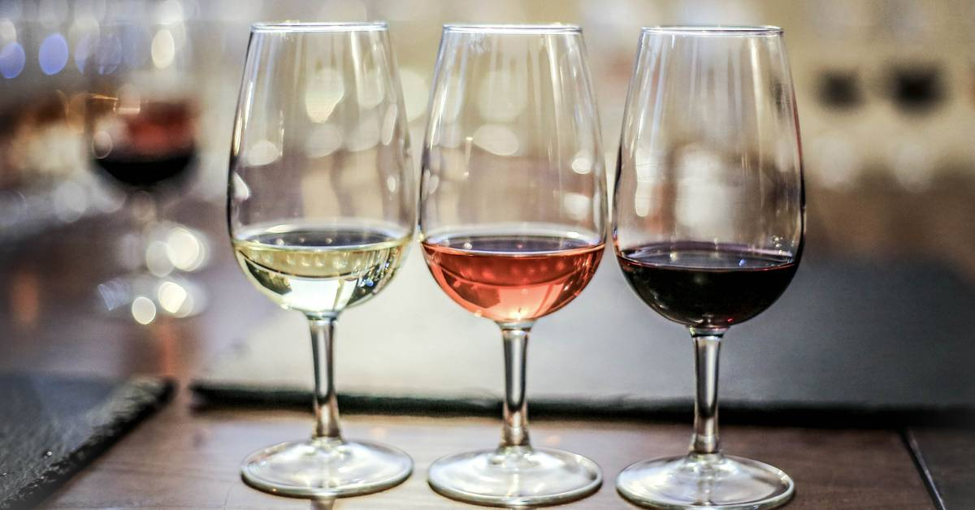
Predicting Wine Quality using Text Reviews

Slide 2
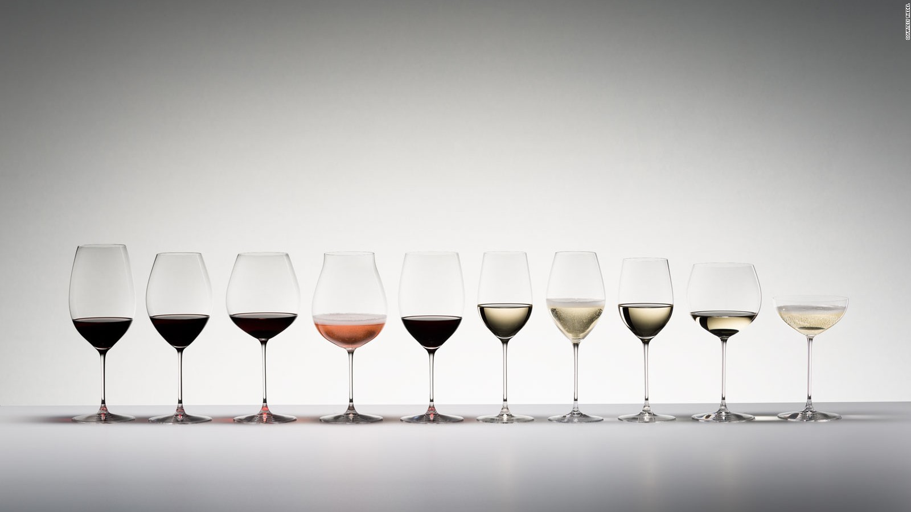
Objective
Exploring the relationship between the review and wine score
Train a Machine Learning model which predicts Wine Quality based on Text Review

Slide 3

About the Data
Location and Key Ingredients
Country and state that the wine is from
The wine growing area
The type of grapes used to make the wine
Professionals
Features
The Winery that made the wine
Tester Name
Reviews and Price
Taster’s Review
Review Title
Bottle’s Price
Score
Target
Wine Rrating ( Between 1 - 100)

Slide 4
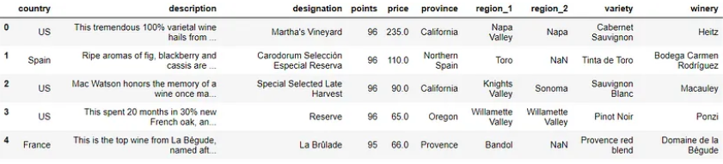
Data Screenshot

Slide 5
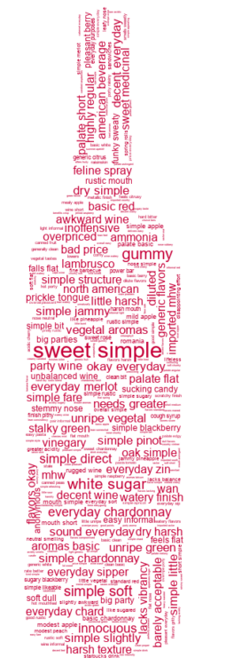
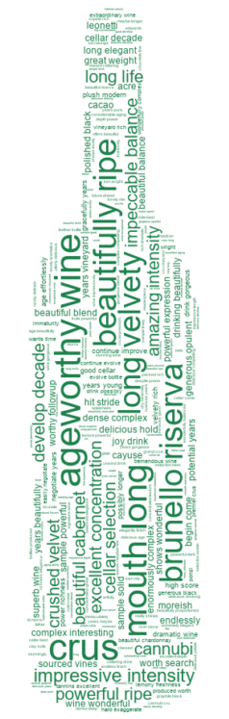
Average Quality v/s Good Quality

