Slide 1
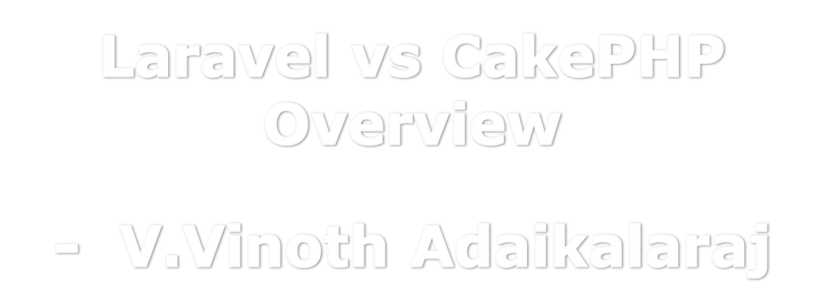
Blog Ref:
https://www.etatvasoft.com/blog/laravel-vs-cakephp-what-to-choose-for-web-development/

Slide 2
What is Laravel Framework
  It is a simple Model View Controller Framework in PHP world.
  It allowed developers to separate the view Layouts and business logic.
  Model which is data-store / Database, can be handled with well equipped methodologies like Routing, Templating and ORM.
        `

Slide 3
Laravel - Key Features
  Dependency management (Composer is tool to build this)
  Eloquent ORM
  Authentication
  Routing
  Security

Slide 4
What is CakePHP Framework
  It is a rich Model View Controller Framework, only for Non enterprise Web Application.
  It allowed developers to develop application with rapid design.
  No need of developing web applications right from scratch.
        `

Slide 5
CakePHP- Key Features
  MVC pattern
  CRUD Scaffolding
  Built-in Validation
  Extend with Plugins
  Auto-Detect

Slide 6
Laravel & CakePHP - Similarities
  MVC is Key in both.
  Both are open source that extend the PHP versions.
  Both are developer friendly.
  Both can be used with HTML & Bootstrap to derive responsive applications.

Slide 7
Laravel & CakePHP – Dissimilarities
Factor | Laravel | CakePHP
Performance | High-end performance | No Databinding, So Low marigin data can only be handled.
Architecture | MVC pattern | HMVC (Hierarchical model–view–controller) architecture
Routing | Complex due to joint binding procedure | Simple
Data Backup | Yes, it does. | No or Less feasible.

Slide 8
Thank You
V VINOTH ADAIKALARAJ – MSc Computer Science.
vsraj1984@hotmail.com

