Slide 1
Predictive Analytics & AI Model Deployment
Customer Churn Prediction using Machine Learning
Vinay Petkar
Cognevance Technologies – Internship Project (Task 3)

Slide 2
Project Overview
• Goal: predict which telecom customers are likely to churn
• Built an end-to-end ML pipeline: data → model → API → dashboard
• Compared 4 models: Logistic Regression, Random Forest, Gradient Boosting, Neural Network
• Deployed best model as a Flask REST API
• Interactive Streamlit dashboard for insights and live predictions

Slide 3
Dataset
• Telco Customer Churn dataset (Kaggle)
• 7,043 customers, 21 columns
• 1,869 churned customers = 26.5% churn rate (imbalanced)
• Features: tenure, contract, monthly/total charges, internet service, payment method, support services
• Target: Churn (Yes/No → 1/0)

Slide 4
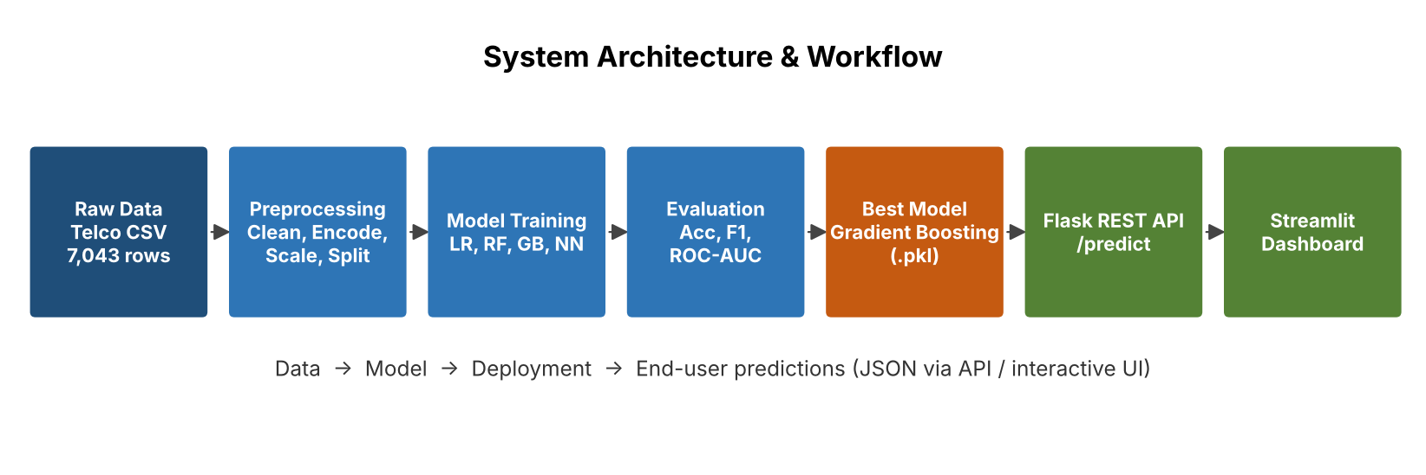
Architecture & Workflow

Slide 5
Data Preprocessing & Feature Engineering
• TotalCharges converted to numeric; 11 missing rows dropped (7,032 left)
• Dropped customerID; Churn encoded to 0/1
• New features: AvgChargesPerMonth, TenureGroup, TotalServices
• One-hot encoding of categorical columns → 35 features
• StandardScaler on numeric columns (saved as scaler.pkl)
• Stratified 80/20 split → train 5,625 / test 1,407

Slide 6
Model Results
Model | Accuracy | Precision | Recall | F1 | ROC-AUC
Gradient Boosting ★ | 0.7996 | 0.6494 | 0.5348 | 0.5865 | 0.8420
Logistic Regression | 0.7953 | 0.6387 | 0.5294 | 0.5789 | 0.8378
Neural Network | 0.7889 | 0.6351 | 0.4840 | 0.5493 | 0.8339
Random Forest | 0.7889 | 0.6296 | 0.5000 | 0.5574 | 0.8190
Gradient Boosting performed best (ROC-AUC 0.842) and was selected for deployment.
All models land in a similar range – typical for this dataset; recall on the churn class is the main trade-off.

Slide 7
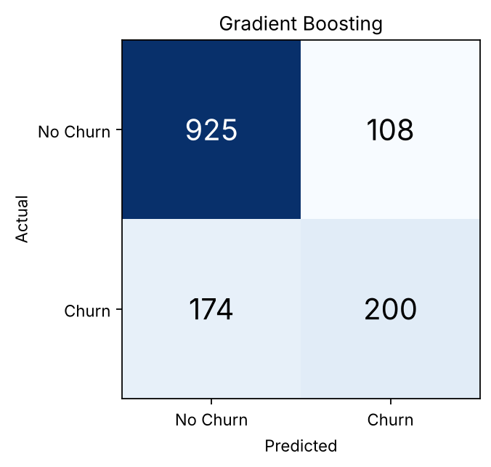
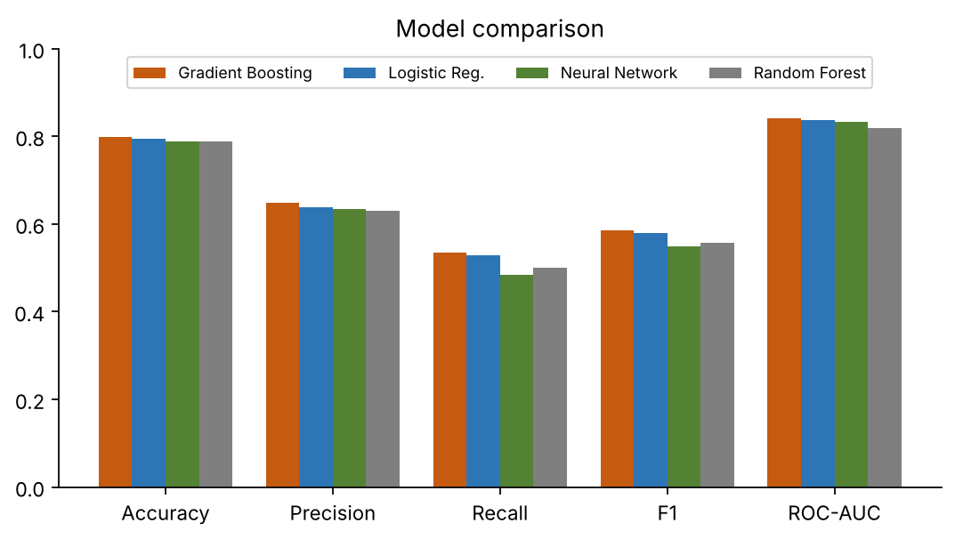
Evaluation – Confusion Matrix & Comparison
Gradient Boosting: TN 925, FP 108, FN 174, TP 200 – catches 200 of 374 churners with 65% precision.

Slide 8
Deployment – Flask REST API
• Endpoints: GET / (health), POST /predict
• Accepts raw customer JSON; API rebuilds features, one-hot encodes and scales
• Returns churn prediction + probability
• Test 1: new month-to-month customer → churn probability 0.7741 (High risk)
• Test 2: loyal two-year customer → 0.0273 (Low risk)

Slide 9
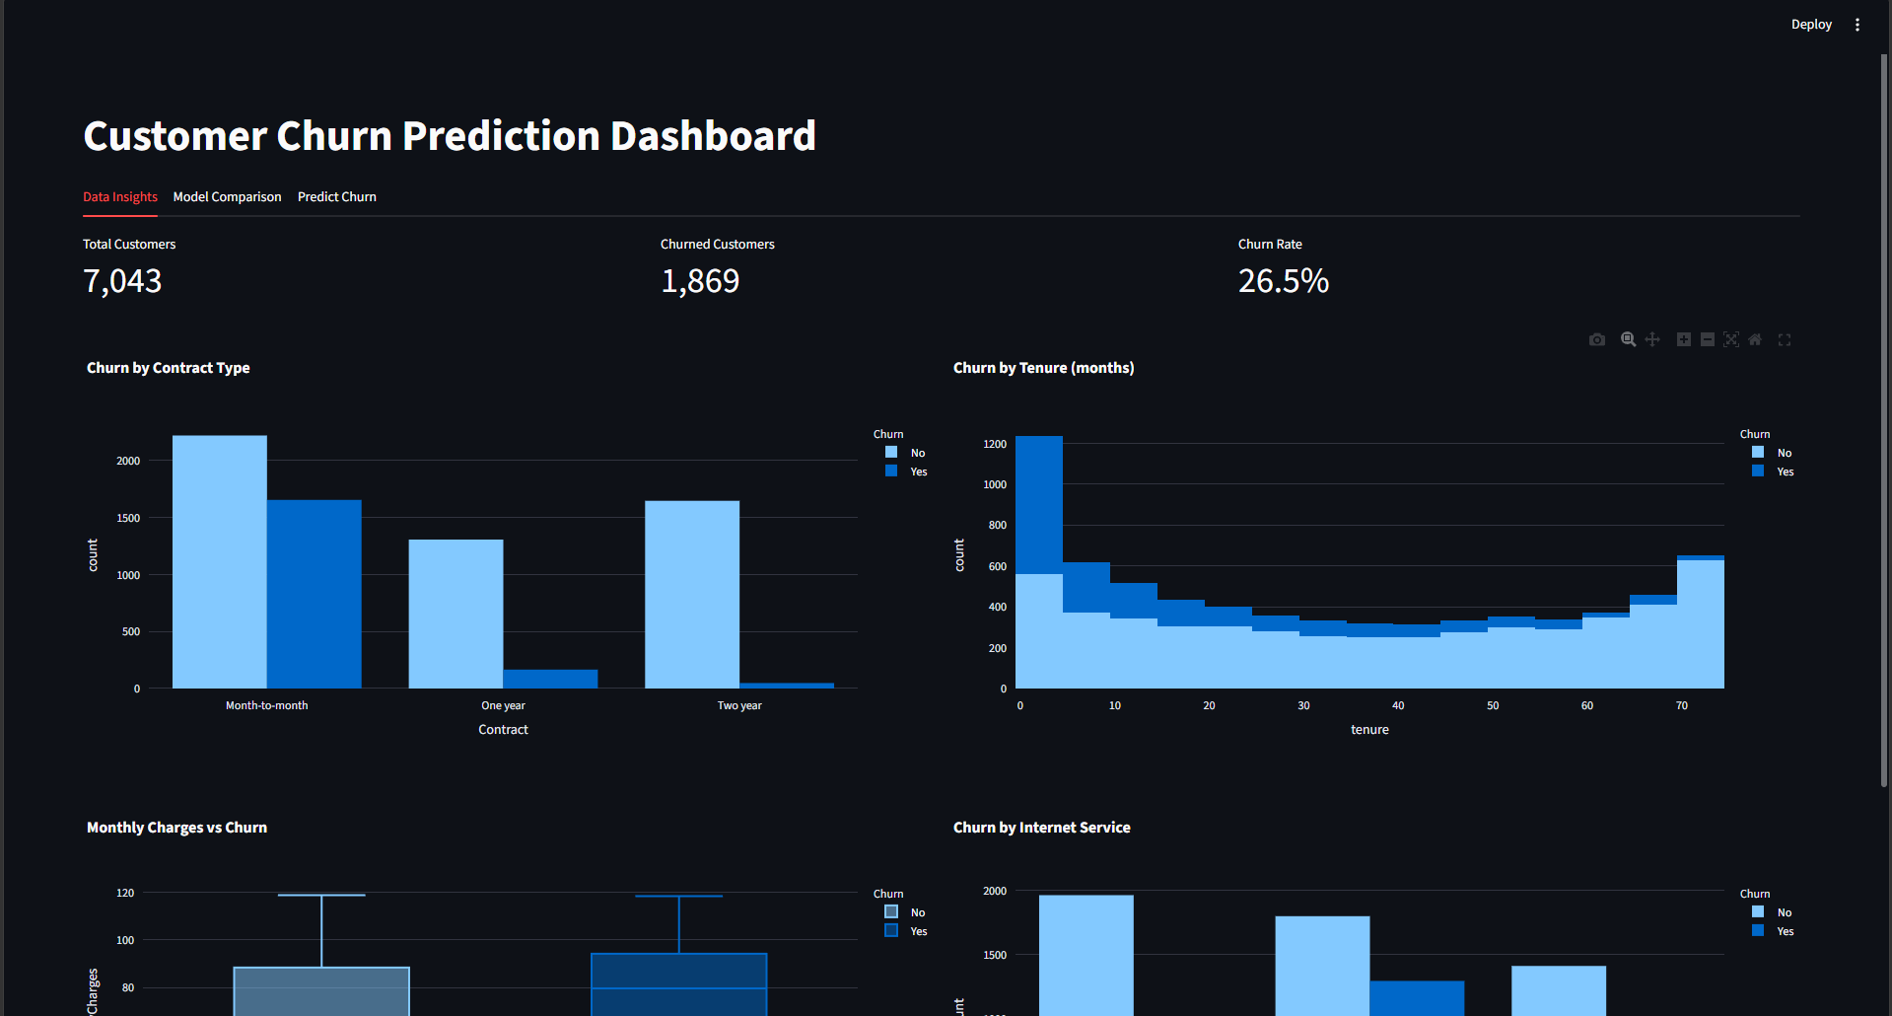
Dashboard – Data Insights

Slide 10
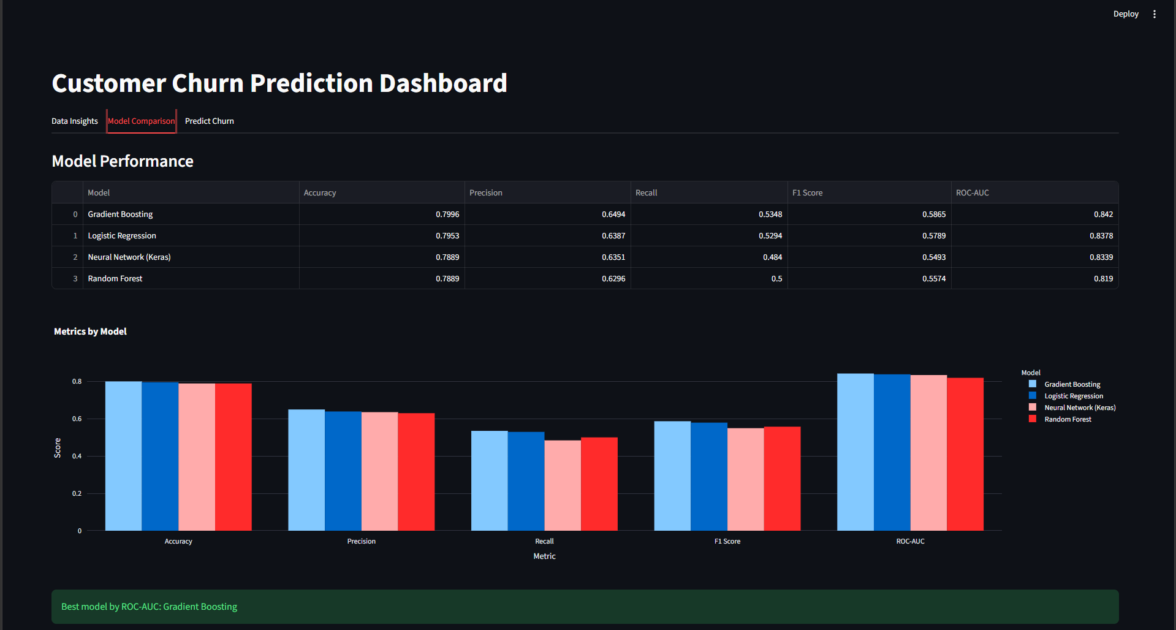
Dashboard – Model Comparison

Slide 11
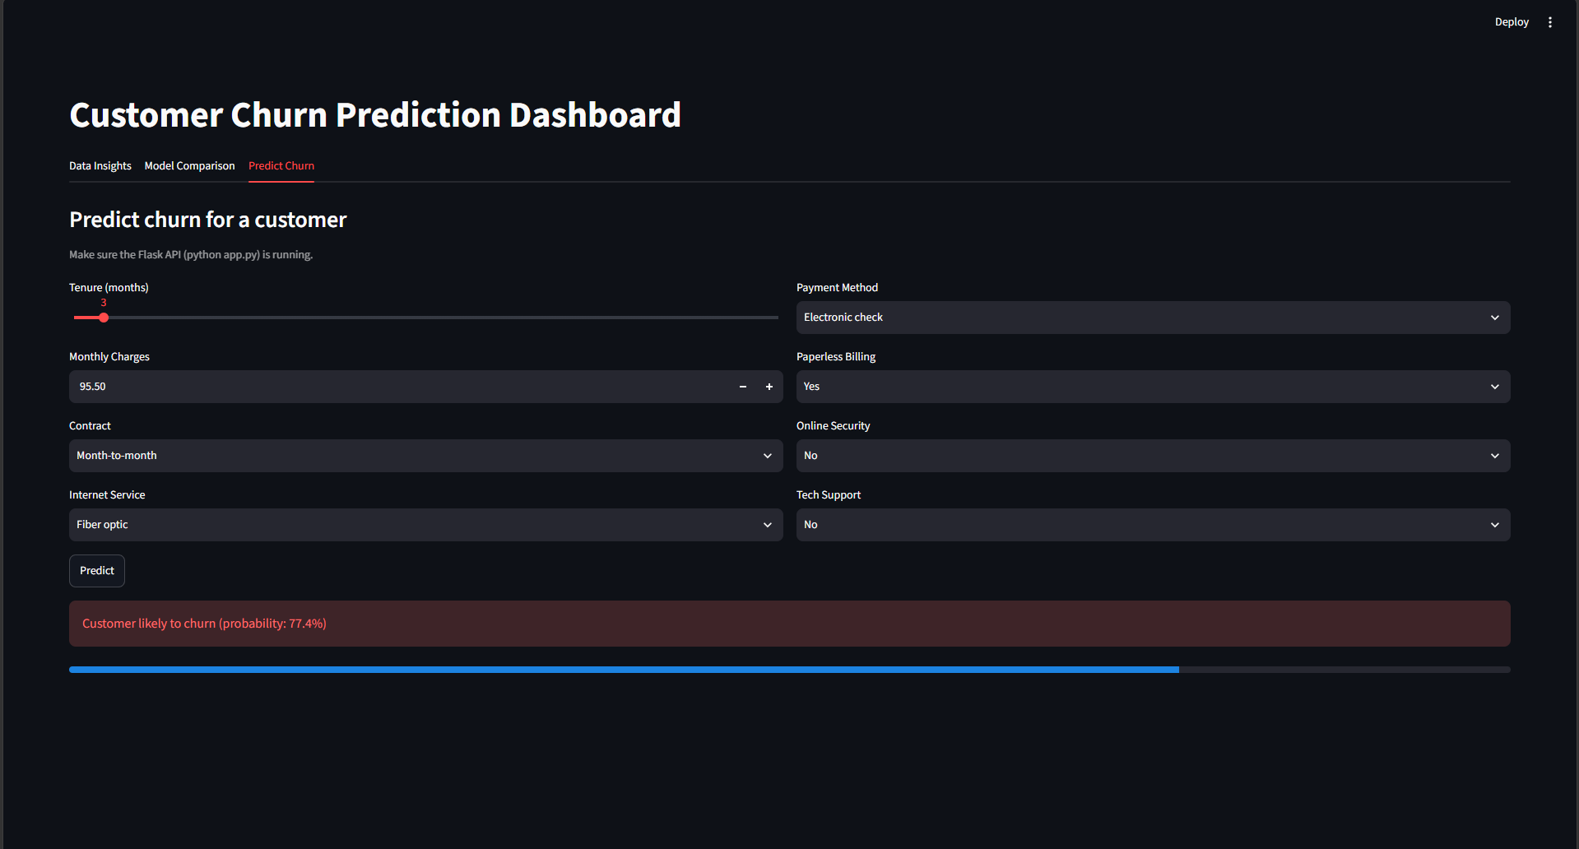
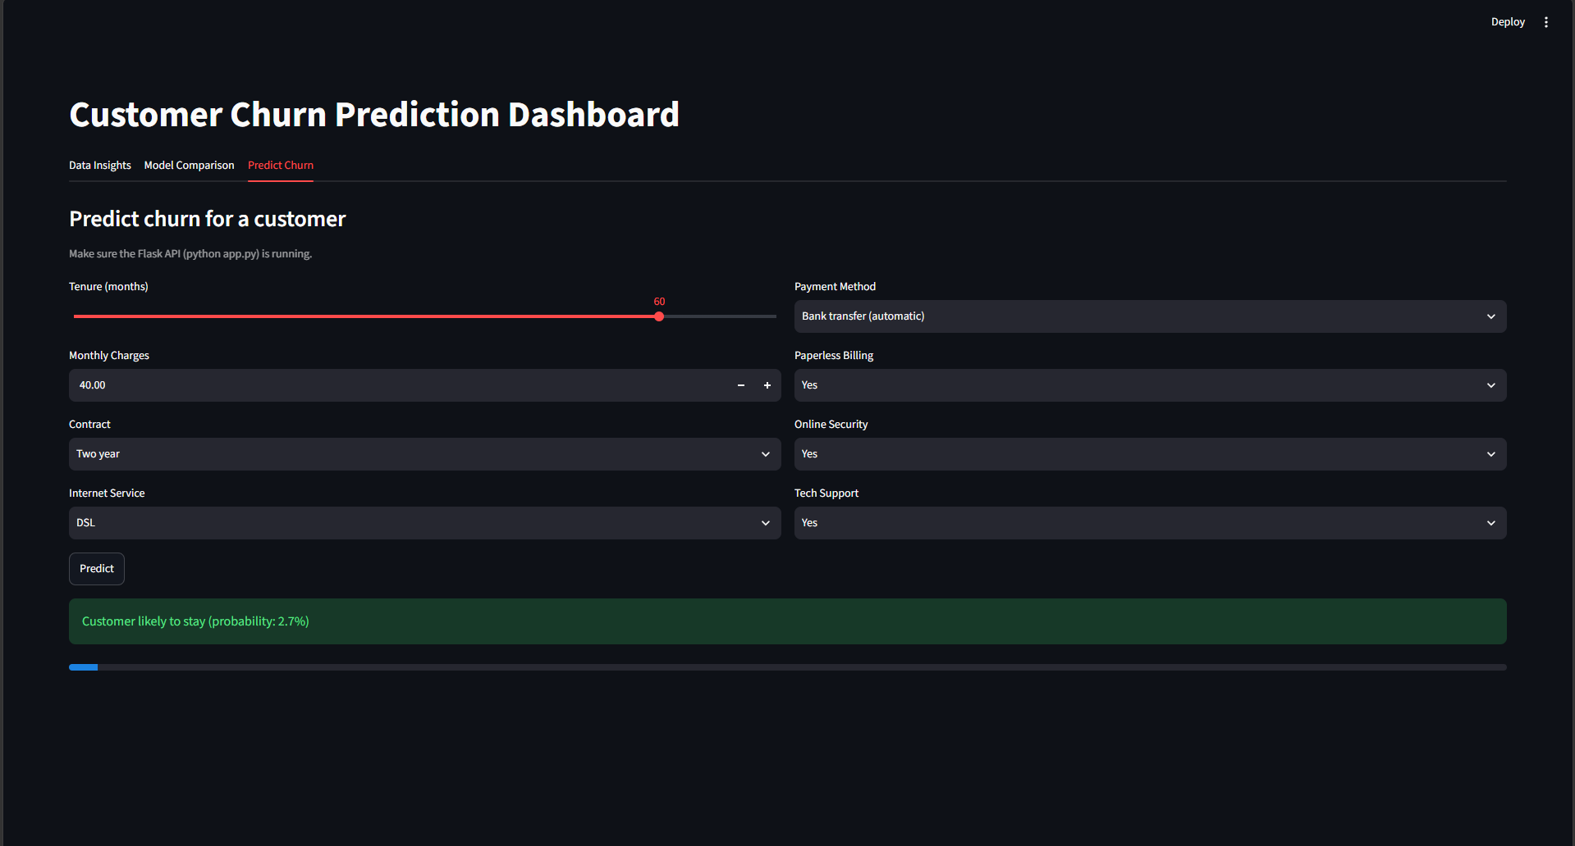
Dashboard – Live Prediction
High-risk customer → churn warning
Low-risk customer → likely to stay

Slide 12
Conclusion & Future Work
• Delivered a complete pipeline: preprocessing, 4 models, evaluation, API and dashboard
• Best model: Gradient Boosting – 80% accuracy, 0.842 ROC-AUC
• Future: hyperparameter tuning, class-imbalance handling (SMOTE), Docker/cloud deployment
• GitHub: https://github.com/vina-gif/churn-prediction-ai
Thank you!

