Slide 1
UserFront Softwares
Servers
API Backend Restful Microservices
Memory DB
MySQL DB
Mongo DB
Admin: Web Application
Notes:
DB hỗ trợ: http://loopback.io/doc/en/lb3/Database-connectors.html
minh họa api backend: http://45.77.45.94:7000/explorer/#!/Question/Question_findById

Slide 2
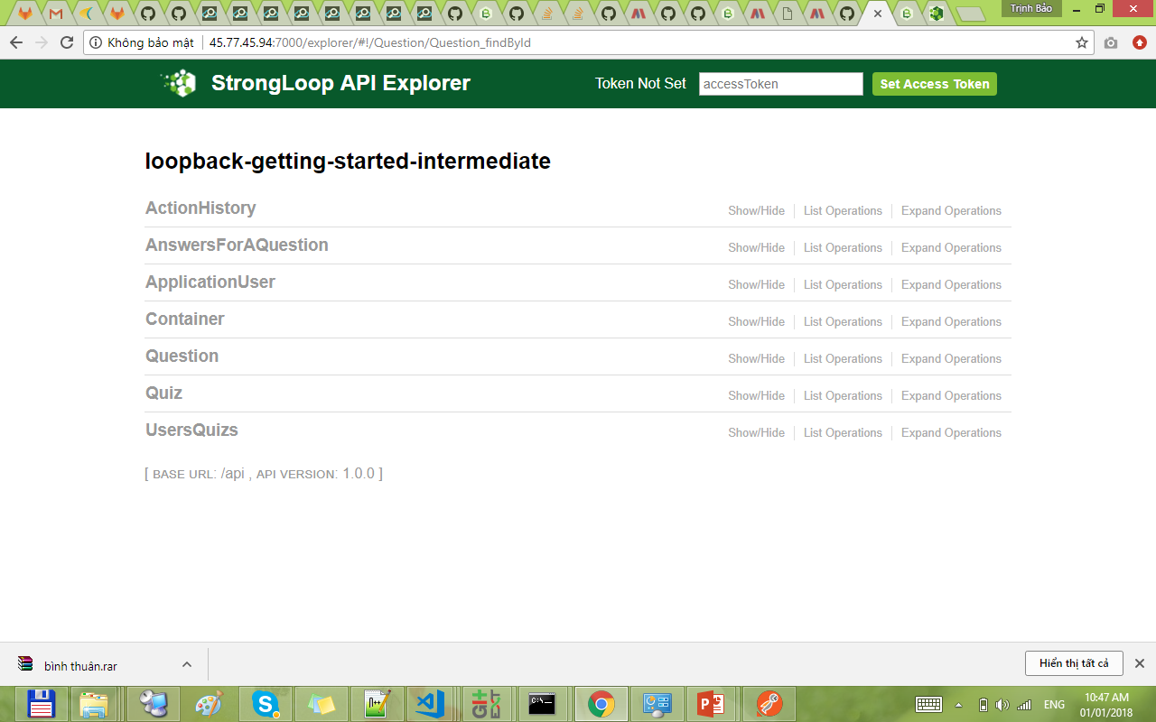

Slide 3
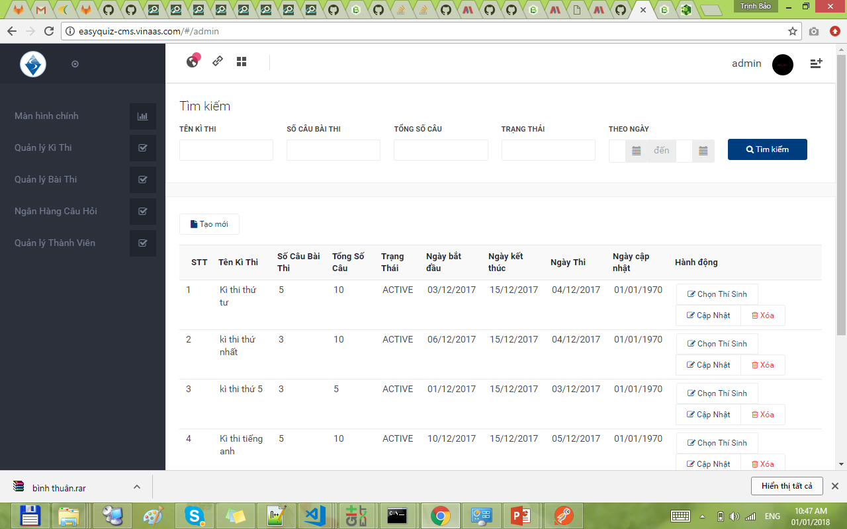
admin

Slide 4
