Slide 1
VISUAR
See Beyond — screen-based vision screening for any laptop
Estimate distance & near eyesight numbers, run clinical-style refraction tests, and get AI-powered guidance — all from a browser with a webcam.
React + Vite
FastAPI
MediaPipe CV
Supabase + pgvector
Gemini RAG
www.visuar-web.app · Project Presentation

Slide 2
WHY THIS PROJECT
Project Motivation
A real eye exam needs a 6-metre room, calibrated charts, trial lenses, and a professional. Most people skip checks until vision is badly degraded. VISUAR asks: how much of that screening can a laptop + webcam responsibly do?
Access gap
Screen-era eyes
Clinic → laptop
Screen, don't diagnose
Eye care is hard to reach, costly, and time-consuming. Routine screening gets postponed for years.
Heavy screen use drives myopia, eye strain and fatigue — yet few tools track vision at home.
Adapt the optometry workflow to a 60–80 cm screen using PPI calibration and webcam distance gating.
Give an approximate, honest number that nudges users to see a professional when needed.
Goal: a full screening platform — onboarding, real-time vision gating, diopter estimates, PDF reports, and an AI consultant — that is approximate by design and never replaces a clinical exam.
VISUAR · 02

Slide 3
WHAT IT IS
Description
VISUAR is a web platform that brings optometry-style checks to any laptop using three core ideas working together:
1 · PPI calibration
2 · Viewing-distance band
3 · Webcam as clinical proxy
User matches an on-screen box to a credit card (85.6 mm ISO). Now we know exactly how many pixels equal one millimetre on THIS display.
Acuity is about visual angle, not size. Letter heights are recomputed from 70 cm geometry so the same angle reaches the eye.
MediaPipe face landmarks + a focal-length model verify face presence, 60–80 cm range, and monocular eye-cover before a test runs.
Delivered capabilities
› 10 vision tests: Snellen, Jaeger, Landolt C, contrast, colour, duochrome, refraction simulator & battery, near–far, blur screener
› Live webcam gating — face / distance / eye-state / glasses detection
› Approximate diopter estimates + session fusion + downloadable PDF report
› AI consultant — profile-aware chat with RAG (Gemini + pgvector), voice I/O
› Supabase auth & onboarding · Free/Basic/Pro plans (Stripe) · EN + Urdu (RTL)
VISUAR · 03

Slide 4
HOW IT'S BUILT
Technology Stack
Frontend
Backend
Data & Infra
• React 18 + Vite 5
• React Router v6
• Tailwind CSS
• Supabase JS client
• Axios · i18next (EN/UR)
• Stripe Elements
• jsPDF report export
• ElevenLabs TTS · Web Speech
• FastAPI + Uvicorn
• SQLAlchemy (async)
• Supabase JWT auth
• OpenCV + MediaPipe
• Face Landmarker model
• Google Gemini
• LangChain + pgvector RAG
• aiosmtplib (email)
• PostgreSQL (Supabase)
• pgvector embeddings
• Vercel — frontend SPA
• Hugging Face Spaces — API
• Docker (HF Space)
• WebSocket /ws/vision
• Stripe billing
• Gmail SMTP
VISUAR · 04

Slide 5
DIAGRAM · SYSTEM ARCHITECTURE
Architecture Overview
BROWSER (React + Vite)
FASTAPI (Hugging Face Spaces)
SUPABASE
Pages & Test Engines
HTTPS + JWT
REST API
Auth (JWT)
PPI Calibrator
Webcam Preview
WebSocket /ws/vision
WS frames
PostgreSQL + pgvector
Results · PDF · AI Chat UI
Vision Module MediaPipe + OpenCV
AI Chat + RAG (Gemini)
SQL · vectors
Email Service
Frontend (Vercel) talks to FastAPI (HF Spaces) over HTTPS+JWT for tests/AI and over WebSocket for real-time webcam frames. Supabase handles auth + Postgres (with pgvector for RAG).
VISUAR · 05

Slide 6
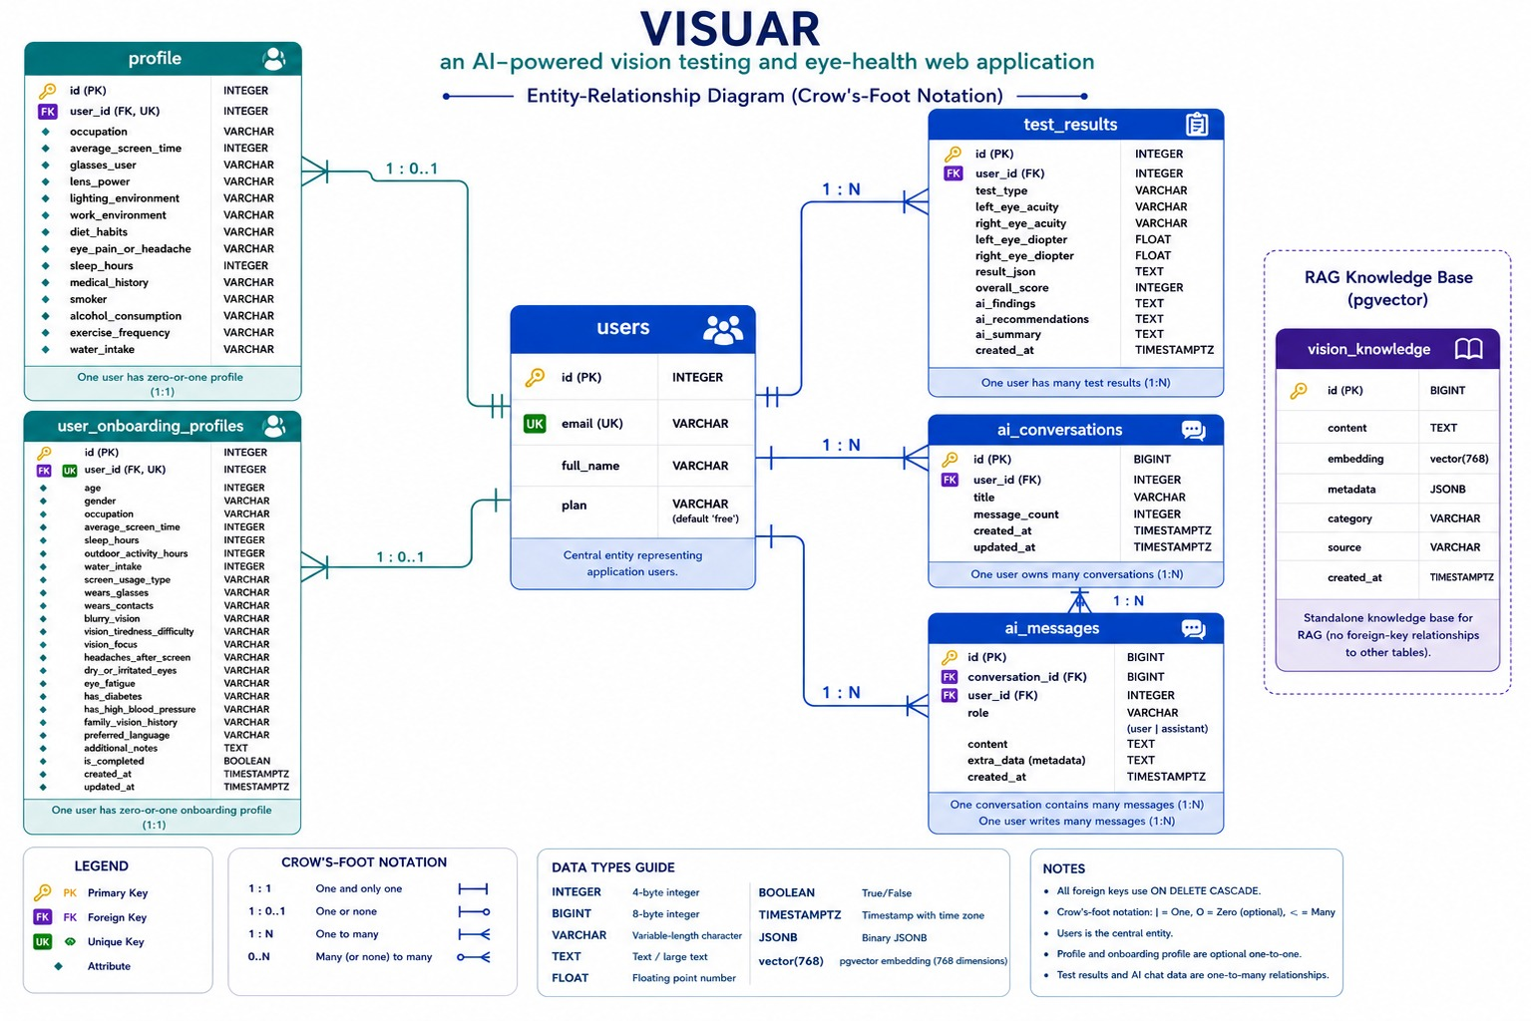
DIAGRAM · ENTITY RELATIONSHIP (ERD)
Database Schema — ERD
Crow's-foot ERD · 7 tables · all FKs ON DELETE CASCADE · pgvector knowledge base is standalone for RAG.
VISUAR · 06

Slide 7
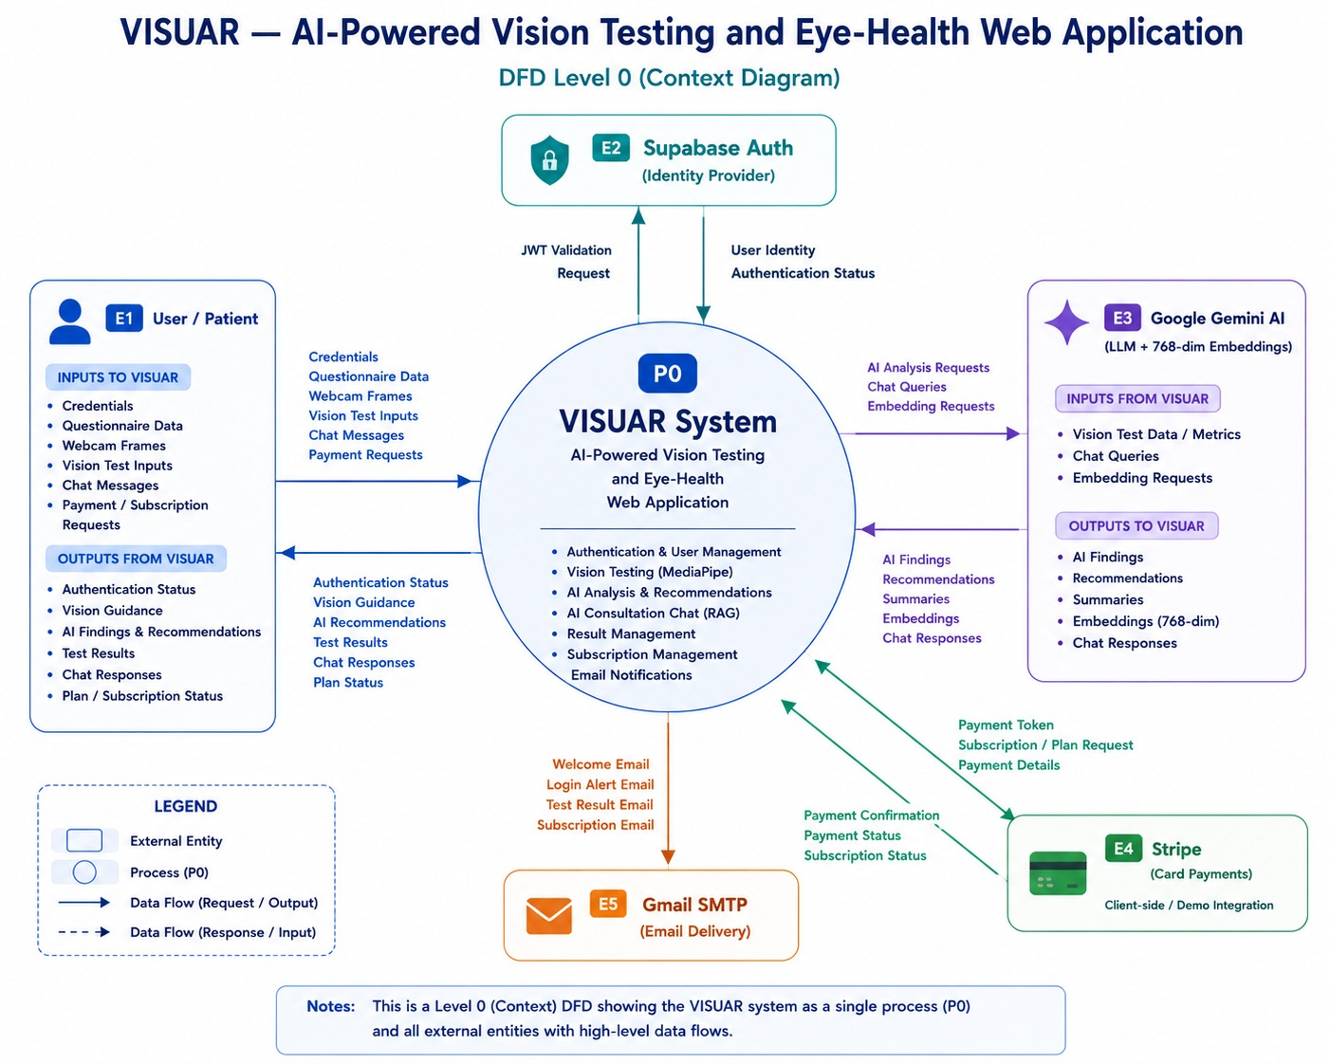
DIAGRAM · DATA FLOW (LEVEL 0)
Data Flow — Context Diagram
Level-0 DFD: VISUAR as a single process (P0) with all external entities and high-level data flows.
VISUAR · 07

Slide 8
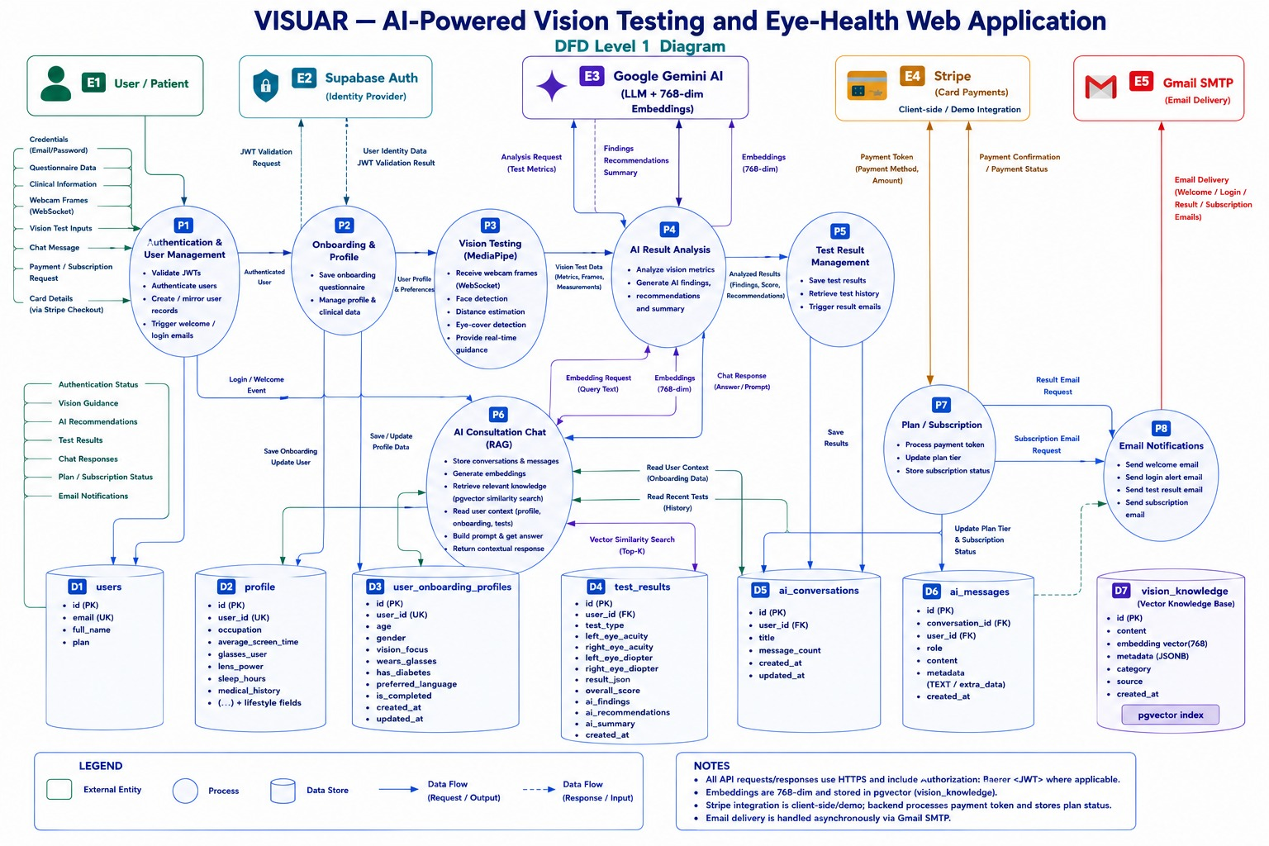
DIAGRAM · DATA FLOW (LEVEL 1)
Data Flow — Level 1
Level-1 DFD: 8 processes, 5 external entities and 7 data stores with request/response flows.
VISUAR · 08

Slide 9
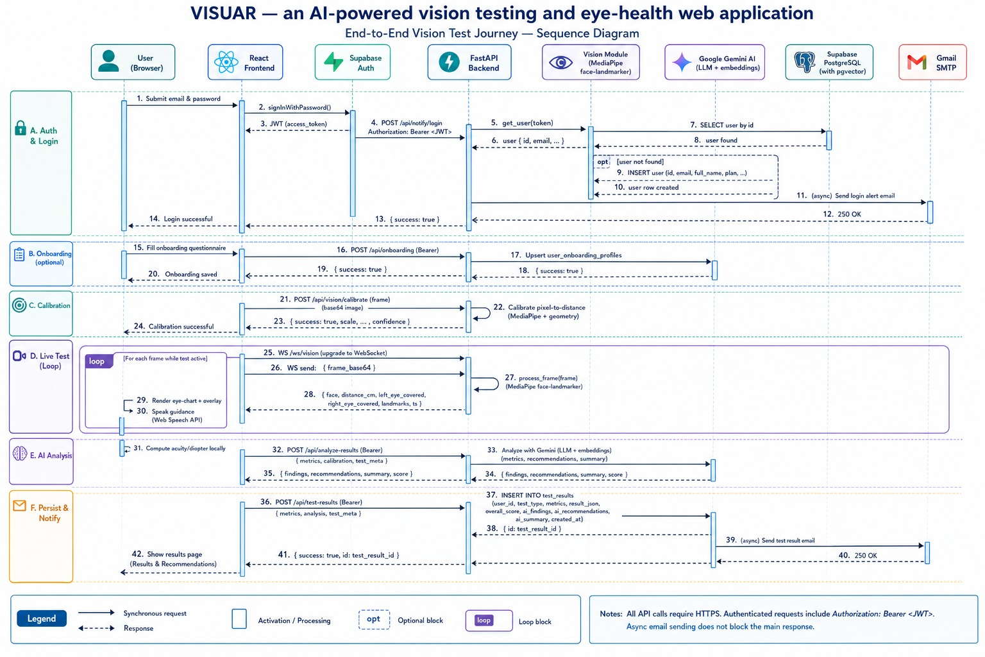
DIAGRAM · SEQUENCE
Sequence — Vision Test Journey
End-to-end session: auth → onboarding → PPI calibration → live WebSocket gating loop → AI analysis → persist & notify.
VISUAR · 09

Slide 10
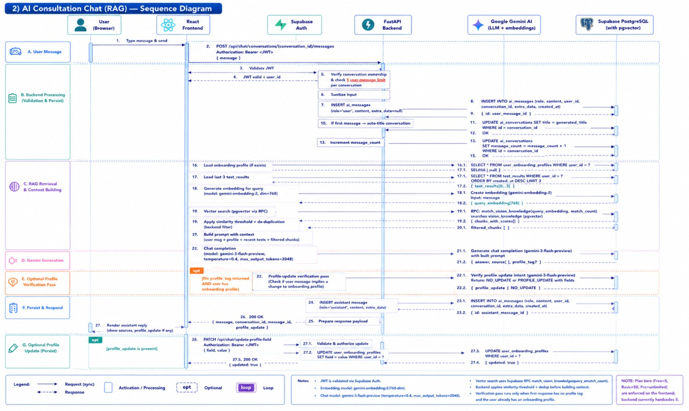
DIAGRAM · SEQUENCE
Sequence — AI Consultation (RAG)
RAG chat flow: validate JWT → persist message → embed query → pgvector retrieval → Gemini generation → optional profile update.
VISUAR · 10

Slide 11
DIAGRAM · STATE MACHINE (WEBCAM GATING)
Vision Module States
TooClose
BothOpen
face too large
EAR > thr
LeftCovered
hand L
start
NoFace
in range
OK (40–80 cm)
RightCovered
hand R
blink
face too small
BothClosed
TooFar
Distance (pinhole model): focal = (face_px × known_cm) / real_face_cm → distance_cm = (real_face_cm × focal) / face_px
MediaPipe Face Landmarker (live-stream) drives the gate; monocular eye-cover states enable per-eye testing. A test row only accepts input while state = OK.
VISUAR · 11

Slide 12
DIAGRAM · USER JOURNEY & PPI FLOW
User Journey
Landing
Sign up / Login
Onboarding
Dashboard
PPI Calibration
Webcam + Distance gate
Run Test Engine
Results + AI insight
PDF / History
from Dashboard
AI Consultant
Profile / Settings
PPI calibration pipeline
Slide box to credit-card width
boxWidth (CSS px)
PPI = boxWidth / 3.37
Letter mm from 70 cm geometry
px = (mm/25.4) × PPI
Correct visual angle on screen
Example: a card spanning 400 px → PPI ≈ 119 → a 5.8 mm letter at 70 cm renders at the correct pixel height for that exact display.
VISUAR · 12

Slide 13
DESCRIPTION · TEST CATALOGUE
Vision Tests
Test
ID
Primary output
Distance Eyesight No.
snellen-acuity
Minus diopters (e.g. −1.50 D)
Near Eyesight No.
jaeger-acuity
Plus reading add (e.g. +1.50 D)
Full Refraction Battery
refraction-battery
Fused Snellen + Duochrome + Sim
Blur Screener
blur-screener
Routes user — no number
Landolt C Acuity
landolt-acuity
Precise acuity estimate
Contrast Sensitivity
contrast-sensitivity
Contrast score (not diopters)
Colour Vision
color-vision
Red-green deficiency screen
Duochrome
duochrome-refinement
±0.25 D sphere refinement
Refraction Simulator
refraction-simulator
Interactive clearer compare
Near–Far Switching
near-far-switching
Focus flexibility
Tests are routed from the Blur Screener by reported problem (distance / near / both / unsure); battery tests fuse multiple signals into one estimate.
VISUAR · 13

Slide 14
OUTCOMES
Findings & Results
10
40–80
768-d
2
3
vision tests
cm gating range
RAG embeddings
languages (EN/UR)
live deployments
What works well
Limits & honest caveats
› End-to-end live — deployed FE (Vercel) + API (HF Spaces) + DB (Supabase)
› Real-time gating — WebSocket face/distance/eye-state at interactive rates
› Calibration works — credit-card PPI yields correct letter sizes per display
› Fused estimates — battery merges Snellen + duochrome + simulator
› AI grounded — RAG over vision_knowledge keeps answers on-topic
› Reports — downloadable PDF + per-user history
› Screening, not Rx — approximate numbers — never a clinical prescription
› Lighting / webcam — accuracy depends on room light and camera quality
› User technique — distance & eye-cover compliance affect results
› Cold starts — HF Space may sleep; first WS connect can lag
› No astigmatism axis — cylinder is screened, not precisely measured
VISUAR · 14

Slide 15
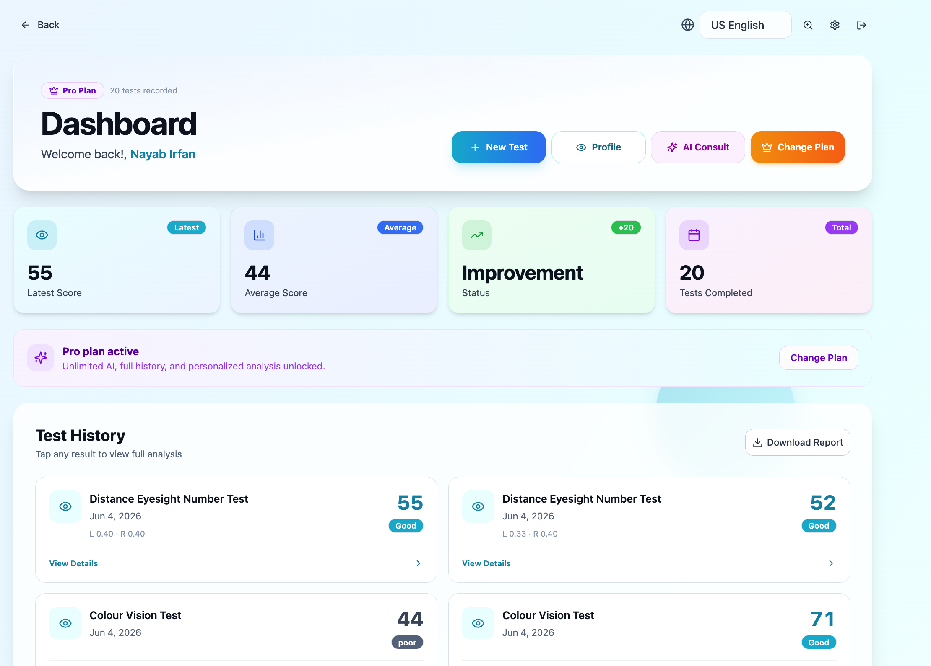
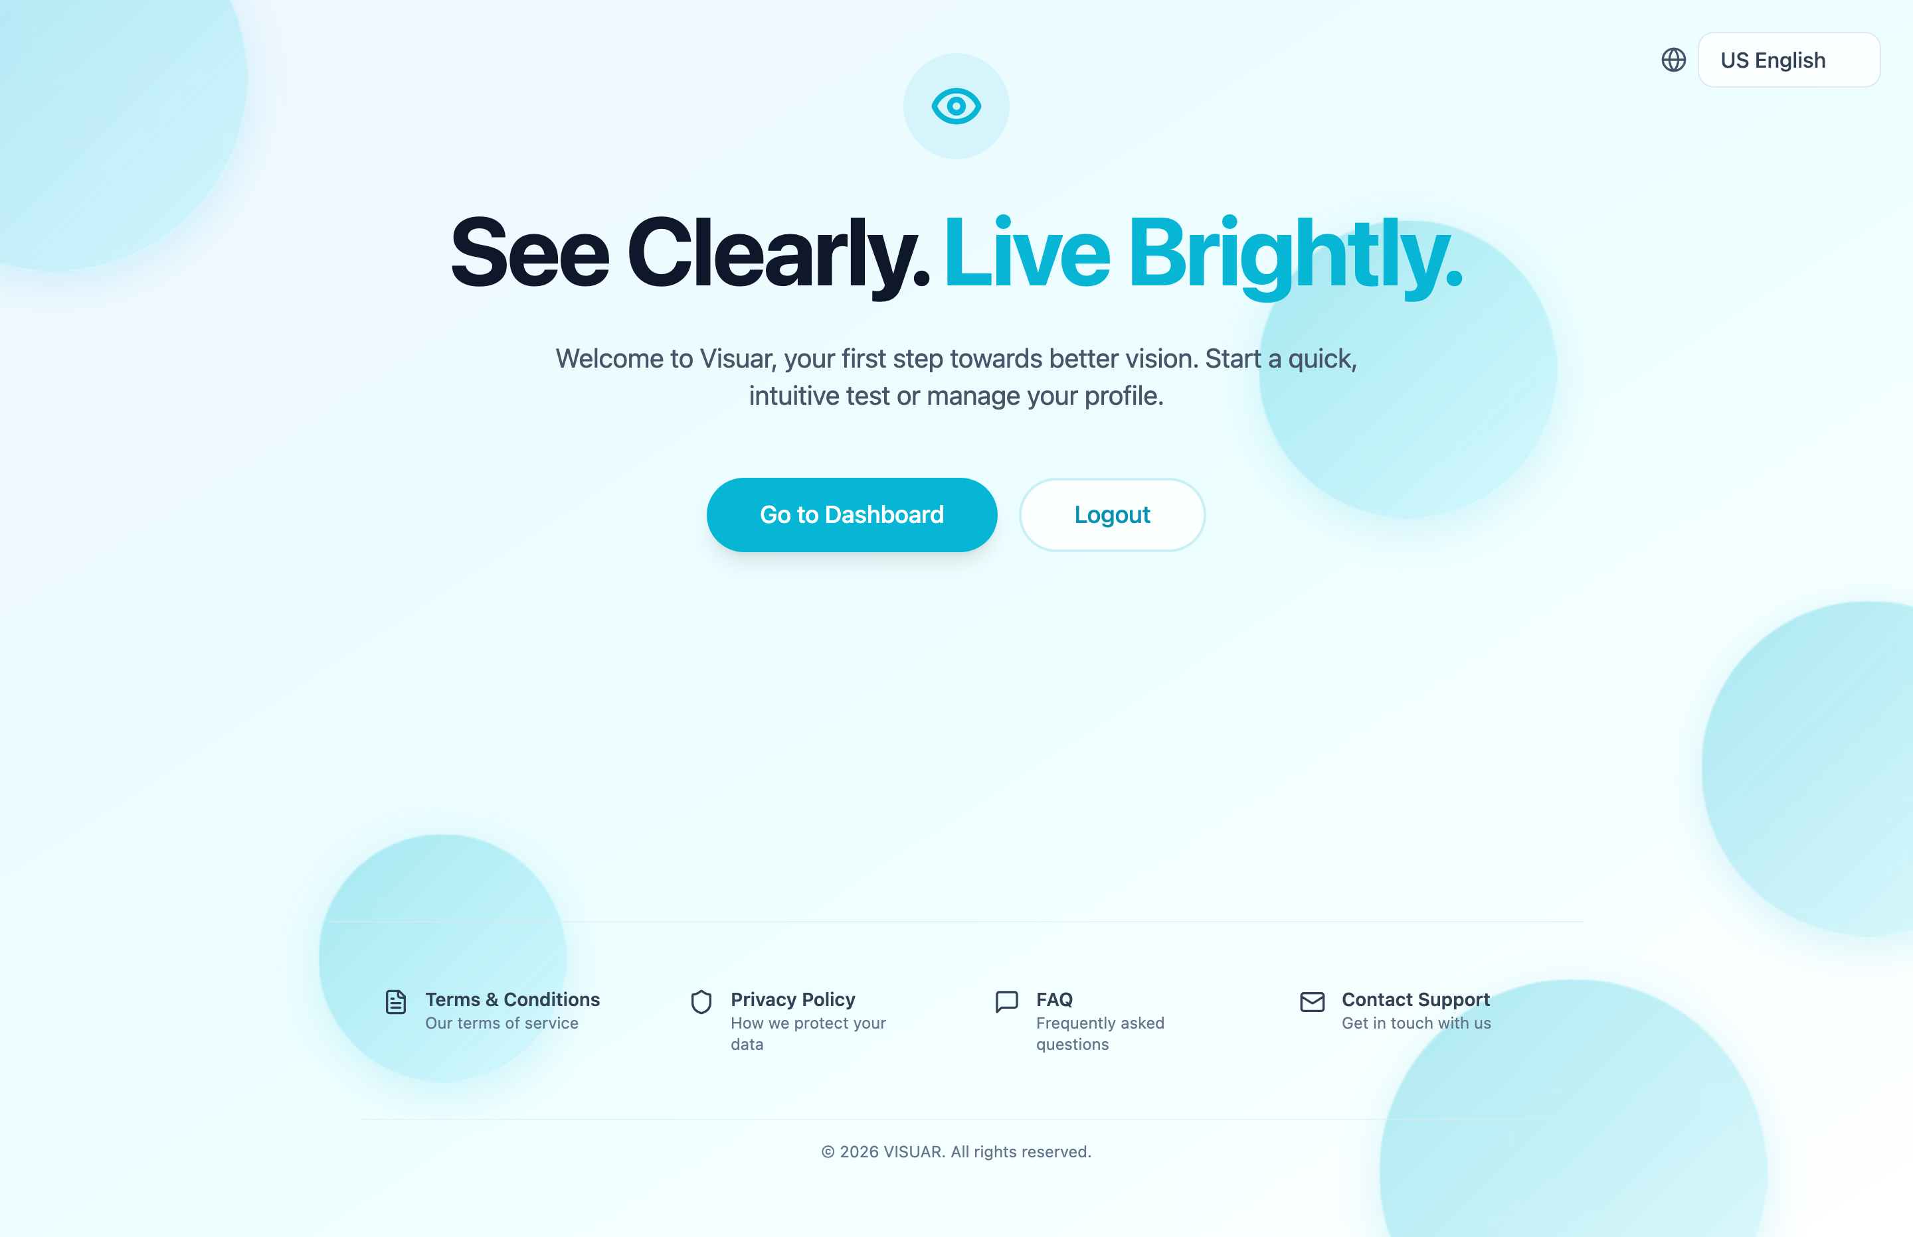
SCREENSHOTS · LIVE FRONTEND
Product UI
Landing — “See Clearly. Live Brightly.”
Dashboard — scores, history & plan
Captured live from www.visuar-web.app — the dashboard surfaces latest/average scores, improvement, test history and PDF report download.
VISUAR · 15

Slide 16
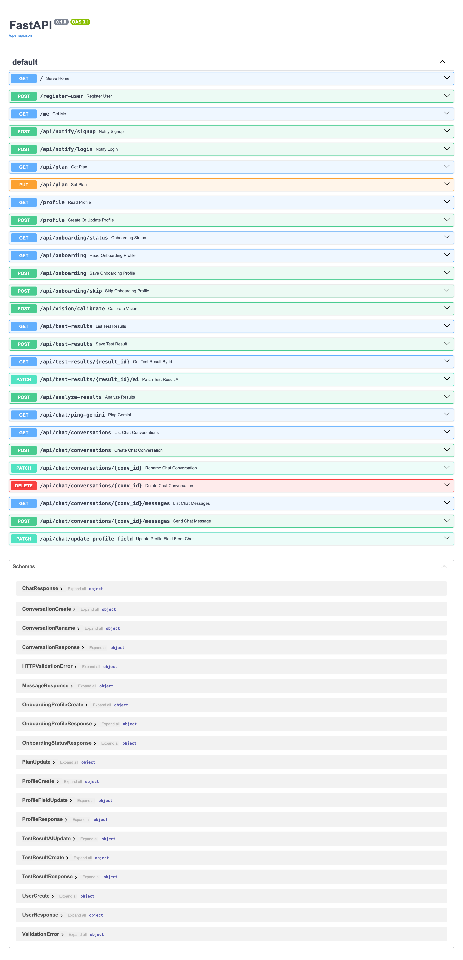
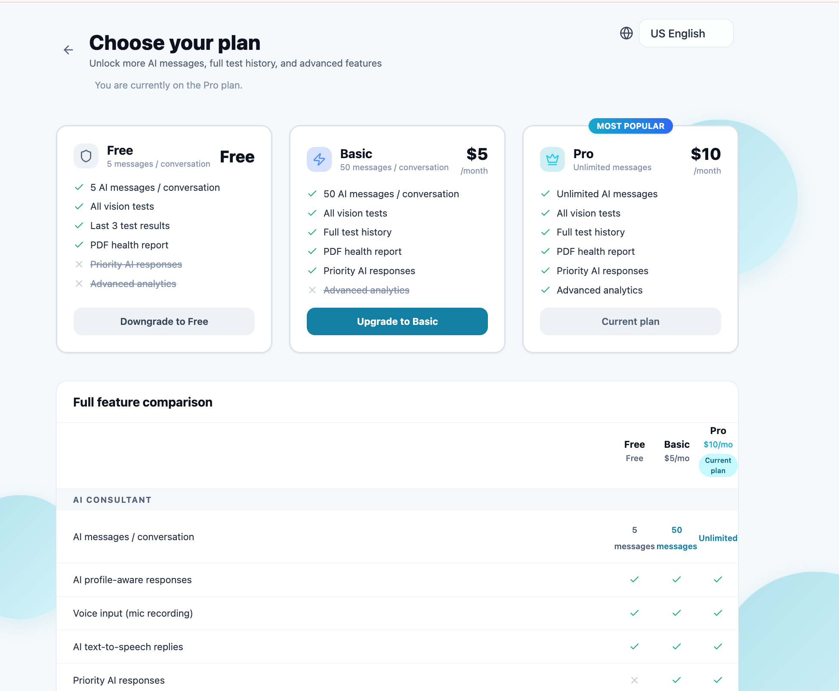
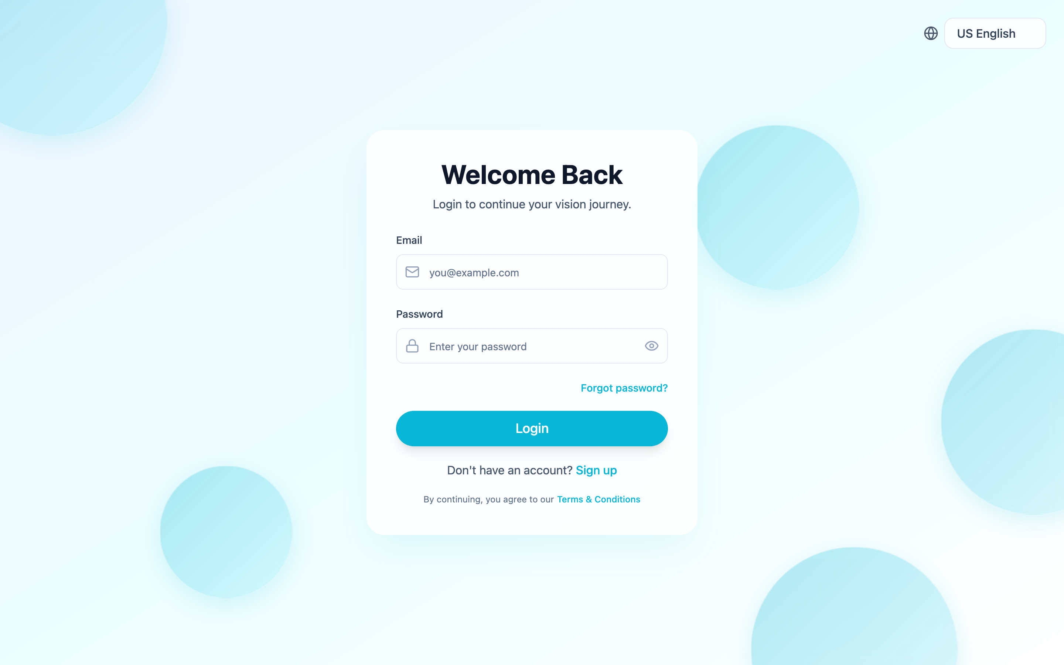
SCREENSHOTS · AUTH, PLANS & LIVE API
More Screens
Login
Pricing — Free / Basic / Pro
Live FastAPI — Swagger /docs
Stripe-backed plan tiers, Supabase auth, and 25+ documented endpoints live on Hugging Face Spaces.
VISUAR · 16

Slide 17
WHAT'S NEXT
Future Plans & Enhancements
Clinical validation
Astigmatism axis
Auto distance calib
Native mobile app
Benchmark estimates against optometrist measurements; publish accuracy bands.
Move from screening the fan to measuring cylinder power & axis precisely.
Replace manual focal calibration with on-the-fly iris-diameter scaling.
Phone front-camera screening with ARKit/ARCore depth for distance.
Longitudinal tracking
Tele-optometry
Expanded RAG
Accessibility & i18n
Trend charts + alerts when a user's numbers drift over time.
One-tap share of PDF report + booking with a local eye-care professional.
Larger, citation-backed vision knowledge base for the AI consultant.
Screen-reader support, more languages, high-contrast modes.
North star: evolve from an honest screening tool into a validated, longitudinal vision-care companion that connects users to professionals.
VISUAR · 17

Slide 18
Thank you
VISUAR — See Beyond
Screen-based vision screening that is approximate by design, real-time, and always points users toward professional care.
App
www.visuar-web.app
API
vinabi-visuar-backend.hf.space
Stack
React · FastAPI · MediaPipe · Supabase · Gemini

