Slide 1
Final Project:
Hotel booking
Cancellation prediction
BY: ERVINA

Slide 2
OUTLINE
01
02
03
DATA PREPROCESSING & ANALYSIS
Machine learning model
DATA BACKGROUND
04
05
Action & recommendation
appendix

Slide 3
01
Data background

Slide 4
Data background
The data comes from two different hotels. One resort hotel and one city hotel. The two hotels are located in Portugal, namely the Algarve resort hotel and the Lisbon city hotel. the data contains bookings that will arrive between 1 July 2015 and 31 August 2017, including bookings that have effectively arrived and bookings that have been cancelled. The data contains 32 variables and 119.390 hotel reservations.

Slide 5
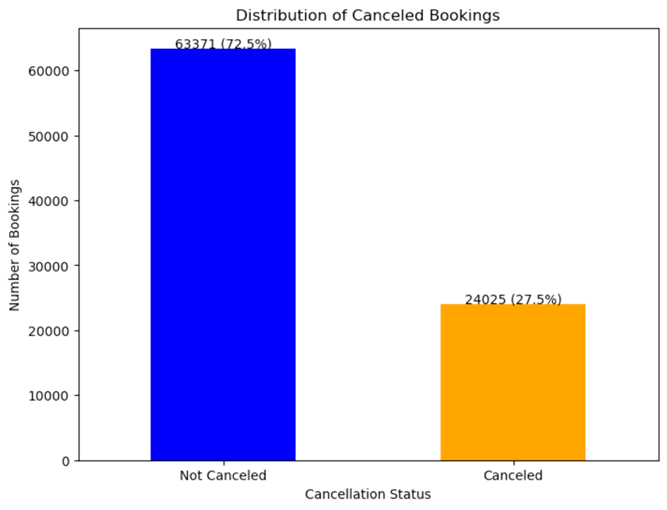
Why does cancellation matter?

Slide 6
24.025
Customers cancel their booking

Slide 7
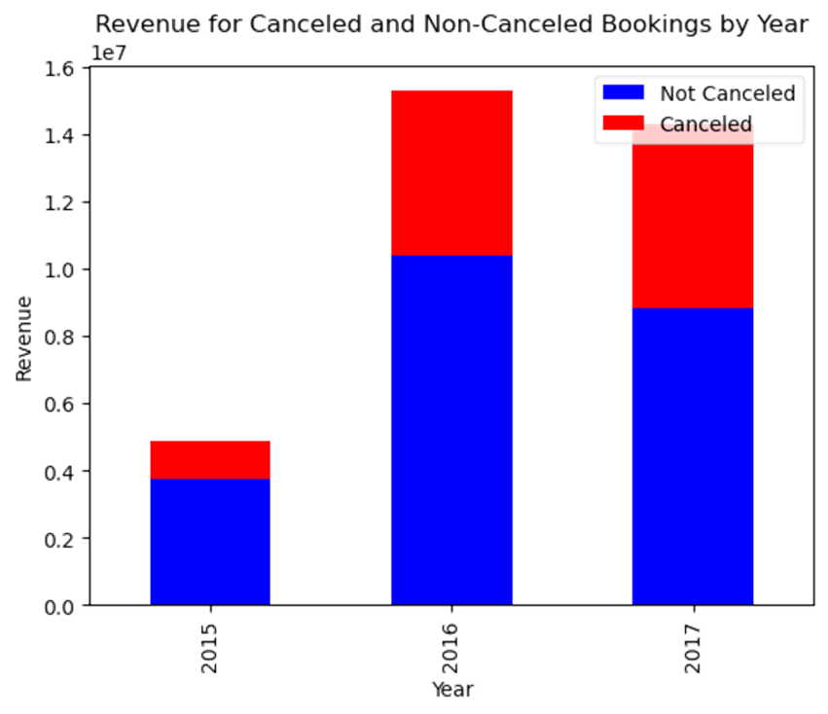
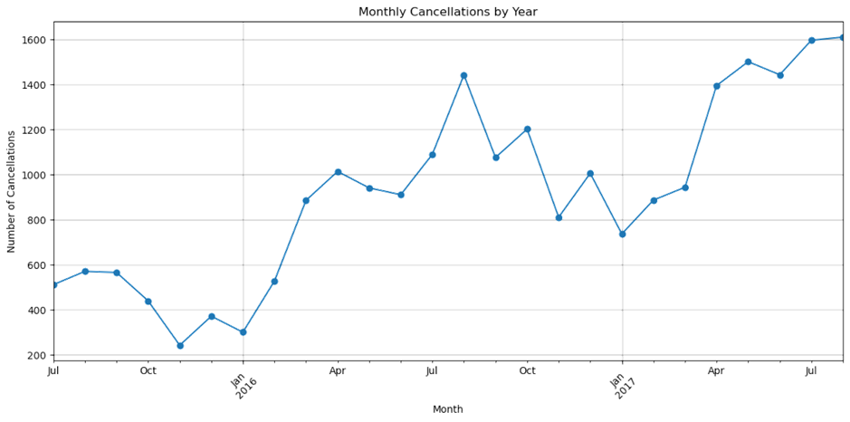
Why does cancellation matter?
Loss revenue increases over the year
Cancellation increases over the year

Slide 8
02
Data preprocessing and analysis

Slide 9
Data Information
Data rows
Features
Target
119390 data rows
32 features
1 target

Slide 10
Data feature
Guests
time
Booking transaction
adults
children
babies
country
company
is_repeated_guest
previous_cancellation
previous_bookings_not_cancelled
customer_type
lead_time
arrival_date_year
arrival_date_month
arrival_date_week_number
arrival_date_day_of_month
reservation_status_date
hotel
stays_in_weekend_night
stays_in_week_nights
meal
reserved_room_type
assigned_room_type
booking_changes
deposit_type
adr
reservation_status
days_in_waiting_list
time
segment
target
required_car_parking_spaces
total_of_special_requests
market_segment
distribution_channel
is_canceled

Slide 11
data cleaning
Missing values
children 4
country 452
agent 12193
company 82137
31994 duplicated data
Drop all duplicated data
Replace all missing value
Children, adults, babies (166)
Arrival_date_month type object
Filtering data (just show data != 0) to avoid noise on data
Change to integer

Slide 12
Data analysis
01
02
03
04
05
06
Where do the guest come from ?
How much the guests pay for a room per night ?
How much the price vary over the year?
Which are the most busy month ?
How long do people stay at hotel ?
How many bookings are cancel?

Slide 13
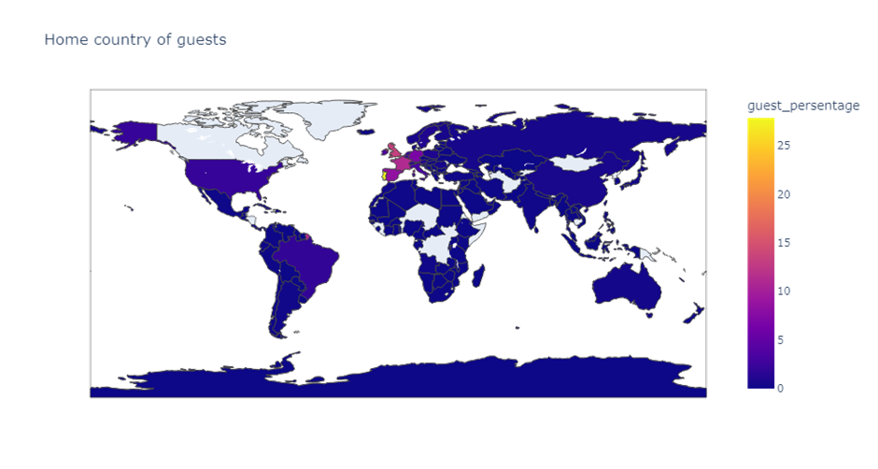
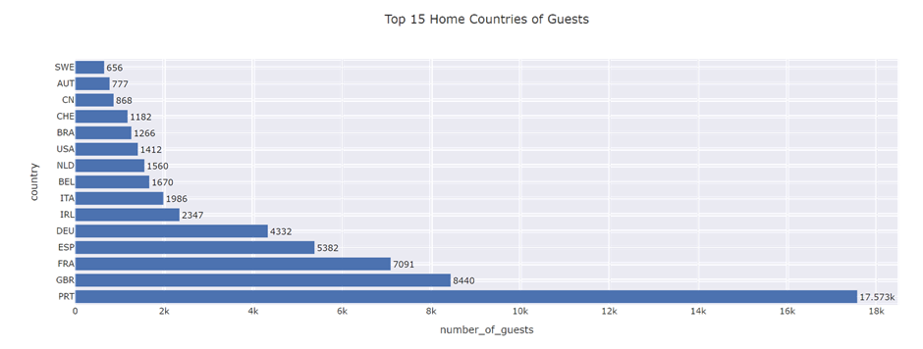
Where do the guest come from ?
People from all over the world are staying in these two hotels. Most guests are from Portugal and other countries in Europe.

Slide 14
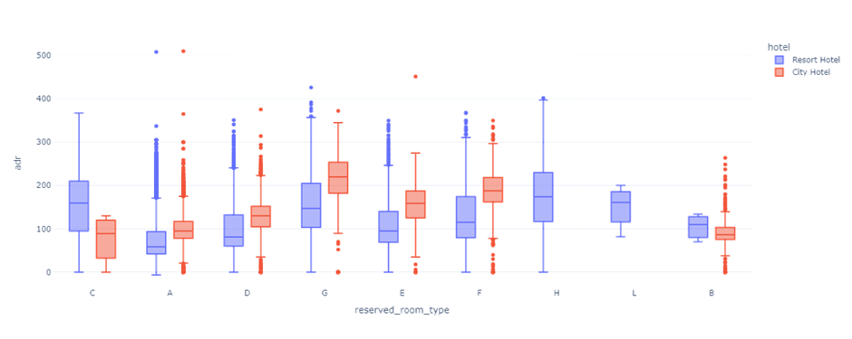
how much do guests pay for a room per night?
The figure shows that the average price per room depends on its type

Slide 15
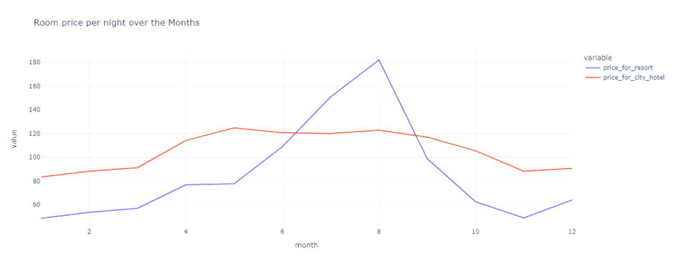
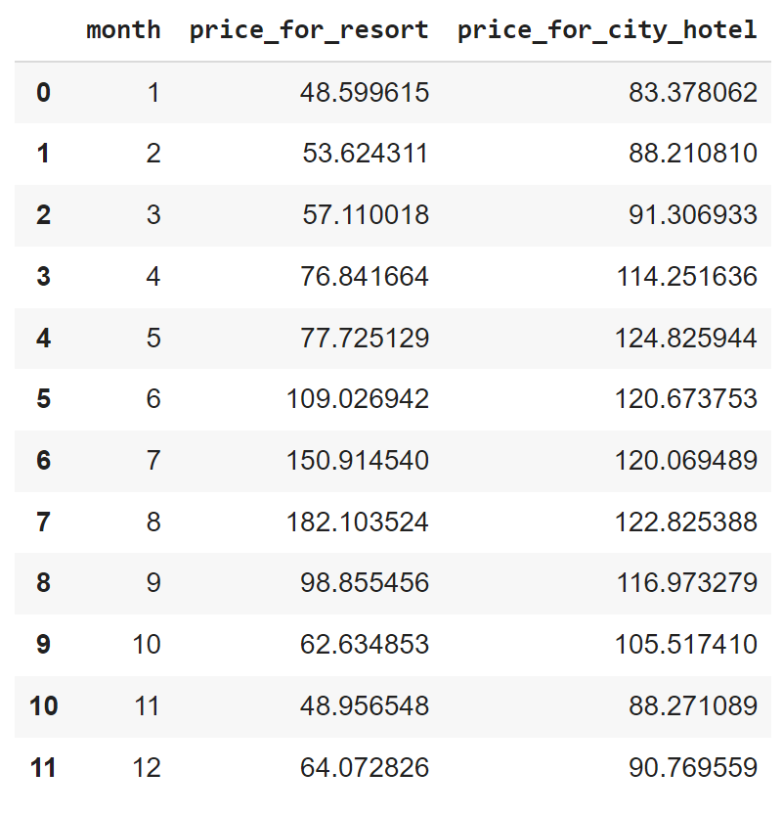
how much the price vary over the year?
spring (mar-june),summer(jun-sept), autumn(sept-oct), winter (des-mar)
- The prices in the Resort Hotel are much higher during the summer
- The prices in the city hotel varies less and is most expensive during Spring to Autumn .

Slide 16
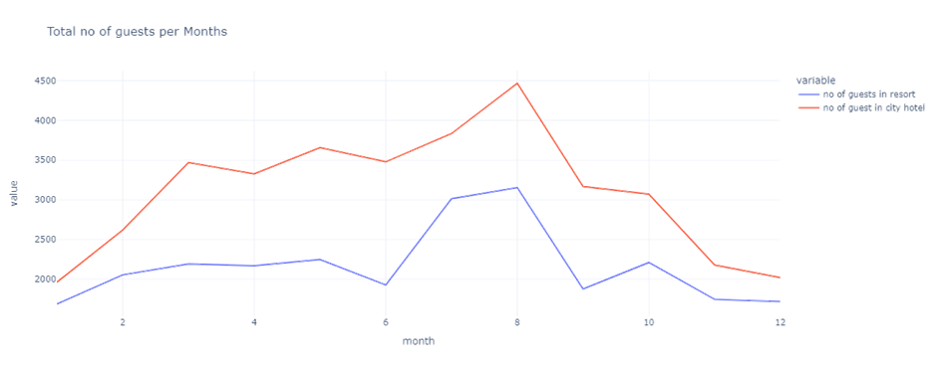
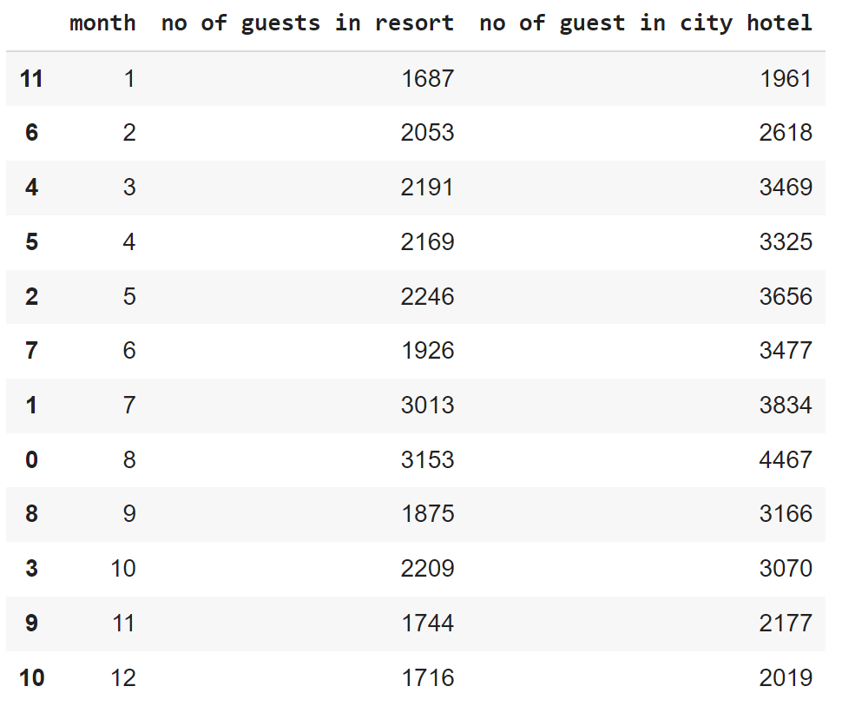
Which are the busy month ?
spring (mar-june),summer(jun-sept), autumn(sept-oct), winter (des-mar)
The City hotel has more guests during spring to autumn, , In July and August there are less visitors.
Guest numbers for the Resort hotel go down slightly from June to September. Both hotels have the fewest guests during the winter.

Slide 17
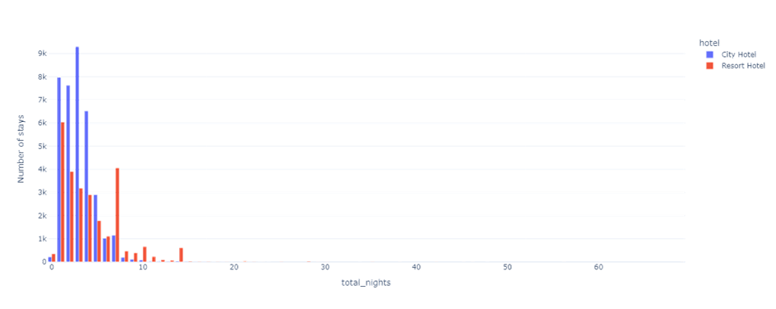
How long do people stay at hotel ?
- In city hotel most people stay for 3 nights
- In resort hotel people stay the most for 1 nights and some for 7 nights

Slide 18
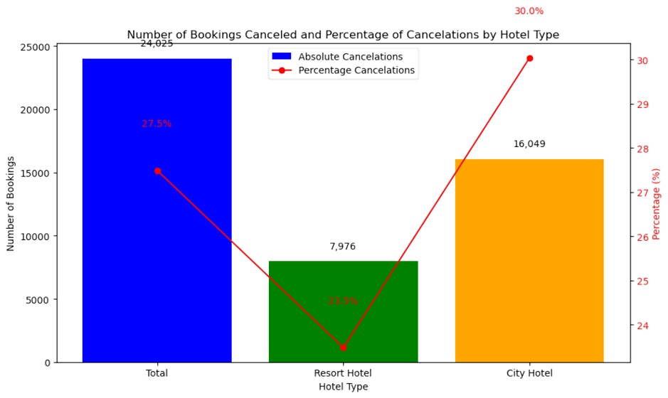
How many booking are cancel?
Total bookings canceled: 24,025 (27 %)
Resort hotel bookings canceled: 7,976 (23 %)
City hotel bookings canceled: 16,049 (30 %)

Slide 19
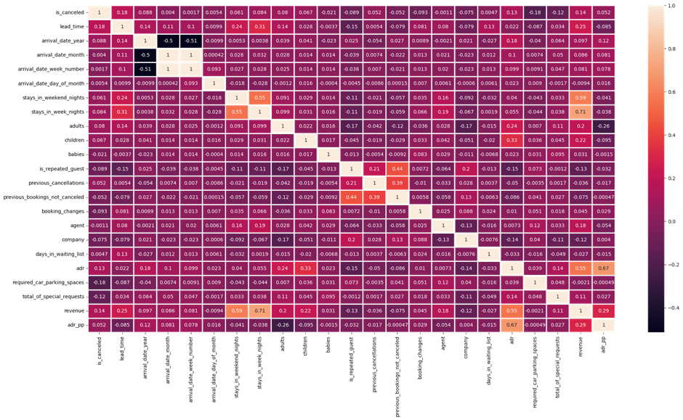
Matrix correlation
There is no High Correlation(>0.83) between feature

Slide 20
FEATURE SELECTION & ENGINEERING
Before cleaning
After cleaning
FROM
32 Features
35 Features
25 Features

Slide 21
categorical data
Separate year, month, day on rervation_status_Date
Separate categorical and numerical
Check on categorical data
ENCODE THE CATEGORICAL DATA
Separate reservation_status_date into 3 columns (month, year, and date), then drop the reservation_status_date
There are 8 categoricals data
Check on categorical data unique columns
Apply Encoding into Categorical data

Slide 22
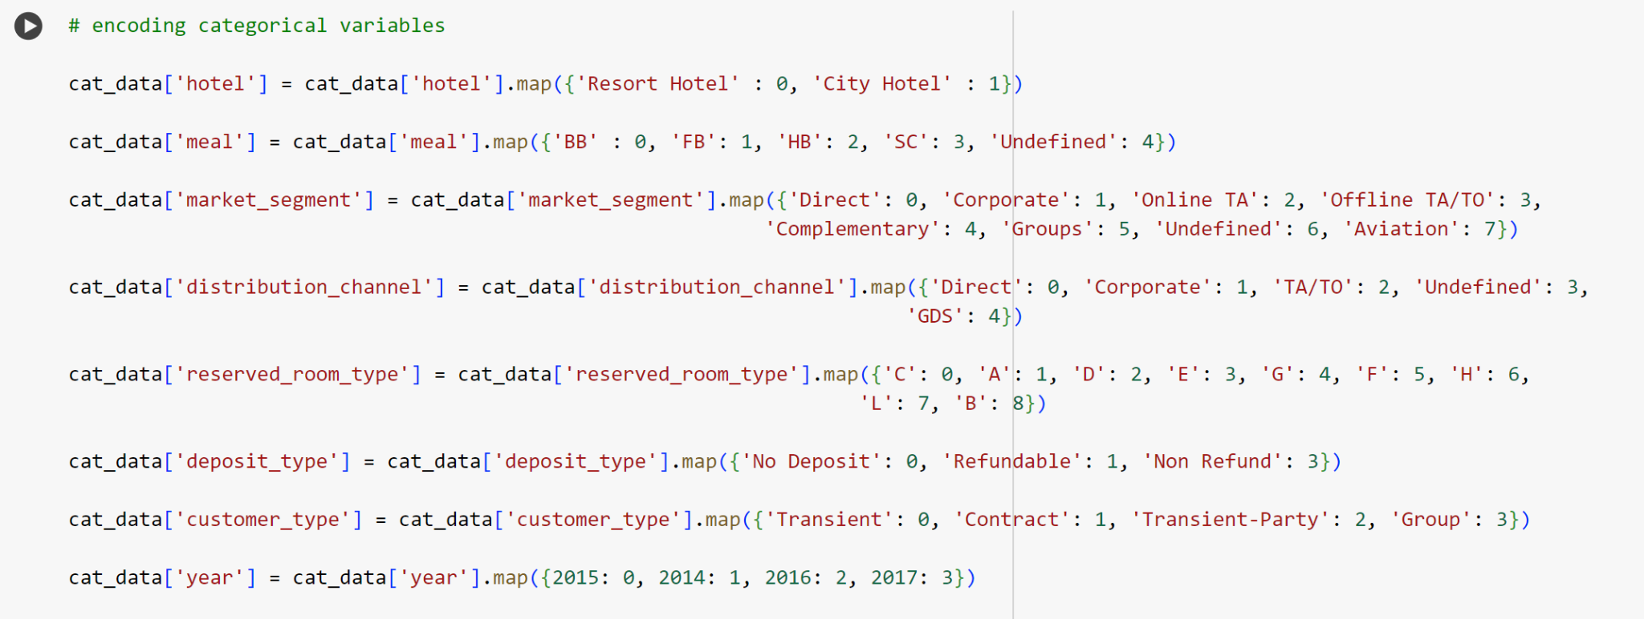
Encode the categorical columns

Slide 23
Numerical data
Separate categorical and numerical
Drop is_canceled
There are 18 numerical data
Drop is_canceld, so we could use it when train for model data

Slide 24
03
Machine learning model

Slide 25
Split train test data
x
y
cat_data and num_data
is_canceled

Slide 26
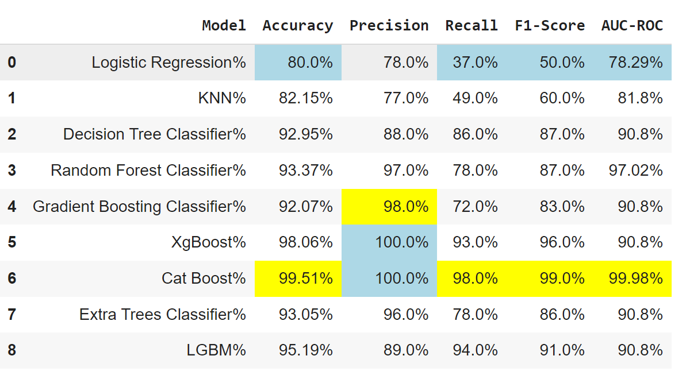
Baseline model
In this case, we need to see some metric evaluation:
Precision(false positive): to know the exact model in cancelation booking
Recall(false negative): to find out the number of errors in determining cancel bookings
The best model is Catboost.
Because it’s has the biggest recall and model accuracy

Slide 27
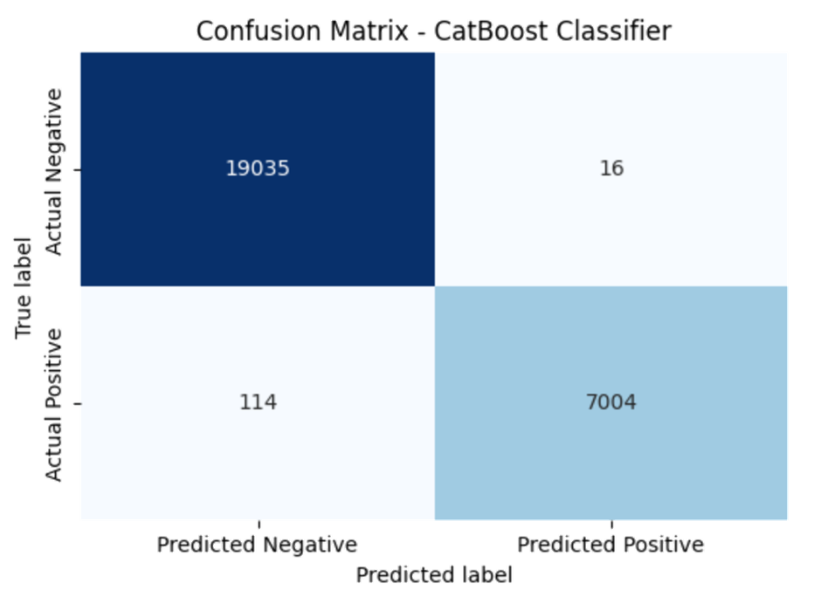
Confusion matrix
19035 bookings were correctly predicted as not canceled (True Negatives).
16 bookings were incorrectly predicted as canceled when they were actually not canceled (False Positives).
114 bookings were incorrectly predicted as not canceled when they were actually canceled (False Negatives).
7004 bookings were correctly predicted as canceled (True Positives).

Slide 28
04
Action
& recommendation

Slide 29
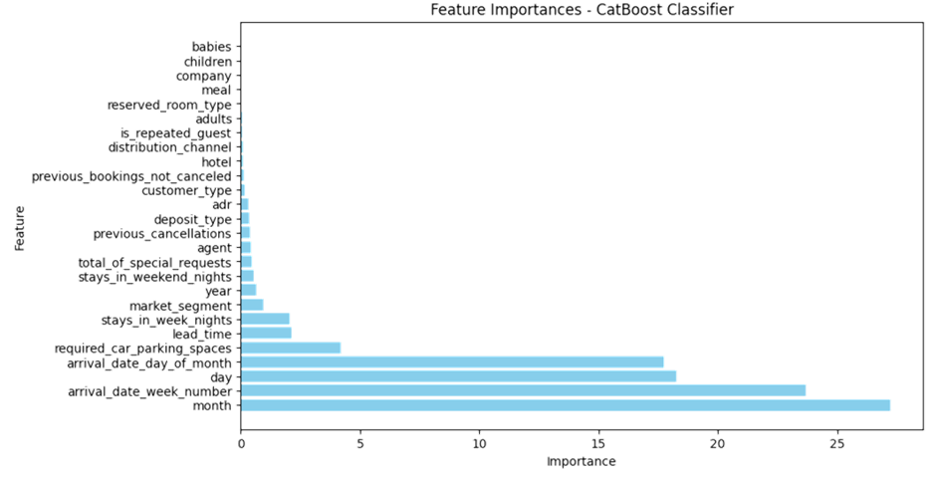
Feature importance

Slide 30
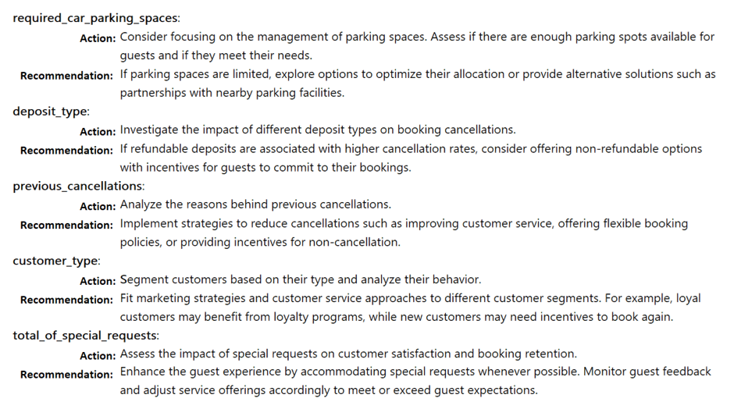
Action & recommendation

Slide 31
Thank you

Slide 32
05
appendix

Slide 33
appendix
https://www.kaggle.com/code/marcuswingen/eda-of-bookings-and-ml-to-predict-cancelations (dataset)
https://www.sciencedirect.com/science/article/pii/S2352340918315191 (about dataset)

