Slide 1


Slide 2
BASIC 19
Hack01

Slide 3
Problem Statement
Identification of Seriousness of the Problem:
In a recent study published in Depression and Anxiety of more than 67,000 college students from more than 100 institutions, 1 in 5 students have had thoughts of suicide, with 9% making an attempt and nearly 20% reporting self-injury.
1 in 4 students reported being diagnosed with a mental illness
According to National Crime Records Bureau, 1 student in 1 hour commits suicide in India.

Slide 4
Problem Statement
Measurement of Students Depression:
Hospital Anxiety and Depression Scale (HADS) is commonly used by doctors to determine the levels of anxiety and depression that a person is experiencing.
HADS score of these questionnaire can depict the depression level in the student.
0-7 = Normal
8-10 = Borderline abnormal (borderline case)
11-21 = Abnormal (case)

Slide 5
Approach Description
Obtain the consolidated data of students from different files for the analysis
Treat the missing values, outliers, duplicates if any
Get the insights from the data using data visualization
__________________________________________________________________________________________________
The year-wise suicide count data will take us to a broad overview about the different features of the persons such as height, weight, age, professional profile, income, etc. affecting the suicidal count in India.
Especially the CAUSE feature from the data can be used to analyze the trend of suicide count over the years with respect to CAUSE feature where CAUSE feature includes the professional profile of the person.

Slide 6
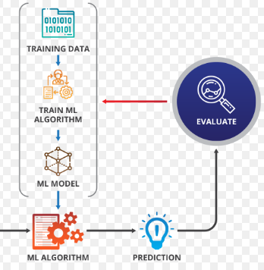




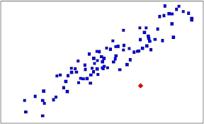

Approach Flow
Missing Values
Feature Engg
Data Consolidation
Outliers

Slide 7
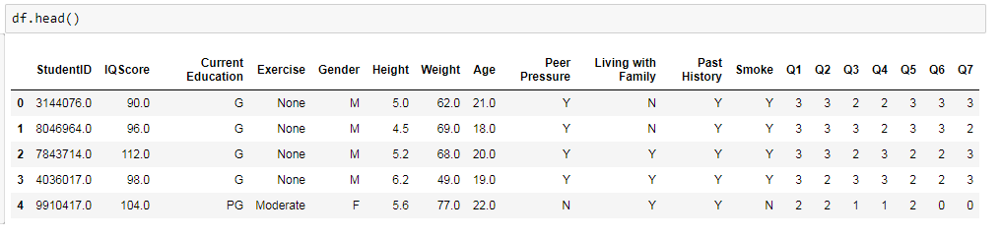
Data Exploration
Data Consolidation:
The given data sets were in different formats such as .csv, .xlsx and .txt
The student related data was consolidated in one data frame.
The final dataset consists of the features

Slide 8
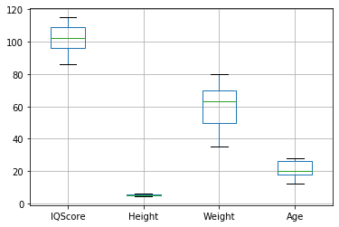
Data Exploration
Feature | Missing Values Percentage
IQ Score | 0.02
Education | 0.018
Exercise | 0.025
Height | 0.0138
Weight | 0.0115
Age | 0.032
Living with Family | 0.025
Past History | 0.0115
Smoke | 0.0115
Data Preparation:
Outliers: (No outliers)
Missing Values: (Dropped)

Slide 9

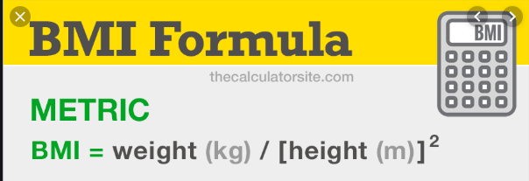
Data Exploration
Data Derivation:
BMI Index
isHealthy
Age Category
IQ Score Category
HADS Score
If Smoke == ‘N’ and
Exercise != ‘None’ and
BMI == ‘Normal’ or ‘Underweight’ or ‘Overweight’,
Then isHealthy = 1, else isHealthy = 0

Slide 10


Data Analysis
Features of Student such as Gender, Age, Weight, Height, etc. obtained from the datasets are compared against Suicide Possibility the feature generated studying the high positive correlation between depression and suicide attempt.

Slide 11
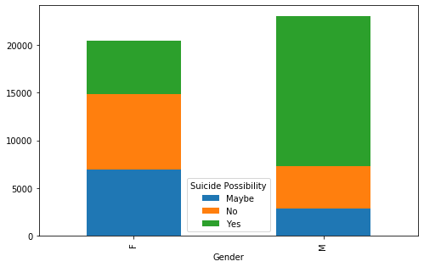
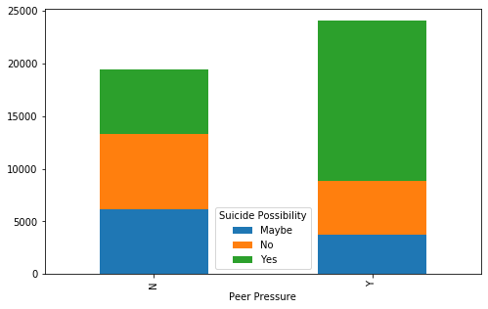
Gender
Peer Pressure

Slide 12
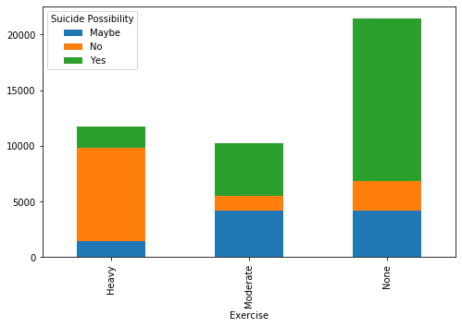
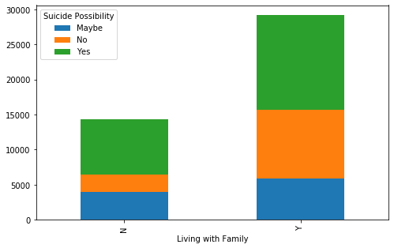
Exercise
Living with family

Slide 13
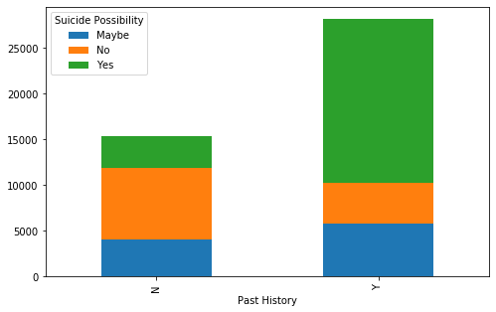
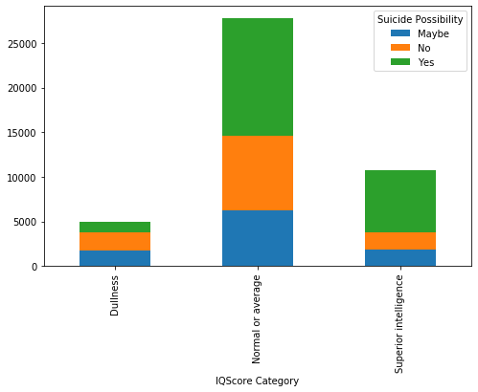
Past History
IQ Score

Slide 14
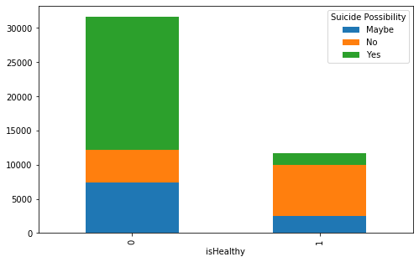
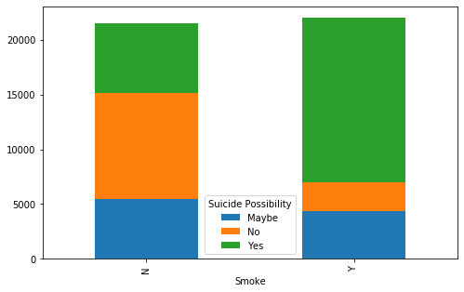
isHealthy
Smoke

Slide 15

Year Wise Suicide Count
The datasets of suicide count from year 2001 to 2014 are consolidated into one dataset.
The analysis is done on various factors such as Cause (Professional profile), Gender, Age group and the yearly visualization has been done in order to observe the trends over the years.

Slide 16
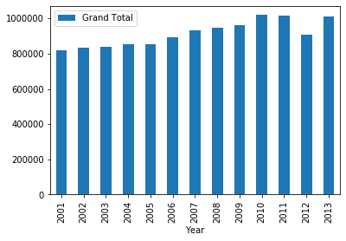
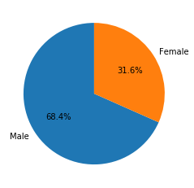
Year
Gender

Slide 17
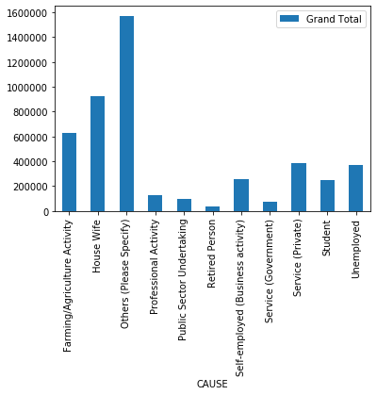
Cause

Slide 18
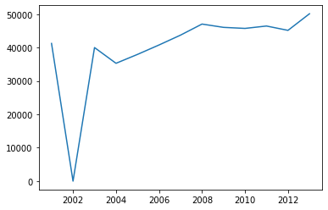
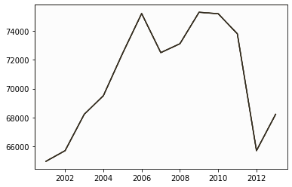
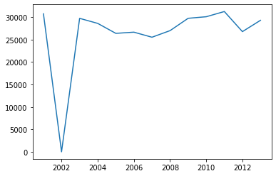
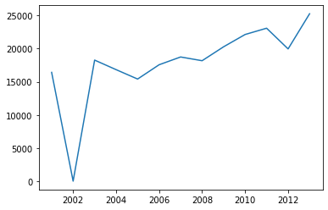
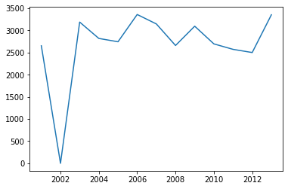
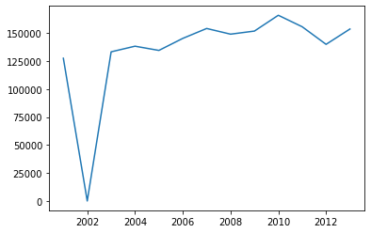
Cause
Salaried
Housewife
Unemployed
Student
Retired Person
Self Employed

Slide 19
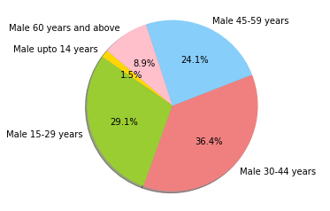
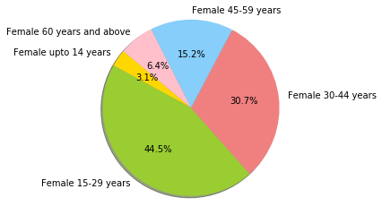
Age & Gender Together

Slide 20
Modelling
Model Evaluation
This includes various evaluation methods such as accuracy score. Gives us clear idea of the best model to be chosen. In our case, Decision Tree performs the best.
1
Model Application
Classification models viz. Logistic Regression, Naive Bayes, Random Forest, Decision Tree, Extra Trees Classifier are applied.
2
Preprocessing
This includes treating missing values, duplicates and outliers. Also, it includes scaling and other normalization measures.
3
Time Consumption Pyramid

Slide 21
Model Evaluation
Model Name | Accuracy Score (%)
Decision Tree | 85.76
Extra Trees (Ensemble Technique) | 85.74
Random Forest | 85.72
Logistic Regression | 74.58
Support Vector Machine (SVM) | 84.75
K Nearest Neighbour (K=3) | 82.71
Naive Bayes | 69.85

Slide 22
Results and Conclusions
Chance of committing suicide is directly proportional to Depression.
Males are more probable to suicide compared to females.
Higher the peer pressure higher the chances to commit suicide.
Teenagers and adolescents i.e. students in graduation are more prone to commit suicide because of the cut-throat competition and career pressure.
Healthy habits like exercise and no smoking reduce the chances of depression
Depression is relapsing
Physical factors like normal height and weight reduce chances of depression
The number of suicides were less in the initial years and the number of suicides are increasing in recent years.
Housewives has the largest count followed by farmers and retired people have the lowest count of suicide.
So we can predict the possibility of suicide using Decision tree which has the highest accuracy for this data.

Slide 23
Implications
Society: 022 2754 6669
Students:
Parents to provide a healthy environment to the children constantly interrogating them about their problems and taking to the counsellors quarterly
Governments:
Anti Depression Campaigns should be conducted by the government
Industry and Institutes:
Ragging should be strictly prohibited and a healthy environment should be maintained

Slide 24


Slide 25


