Slide 1
AI INTERN PROJECT
Tasks Image segmentation, object identification, Text Extraction and Summarization Presented by:- Vinay Kumar
Date:- 20-Aug-2024

Slide 2
PROJECT OVERVIEW
Objective:
Develop a Python-based tool that segments images, identifies objects, extracts text, summarizes the findings, and provide visualization of the results over the Streamlit UI.
Key Features:
Image Segmentation
Object Identification
Text Extraction
Summary Generation
Streamlit-based UI

Slide 3
Features & Functionality
Image Segmentation:
Find the different objects in the image and divides the image into those distinct regions called as segments.
Save the processed data into the database and dump files.
Object Identification:
Recognizes and labels objects within each segmented region.
Save the processed data into the dump files.
Text Extraction:
Extracts and decodes any text present in the segmented images.
Save the extracted text data into the dump files.
Summarization:
Provides a concise summary based on the identified objects and extracted text.
Save the processed data into the dump files
Streamlit UI:
Interactive user interface for uploading images and viewing results.

Slide 4
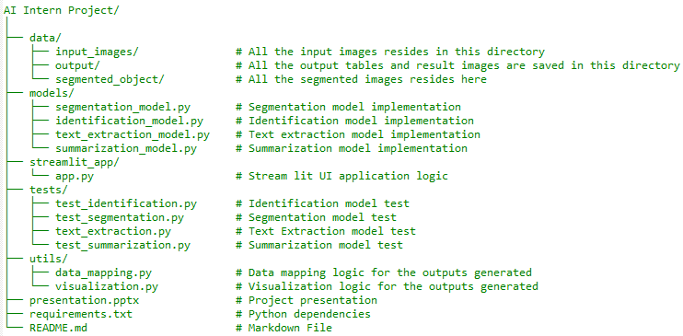
Project Structure
Directory Overview:

Slide 5
Key Components:
data: Contains input image, output and segmented objects directory..
models: Contains all the models used in the project.
streamlit_app: Contains streamlit UI application
utils: Contains utility files to facilitate data mapping and visualizations.
tests: Contains tests for the models.

Slide 6
Conclusion
Current Achievements:
Successfully developed a tool that integrates segmentation, identification, text extraction, and summarization.
Created an interactive Streamlit interface for end-users.

