Slide 1
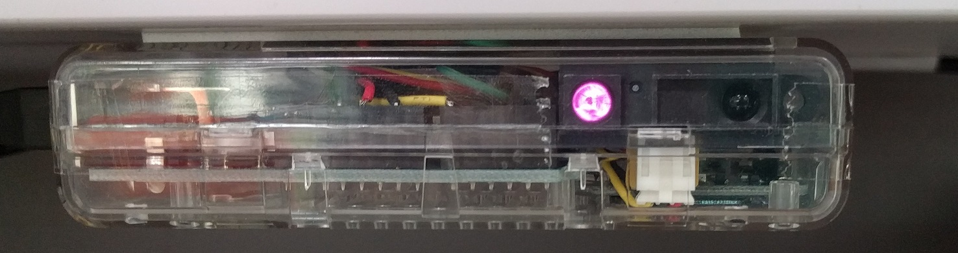
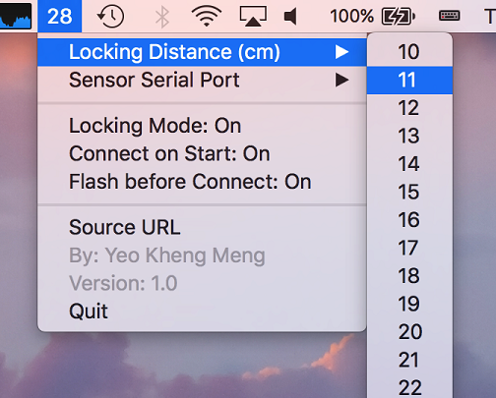
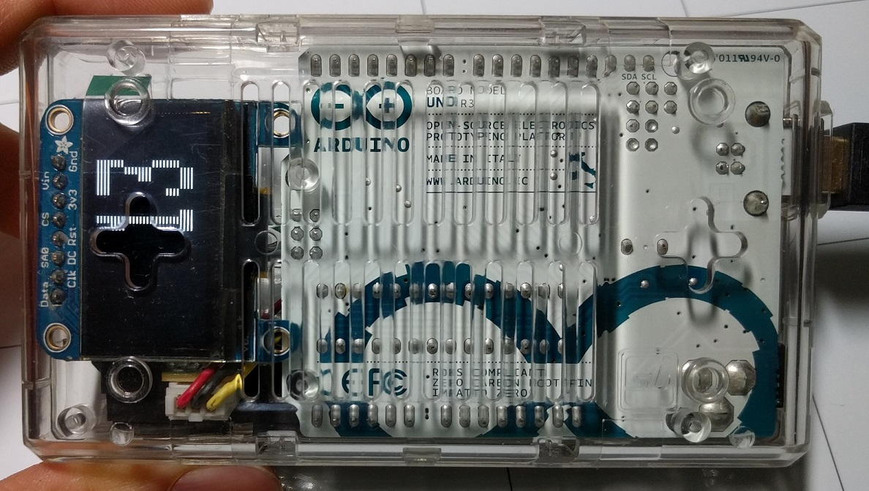
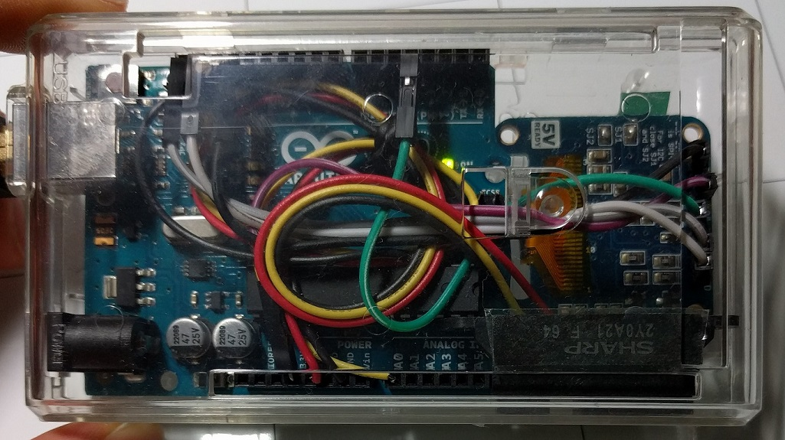
Distance Machine Locker
SP Digital Tech Talk (12 Jan 2017)
By: Yeo Kheng Meng (yeokm1@gmail.com)
https://github.com/yeokm1/distance-machine-locker

Slide 2
Demo video
https://www.youtube.com/watch?v=mWyIHkdfHz4

Slide 3

Problem?
Malicious person + unlocked machines
Solution:
Distance-measuring system
Locks machine when I leave

Slide 4
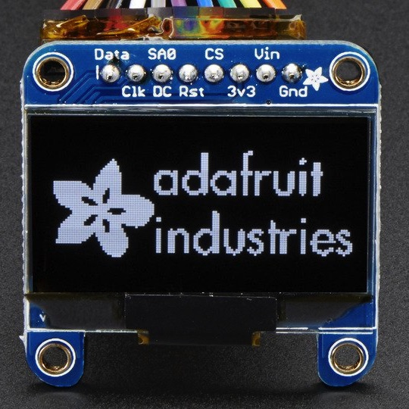
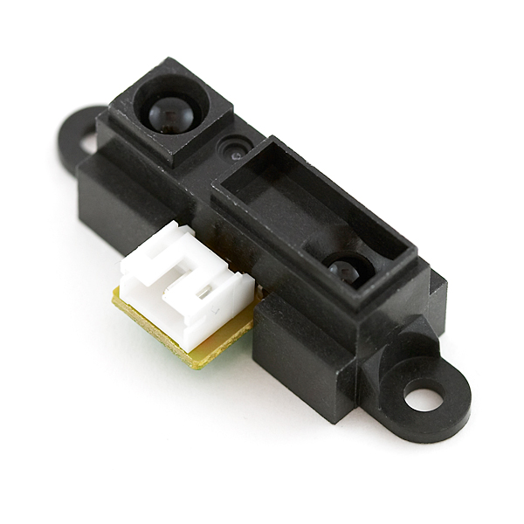
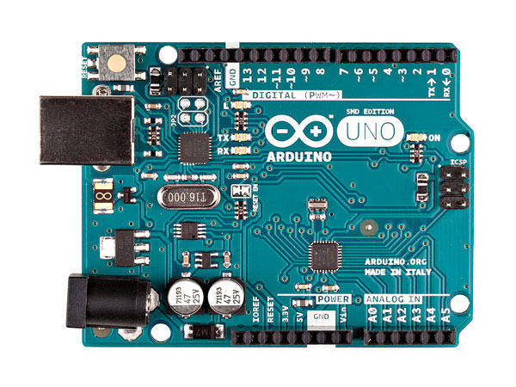
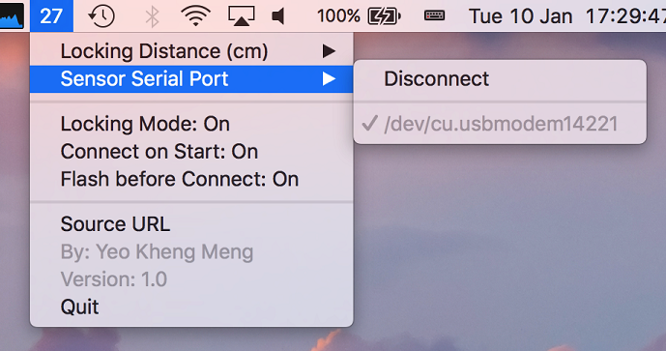
System setup overview
OLED screen
(Debugging)
Distance Sensor
Arduino Uno
Mac Menubar app

Slide 5
Hardware

Slide 6
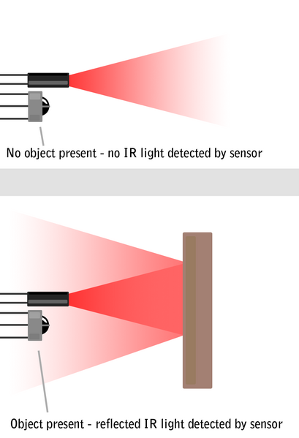
Active IR distance sensor
Sharp Infrared (IR) Distance Sensor GP2Y0A21YKR
Effective range: 10 to 80cm
Active IR
Less noisy than ultrasonic sensors
Source: http://education.rec.ri.cmu.edu/content/electronics/boe/ir_sensor/1.html

Slide 7
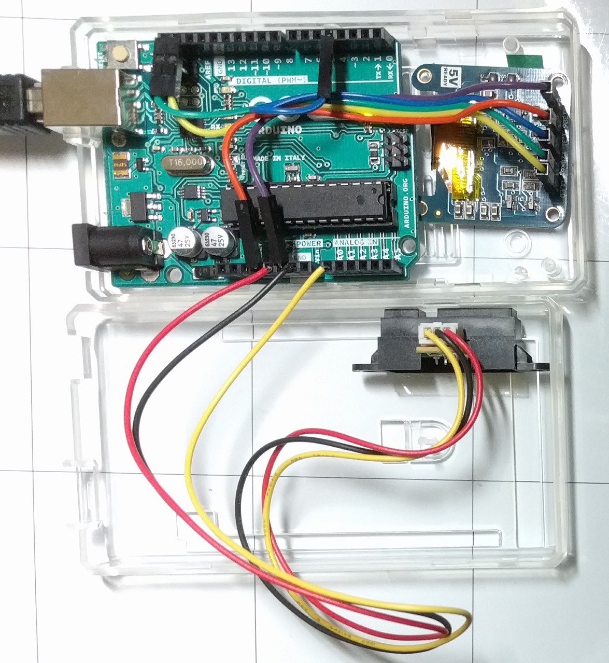
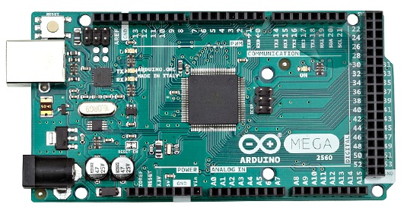
Putting them all together
Arduino Uno in case meant for Mega 2560

Slide 8
Host App
Swift 3 Menubar app
Receives Data from USB-Serial Port
Locks machine on threshold reached

Slide 9
About the app
Uses SwiftSerial library written by yours truly
Menubar app (MainMenu.xib)
No Main Window
No Storyboards, just a single xib
Lock screen programmatically (Locking.swift)

Slide 10
Potential Hacking Strategies and Defenses

Slide 11
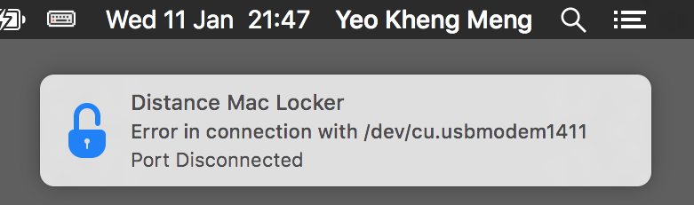
Hack 1: Disconnecting device
Defense:
Lock machine immediately
Issue system notification

Slide 12
Hack 2: Tamper hardware to provide incorrect values
Defense:
Dynamic monitoring of distance values on menu bar
Requires “human” monitoring

Slide 13
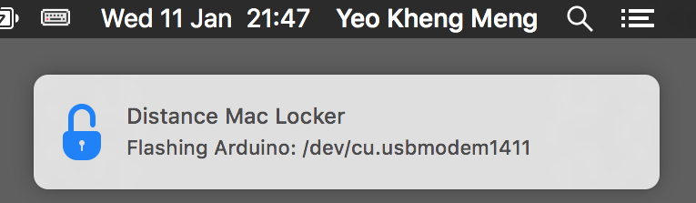
Hack 3: Reprogramming with malicious firmware
Defense: Reprogram Arduino before using it
Swift App contains hex (firmware) file
Flashes hex file to Arduino before using

Slide 14
A possible “undetectable” hacking strategy
Overwrite the Arduino bootloader

Slide 15
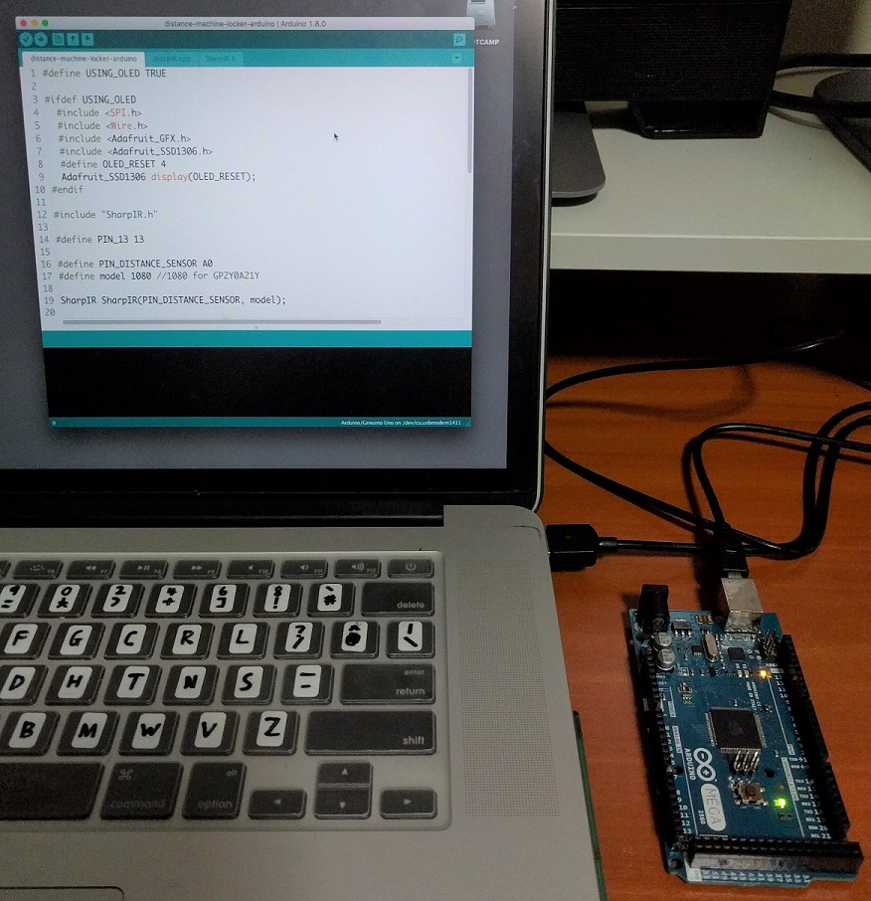
Typical Arduino Programming
Arduino IDE
USB cable

Slide 16
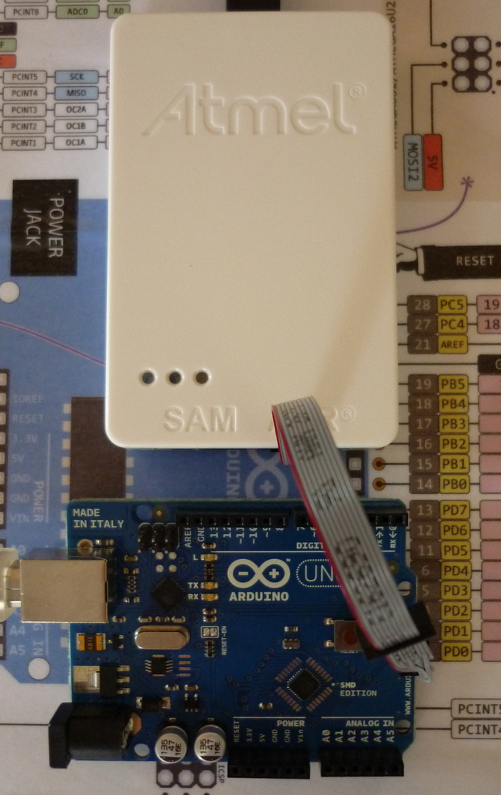
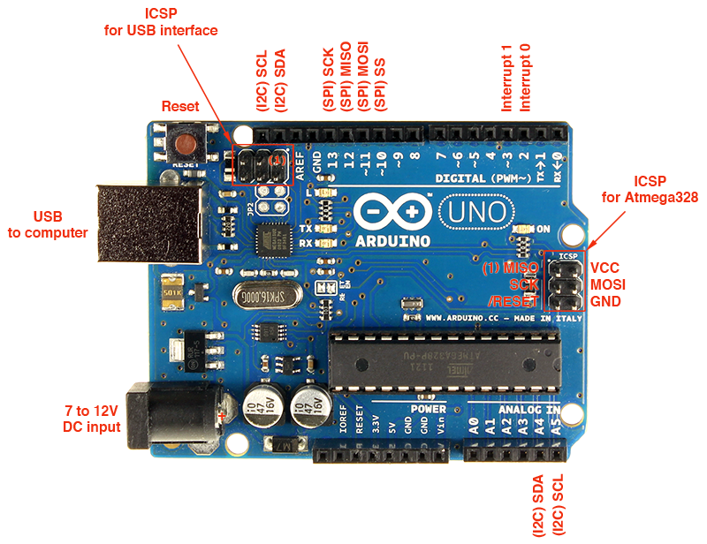

Microcontroller programming the actual way
Using dedicated programmers with ICSP port
ICSP – In-circuit system programmer
+
=
Image sources:
http://www.atmel.com/tools/atatmel-ice.aspx
http://blog.alrightythen.de/2014/08/debugging-with-the-new-atmel-ice/

Slide 17
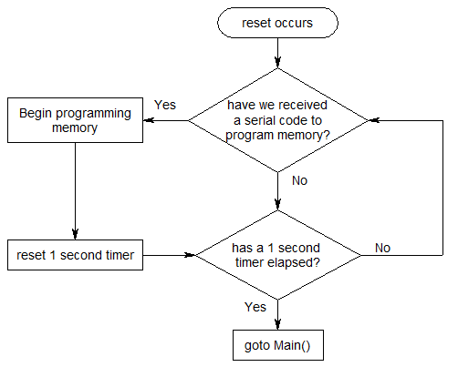
What is an Arduino bootloader?
Allows Arduino IDE to program Arduino board via USB
On reset, wait 1 second for computer to program board before resuming

Slide 18
Just pull me away from my desk to troll me
Hack 4:

Slide 19
Hackers always win
Questions?
No physical security -> No security
https://github.com/yeokm1/distance-machine-locker

