Slide 1
Predicting Diabetes Risk from
Population Health Survey Data
A reproducible machine-learning pipeline on 229,787 CDC BRFSS respondents - exploring six model families, fairness across subgroups, and clinical-screening trade-offs.
Project Team Members: Vinamratha Raghavendra Jagirdar(A20614061) Urjita Saxena(A20578349) Deepali Budhiraja(A20615733) Naman Singh(A20574372)
Notes:
[SPEAKER: Vinamratha - ~30 sec]
Good morning, everyone. Our project is titled Predicting Diabetes Risk from Population Health Survey Data. We built a reproducible machine-learning pipeline on roughly 230,000 CDC BRFSS respondents, comparing six model families and auditing both fairness across subgroups and clinical screening trade-offs. I am Vinamratha, and joining me today are Urjita, Deepali, and Naman. I will cover the executive summary and our project plan; the team will then walk you through the data, the modeling, and our recommendations.

Slide 2
01 • EXECUTIVE SUMMARY
What we set out to do — and what we found
229,787
0.804
+49%
0.161
BRFSS respondents
analyzed (post-dedup)
best test AUC
(XGBoost screening model)
minority-class sensitivity
gain from SMOTE
income-based
fairness gap • BIAS
KEY RESEARCH FINDING
XGBoost narrowly leads on AUC, but Logistic Regression nearly matches it (0.798) while staying interpretable and well-calibrated. The real story isn't the model. It is about lowering the decision threshold to 0.30 doubles diabetic-case detection, and that the model under-screens higher-income patients by 16 sensitivity points.
Recommended next work
Apply Platt scaling on RF/XGBoost probabilities before clinical use
Adversarial debiasing or per-income reweighting to close the fairness gap
External validation against HbA1c-confirmed clinical records
CDC Diabetes Health Indicators • Group Project
2 / 9
Notes:
[SPEAKER: Vinamratha - ~75 sec]
Here is what we found at a glance. After de-duplication we worked with 229,787 respondents. Our best test AUC was 0.804, achieved by XGBoost. SMOTE gave us a forty-nine-percent relative gain in minority-class sensitivity, and we surfaced an income-based fairness gap of 0.161 in detection sensitivity, which we flagged as a bias concern. The headline, though, is not which model wins. XGBoost narrowly leads, but Logistic Regression nearly matches it at 0.798 while staying interpretable and well-calibrated. The real story is that lowering the decision threshold from 0.5 to 0.3 nearly doubles diabetic-case detection, and that the model under-screens higher-income patients. Our recommended next steps are Platt scaling on the tree models, debiasing by income, and external validation against HbA1c-confirmed clinical records.

Slide 3
02 • PROJECT PLAN
Team, timeline, methodology, and what changed
Team (4 graduate students)
Timeline & methodology
1
Wk 1–2
Scoping & data acquisition
M1
Urjita
M2
Vinamratha
UCI BRFSS-2015, target framing
Data engineering & cleaning
EDA & visualization
2
Wk 3–4
Cleaning & EDA
Dedup → 229,787 rows; correlation
3
Wk 5–6
Pre-processing & SMOTE
80/20 split, scale on train only
M3
Naman
M4
Deepali
4
Wk 7–8
Modeling & 5-fold CV
6 model families incl. XGBoost
Modeling & hyperparameter tuning
Fairness, calibration & reporting
5
Wk 9
Fairness, calibration, SHAP
Threshold tuning + bias audit
6
Wk 10
Report & deck
Recommendations + future work
CHANGES TO THE ORIGINAL PLAN
Added fairness audit (sex / age / income) after spotting subgroup gaps in early CV results.
Added calibration plots and SHAP attribution to defend model choice for clinical use.
Dropped manual feature engineering — engineered features gave no AUC lift on tree ensembles.
CDC Diabetes Health Indicators • Group Project
3 / 9
Notes:
[SPEAKER: Vinamratha - ~60 sec]
Quick note on how the work was divided and how we executed. Four graduate students contributed: data engineering, EDA, modeling, and fairness and reporting. The timeline ran ten weeks: scoping and data acquisition, then cleaning and EDA, then preprocessing and SMOTE, then modeling with five-fold cross-validation across six families, and finally fairness, calibration, SHAP, and writeup. Two important changes from the original plan: we added a fairness audit by sex, age, and income after seeing subgroup gaps in early CV results, and we added calibration plots and SHAP attribution to defend our model choice for clinical use. We dropped manual feature engineering because the engineered features gave no AUC lift on tree ensembles. I will hand it over to Urjita to walk through the data.

Slide 4
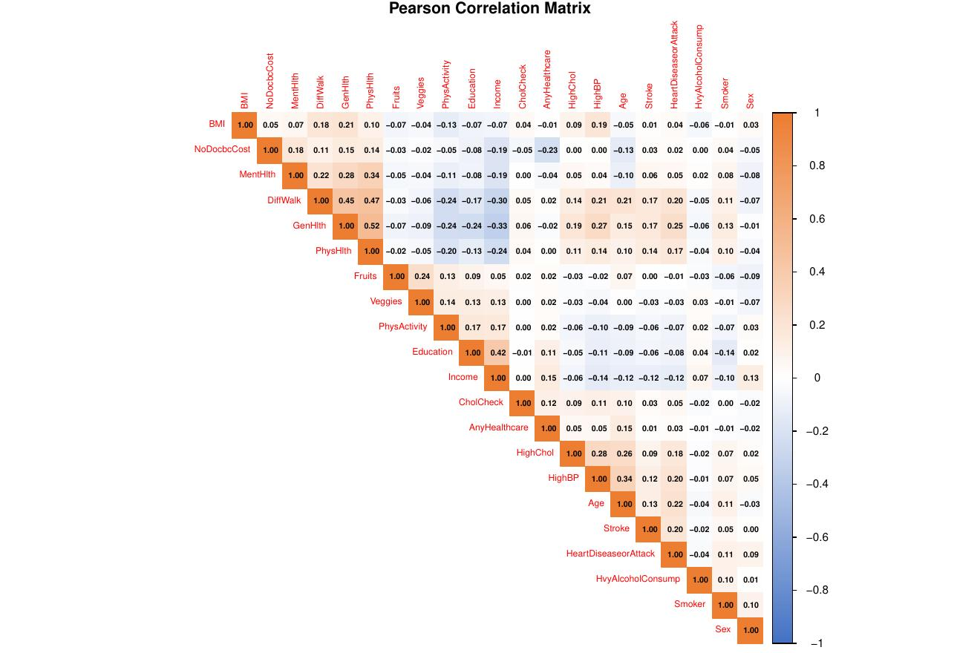
03 • DATA PIPELINE
From 253,680 raw rows to a leakage-safe modeling table
STEP 1
STEP 2
STEP 3
STEP 4
STEP 5
Load
›
Clean
›
EDA
›
Split + Scale
›
SMOTE
UCI BRFSS-2015
253,680 rows × 22 cols
Dedup + type fix
→ 229,787 rows
Class, BMI, age,
corr. matrix
80/20 stratified;
center & scale on TRAIN
Synthetic Yes-class
on TRAIN only
Issue: 83% / 17% class imbalance
Discovery: zero missing values, ~9% duplicates
Decision: scale fit on TRAIN only
A naive 'predict No' baseline already scores 83% accuracy. We chose AUC + recall as primary metrics and applied SMOTE (k=5) to the training set only.
Survey design enforces complete responses. dplyr::distinct() removed 23,893 exact duplicate rows that would have inflated CV scores.
preProcess() parameters were learned on the 80% partition and applied to test. Strict anti-leakage; necessary for unbiased AUC.
UNSUPERVISED CHECK • CORRELATION
Strongest pair: GenHlth ↔ PhysHlth (r ≈ 0.52). Income ↔ Education (r ≈ 0.42). No |r| > 0.55 - multicollinearity not a concern, all 21 raw features kept for modeling.
CDC Diabetes Health Indicators • Group Project
4 / 9
Notes:
[SPEAKER: Urjita - ~75 sec]
Thanks, Vinamratha. Our pipeline starts from the UCI BRFSS-2015 release: 253,680 rows by 22 columns. Step one is loading. Step two, cleaning and de-duplication, brings us to 229,787 rows; about nine percent of the original rows were exact duplicates that would have inflated our cross-validation scores. Step three is EDA on class, BMI, age, and the correlation matrix. Step four is an 80/20 stratified split, with centering and scaling fit only on the training partition - this is critical to avoid leakage into the test AUC. Step five is SMOTE, applied only to the training set with k equal to five. Three things are worth highlighting. First, the 83/17 class imbalance: a naive predict-no baseline already scores 83 percent accuracy, so we anchored on AUC and recall instead. Second, there are zero missing values - the survey design enforces complete responses. Third, the strongest correlation we observed was between general health and physical health at about 0.52, well below any multicollinearity threshold, so we kept all 21 raw features.

Slide 5
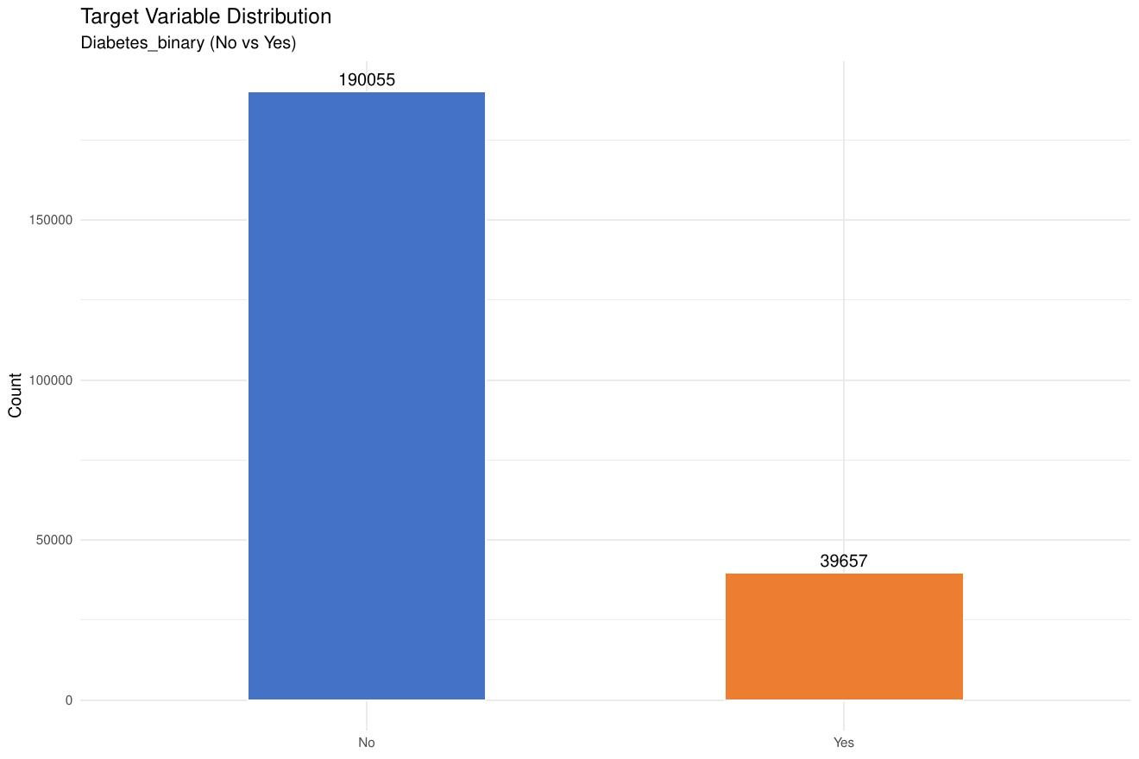
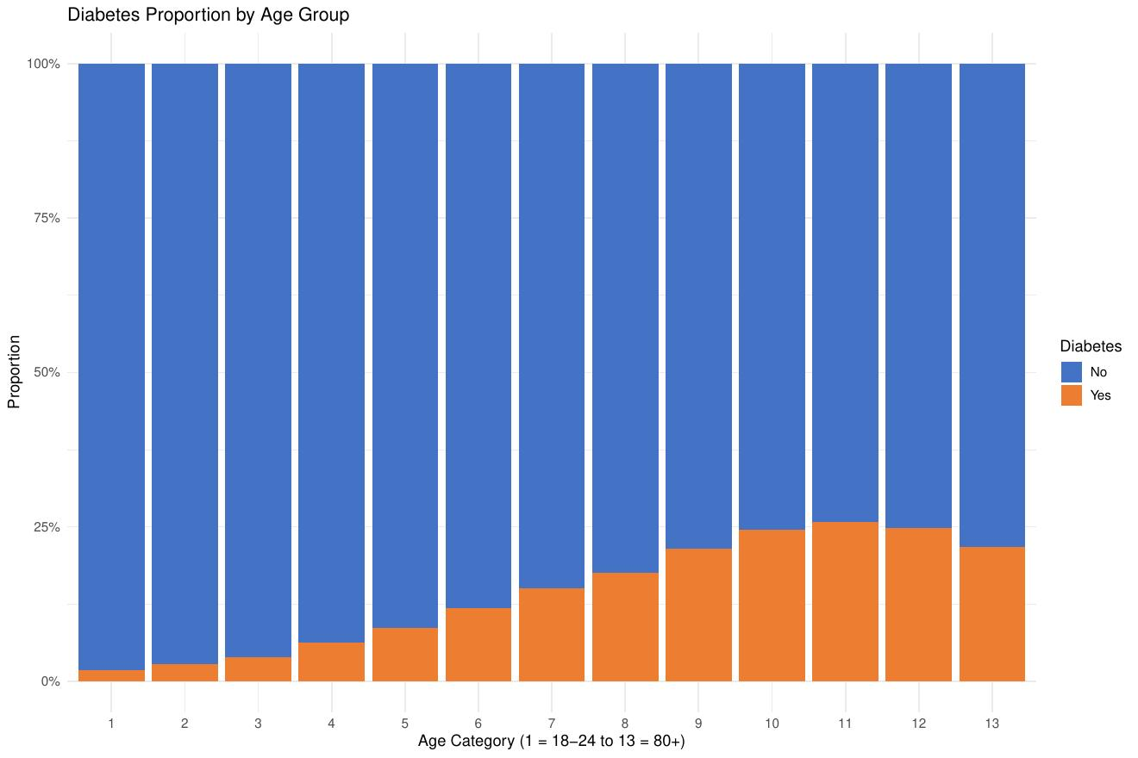
04 • EXPLORATORY ANALYSIS
Three patterns that drove every modeling decision
Severe class imbalance
Diabetes rises monotonically with age
GenHlth ↔ PhysHlth is the strongest pair
190,055 No vs. 39,657 Yes (17.3%) - motivated SMOTE and AUC-first metric.
<5% prevalence at age 18-24, >25% by 70+. Age becomes a top-3 RF predictor.
r ≈ 0.52; otherwise correlations stay <|0.55| - no feature dropped for redundancy.
Diabetic respondents are systematically heavier (BMI median 31 vs 27), older, in worse self-rated health, and less physically active — all consistent with established clinical risk profiles.
CDC Diabetes Health Indicators • Group Project
5 / 9
Notes:
[SPEAKER: Urjita - ~50 sec]
EDA surfaced three patterns that drove every modeling decision. First, the severe class imbalance I just mentioned - 190,055 no versus 39,657 yes, which motivated SMOTE and AUC as our primary metric. Second, diabetes prevalence rises monotonically with age: under five percent in the 18 to 24 bracket, over twenty-five percent at 70-plus. Age becomes a top-three predictor for the Random Forest. Third, the general-health and physical-health pair is the only correlation worth noting; nothing else exceeds 0.55, so no feature was dropped for redundancy. The clinical pattern is consistent and clean: diabetic respondents are heavier, with a BMI median of 31 versus 27, older, in worse self-rated health, and less physically active. With that, I will hand it over to Deepali for the modeling results.

Slide 6
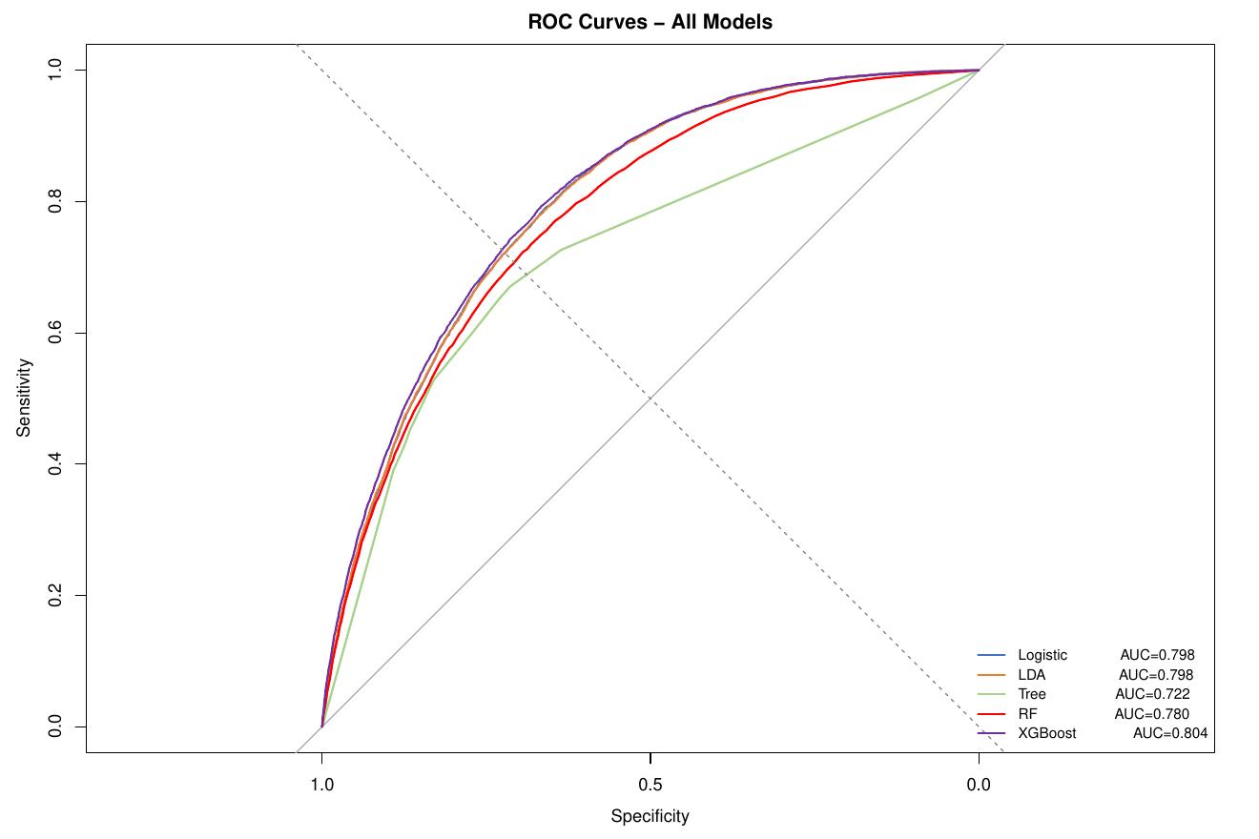
05 • MODELING
Six model families, 5-fold CV, AUC as primary metric
MODELS TRAINED
Logistic Regression
interpretable baseline + odds ratios
0.798
LDA
well-calibrated parametric
0.798
Decision Tree (rpart)
CP tuned over 10 values
0.722
Random Forest
ntree=200, mtry∈{3,5,7}
0.780
XGBoost
narrow→wide grid, 216 combos
0.804
KNN
k tuned ∈ {3,5,7,11,15,21}
0.561*
* KNN AUC reflects hard-label predictions, not probabilities.
ROC overlay - XGBoost edges out LDA / Logistic at high sensitivity; Decision Tree trails.
TOP-5 RISK FACTORS →
GenHlth
BMI
Age
HighBP
HighChol
OR 1.90
OR 1.62
OR 1.59
OR 1.37
OR 1.27
CDC Diabetes Health Indicators • Group Project
6 / 9
Notes:
[SPEAKER: Deepali - ~75 sec]
Thanks, Urjita. We trained six model families with five-fold cross-validation and AUC as the primary metric. Logistic Regression gives us an interpretable baseline with odds ratios and lands at 0.798. LDA matches it at 0.798 and is well-calibrated. A single Decision Tree, with the complexity parameter tuned over ten values, comes in at 0.722. Random Forest with two hundred trees and mtry swept across three, five, and seven reaches 0.780. XGBoost, tuned over a 216-combination grid, is our top performer at 0.804. KNN shows 0.561, but that figure reflects hard-label predictions rather than probabilities, so it is not directly comparable. The ROC overlay shows XGBoost edging out LDA and Logistic at high sensitivity, with the Decision Tree clearly trailing. From the Logistic odds ratios, the top-five risk factors are general health, BMI, age, high blood pressure, and high cholesterol - in that order.

Slide 7
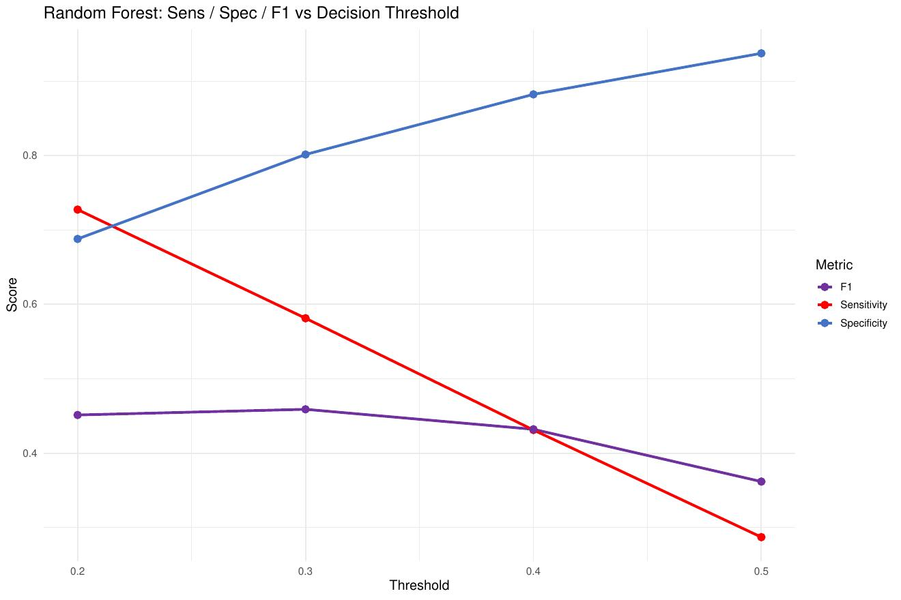
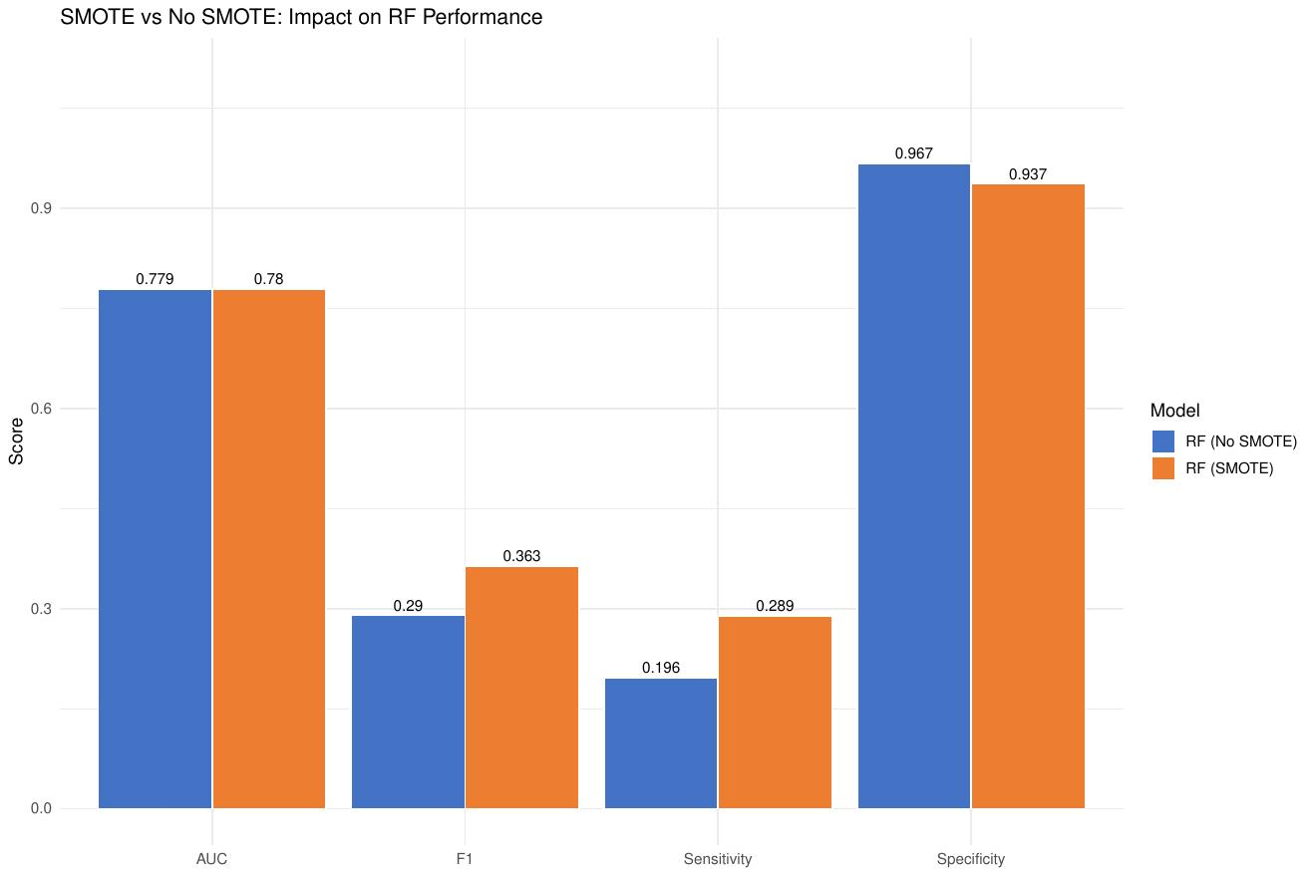
06 • PRACTICAL WINS
Threshold tuning and SMOTE — the two changes that mattered
Threshold sweep (Random Forest)
SMOTE vs No SMOTE (RF)
0.50 default → 29% sensitivity.
Misses 71% of diabetic respondents.
0.30 → 57% sensitivity, specificity stays > 0.80, F1 peaks here.
→ Apply 0.30 in any screening deployment.
Sensitivity: 0.196 → 0.289 (+49% relative).
F1: +25%. AUC essentially unchanged.
Specificity drops only 3pts (0.967 → 0.937).
→ SMOTE is non-negotiable for any retrain.
CDC Diabetes Health Indicators • Group Project
7 / 9
Notes:
[SPEAKER: Deepali - ~60 sec]
Two practical changes mattered far more than the choice of model. First, threshold tuning. At the default 0.5 threshold, Random Forest sensitivity is only 29 percent - we miss seventy-one percent of diabetic respondents, which is unacceptable for screening. Lowering the threshold to 0.3 lifts sensitivity to 57 percent, specificity stays above 0.80, and F1 actually peaks. Our recommendation: deploy at 0.3 in any screening context. Second, SMOTE. Sensitivity goes from 0.196 to 0.289, a forty-nine percent relative gain. F1 improves twenty-five percent, AUC is essentially unchanged, and specificity drops only three points. SMOTE is non-negotiable for any retrain on this kind of imbalanced survey data. Naman will now take you through fairness and final recommendations.

Slide 8
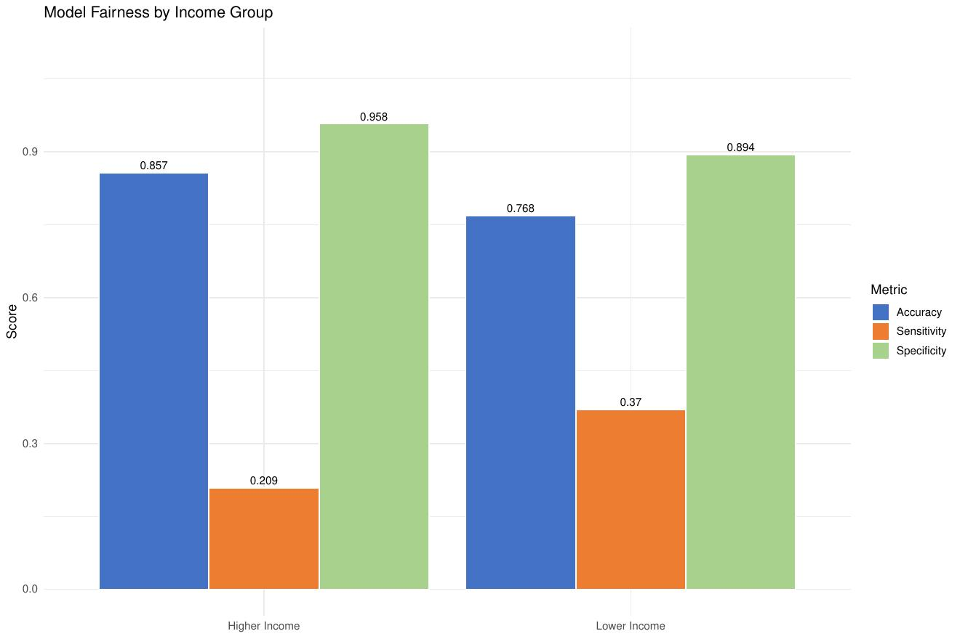
07 • FAIRNESS AUDIT
An income-based sensitivity gap is the deployment risk
BIAS DETECTED
0.161
sensitivity gap by income
Lower-income diabetic respondents are detected at 37%; higher-income diabetic respondents at only 21%. Wealthy diabetic individuals are systematically under-screened, likely because they present with less stereotypical risk profiles.
Sex (gap 0.006)
Age (gap 0.080)
Income (gap 0.161)
OK
OK
BIAS
RECOMMENDATION • Adversarial debiasing or per-income reweighting before deployment. Threshold acceptance: gap must drop below 0.10.
CDC Diabetes Health Indicators • Group Project
8 / 9
Notes:
[SPEAKER: Naman - ~60 sec]
Thanks, Deepali. Once we had a working model, we ran a fairness audit across three subgroups: sex, age, and income. Sex was clean with a sensitivity gap of 0.006. Age was acceptable at 0.080. Income was the problem: a 0.161 sensitivity gap, which we are flagging as bias. Concretely, lower-income diabetic respondents are detected at thirty-seven percent, while higher-income diabetic respondents are detected at only twenty-one percent. Wealthier diabetic individuals are systematically under-screened, likely because they present with less stereotypical risk profiles - lower BMI, better self-rated general health. Our recommendation is adversarial debiasing or per-income reweighting before any deployment, with a hard threshold that the gap must drop below 0.10 before the model goes live.

Slide 9
08 • RECOMMENDATIONS & FUTURE WORK
What we ship — and what we'd build next
1
Deploy XGBoost for screening
2
Use Logistic when explanation matters
AUC 0.804 — best risk stratification on routine survey data; no labs required.
AUC 0.798, full odds-ratio interpretability, well-calibrated probabilities.
3
Lower decision threshold to 0.30
4
Apply Platt scaling on RF / XGBoost
Doubles true-positive detection; specificity stays above 0.80.
Raw probabilities are over-confident in the 0.3–0.6 mid-range.
5
Fairness-aware retrain by income
6
Validate externally on HbA1c records
Adversarial debiasing or per-stratum reweighting to drop the 0.161 gap below 0.10.
Self-reported BRFSS data alone is insufficient evidence for clinical adoption.
Thank you • Questions?
9 / 9
Notes:
[SPEAKER: Naman - ~60 sec]
To summarize, six recommendations. One: deploy XGBoost for screening at AUC 0.804 - best risk stratification on routine survey data with no labs required. Two: fall back to Logistic Regression when explanation matters; AUC 0.798 with full odds-ratio interpretability and good calibration. Three: lower the decision threshold to 0.3 to roughly double true-positive detection while keeping specificity above 0.80. Four: apply Platt scaling on the tree models, since raw probabilities are over-confident in the 0.3 to 0.6 mid-range. Five: do a fairness-aware retrain by income to drop the 0.161 gap below 0.10. And six: validate externally on HbA1c records before any clinical adoption, because self-reported BRFSS data alone is not sufficient evidence. Thank you - we are happy to take any questions.

