Slide 1
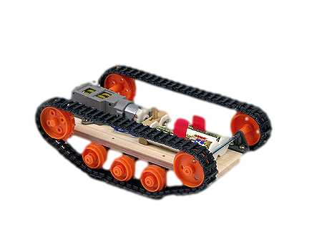
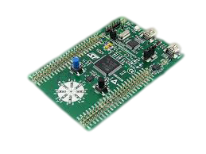
RC Tank
Vinay Rajagopalan
Prasad Hirlikar

Slide 2

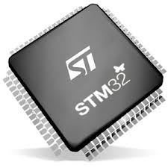
OUR IDEA/MOTIVATION
Build a tank that can be controlled remotely
User controls the tank using command line instructions
A program will be loaded onto the chip to execute the commands
The RC tank will move in the direction(in degrees of rotation)specified by the user

Slide 3
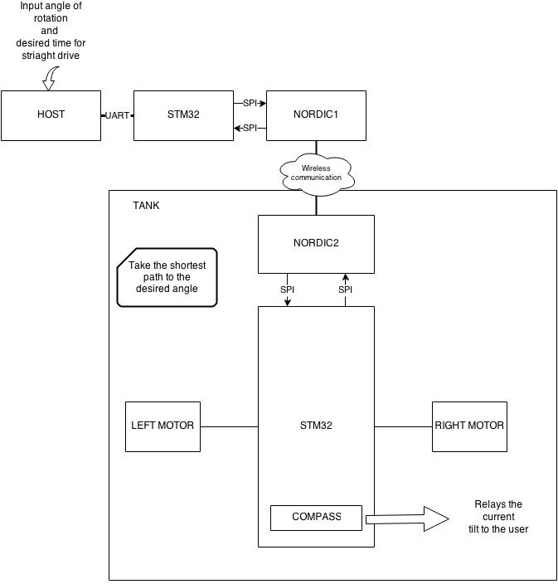
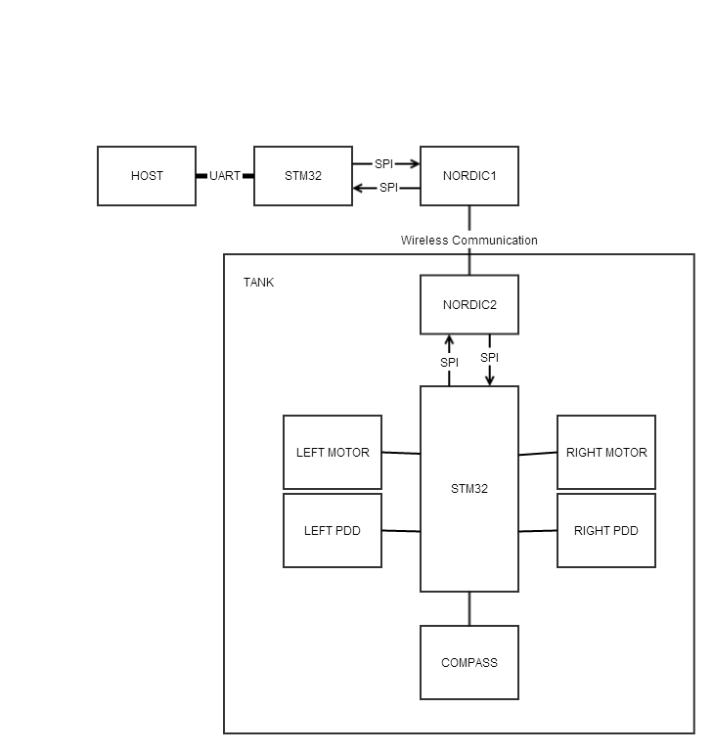
BLOCK DIAGRAM

Slide 4
TECHNICAL PROFILE
Category | Design Objective | Deliverable | Status
Power | Battery life | Based on the usage | Complete
Power | Battery availability | Uses commercially available AA batteries or any other batteries | Complete
Communication | Tank movement | Device and the host should reliably communicate | Complete
Communication | Tank movement | Host should be able to send the time it should be move straight and angle it should turn | Complete
User Interface | Command line access | An interface that will help user to communicate with the device | Complete
User interface | Device updates and information | Relays the status to the user | Complete
Mechanical | Environmental | Device should be run under suitable condition | Complete

Slide 5
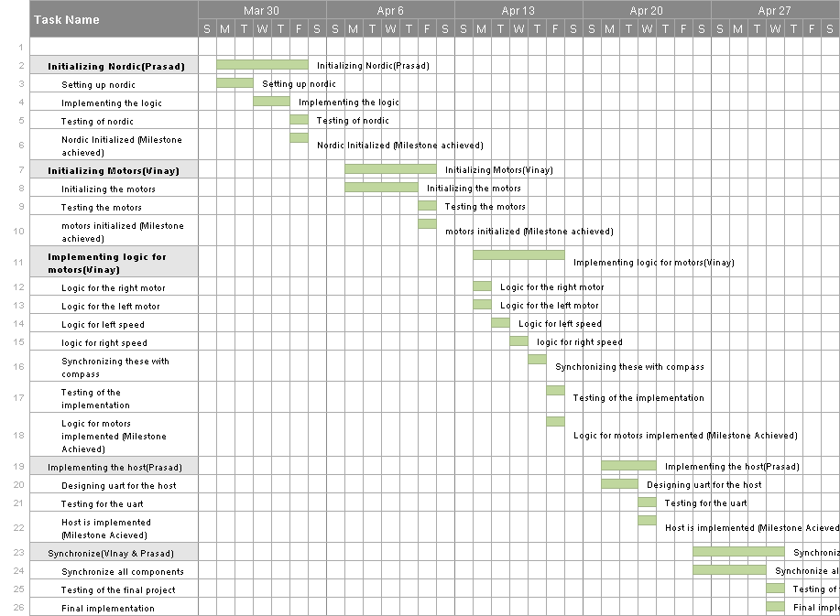
PROJECT TIMELINE

Slide 6
PROJECT TIMELINE
Group Tasks | Sub Tasks | Dates
Initializing Nordic (Prasad ) | Setting up nordic | 3/31/2014-4/1/2014
 | Implementing the logic | 4/2/2014-4/3/2014
 | Testing of nordic | 4/4/2014
 | Nordic Initialized (Milestone) | 4/4/2014 (Completed)
Initializing Motors (Vinay ) | Initializing the motors | 4/7/2014-4/10/2014
 | Testing the motors | 4/11/2014-4/11/2014
 | motors initialized (Milestone) | 4/12/2014 (Completed)
Implementing logic for motors (Vinay) | Logic for the right motor | 4/13/2014-4/14/2014
 | Logic for the left motor | 4/14/2014-4/14/2014
 | Logic for left speed | 4/15/2014-4/15/2014
 | logic for right speed | 4/16/2014-4/16/2014
 | Synchronizing these with compass | 4/17/2014-4/17/2014
 | Testing of the implementation | 4/18/2014-4/18/2014
 | Logic for motors implemented (Milestone) | 4/18/2014 (Completed)
Implementing the host (Prasad) | Designing uart for the host | 4/21/2014-4/22/2014
 | Testing for the uart | 4/23/2014-4/23/2014
 | Host is implemented (Milestone) | 4/23/2014 (Completed)
Synchronize (Vinay and Prasad) | Synchronize all components | 4/26/2014-4/29/2014
 | Testing of the final project | 4/30/2014-4/30/2014
 | Final Implementation(Milestone) | 5/01/2014 (Completed)

Slide 7
Demo

Slide 8
Challenges
1.Establishing Nordic Connection.
2.Compass reading where affected due to the magnetic field of the motors.
3.Motors initialization
4.The loss of data packet
5. Restart the program to accept a new command

Slide 9
Potential Future Work
1.Controlling the speed at which the tank moves
2.The tank should track back to the source.

Slide 10
THANK YOU !

