Slide 1

Predicting and analyzing the features of Git hub repositories
By
Vinati Gattupalli

Slide 2
Statement of the project problem
GitHub contains various types of repositories which may or may not correspond to software.
They could correspond to different types of software languages.
Each repository will a have a purpose and could be different from one another.
It is very important to understand the trends and characteristics of the repositories to filter out the junk. By categorizing them.

Slide 3
Objectives of the project
1.To understand the trends of the GitHub repositories.
2.To identify the similarities and dissimilarities among the GitHub repositories.
3.To identify the categories of GitHub repositories.
4. To filter the repositories and use the required categories for further research on team sizes.

Slide 4

Tools:
1. Python
Numpy, Pandas –To handle, manipulate and pre-process the data.
Matplotlib, Seabornhorse,- For Exploratory Data Analysis and Visualization.
Scikit-learn- Predictive Modelling.
NLTK- Text Analysis and Natural Language Processing
MYSQL, SQL-DataBase
Linux- Using the high-performance machine and for accessing the database
Tableau- Final Visualizations and Dashboards.

Slide 5
Research Design and Methodologies
Data Extraction
Feature processing and selection
Data Scrubbing
Handling null values and special characters
Exploratory Data Analysis
Predictive Modelling
Presentation/Visualizing Report
Feature Engineering

Slide 6
Data Extraction
There is a public API provided by data.org to get the time lined GitHub data which can be taken as source for data collection.
url = https://data.gharchive.org/2014-04-01-15.json.gz
The data collected is a transactional data and is based on the type of action performed on GitHub repositories by the users.
I extracted data for the month of April in 2015.
The data extracted is unpredictable and it does not follow a pattern. I have handled all those cases and extracted the data useful to the project.

Slide 7
Some details about the Data Extraction
We are dealing with a time lined API- the output of the API is given as a gzipped file containing the list of JSON strings corresponding to one hour.
Since the data is semi-structured and in raw format- the data goes through lot of processing to convert it into structured format.
We are storing the structured data in MYSQL data base and use it for our analysis.
There are about 10,396,489 rows of data and 588 columns for the data collected from April 1 st to April 30 2015.

Slide 8
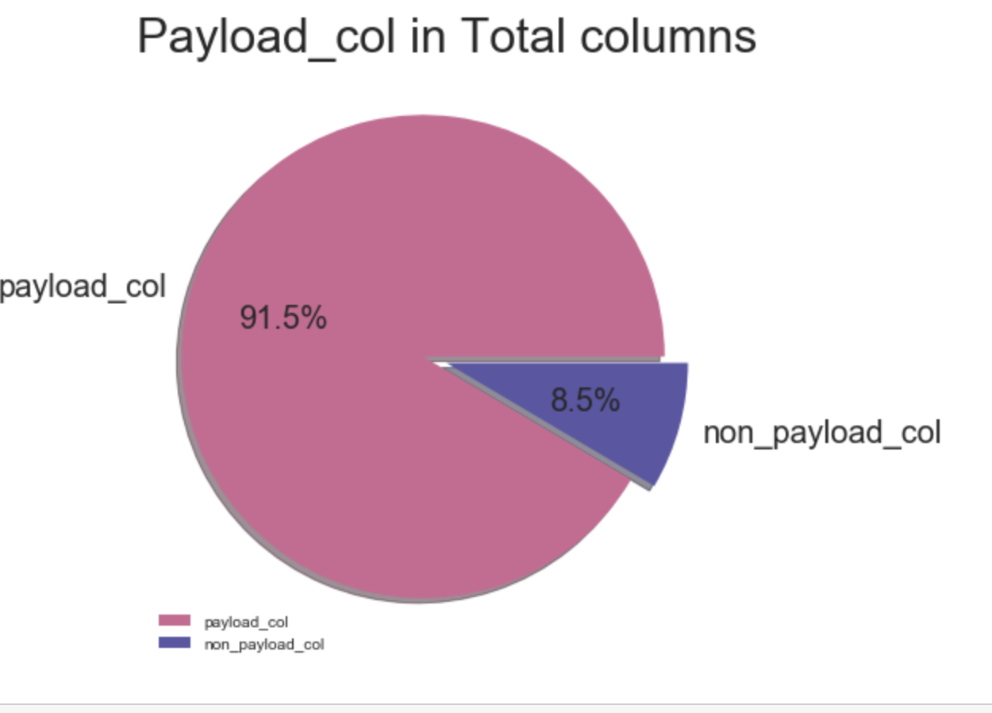
Feature Processing and selection
Explored the features present in my data set.
There are identical columns in our data with different names.
Ihave removed the redundant columns.
There are about 588 features which consist of payload and non_payload.
Selected the features that are useful to our project.

Slide 9
Data Scrubbing
Removing the duplicate rows.
Subsetting the repository information from the transactional data.
Understanding the data-types .
Detecting the null values.
Understanding the data columns and their purpose.
Got correlation between non categorical, categorical and textual features.

Slide 10
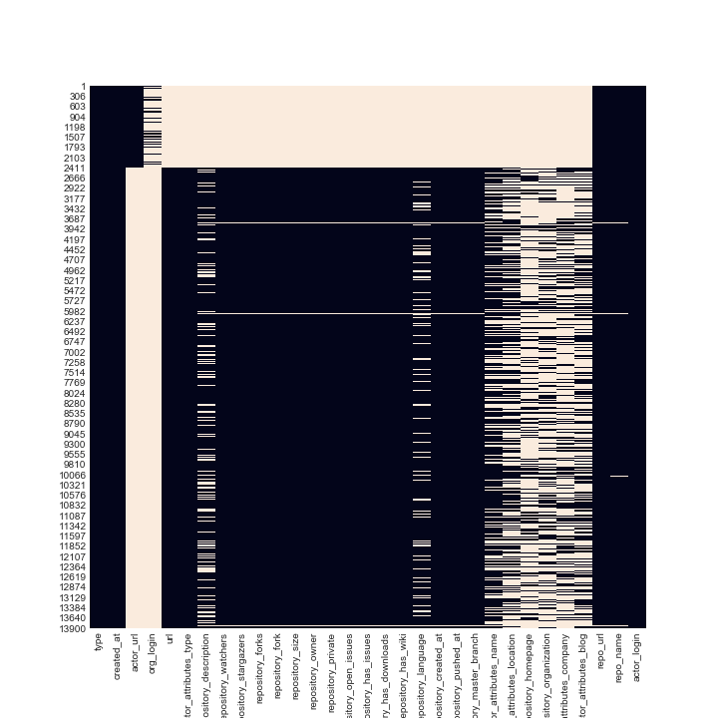
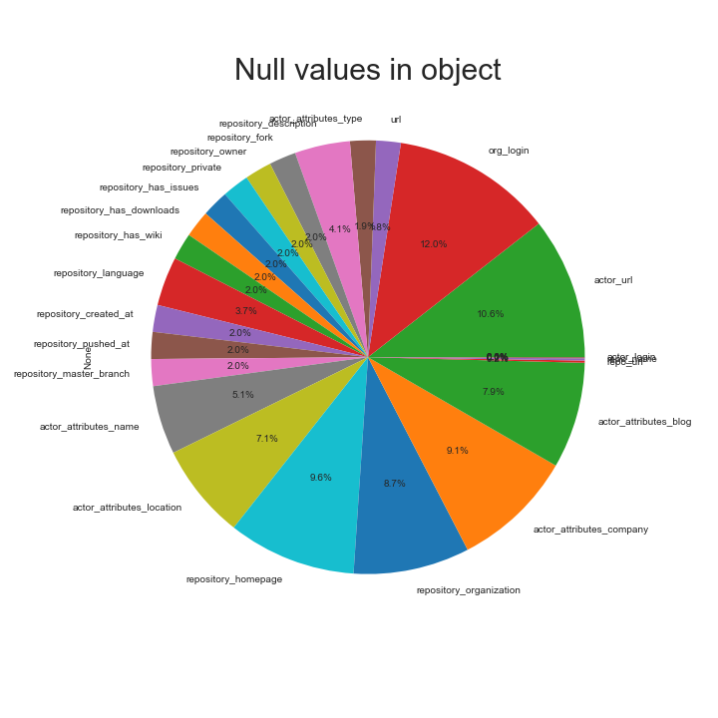
Null values in our data
We can see that the cream patches in the heat map are the null values present in the whole data set on the right and the percentage of null values in object type variables in the bottom..

Slide 11
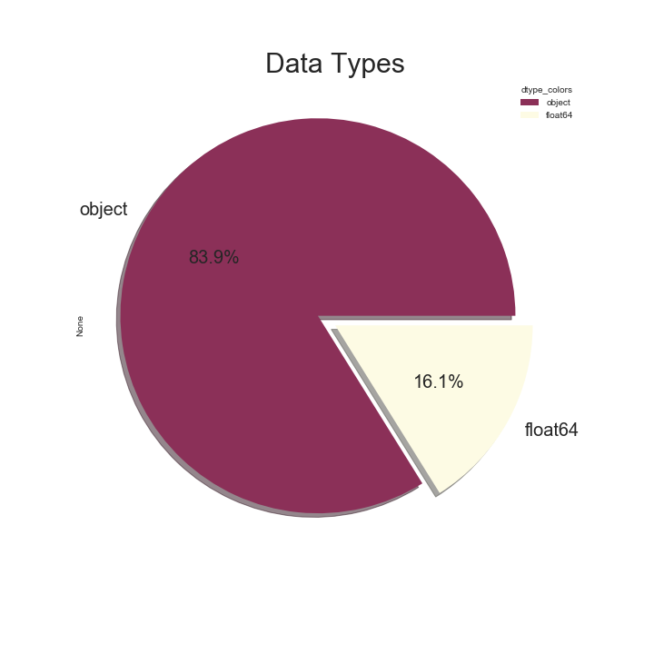
Data Types
Our data contains two major types od datatypes – Float and object
Object further has nominal data, categorical data, text data, unprocessed bool data.
Our data has a mix data types and each of them have to be dealt differently to continue analysis..

Slide 12
Feature Engineering
We have to perform the following to deal with our mixed type of data.
Categorical Analysis
Text Analysis.

Slide 13
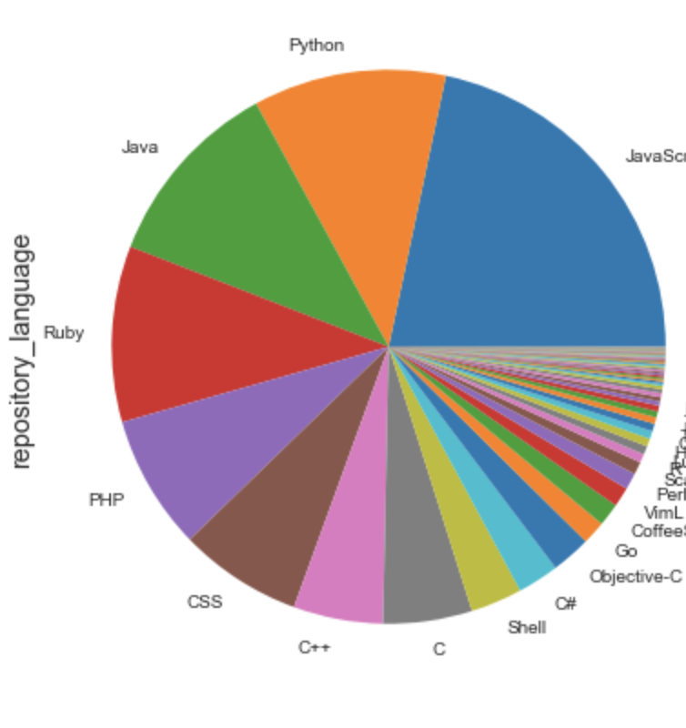
Categorical ANALysis
I chose my target variable as repository_language variable. It consists of more than 80 languages. I have used the top 11 languages that includes python, java, java-script, C, Objective-C etc.
I have coded the rest as others. Therefore now we have 12 classes,
The repositories will be classified among these languages.
Along with this all other categorical variables will be converted to
Numerical.

Slide 14
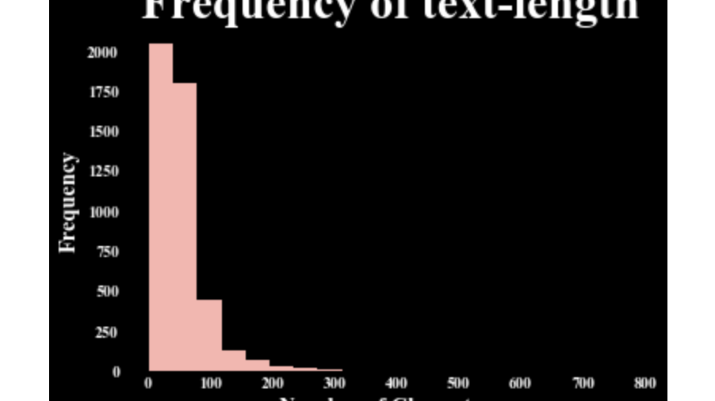
Text Analysis
Converted lower to upper.
Removed punctuations.
Exploratory data Analysis for text.
Used TF-IDF algorithm to get the term
Frequency matrix.
Applied LSA to reduce the dimensions.

Slide 15
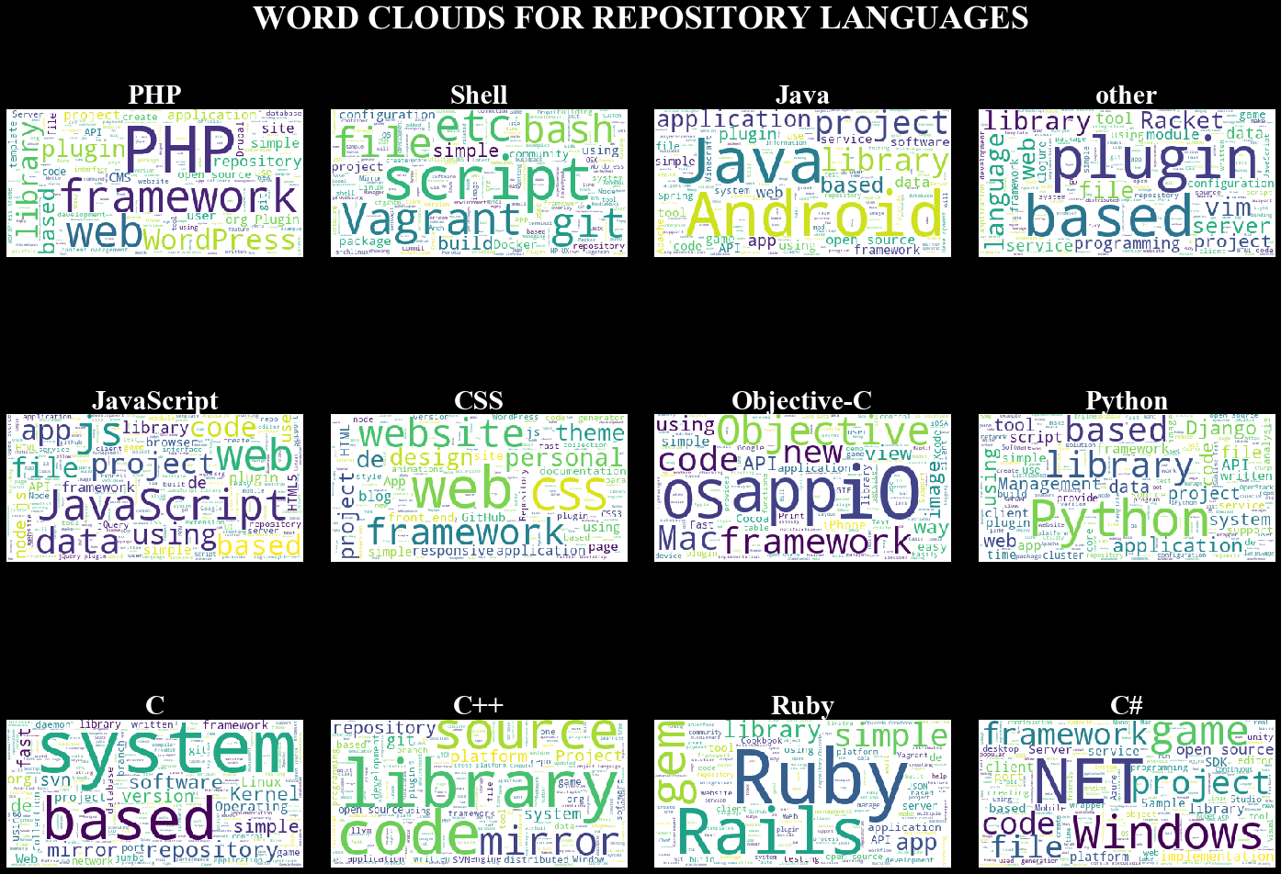
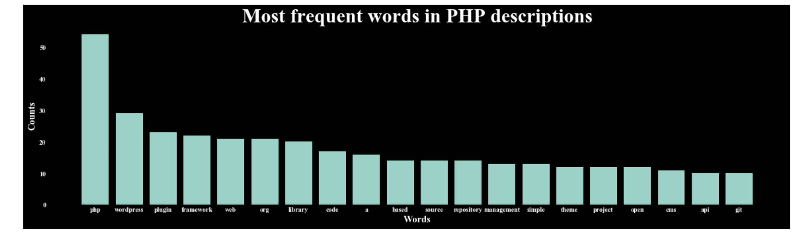
Exploratory Data Analysis on TEXT
Constructed word clouds for all the classes in our data set and bar chart to see the frequency of words in a particular class.

Slide 16
Feature importance and Extraction
I will now have all numeric data after feature engineering and this will be my new data set.
I will be using dimension reduction algorithms such as PCA and LSA to reduce the number of dimensions and retain the important information to classify the repositories.
I will be using feature importance techniues such as Extra trees and Random forest to get the importance of the features in model prediction capacities.

Slide 17
descriptive analytics
Use k-means clustering to obtain the trends and insights of the repositories.

Slide 18
Predictive analytics
Random Forest
XGBoost
SVM
Decision Trees

Slide 19
Improving the performance
I will be using to use ensemble of all these models to improve the performance of my model.

