Slide 1
Identifying viruses using metagenomics and LINs
Mitchell Gercken
mitchellgercken@vt.edu

Slide 2
Metagenomics-based viral identification
Obtain infected plant sample
Extract and quantify RNA
Metagenomic sequencing of RNA
Classify plant metagenome using Kraken 2 custom database
Extract most abundant viral reads
Assemble reads with SPAdes
Generate phylogenetic tree with IQ-tree
Assign LINs to assembled contigs

Slide 3
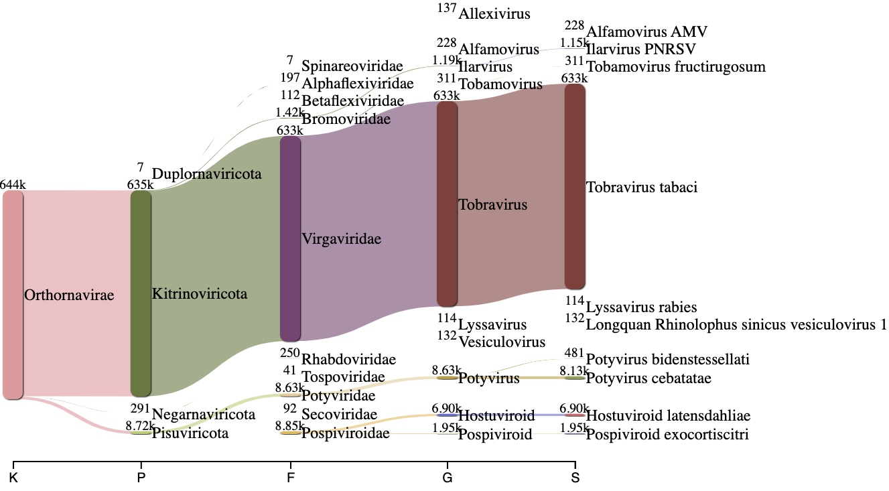
From taxonomic profiling to genome assembly
Contig from assembly | Contig Length (nts) | Reference Length (nts)
Contig 1 | 6,815 | 6,791
Contig 2 | 2,470 | 3,855
Table 1. Assembly results of most abundant viral reads (Tobacco rattle virus) from Kraken 2 results using SPAdes.
Figure 1. Sankey plot of Kraken 2 results from a Bleeding-Heart metagenome.

Slide 4
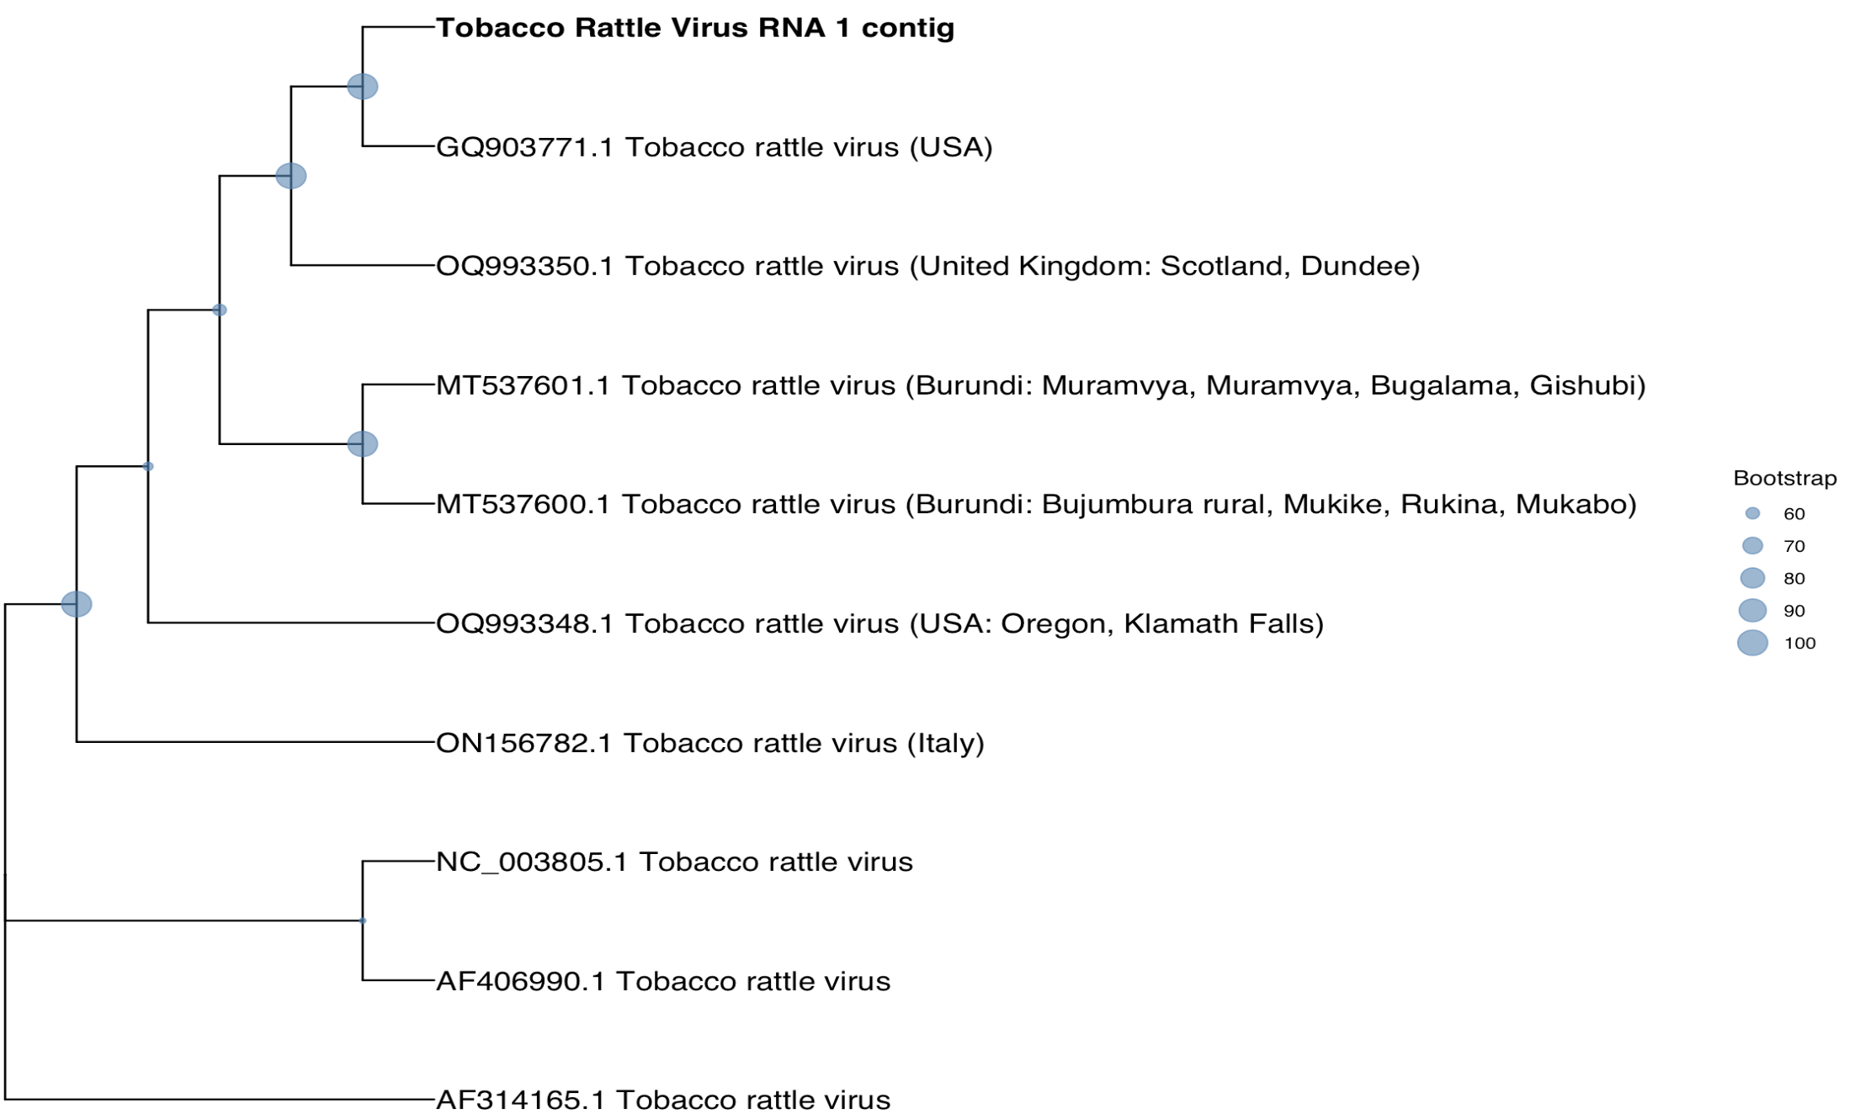
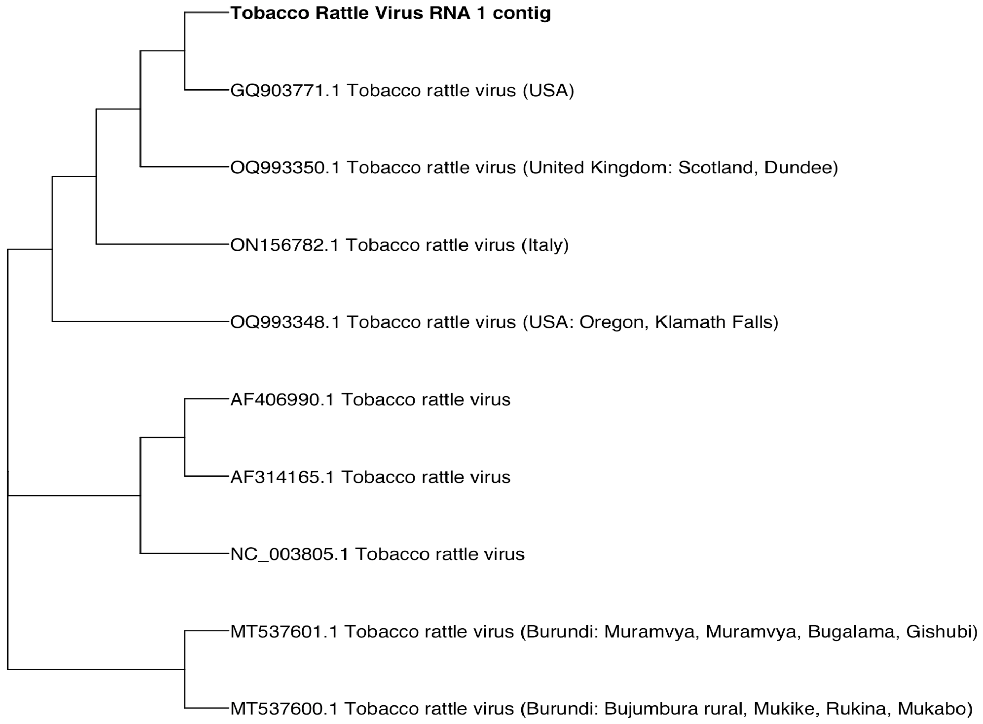
From genome assembly to phylogenetic trees
Phylogenetic (IQ-tree) Tree
Sourmash Distance Tree
Figure 2. Phylogenetic (IQ-tree) tree of Tobacco rattle virus RNA 1 compared to Tobacco rattle virus RNA 1 references.
Figure 3. Sourmash distance tree of Tobacco rattle virus RNA 1 compared to Tobacco rattle virus RNA 1 references.

Slide 5
From genome assembly to phylogenetic trees
Phylogenetic (IQ-tree) Tree
Sourmash Distance Tree
Figure 2. Phylogenetic (IQ-tree) tree of Tobacco rattle virus RNA 1 compared to Tobacco rattle virus RNA 1 references.
Figure 3. Sourmash distance tree of Tobacco rattle virus RNA 1 compared to Tobacco rattle virus RNA 1 references.
GQ903771.1 is the most similar genome for RNA 1

Slide 6
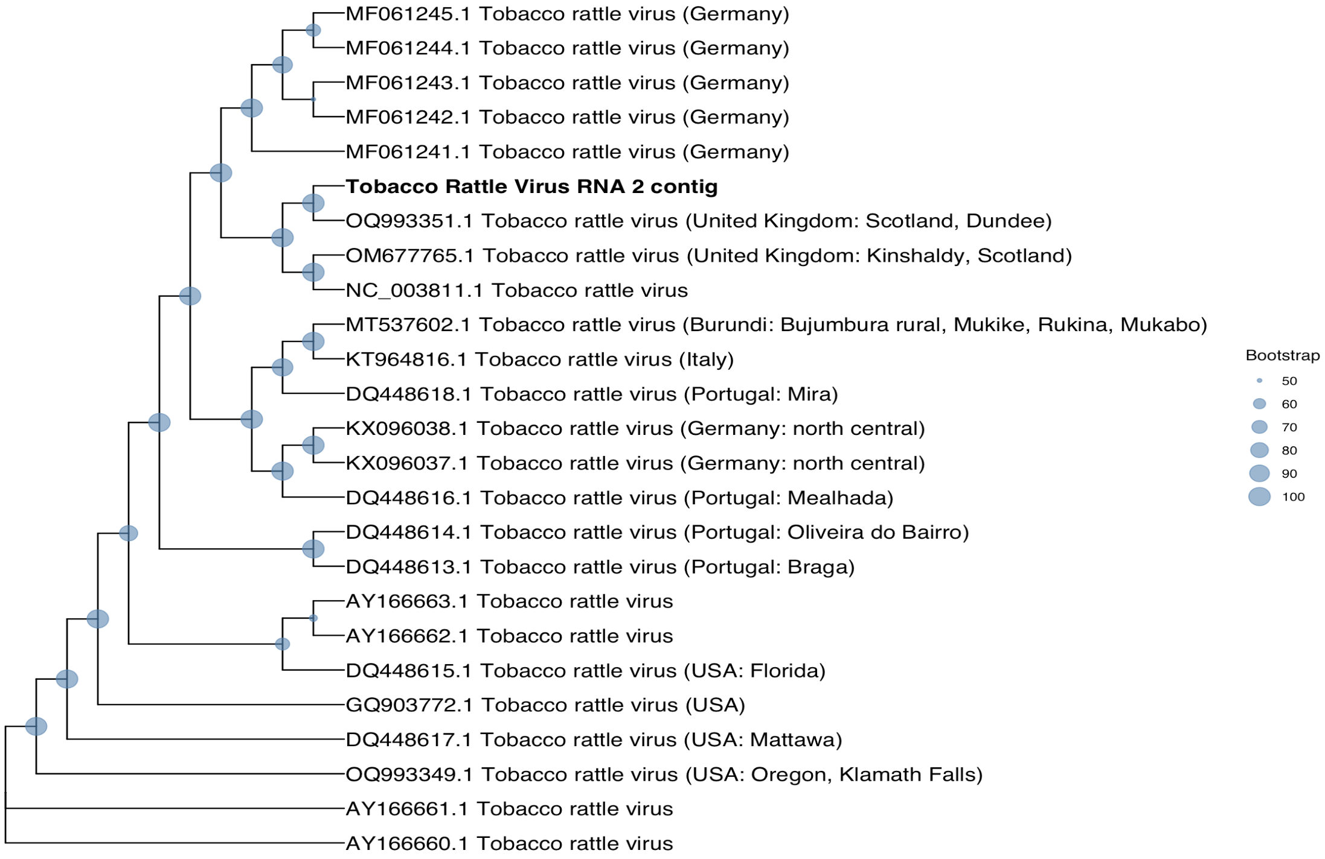
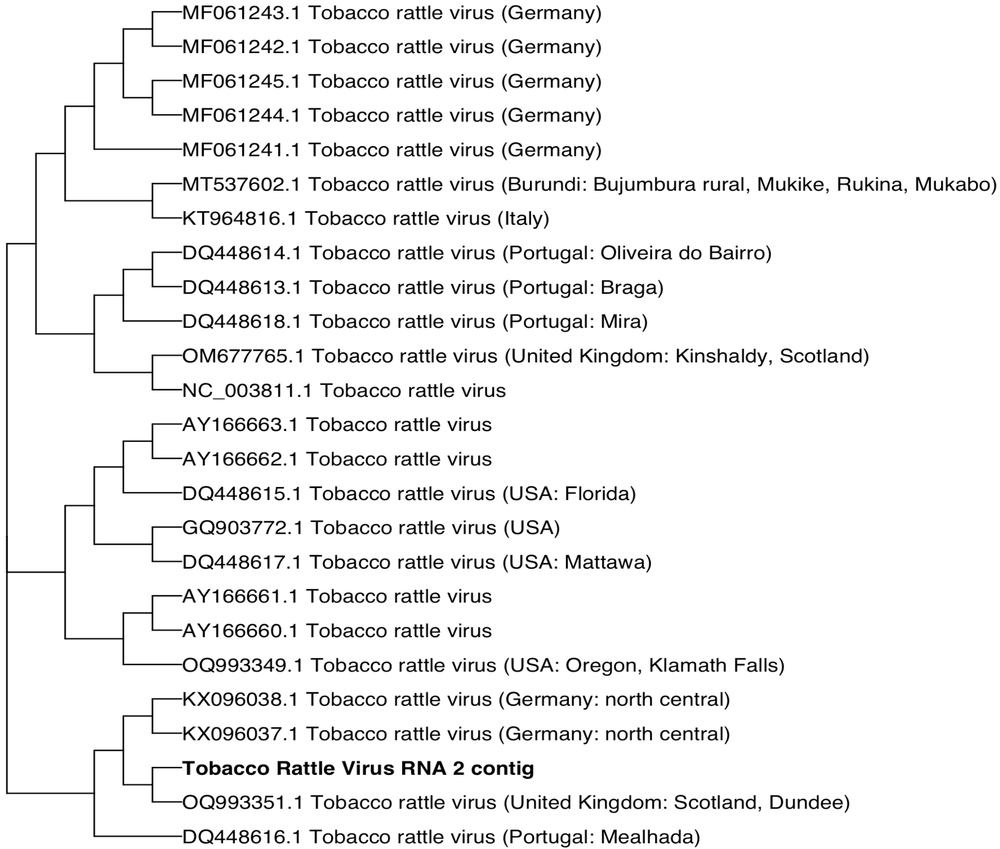
From genome assembly to phylogenetic trees
Phylogenetic (IQ-tree) Tree
Sourmash Distance Tree
Figure 4. Phylogenetic (IQ-tree) tree of Tobacco rattle virus RNA 2 compared to Tobacco rattle virus RNA 2 references.
Figure 5. Sourmash distance tree of Tobacco rattle virus RNA 2 compared to Tobacco rattle virus RNA 2 references.

Slide 7
From genome assembly to phylogenetic trees
Phylogenetic (IQ-tree) Tree
Sourmash Distance Tree
Figure 4. Phylogenetic (IQ-tree) tree of Tobacco rattle virus RNA 2 compared to Tobacco rattle virus RNA 2 references.
OQ993351.1 is the most similar genome for RNA 2
Figure 5. Sourmash distance tree of Tobacco rattle virus RNA 2 compared to Tobacco rattle virus RNA 2 references.

Slide 8
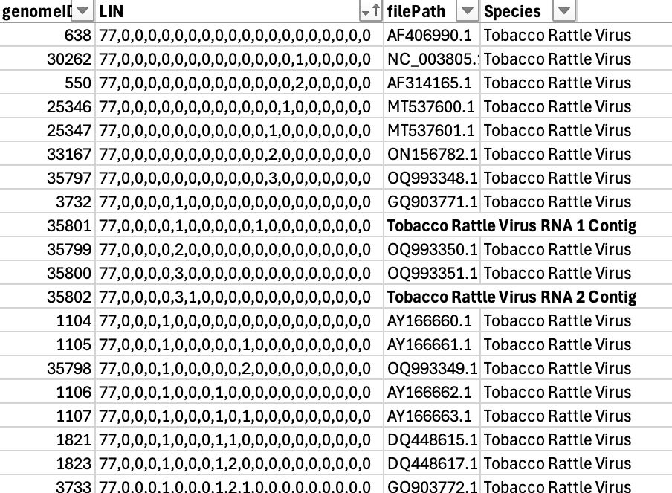
From phylogenetic trees to LIN assignment
Table 2. LIN assignment of Tobacco rattle virus contigs.

Slide 9
From phylogenetic trees to LIN assignment
Phylogenetic trees agree with LIN assignment
Table 2. LIN assignment of Tobacco rattle virus contigs.

Slide 10
Conclusions
It is not always easy.
For this case both the phylogenetic tree analysis and LIN assignment agreed.
Viral LINs work well, but the 95% species threshold seen in bacteria is not the case for viruses (ranges from 88-95%).
Planning to use viral LINs for the creation of a viral GenomeRxiv.

