Slide 1
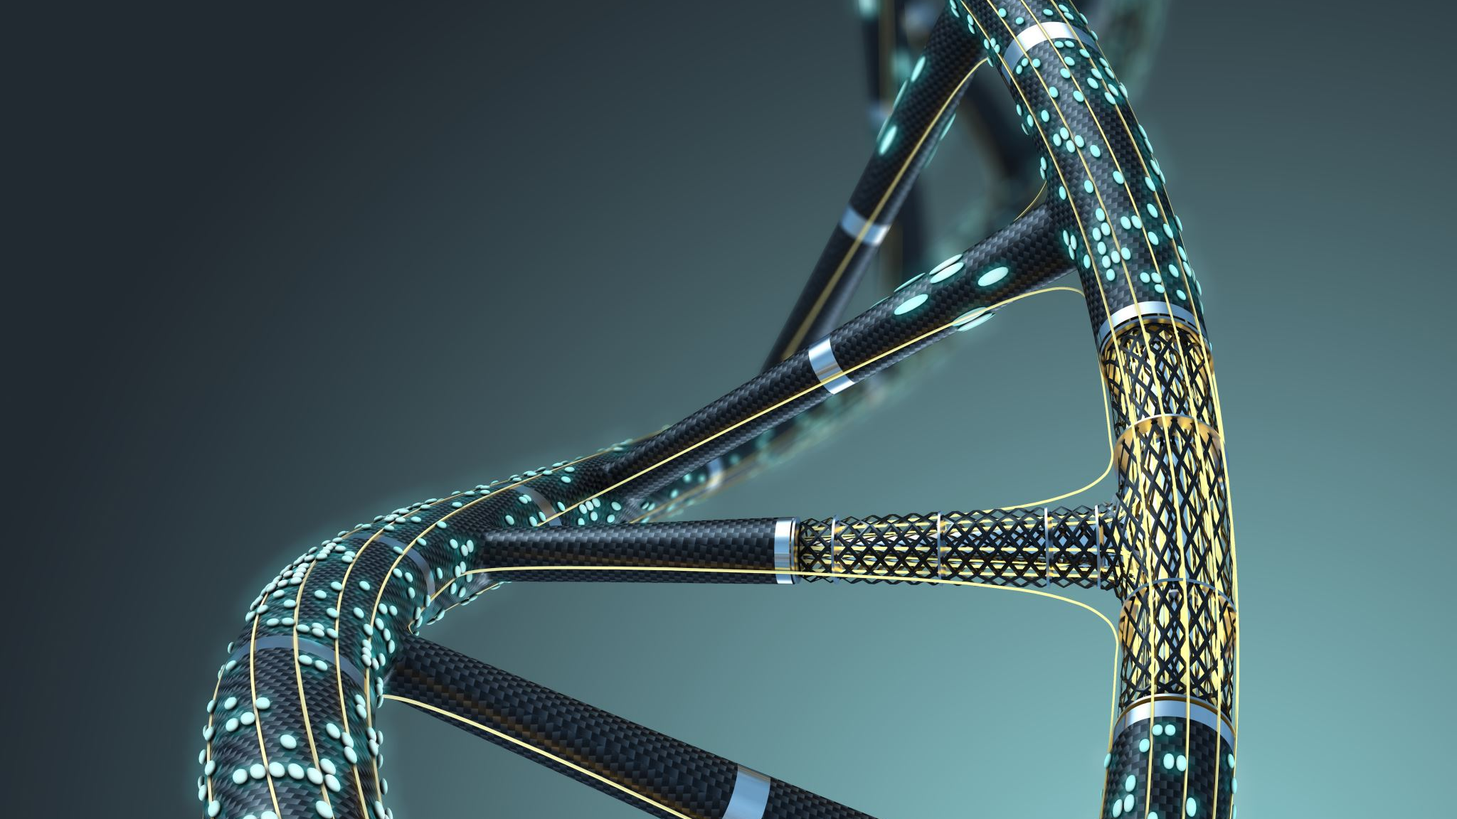
GenomeRxiv
Reza Mazloom
rmazloom@vt.edu

Slide 2
Grouping Pantoea genomes
Imagine you have 7 assembled genomes
Solution: Create a phylogenetic tree using
Core genes
BUSCO
Average Nucleotide Identity (ANI)
Goal: How do you find the relationship between them?

Slide 3
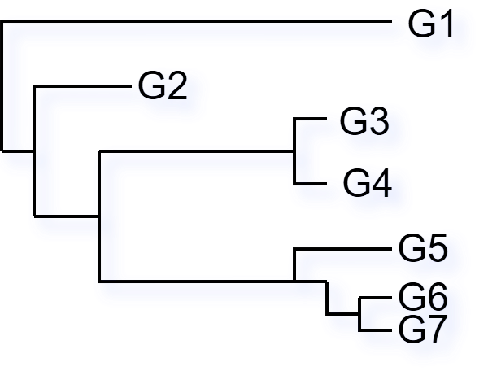
Phylogeny Example
1
2
3.1.1
3.1
3.1.2
3
3.2
3.2.1
3.2.2
3.2.3
Now what if we do this for all Ralstonia genomes or better yet all Bacteria?

Slide 4
Life Identification Numbers
Life Identification Numbers (LINs)
Assembled genome input
Numbers are not values but symbols (class labels)
LIN assignment is based on the k-nearest neighbors
The assignment can be dependent on more than one criteria e.g., ANI similarity and alignment coverage
Genus → Species
within Species
`

Slide 5
Prefixes and LINgroups
Prefixes are partial LINs
Genomes starting with the same values as a Prefix are its members
LINgroups are taxonomy circumscriptions based on LINs
Each LINgroup describes one or more Prefixes
The Genus Ralstonia includes all genomes LINs starting with “864 _{A},0 _{B}” Grey
The Species Ralstonia Solanacearum includes all genome LINs starting with “864 _{A},0 _{B},0 _{C},1_{D},[0,2] _{E}” Blue
The Species Ralstonia PseudoSolanacearum includes all genome LINs starting with “864 _{A},0 _{B},0 _{C},1_{D},1_{E}” Yellow
Genus → Species
within Species
Clades from
Sharma et. al. 2022 https://doi.org/10.1099/mgen.0.000791
Notes:
https://genomerxiv.cs.vt.edu/index.php/result/686e340f902a1

Slide 6

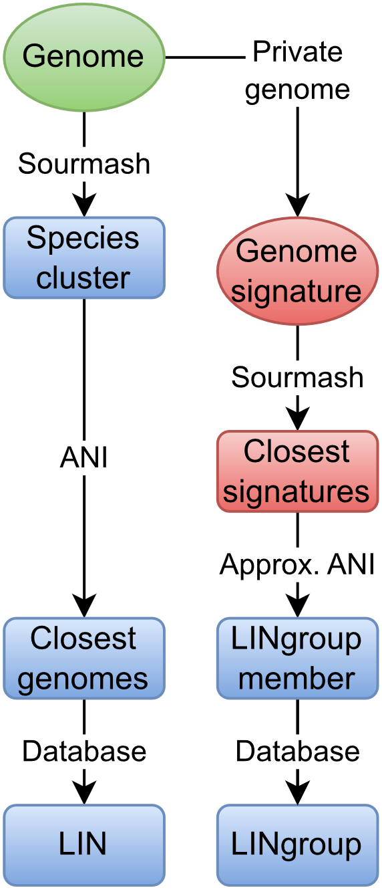
genomeRxiv Demo genomerxiv.cs.vt.edu
Assembly file from sample
Identify: http://genomerxiv.cs.vt.edu/index.php/result/668ac204c9bd7
Closest genome: http://genomerxiv.cs.vt.edu/index.php/genome/864,0,0,1,0,0,0,0,0,0,0,0,0,3,0,0,0,0,0,0
Species Ralstonia Solanacearum LINgroup: http://genomerxiv.cs.vt.edu/index.php/lingroup/864,0,0,1,0,0
Different Ralstonia LINgroup Prefix: http://genomerxiv.cs.vt.edu/index.php/lingroup/864,0,0,1
High level prefix: http://genomerxiv.cs.vt.edu/index.php/lingroup/864
Ralstonia Solanacearum members: http://genomerxiv.cs.vt.edu/index.php/result/668ac36f2a7bf

