Slide 1

Bluestock Mutual Fund Analytics Capstone Project
Presented By:
Viyyapu Vinay
B.Tech CSE (AI & ML), ANITS
Mail: viyyapuvinay939@gmail.com

Slide 2
Problem Statement & Objectives
Problem
Mutual fund data is scattered across multiple sources such as NAV history, AUM reports, SIP inflows, benchmark indices, and investor transactions. Investors and analysts need a unified analytics platform for better decision-making.
Objectives
Build ETL pipeline
Clean and validate data
Perform Exploratory Data Analysis
Compute performance metrics
Develop Power BI dashboard
Generate advanced risk analytics

Slide 3
Data Sources
Datasets Included
Fund Master
NAV History
AUM by Fund House
Monthly SIP Inflows
Category Inflows
Industry Folio Count
Scheme Performance
Investor Transactions
Portfolio Holdings
Benchmark Indices
Data Sources Used
AMFI
CSV Datasets
mfapi.in
NSE / BSE

Slide 4
Project Architecture
Raw Data Sources
Data Cleaning
Processed CSV Files
SQLite Database
EDA Analysis
Performance Analytics
Advanced Analytics
Power BI Dashboard
Raw Data → Cleaning → Processed Data → SQLite → EDA → Performance Analytics → Advanced Analytics → Dashboard

Slide 5
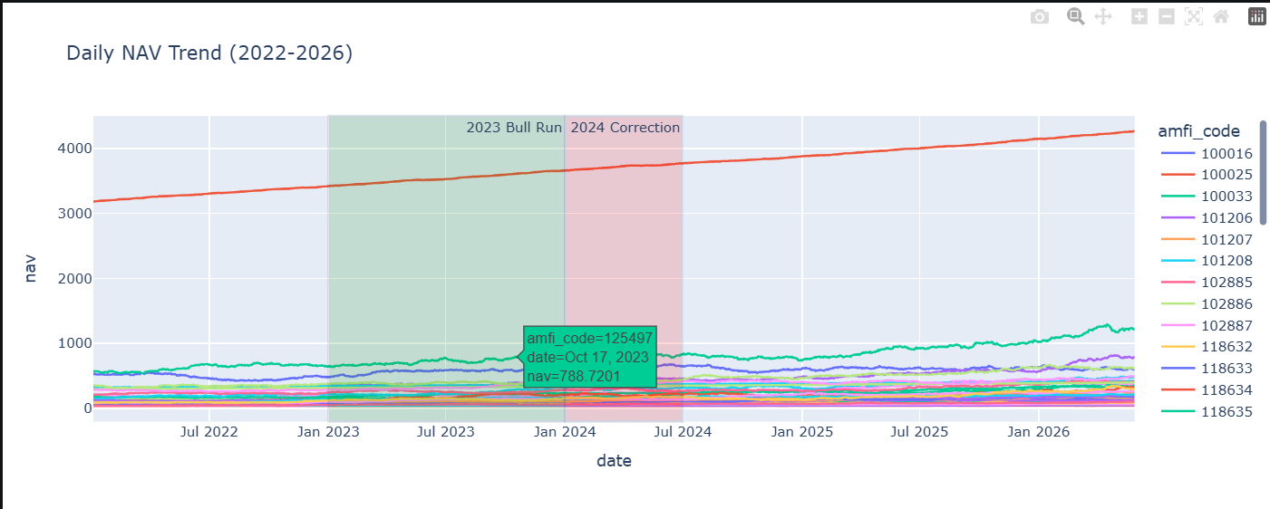
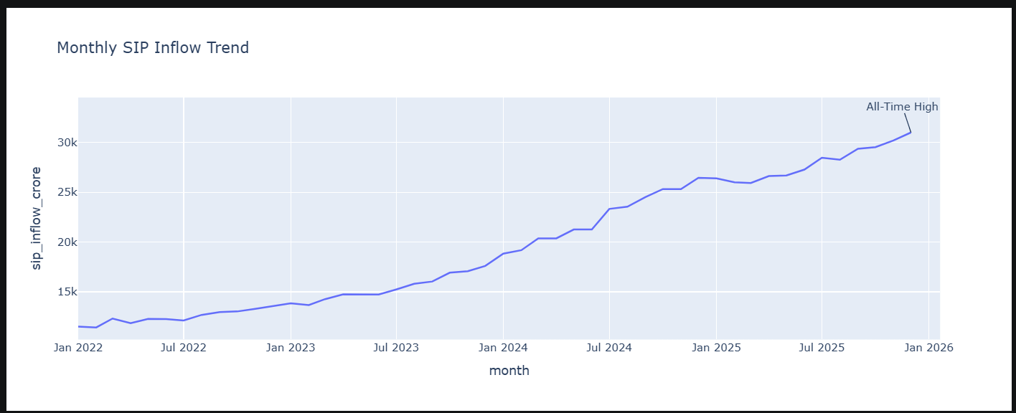
EDA Highlights - Industry Analysis
Key Findings
Industry AUM increased steadily between 2022–2025.
SIP inflows reached ₹31,000+ Crore.
SBI Mutual Fund maintained the highest AUM.
Folio count almost doubled during the study period.
Liquid funds received the highest category inflows.

Slide 6
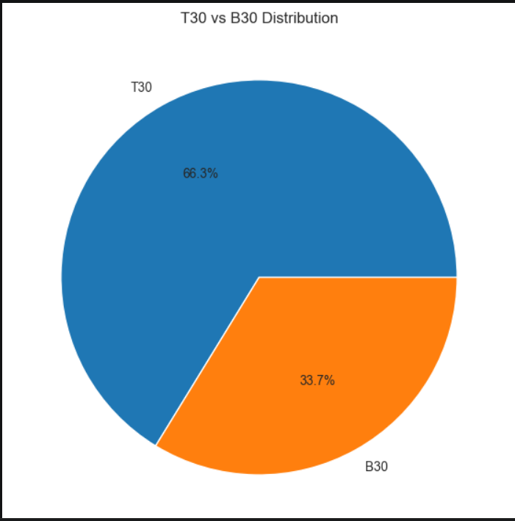
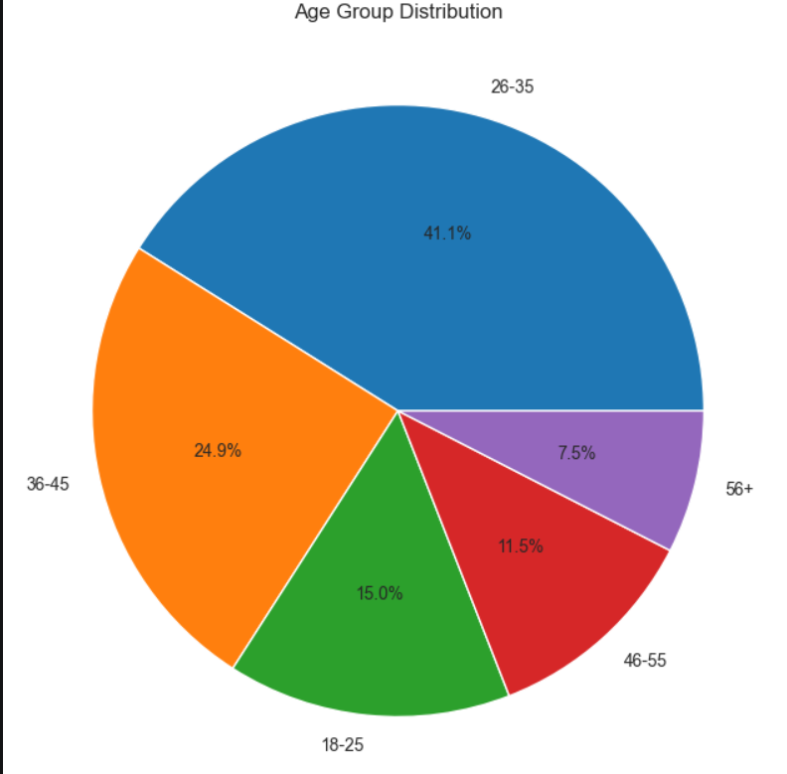
EDA Highlights - Investor Analysis
Key Findings
25–40 age group dominates investing activity.
T30 cities contribute higher investments than B30.
Investment participation is spread across multiple states.
Equity-oriented funds attract more investors than debt funds.

Slide 7
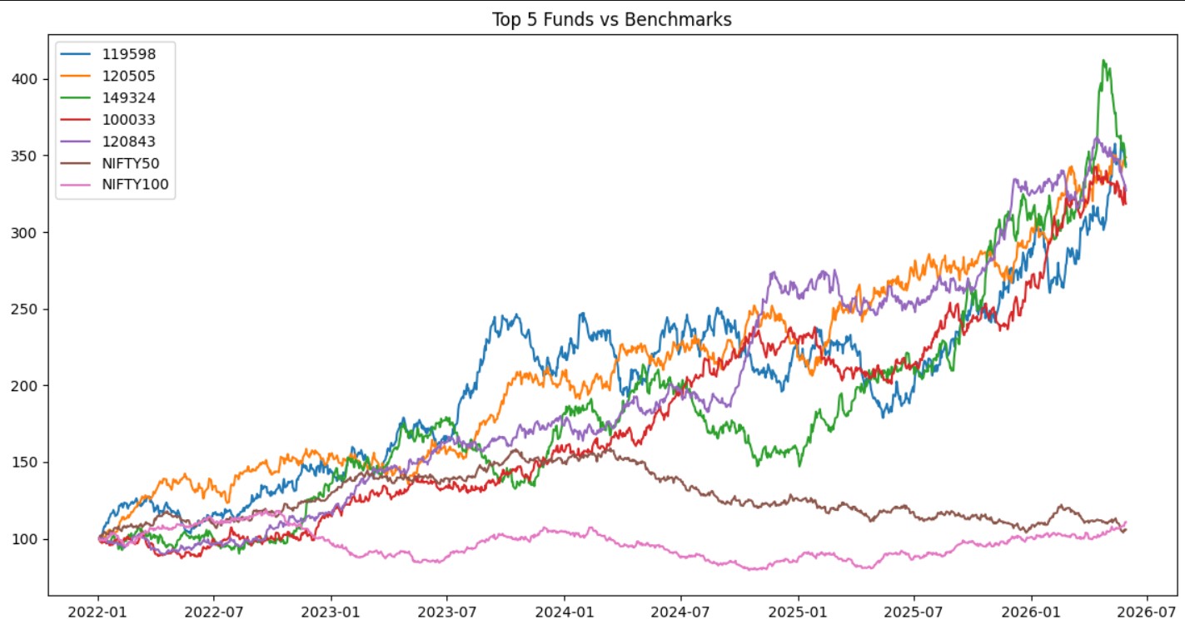
Performance Analytics
Metrics Calculated
CAGR
Sharpe Ratio
Sortino Ratio
Alpha
Beta
Maximum Drawdown
Findings
Several schemes achieved strong 3-Year CAGR.
Sharpe Ratios above 1 indicate strong risk-adjusted returns.
Positive Alpha indicates benchmark outperformance.

Slide 8
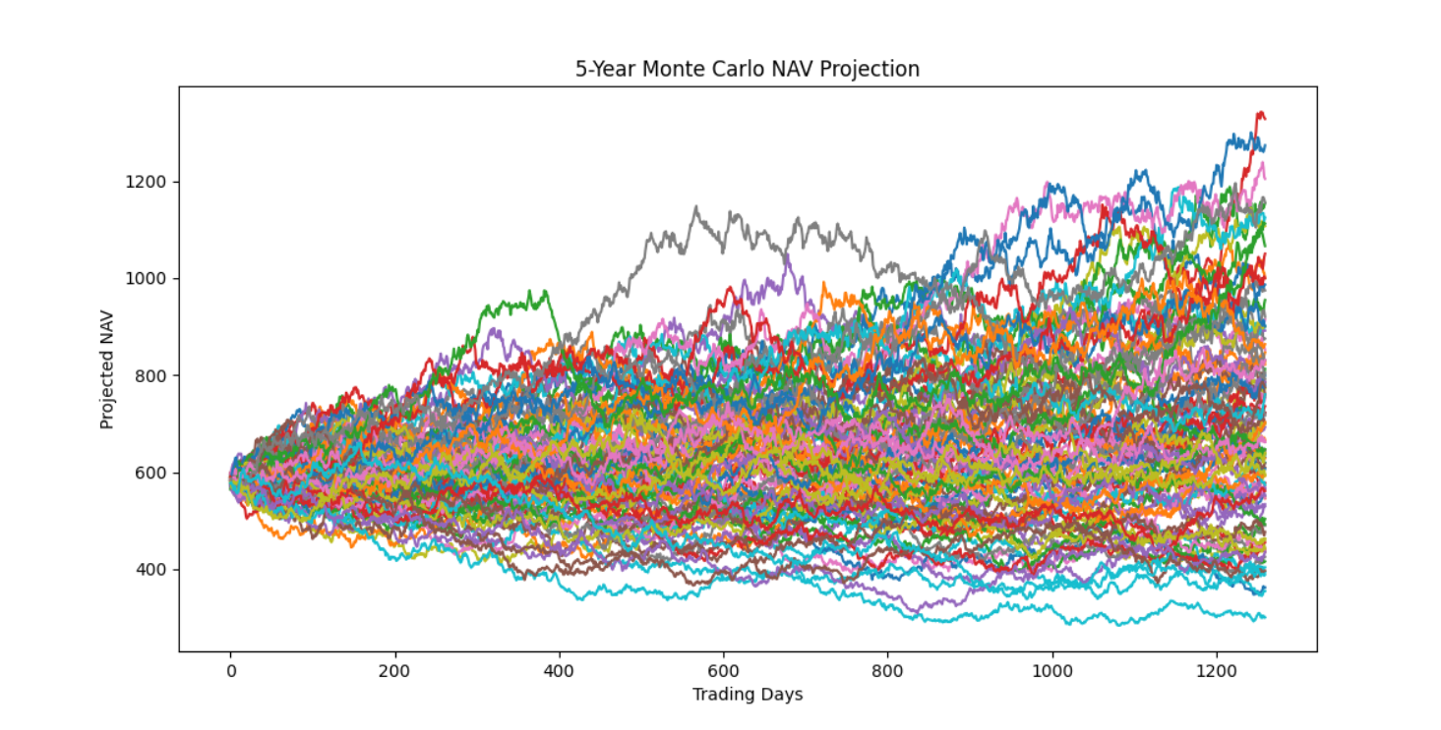
Advanced Analytics
Advanced Models Implemented
Value at Risk (VaR)
Conditional VaR (CVaR)
Rolling Sharpe Ratio
Investor Cohort Analysis
SIP Continuity Analysis
Fund Recommender System
Sector HHI Analysis
Monte Carlo Simulation
Findings
Risk varies significantly across schemes.
Some investor cohorts invest substantially more.
Rolling Sharpe revealed changing fund quality over time.

Slide 9
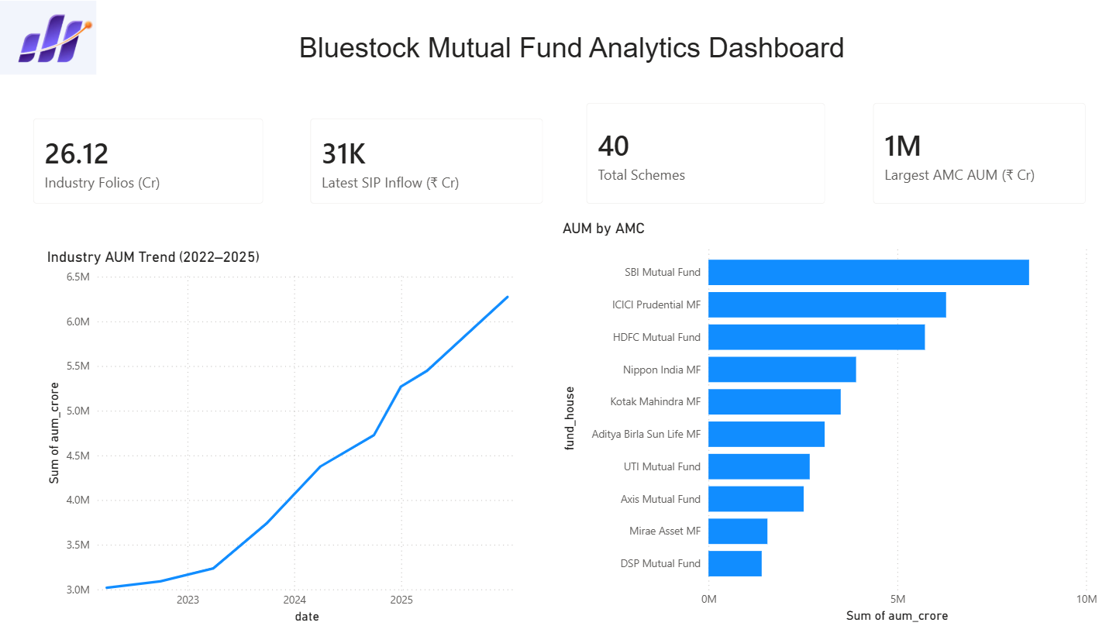
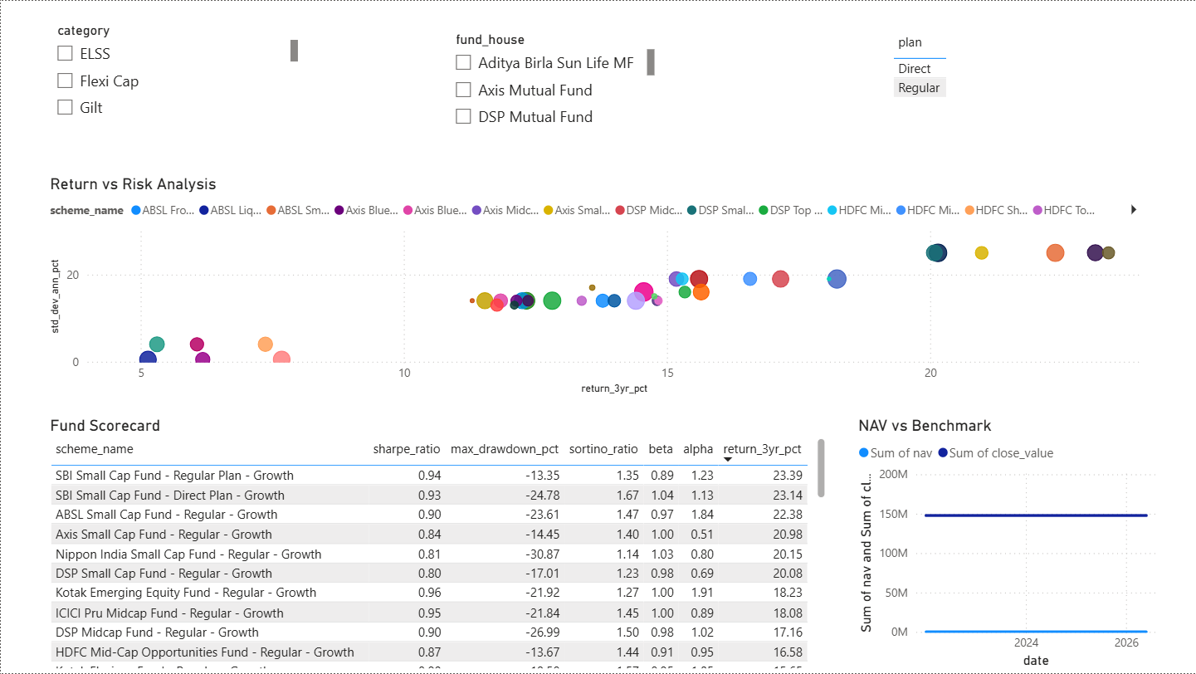
Dashboard - Industry Overview
Industry Overview Dashboard
AUM Trend
AMC Comparison
SIP Inflows
Folio Counts
Fund Performance Dashboard
Return vs Risk Analysis
Fund Scorecard
Benchmark Comparison

Slide 10
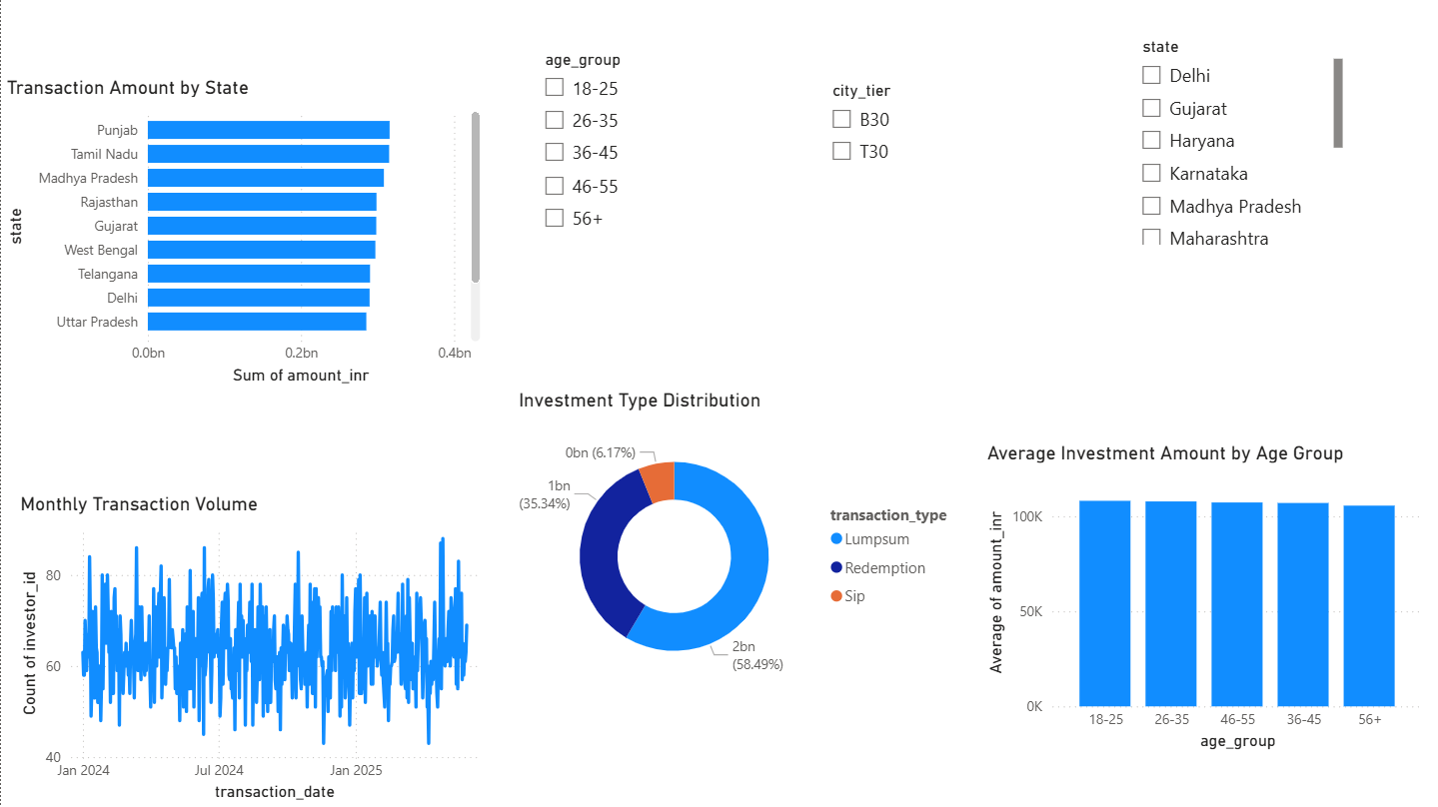
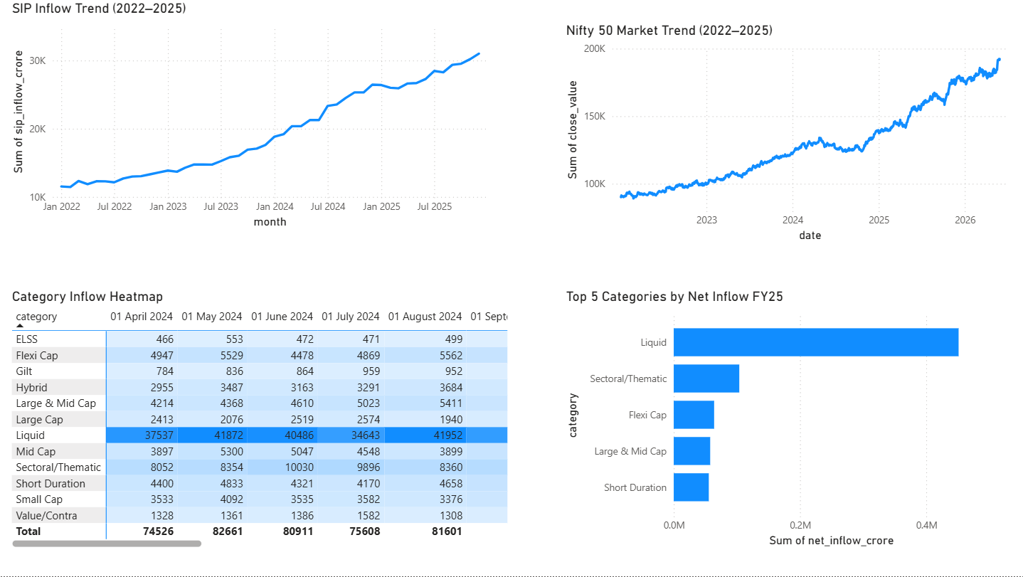
Dashboard - Fund & Investor Analytics
Investor Analytics Dashboard
State-wise Transactions
Age Group Analysis
Investment Type Distribution
SIP & Market Trends Dashboard
SIP Growth
Nifty Trend
Category Inflows

Slide 11
Key Findings & Bonus Challenge
Key Findings
Industry Assets Under Management (AUM) showed strong growth between 2022 and 2025, reflecting increasing investor participation.
Monthly SIP inflows reached approximately ₹31,000 Crore, indicating growing confidence in mutual fund investments.
SBI Mutual Fund maintained the highest AUM among all analyzed fund houses.
Investors aged 26–35 years represented the largest share of mutual fund investors.
Several schemes achieved strong risk-adjusted performance, with Sharpe Ratios above 1 and positive Alpha values.
Liquid Funds attracted the highest category inflows, while equity-oriented schemes dominated investor participation.
Bonus Challenge Completed – Monte Carlo Simulation
Implemented a Monte Carlo Simulation model to project future NAV growth over a 5-year horizon.
Generated 100 possible NAV paths using historical return and volatility data.
Analyzed the impact of market uncertainty on long-term fund performance.
Demonstrated scenario-based forecasting instead of relying on a single prediction.
Provided additional insights into potential future fund behavior under different market conditions.

Slide 12
Conclusion
The Bluestock Mutual Fund Analytics Project successfully transformed raw mutual fund data into meaningful business insights through a structured ETL pipeline, exploratory data analysis, performance analytics, advanced risk metrics, and interactive Power BI dashboards.
The project demonstrated the practical application of Python, SQLite, Power BI, and financial analytics techniques to evaluate fund performance, understand investor behavior, and identify industry trends. The insights generated can support data-driven investment decisions and improve mutual fund analysis.

Slide 13
THANK YOU

